Slide 1




CRN3 Researchers Meeting: Results and Outcomes
29 November – 1 December 2017, Cancun, Mexico
NITROGEN CYCLING IN LATIN AMERICA: DRIVERS, IMPACTS AND VULNERABILITIES (Nnet)
Maria Cristina Forti
Gervasio Piñeiro
Nnet Project Team
CCST/INPE
http://nitrogen.ccst.inpe.br/

Slide 2
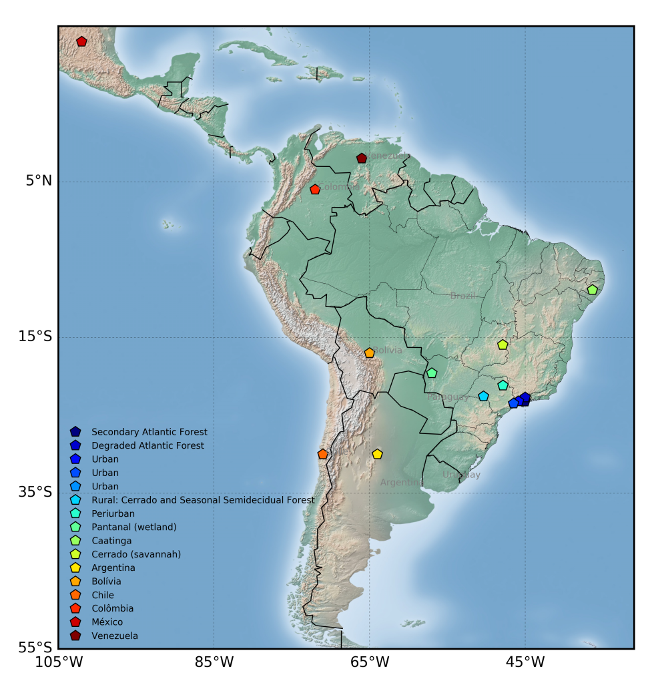
A scientific cooperation network across Latin American countries (Argentina, Bolivia, Brazil, Chile, Mexico, and Venezuela) to investigate the processes that modify different aspects of the nitrogen cycle.
Study, document, and understand the processes that modify different aspects of the nitrogen cycle through an integrated approach:
Mapping sources and long-range transport of N_{r} in the atmosphere connected to natural and anthropogenic processes;
Inputs of nitrogen (N) into natural and human managed systems;
Changes in ecosystem dynamics by excess nitrogen loads; and
Socioeconomic dynamics and its institutional arrangements and impacts.

Slide 3
SCIENCE: Relevant Results
A regional mapping of the nitrogen fluxes were produced and are paving the path to the preparation of the regional nitrogen budget in this coming period ➔ Human impacts have profound effect on BNF.
Land use transformations such as forest selective logging and reforestation with non-native species, lead to decreasing the input of new N in low N deposition regions (as the case of Chile, for instance).
Predicted trends of increasing drought and the use of fertilizers will decrease rates of BNF as have been demonstrated experimentally and with observational data.
Over extensive agricultural landscapes of south America, GHG emissions and fertilizer use can be reduced by changing management rotations to include new winter crops that provide multiple ecosystem services.

Slide 4
SCIENCE-POLICY
The project has advanced substantially on the political analysis of the nitrogen cycle in the region, including food security, nitrogen use efficiency and cost-benefits analysis.
A policy survey was performed, indicating that there are no nitrogen specific policies in the region, neither a common directive nor a framework in which nations can create their own regulations, as is observed in Europe.
A positive collaboration with the INMS (International Nitrogen Management System) was of central importance to this step.
major challengeS ➔ how to communicate results to non-specialists: attract stakeholders and government institutions attention to our scientific findings, which may provide the baseline for using landscape at a sustainable manner

Slide 5
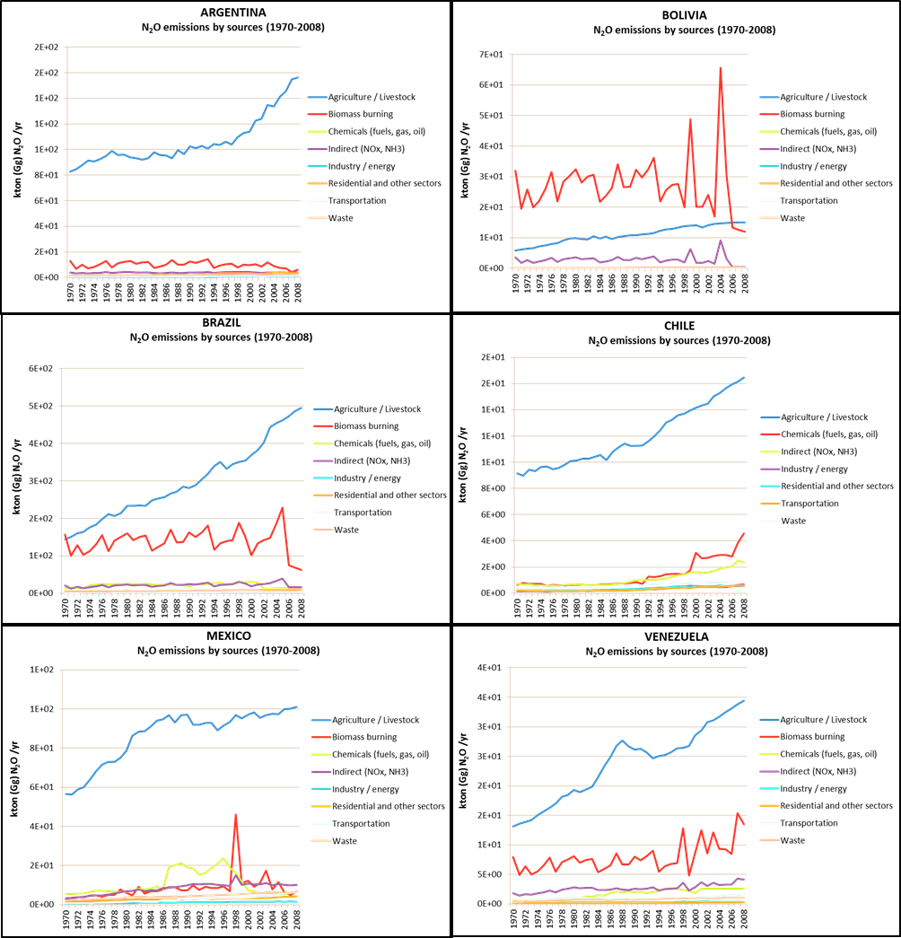
Scientific results: social dimension
Factors responsible for nitrogen emissions are related to production of FOOD and ENERGY
Figure: N₂O emissions by sources 1970-2012 (Source: EDGAR)

Slide 6
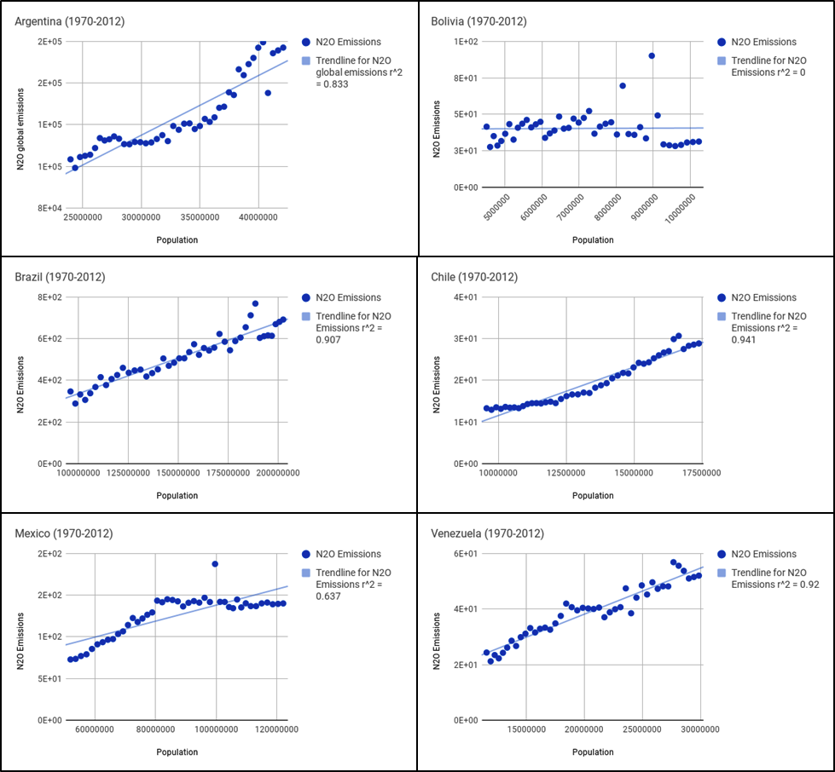
Scientific results: social dimension
Population growth may NOT be the ultimate cause for the continuous expansion of emissions. Many other components can influence the process, especially considering the disparities among LA countries:
Land size and income
Agricultural practices
Cultural aspects
Dietary habits
Government systems
Policies and regulations
Figure: Correlations between N₂O emissions and population
1970-2012 (Source: World Bank)

Slide 7
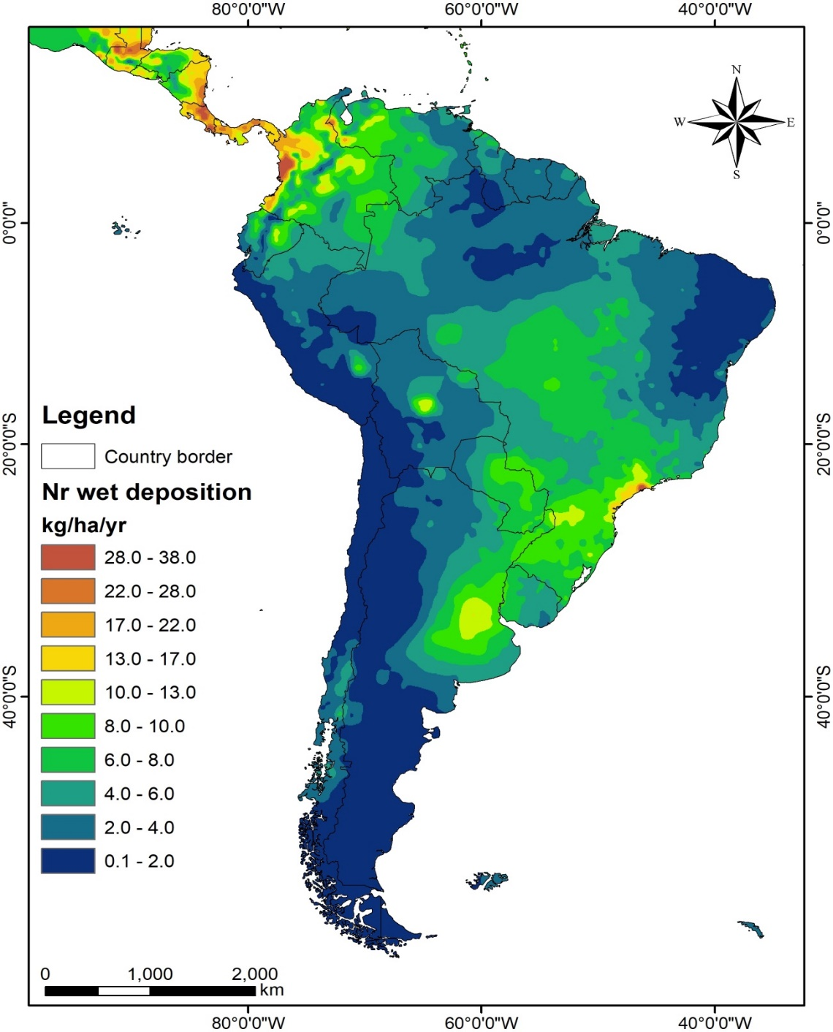
Scientific results: observation output
Wet deposition map of Nr in kg/ha/yr, for South America and Central America estimated from observation data.

Slide 8
Scientific results: modelling output
Reactive nitrogen wet deposition estimated with EMEP (The European Monitoring and Evaluation Programme), model, for the Brazilian territory in mgN/m²
Notes:
Modelo de trnsporte
Similar a las observcaciones mostradas antes

Slide 9
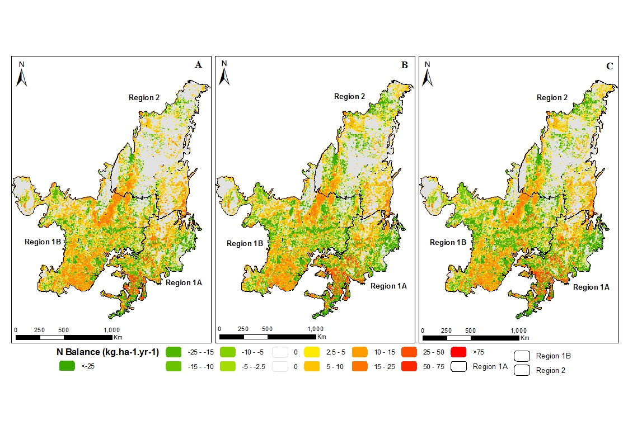
Scientific results: observation output
Soil nitrogen Balance in the Brazilian Cerrado region. Warm colors indicate loss of nitrogen and green colors gain, for the years 2000 (A), 2010 (B), and 2012 (C).
Notes:
Balance de N, con modelos datos medidos

Slide 10
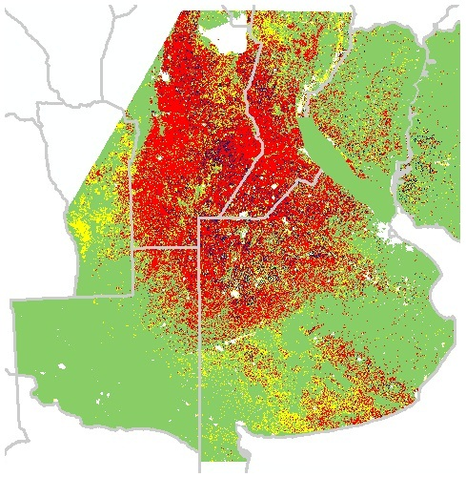
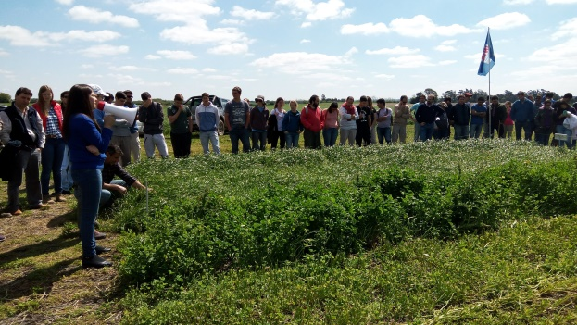
Service Crops for reducing fertilizer use
Lupino
Vicias-Hairy and common vetch
Medicagos
Treboles / Clovers
New winter legumes to include in crop rotations, pre-harvest seeding and management rolling with hollow drum with blunt blades.
Pinto, Piñeiro, et al 2017

Slide 11
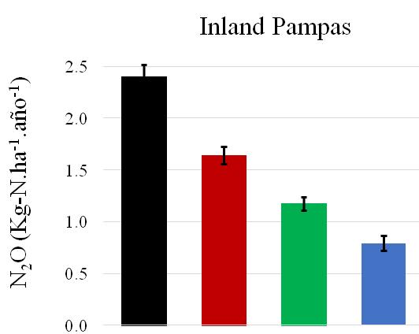
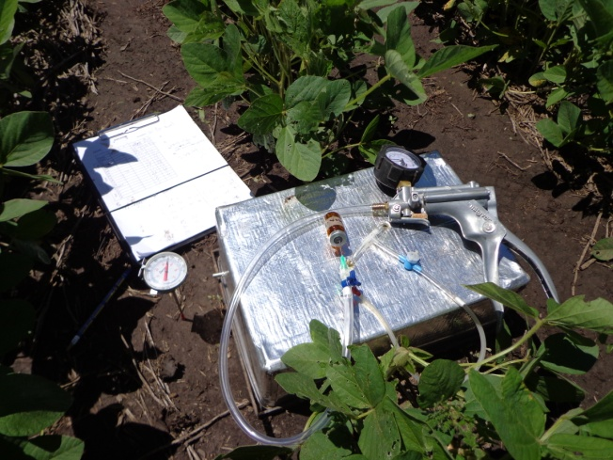
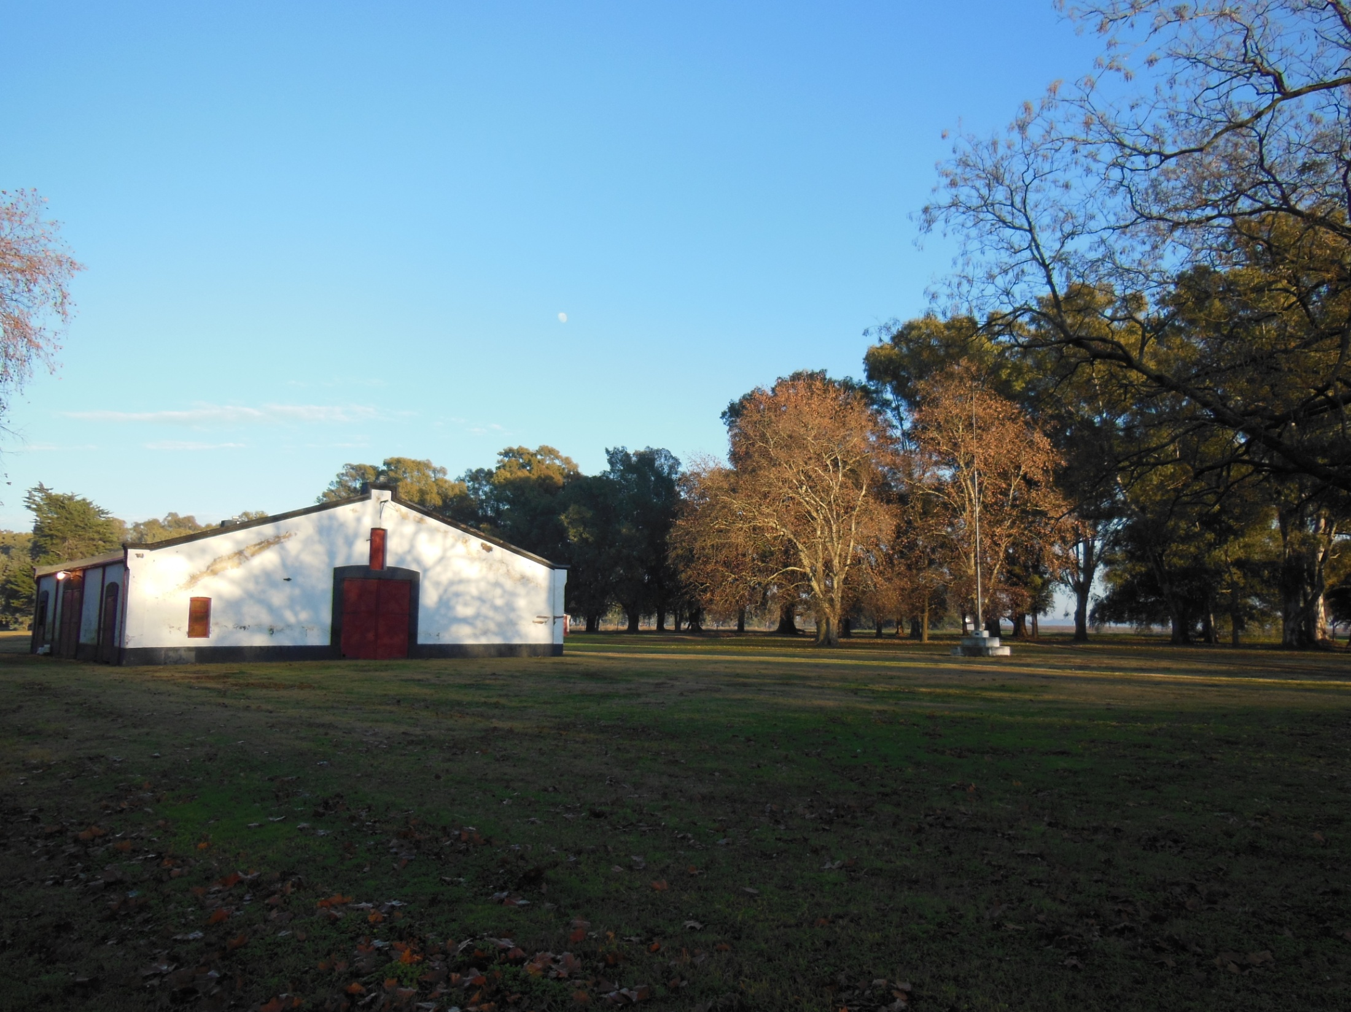
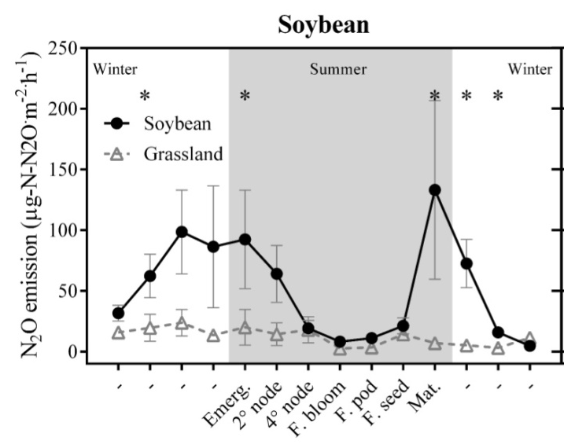
Service Crops for reducing N₂O emissions
2.4
1.6
1.2 Kg/ha/yr 50%
1.2
0.8
Service crops
Della Chiesa, et al 2017

Slide 12
Service Crops: Economic analyses
Type of Service | Ecosystem service | Valuation Method
Private Services | 1- Fixing nitrogen | Substitution with fertilizers (inputs) Increase in yields
 | 2- Erosion | Real estate value Substitution with fertilizers
 | 3- Compaction / infiltration - dynamics and water storage | Replacement with irrigation Decrease in yields
 | 4- Weed control | Herbicide cost Decrease in yields
 | 5- Nutrient recovery (catch crop) | Substitution with fertilizers Decrease in yields
 | 7- Water table balance | Decreased planting area because of flooding Increased yields
Public or Social Services | 1-Erosion, Leaching of N, P and pesticides. | Marginal changes in the leached kg of P and N. Basin needs to be defined. Costs of purification, tourism, etc.
 | 2- Flood control | Probability of flood occurrence and losses caused. Decreased of regional planted area and taxes, costs of infrastructure repair.
 | 3 - GHG (changes in net emission) | Less emissions of N2O, C sequestration in organic matter, displacement of less fertilizer and gasoil (life cycle-carbon footprint)

Slide 13
Science policy
The number of policy instruments specific for nitrogen is actually limited worldwide, in contrast with the huge diversity in N_{r} emission sources and pathways. Existing policies are generally focused on individual compounds from specific sectors, instead of an integrated approach.
A survey was performed, indicating that there are no nitrogen specific policies in the Latin American region, neither a common directive nor a framework in which nations can create their own regulations, as is observed in Europe.
A potential solution for policy integration would be adherence and commitment of Latin American countries to the “Policy Arena on Nitrogen”, proposed by the International Nitrogen Management System (INMS).

Slide 14
Science policy
Nnet challenge:
Identify niches for disseminating research results and promoting alternative nitrogen management practices
  Through FOOD SECURITY
Questions to be addressed:
What are the spatial patterns of the distribution of Nr loss/gain in the territory?
How the food system can best be managed at the local level to reduce the negative impacts related to the nitrogen cycle and it is possible to find reliable data for countries other than Brazil in Latin America?
How to promote the adherence of Nnet results to the “Policy Arena on Nitrogen”?

Slide 15
Science policy
Policy Relevance
The project helped to catalyze some actions in the region → OCDE has contact, based on Nnet indications, members of the Brazilian Government, NGOs and few government institutions asking to provide information on Nitrogen use in the country.
N-Net result are relevant for political and commercial purposes since it will improve the National GHG Inventory in Latin American (LA) countries, particularly for estimating N₂O emissions form croplands.
International crop markets are raising their environmental standards for crop production in LA countries; accurate information about soil GHG emissions is required → Nnet results help stakeholders to design policies that promote management systems designed to reduce or minimize the negative impact of current agricultural practices on the environment.
Modeling and observational data, by Nnet efforts in Argentina and Uruguay, suggests that planting service crops before harvesting soybean crops, can reduce N₂O emissions, reduce fertilizer use and increase C sequestrations in soils. Future outreach efforts on broadcasting service crops in the region with multiple beneficial environmental effects are needed.

Slide 16
Regional Collaboration/Networking
The Nnet Project, through the International Nitrogen Initiative Latin America Office, catalyzed the participation of the region in the establishment of an International Nitrogen Management System (INMS)’ http://inms.ceh.ac.uk.
Extract From the Project web page “INMS is a project implemented by the UN Environment with funding through the Global Environment Facility (GEF). ‘Towards INMS’ will be executed through the UK’s Natural Environment Research Council (NERC), and its’ Centre for Ecology & Hydrology (CEH), on behalf of the International Nitrogen Initiative (INI). There are over 70 global project partners, supporting the work through co-finance and we will be conducting five funded regional demonstrations”.
La Plata Basin is one regional demonstration: partners in the Nnet Argentina and Chile (even not being in the La Plata Basin), but also from the IAI community from Paraguay and Uruguay.
The Project will [...] “develop the evidence base to showcase the need for effective practices for global nitrogen management and highlight options to maximize the multiple benefits of better nitrogen use. The project presents a key opportunity to pull together a global and critical mass of science evidence on the nitrogen cycle, and develop a sustained process that gets science, governments, businesses and civil society working together to build common understanding and deliver real change. A vital part of the task over the next four years will be to show how management of the global nitrogen cycle can deliver measurable benefits for oceans, climate, the atmosphere, land ecosystems and global society”.

Slide 17
THANK YOU

