Slide 1
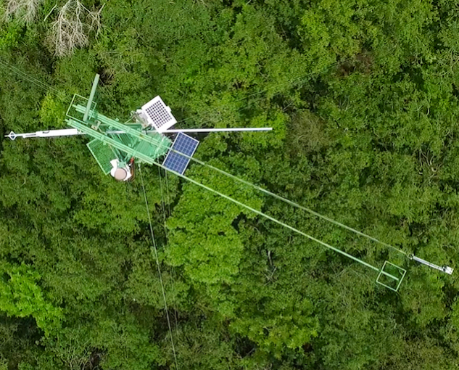
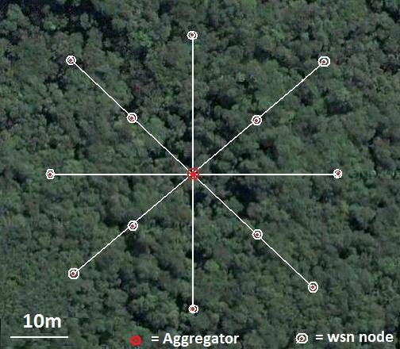
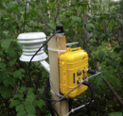
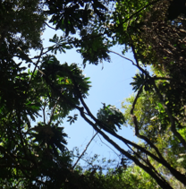


Tropi-Dry: Human and biophysical dimensions of Tropical Dry Forests in the Americas
Prof. Dr. Arturo Sanchez-Azofeifa, Ualberta, Canada
Mario Marcos Espirito Santo, UNIMONTES, Brazil
IAI – 2017 Meeting, Cancun

Slide 2
What’s a Tropical Dry Forest?
Tropical dry forests (TDFs) are defined as forests with 50-100% deciduous forests, with a mean annual annual precipitation between 900 – 2000 mm, six or more months of no rainfall, and an average temperature of 25ºC.
TDFs represent close to 47% of off all tropical forests, as today more than 60% of the extent of TDFs in the Americas has been converted to other land uses.
Highest deforestation rates are present in Mexico, Brazil, Bolivia and Argentina.

Slide 3
What do know?
Well… Very little to start with (although 47% of the tropics are TDFS).
Tropical Forests are not considered part of any global monitoring networks efforts.
Dry forest research lags on a ratio of 1:300 scientific papers when compared with tropical rainforests.
  Arid and semi-arid regions lag on long term studies aimed to understand their response to climate change.

Slide 4
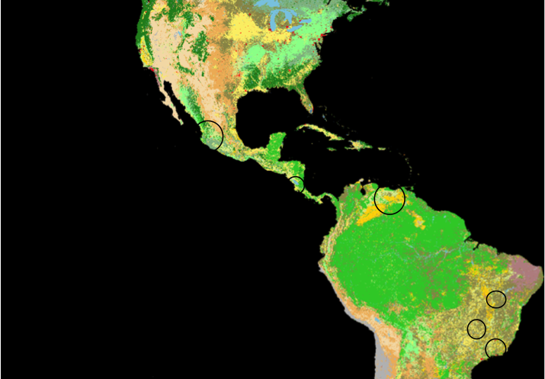
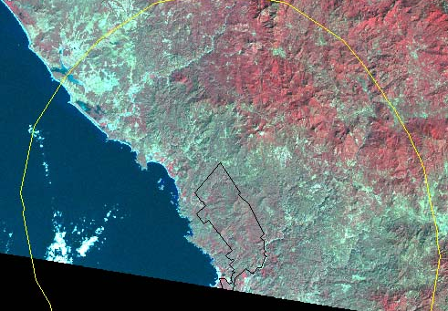
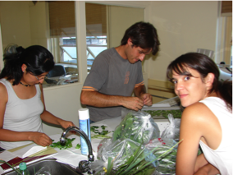
What’s Tropi-Dry?
Tropi-Dry: A project aimed to understand the human and biophysical dimensions of tropical dry forests in the Americas.
Participants: Canada, USA, Costa Rica, Brazil, Colombia, Germany, England, Finland, & Belgium
Capacity Building: >300 students involved since 2005.
Impact on Policy Making: Direct work with policy makers.

Slide 5
Ecology
Supporting
Policy-Making
Human
Dimensions
Remote
Sensing

Slide 6
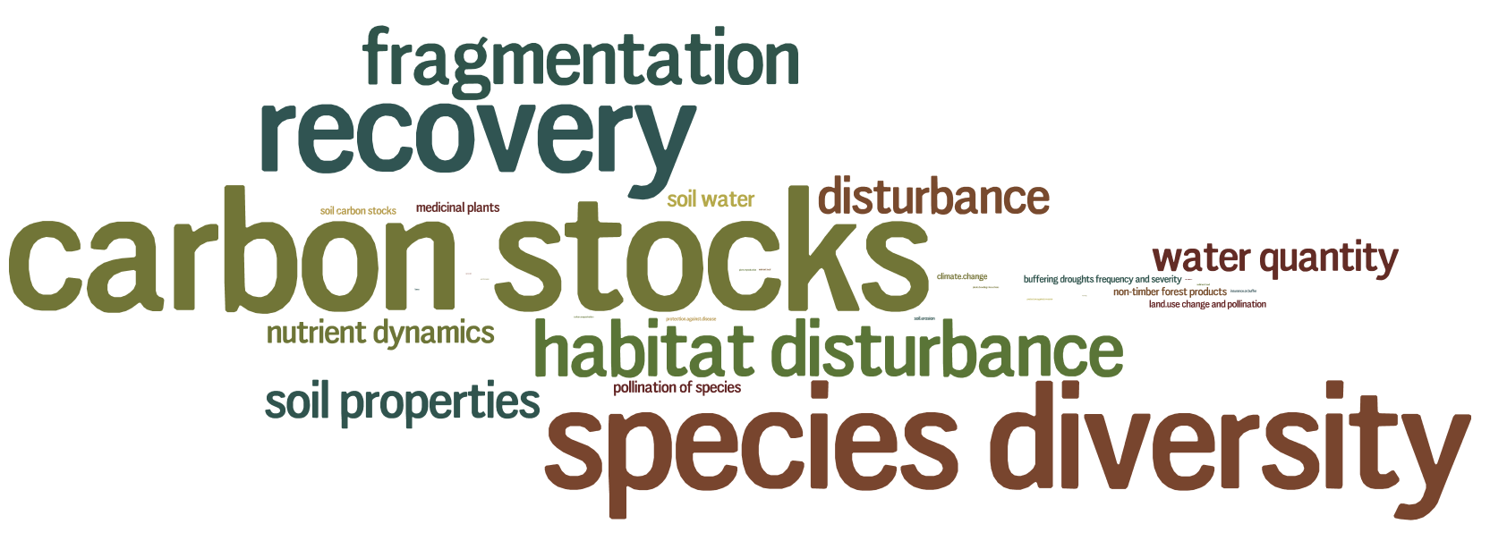
Most Studied Variables
by Tropi-Dry (2006-2017)
N= 100 scientific publications (2006-2017)

Slide 7
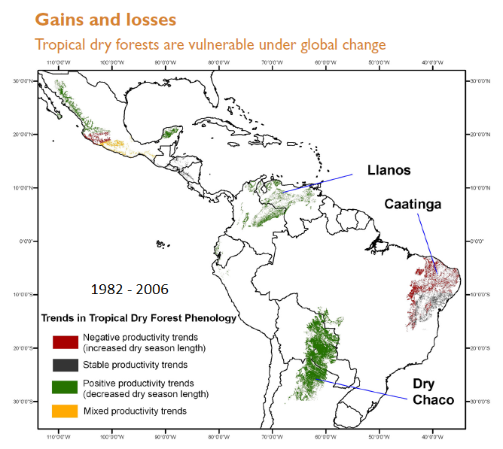

Slide 8
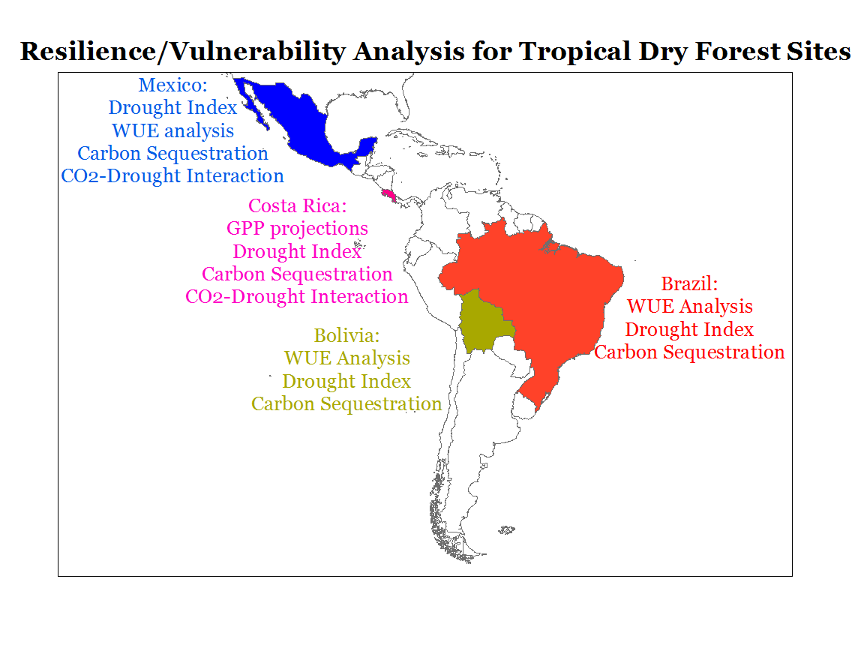

Slide 9
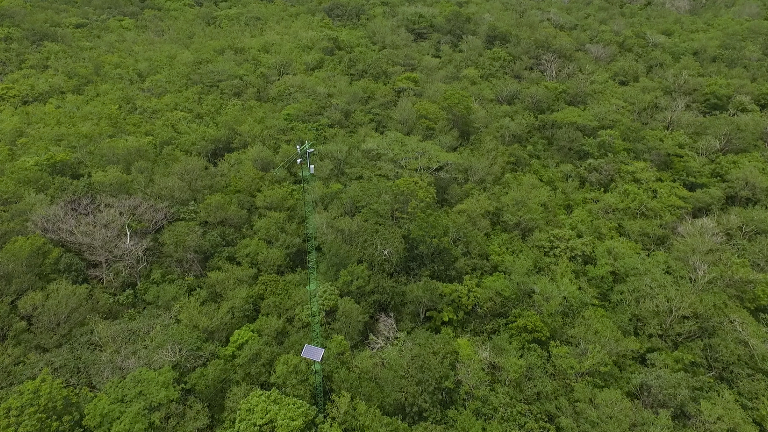
Santa Rosa National Park, Environmental Monitoring Super Site, Guanacaste, Costa Rica:
10 billion data points/year
CO₂/H₂0 fluxes (vegetation and soil)
Hyperspectral canopy observations
Wireless Sensor Networks
On-line/Real time communication via satellite technology
Drone research
Micro-Satellite testing site (AlbertaSat)
Atmospheric Sounding calibration site
NASA Calibration/Validation site
Airborne and ground-based LiDAR

Slide 10
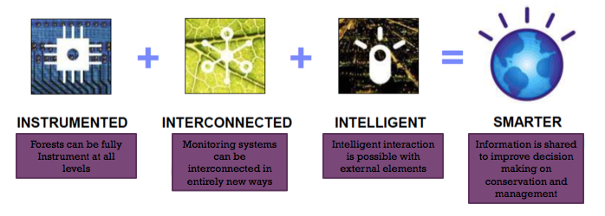
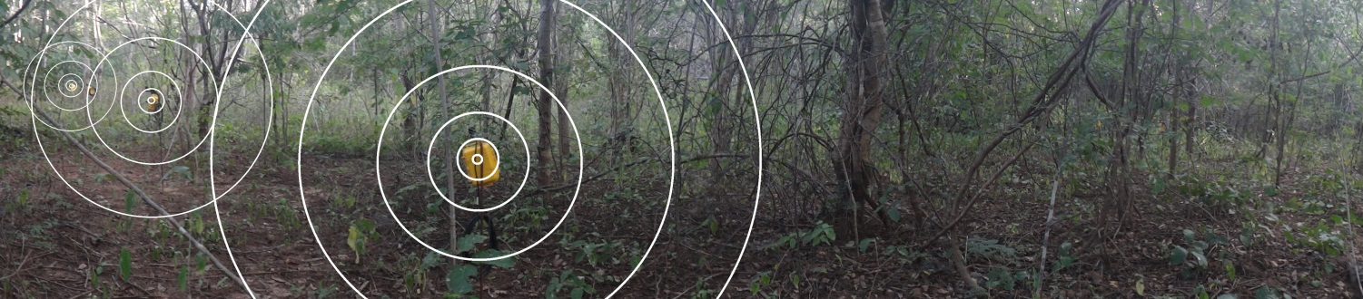
Tropi-Dry: Changes to the environmental monitoring paradigm
TDF can be fully instrumented at all levels
Monitoring systems are interconnected in entirely new ways
Intelligent interaction is made possible with external elements
Information is shared to improve decision-making

Slide 11
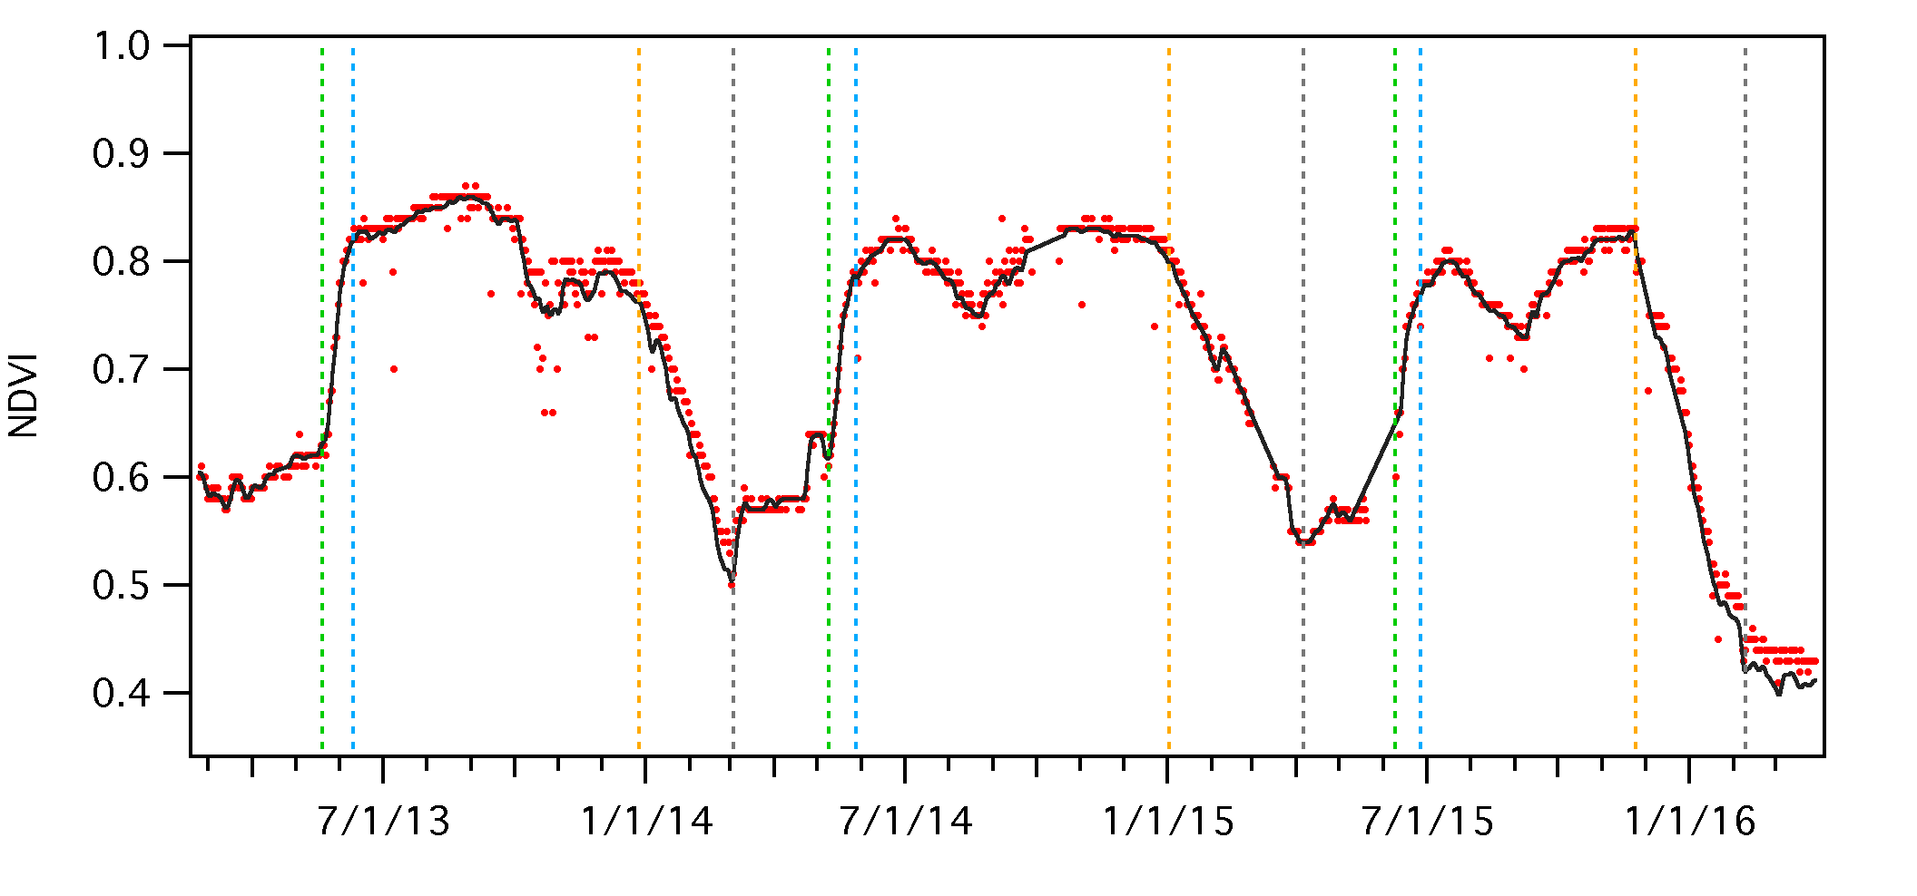
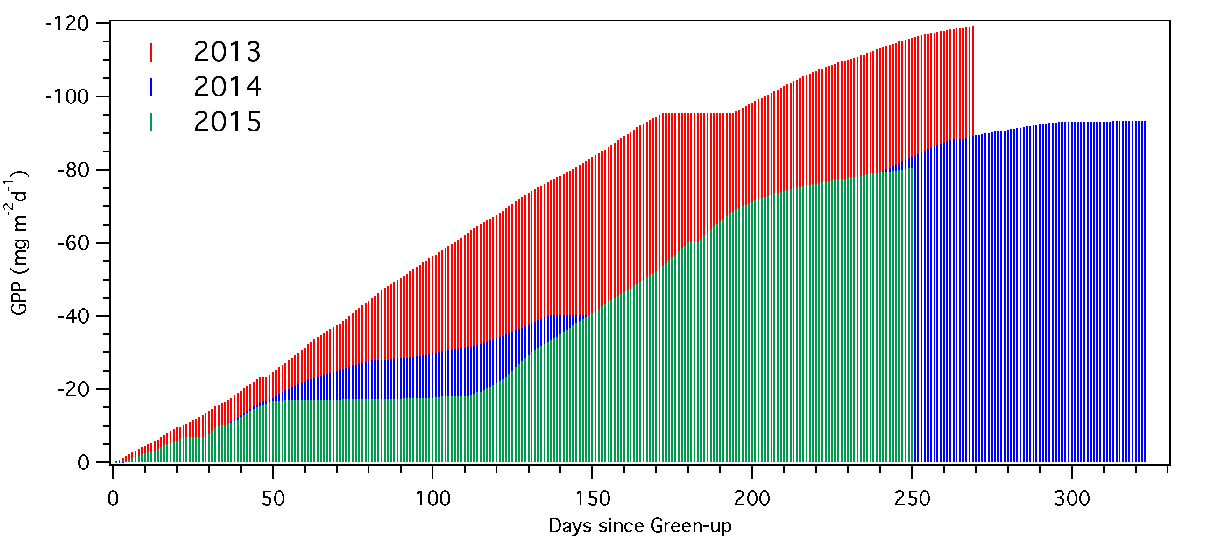
Some fundamental scientific questions for TDF (Tropi-Dry emerging Research)
How tropical ecosystems are responding in terms of carbon sequestration
    Are they sequestering more? Releasing more? Gaining?
    How we can predict changes in real time?
How this relate to phenology?
  Longer or shorter growing seasons?
How we integrate these changes on carbon accounting mechanisms?

Slide 12
Tropi-Dry Contributions
Scientific production:
  2 books, 3 journal special issues, 100 accepted papers (30 currently submitted).
Interactions with policy-makers:
  Mexico: National Forest Commision, Climate change office.
  Costa Rica: Costa Rica’s National Forest Financing Fund, Costa Rican Central Bank, Guanacaste Conservation Area.
  Brazil/Minas Gerais: Environmental Attorney General, State forest organizations, several NGOs.
Interactions with local Communities:
  Mexico: Chamela/Cuixmala regional ejidos
  Costa Rica: Junquillal village
  Brazil: Quilombos and other indigenous communities.

Slide 13
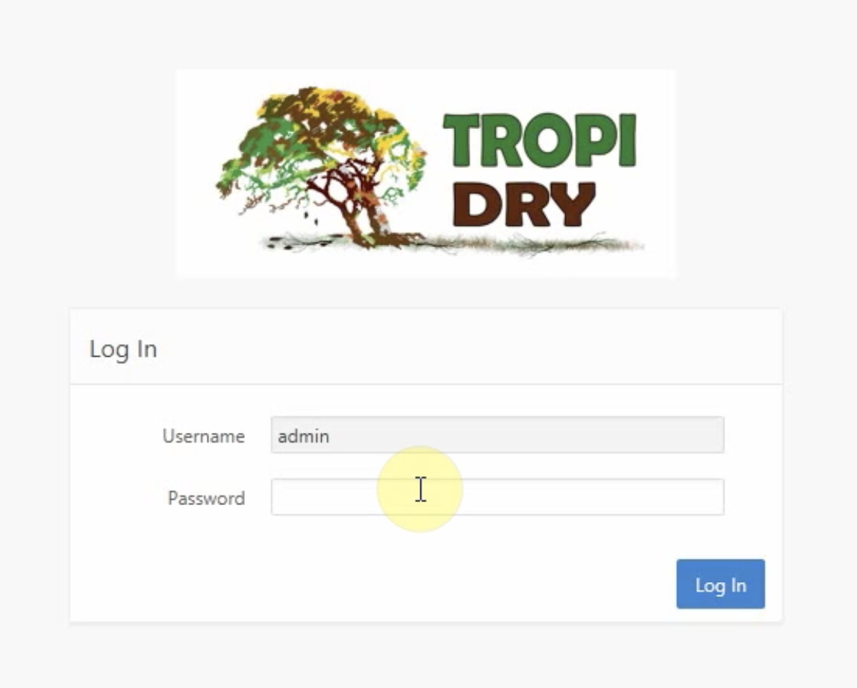
Tropi-Dry: Main Contributions
App for forest monitoring and species barcoding
and open data portal (www.enviro-net.org)
(ca. 200 users as Nov. 2017)

Slide 14
Tropi-Dry: Knowledge Transfer Activities
Social media presence: YouTube Channel, Facebook (3000 followers), Twitter, short video documentaries, and Website.
Print media: Articles on print media in Costa Rica, Canada and Brazil. Brochures for Costa Rica and Brazil.
Training:
  MOOC: ~ 8000 people registered, new MOOC been planned for 2018
  Summer School: 30 students from Latin American and Canada.
  Webinars: 150 participants. New offering on Winter 2018.
  Graduate students: over 300 students since 2006, 30+ PhD students.
International meetings: UNFCCC (Peru and Morocco), UNFCCC SBTA (Germany), IPBES (Mexico).
International panels: IPCC and IPBES assessments.

Slide 15



Thank You!
Notes:
Collaborations with computer sciences, electrical engineering, physics, and industry enables rapid advancement of research capabilities in earth system monitoring
Sensor cloud demo anyone? http://sensorcloud.com/

Slide 16
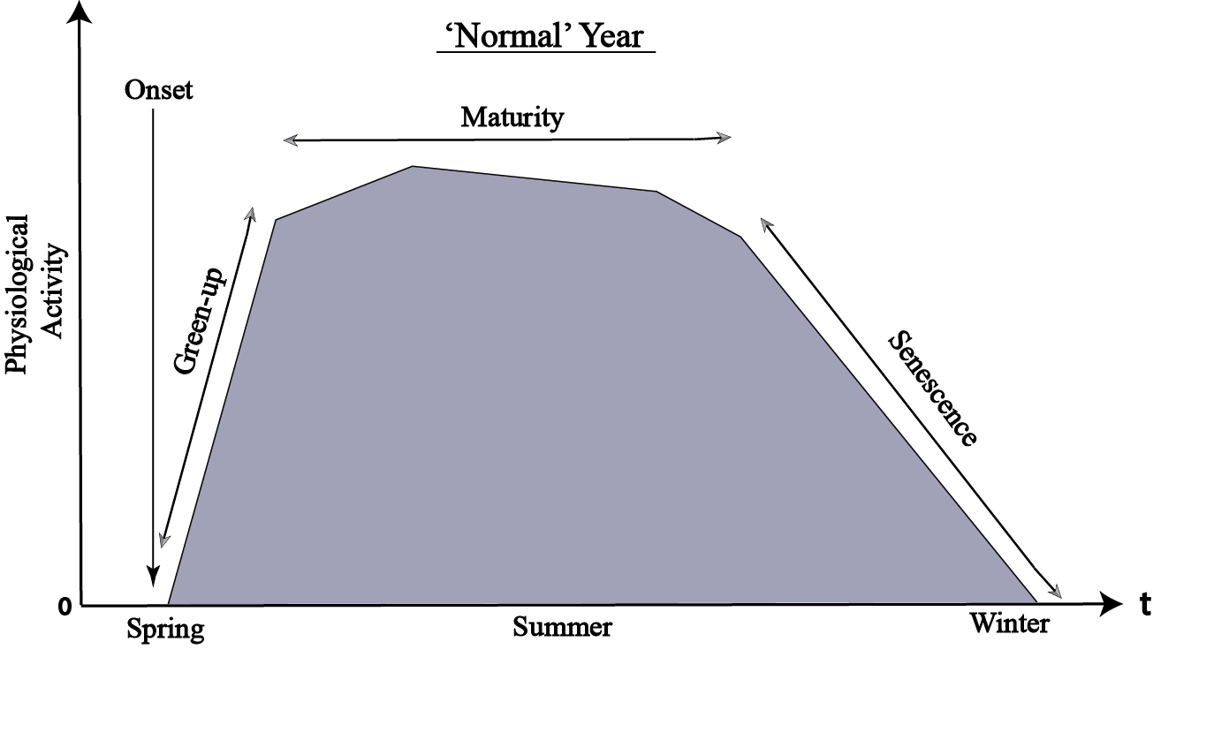
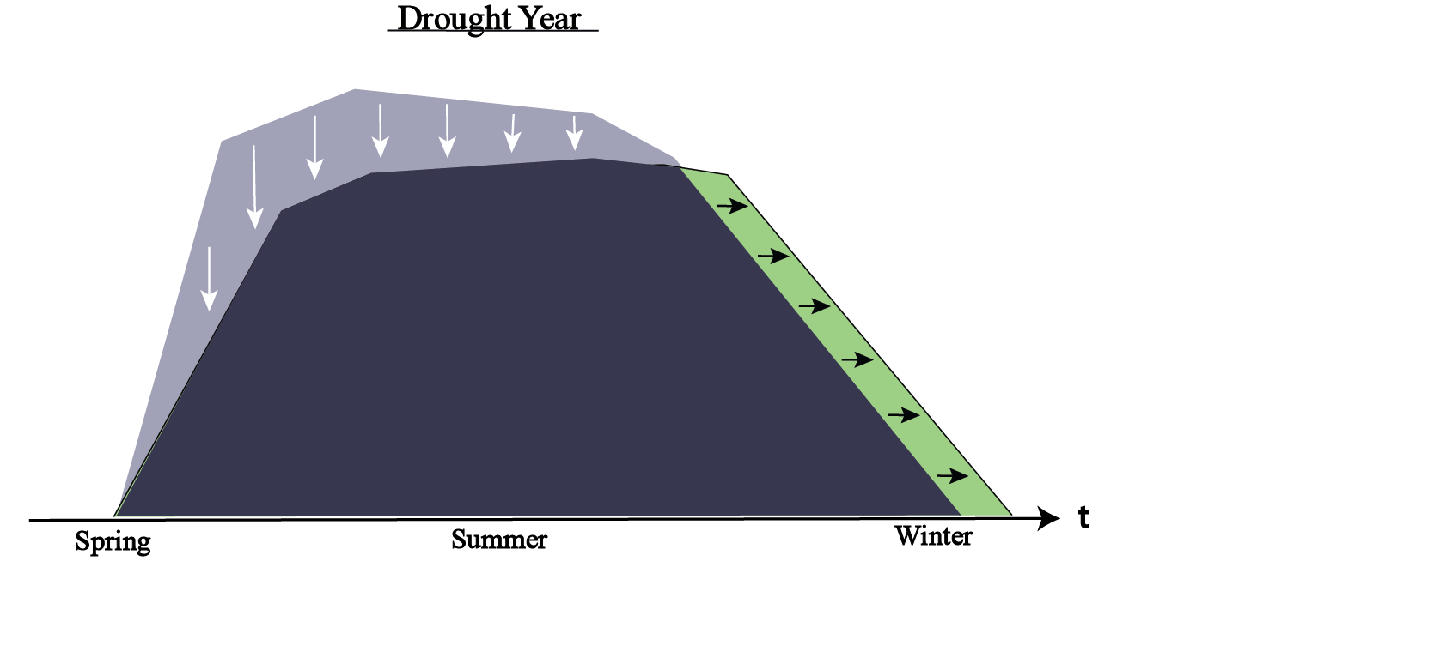
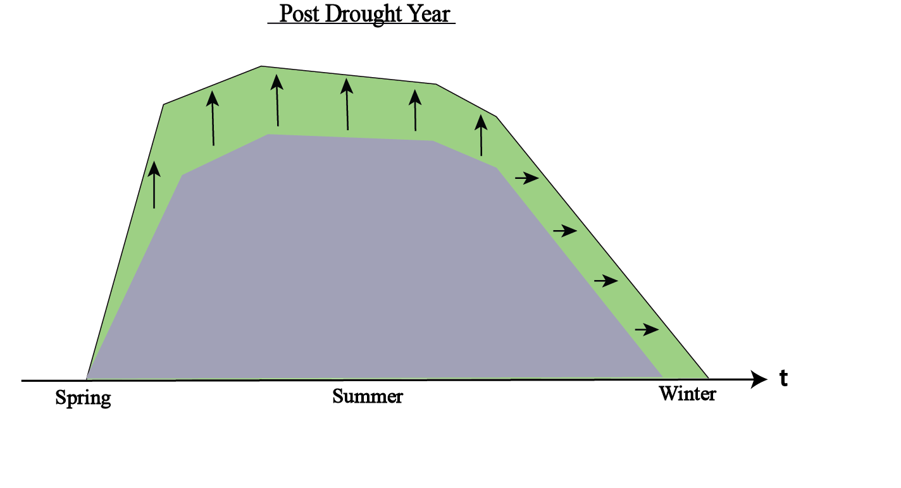
Strategies for Drought Resistance and Recovery:
1) Extension of growth season
2) Increase in productivity.

Slide 17
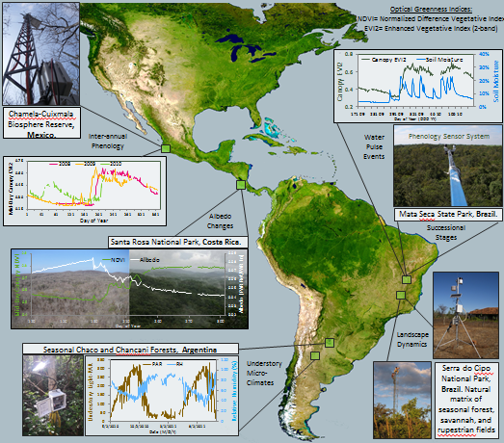

Slide 18
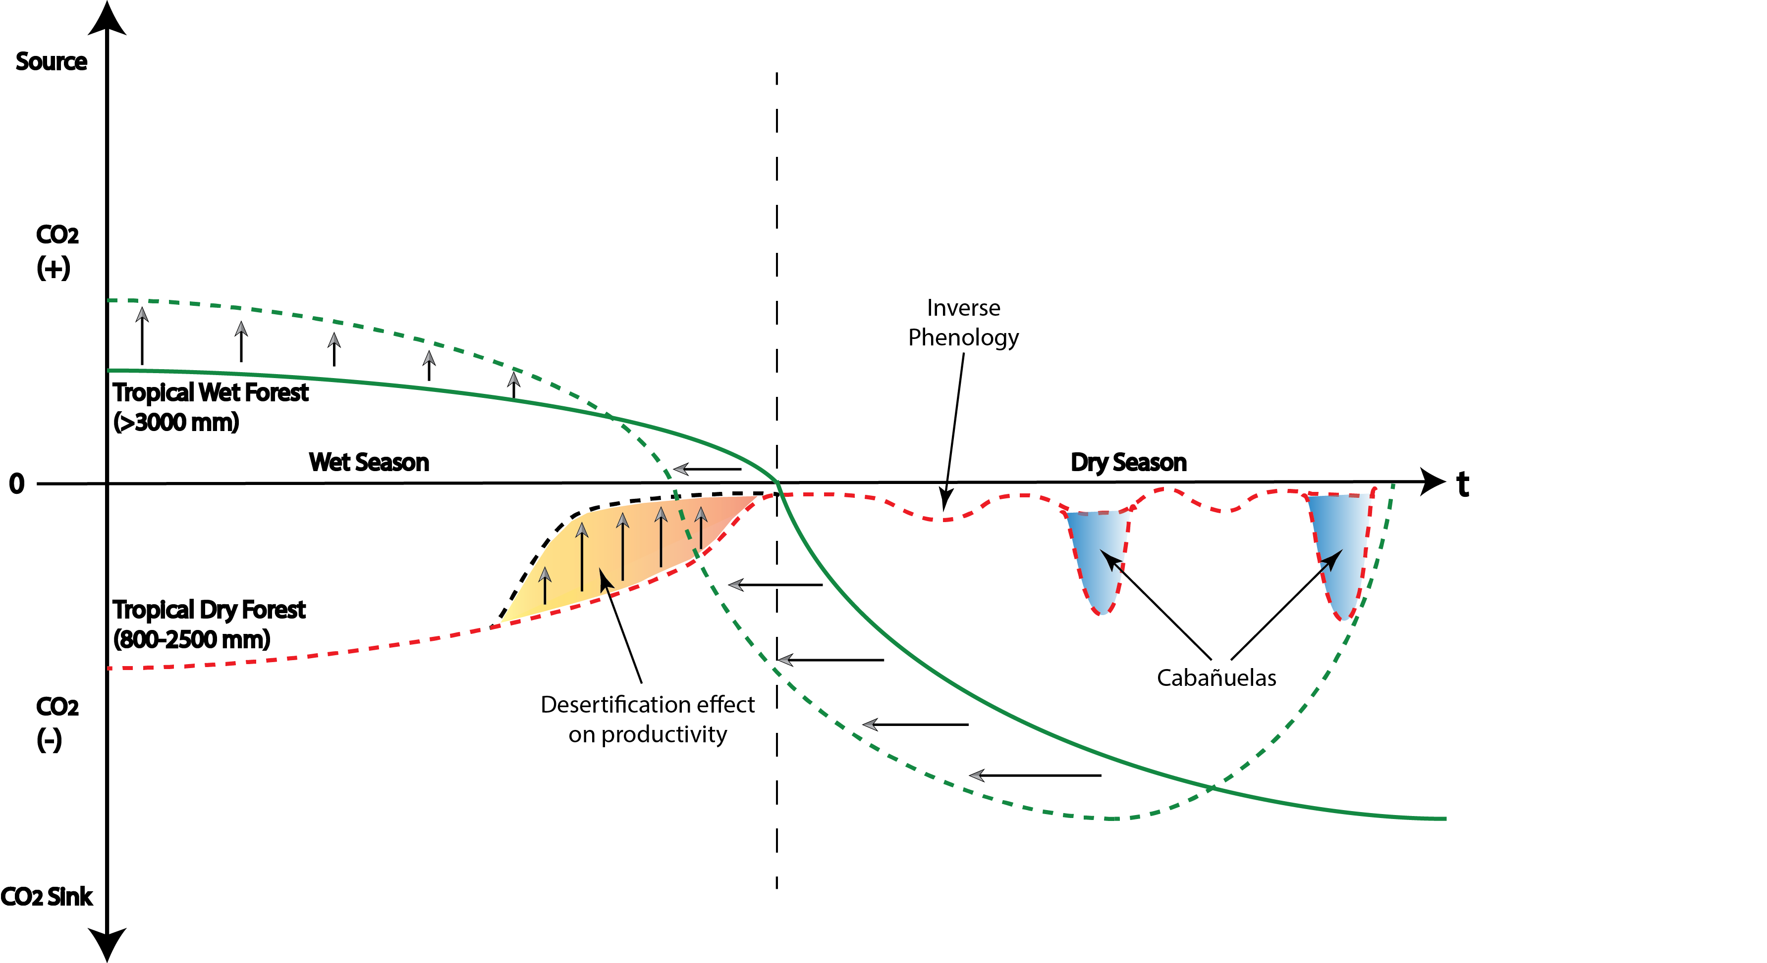
Conceptual model of Future Behavior under Drought and Climate Change
Notes:
Based on a literature review of carbon flux systems and our own data from the collaborative research grant. What will happen? For tropical rainforests we will see and increment of dieback with will increase their role as sources of carbonand also a reduction of their capacity of sequestring it.
For tropical dry regions will will see a significant effect of desertification and probably large increase of “off-season fluxes”

Slide 19
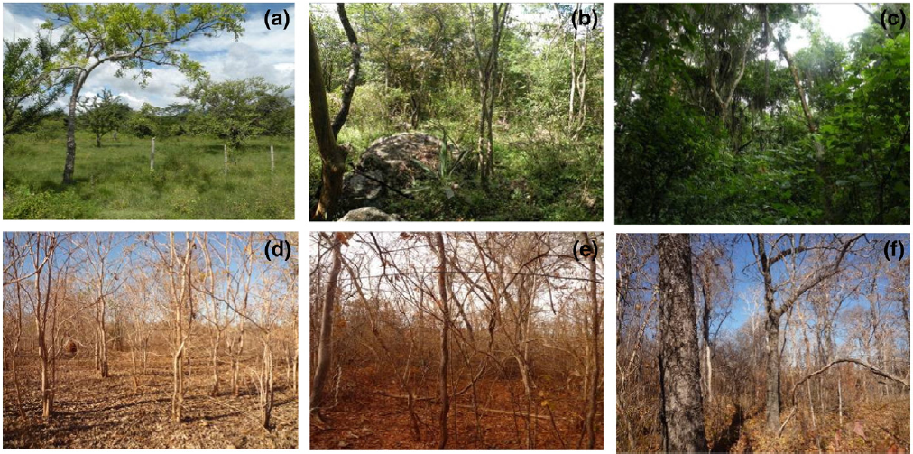
TROPI-DRY work is driven by
Forest succession
Early (0-10 yrs)
Intermediate (10 – 30 yrs)
Late (> 50 yrs)

