Slide 1

Project IAI-CRN3035
Towards usable climate science - information for decision-making and the provision of climate services for agricultural and water sectors of the South-East of South America
PI: Cecilia Hidalgo (UBA)
proyectoiai.serv.climaticos@gmail.com
http://serviciosclimaticos.blogspot.com.ar/
Presentation made by Hugo Berbery and Julian Baez

Slide 2
Climate Services
“The timely production and delivery of useful climate data, information, and knowledge to decision makers”
(National Research Council, 2001).
The CRN-3035 has a strong interaction with the Regional Climate Center for southern South America (RCC-SSA) established by the WMO’s Regional Association III (South America)

Slide 3
Conceptual Framework
research to improve the way in which climate information and knowledge is analyzed, assessed, synthesized, communicated
(translation and tailoring)
research on climate science including social and natural dimensions

the needs, procedures and decision protocols of climate-sensitive sectors of society

Slide 4
CRN - 3035
(Academia, Stakeholders, Services and Users)
Argentina
Brasil
Paraguay
United States
Univ Buenos Aires
INTA
SMN
INA
ORA
AACREA
Univ Fed do Parana
Univ do Passo Fundo
Univ Federal do São Paulo
EMBRAPA
Instituto Nac de Meteorologia
CPTEC
Univ Católica de Asunción
Univ de Asunción
Dirección Nac de Meteorología
Ministerio de Agricultura
University of Maryland
University of Miami

Slide 5
Research Topics

Slide 6

(1) Compilation of regional climate and sectoral (water, agricultural) data sets
The goal of this component is to develop usable, quality‐controlled regional climate datasets for southern South America.
Stewardship of climate data (quality control, management and dissemination) is a prime example of the critical role of IAI‐sponsored networks in fostering and facilitating regional collaboration and coordination.
The successful compilation of a climate data base has been a major step for the region; indeed, to our knowledge, this is the first time that countries in the region have collaborated to produce a consolidated set of climate data, consistently controlled for quality.

Slide 7
(2a) Implementation of regional drought monitoring and assessment system
Because of the regional importance of agricultural production and water resources in southern South America, drought was identified by the RCC-SSA as a common focus around which initial collaboration activities could be organized.
CRN‐3035 is engaged in the creation of a drought early‐warning system that will be initially tested in southern South America and subsequently adapted to the different contexts and needs of the entire continent.
A strategic plan was developed in a workshop held at the National Meteorological Service in Buenos Aires, Argentina, from 8 to 10 August 2017. Stakeholders and scientists of the CRN3035 transdisciplinary team were active contributors.

Slide 8
(2b) Studies of Climate Variability and Trends
Investigate the interdecadal variability with regard to its relationships with interannual variability, such as the interference between the Interdecadal Pacific Oscillation (IPO) and ENSO;
Assess the skill of models of the Subseasonal to Seasonal (S2S) Project for predicting in a subseasonal time range the MJO and its impacts over South America, as well as extreme events, with focus on populous regions of the Parana‐La Plata Basin.

Slide 9
(2b) Studies of Climate Variability and Trends
Climate variability and trends - P_{5d}
Reanalysis vs Obs
Climate variability, extremes, and trends - Tmax

Slide 10
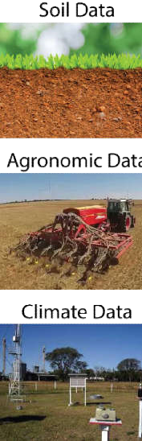
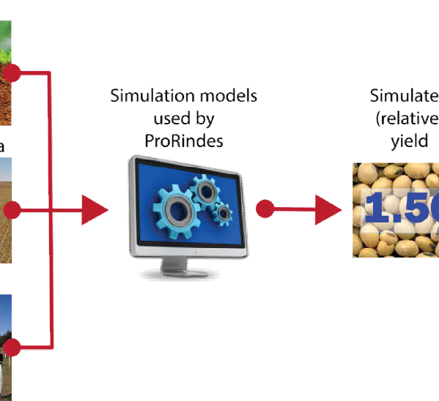

(3) Crop yields and index insurance
We developed a pilot tool – called ProRindes – to anticipate the likely range of yields for important crops (maize, soybeans, wheat) in the Argentine Pampas throughout a particular cropping cycle. The system produces forecasts for 14 agriculturally relevant locations distributed in the Argentine Pampas. The forecasts currently can be seen on this link: www.prorindes.com.ar.
The yield forecasts are based on computational models that simulate the growth and development of a crop.
The crop models require as inputs data on the agronomic management of a crop (e.g., early or late planting for maize), soil characteristics, and climate data.
ProRindes forecasts yields for each combination of the following factors: Location; Soil type; Crop (soybean, early‐planting maize, late‐planting maize, wheat); Agronomic management; and Soil water content at time of planting.
Figure
11
.
Schematic
descrip
tion of the inputs and components of the
ProRindes crop yield
forecasting system.

Slide 11

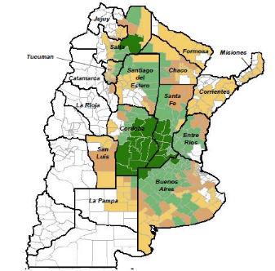
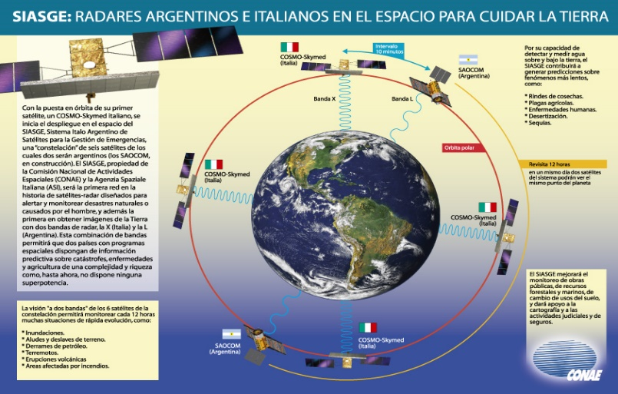
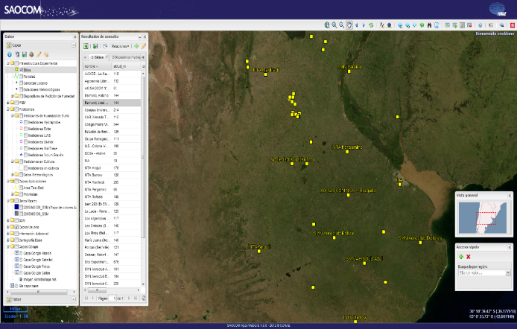
Motivation for a soil moisture study in southern South America
Climate scientists and stakeholders in agriculture and water resources in SESA are in need of reliable products describing current soil moisture that can be used as a model benchmark, for planning purposes, and as a drought indicator.
Adequate estimates of soil moisture are critical for crop management and planning purposes.
The Argentine Space Agency is constructing two satellites with L-band full polarimetric Synthetic Aperture Radars (SAR). These satellites are designed for environmental purposes including estimation and monitoring of soil moisture.
In support of the satellite mission, a network of about 70 sites are continuously measuring in situ soil moisture with Hydraprobe II automatic sondes, and complemented with other methods.

Slide 12
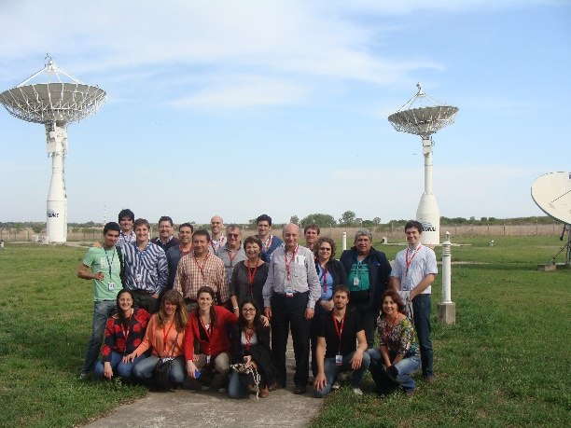
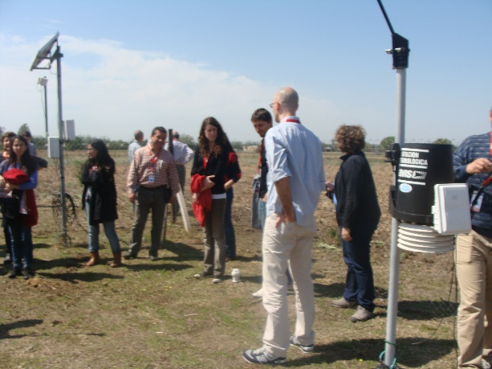
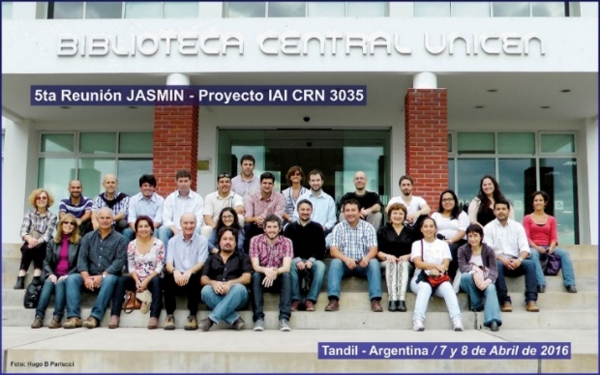
(4) Joint Assessment of Soil Moisture Indicators (JASMIN)
Bring together a community that had been working for the most part independently,
Document methods and assess strengths and weaknesses of the different soil moisture estimates (in-situ obs, satellite estimates, water balance, land surface or hydrological models)
Explore ways of harmonizing current estimates into a consistent product that can be easier to interpret than the individual components.
Assess the quality of satellite products and develop soil moisture estimates from multiple sources by data assimilation
The initial premise "each of us has something positive to offer to the group; let's focus on this and not the weaknesses" proved to be determinant in creating an atmosphere of trust and sharing of ideas.

Slide 13










Participating groups
Argentine Agricultural Agency (INTA)
Argentine Space Agency (CONAE)
Argentine National Weather Service
Office of Agricultural Risks (Ministry of Agriculture)
School of Agriculture (UBA)
Center for Research of the Sea and Atmosphere (CIMA, CONICET/UBA)
University of Maryland (UMD)
National University of the Littoral (UNL, Arg)
Institute for Plains Hydrology “Dr. Eduardo J. Usunoff” (UNICEN)
Institute for Research in Astronomy and Astrophysics (CONICET/UBA)
Working w/ end users and stakeholders

Slide 14
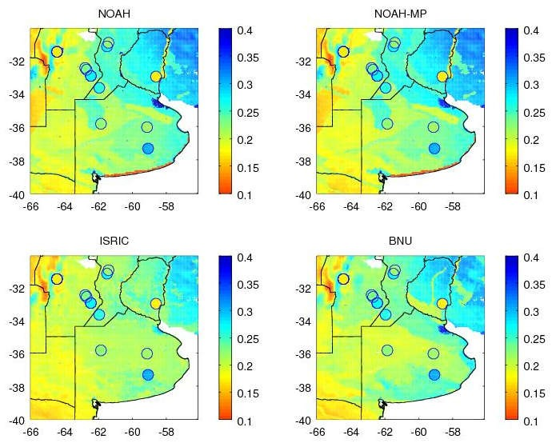
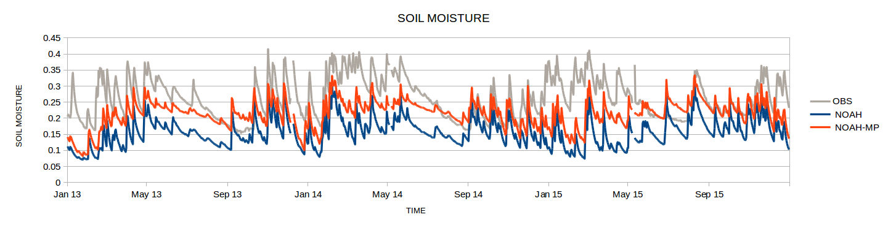
Major Science Themes in JASMIN
Evaluation of a Hierarchy of Land Surface Models (Noah, Noah-MP, VIC)
Groundwater effects
Validation of satellite products
Merging of products
Monitoring based on (1) water balance concepts, (2) land surface models, (3) satellite estimates
.
‐
‐
‐
‐
‐
‐
‐
‐
‐
‐

Slide 15
Policymakers and other stakeholders involved
JASMIN identified needs from stakeholders of agriculture and water management to have reliable estimates of a key element -soil moisture- needed for planning purposes.
How was the spark between science and policy generated ?
Researchers were presented with the opportunity to showcase their interests and identify common priorities.
Then a community effort was started to address those priorities responding to stakeholders needs by taking advantage of the strengths of each approach.
Means used to interact with stakeholders
Our main stakeholders are national agencies that work with end users. Members of these agencies are part of JASMIN and are actively involved in its research agenda. Stakeholders have a direct interaction with researchers, and there is a blend of interests that blurs (in a positive manner) the line between research and applications.
What does the project provide to stakeholders?
One key achievement of JASMIN was to bring together a diverse community that at the time was working disjointedly. This initiated community effort identified the best approaches for estimating soil moisture from multiple sources, from in-situ observations to models and to satellite information

Slide 16
In your opinion, what were your biggest successes? What decisions / options turned out to be the good ones?
Six well-attended workshops demonstrate the creation of a strong and motivated team that kept its goals and desire to interact through the years. The initial premise "each of us has something positive to offer to the group; let's focus on this and not the weaknesses" proved to be determinant in creating an atmosphere of trust and sharing of ideas.
In hindsight, what would you do differently?
JASMIN was successful because it kept a realistic view of the research possibilities while focusing on the demands from stakeholders. The workshops involved a lively sharing of ideas and future planning. In this context, it is difficult to say that something should have been done differently. Perhaps more efficiently? Putting more effort on finding alternative sources of funding?

Slide 17

Thank you
“Una documentación de los distintos métodos empleados actualmente para estimar la humedad del suelo”.

Slide 18
(1 of 2) JASMIN achievements, big and small
Published a book documenting work done
Developed means for interactions and collaborations among individual research and application groups
Bring academia closer to applications and services.
Publications
Formal recognition of the complexities of the subject and share the latest research on different areas relates to soil moisture estimation

Slide 19
(2 of 2) JASMIN achievements, big and small
(As described by the stakeholders involved in JASMIN)
Extending the area of interest to Paraguay
JASMIN is an achievement in itself, that had the academic community start using data created at National Agencies. “JASMIN ha logrado que informacion generada con fondos del estado sea empleada por el sector academico.”
CONAE (Arg Space Agency) recognized the development of a community that became aware of the promising data to be developed with SAOCOM’s Mission.
Capacity Building and Outreach.

