Slide 1

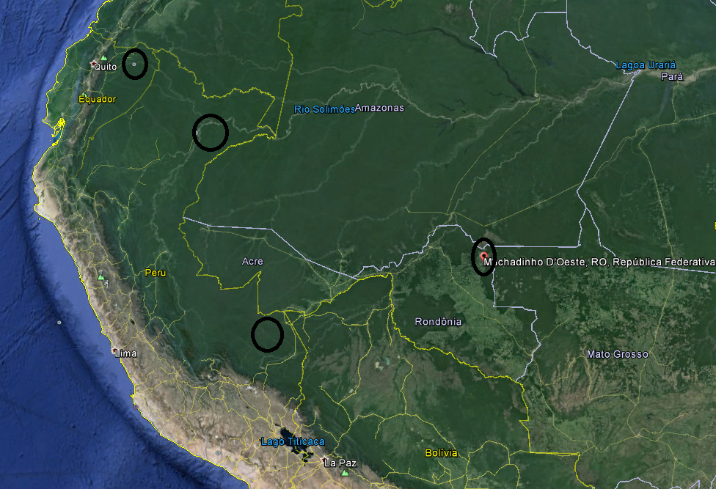
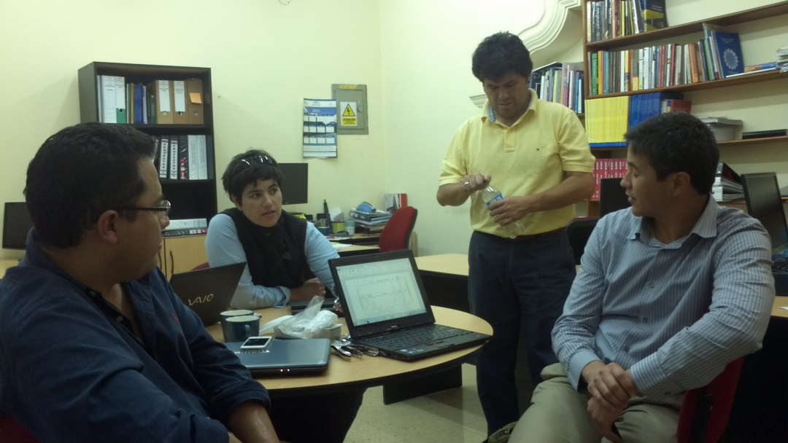
Inter-American Institute for Global Environmental Research (IAI), A.F. Barbieri, PI; W. Pan, J. Miranda. B. Feingold, C Mena, G. Guedes, U. Confalonieri and L. Wong, Co-PIs)
LUCIA – Land Use, Climate and Infections in the Western Amazonia
Science-Policy Impacts

Slide 2
Contributions to Science based on CRN3036 Objectives
  General: Understand the relationships between population changes, LULCC, climate change and infectious disease transmission in Western Amazonia
    Justification: Land Use and Land Cover Changes (LULCC), coupled with the effects of a changing climate will have important impacts on the natural environment and the human population of the Amazon. Forest conversion in Amazonia has also an influence on the dynamics of endemic infectious diseases such as malaria, yellow fever and leishmaniasis
  Specific:
  Build a comparative methodology based on collection of field data (surveys and qualitative research) and secondary data analysis: understand local drivers and project plausible scenarios of Land Use
  Analyze current and future vulnerabilities of selected socio-ecological systems (SES) to the impacts of global environmental change and develop a multidimensional metric of population vulnerability, composed of aggregate indicators, incorporating downscaled climate change and LULCC scenarios

Slide 3
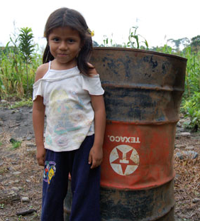
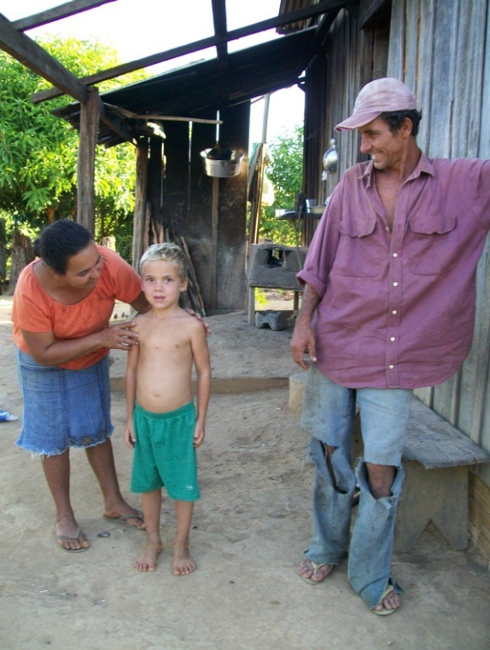
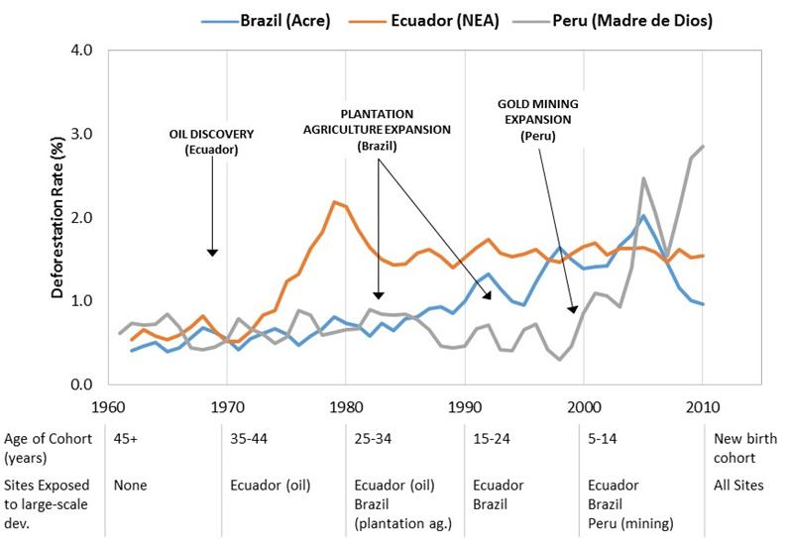
  Specific Objective 1: understand local drivers and project plausible scenarios of Land Use
Impacts of oil extraction on indigenous/colonist land use and health in Ecuador
Gold mining, deforestation and health in Peru
Understanding the co-evolution of land uses, deforestation, demographic and health dynamics in Brazil
Figure 1- Deforestation dynamics in the study areas over time

Slide 4
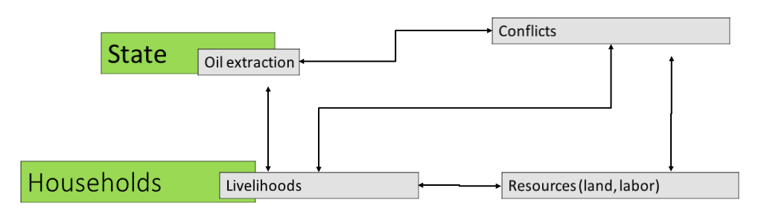
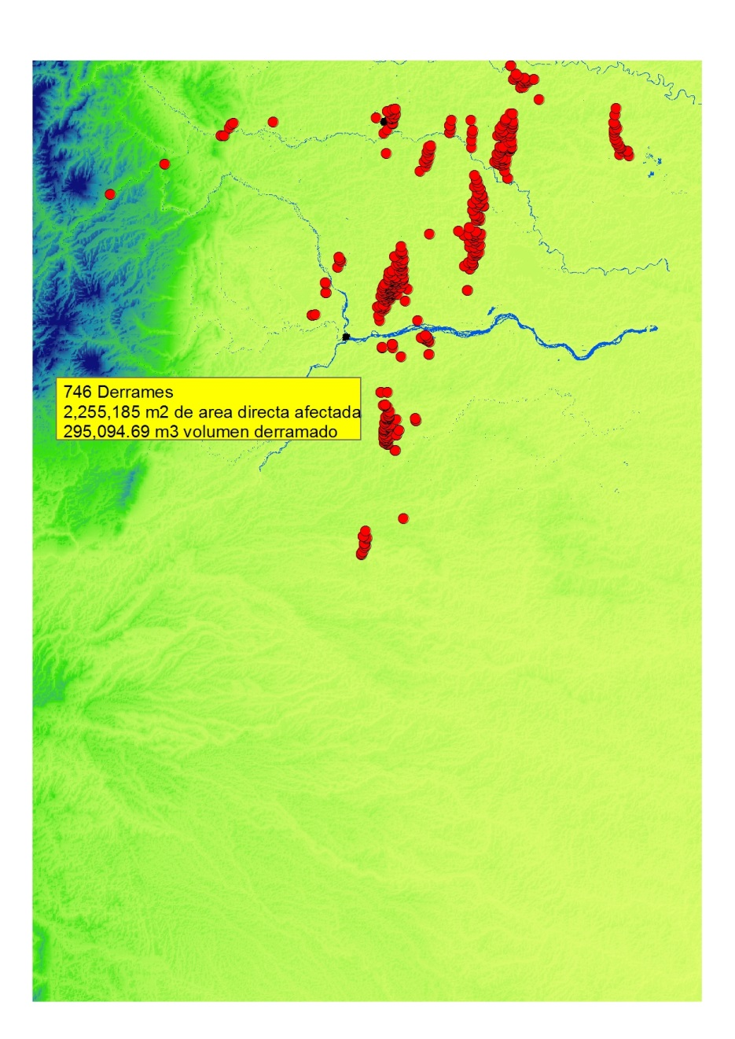
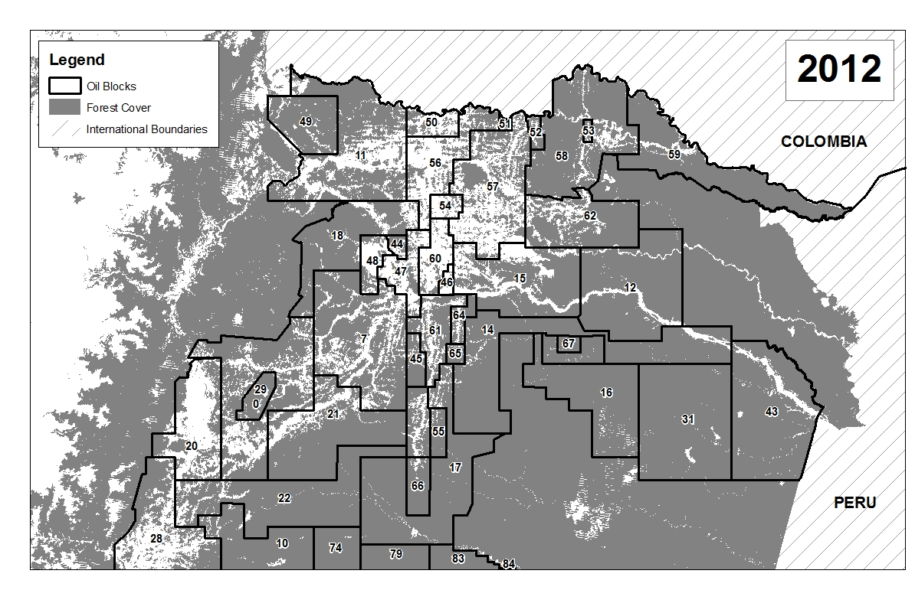
  Objective 1, example: LULCC, oil extraction and conflicts in the Ecuadorian Amazon

Slide 5
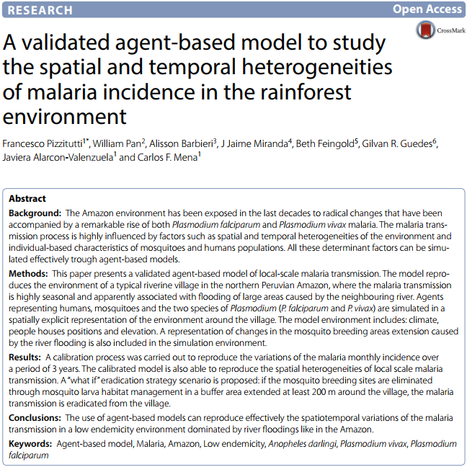
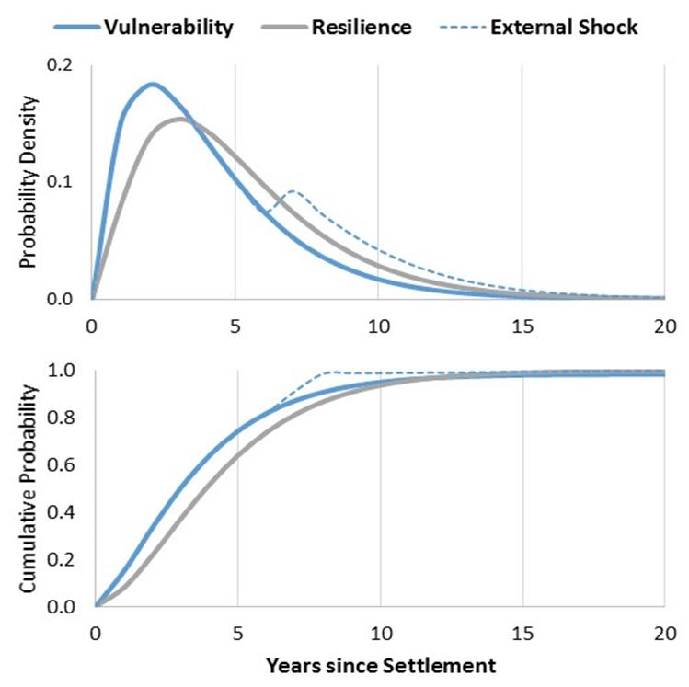
  Objective 2, examples: vulnerability analysis
Vulnerability and Resilience Assessment Framework:
  Brazil (1): develop a multidimensional index to look at which non-monetary dimensions of well-being affect income vulnerability
  Brazil (2): analysis of the transition between poor and non-poor with the description of the individual behavior represented by a matrix of transition probabilities using Markovian process
First ABM of malaria
  ABM models to simulate emergent LULC, demographic, socioeconomic and health scenarios given exogenous shocks (climate change and infrastructure building)
  ABM - composed of 4 interconnected modules: Household decision-making and health condition, land cover change, climate change, anopheline ecological model

Slide 6
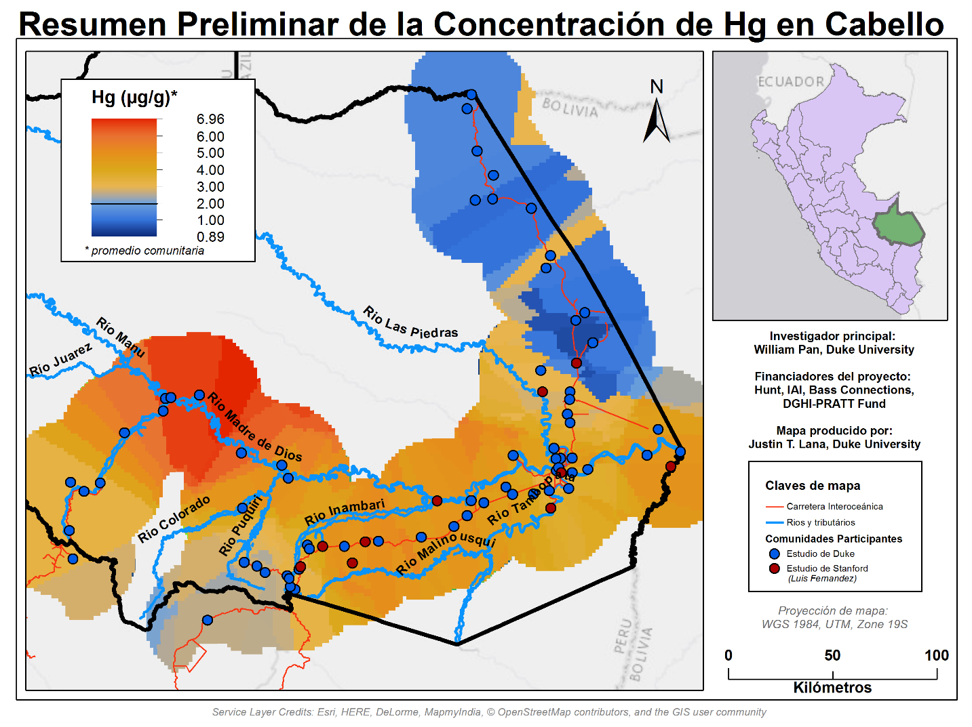
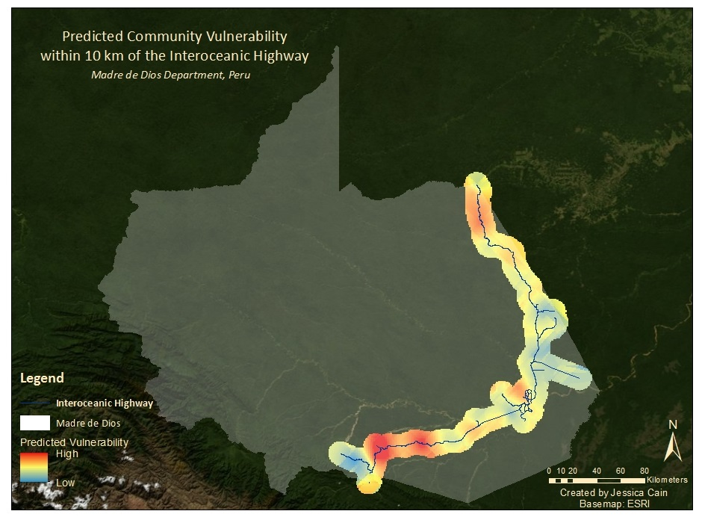
  Specific Objective 2, examples: Vulnerability Analysis
Vulnerability Index:
  HH survey module applied to measure household vulnerability to adverse health outcomes.
  A spatially explicit vulnerability index was created (designated Survey Vulnerability Index)
Biomonitoring of Hg in ASGM impacted areas
  Measured hair mercury in 4000 residents of Madre de Dios
  Results: 90% higher risk of mercury exposure among indigenous vs. non-indigenous populations
Vulnerability surface interpolated for the 10 km buffer surrounding the Interoceanic Highway
UNPUBLISHED DATA – DO NOT CITE OR SHARE

Slide 7
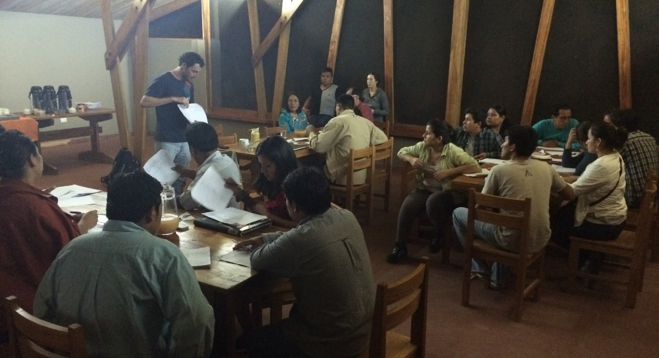
Inter-related Science-Policy Impacts
Training & Capacity Building
Community Engagement
Health & Environmental Policy

Slide 8
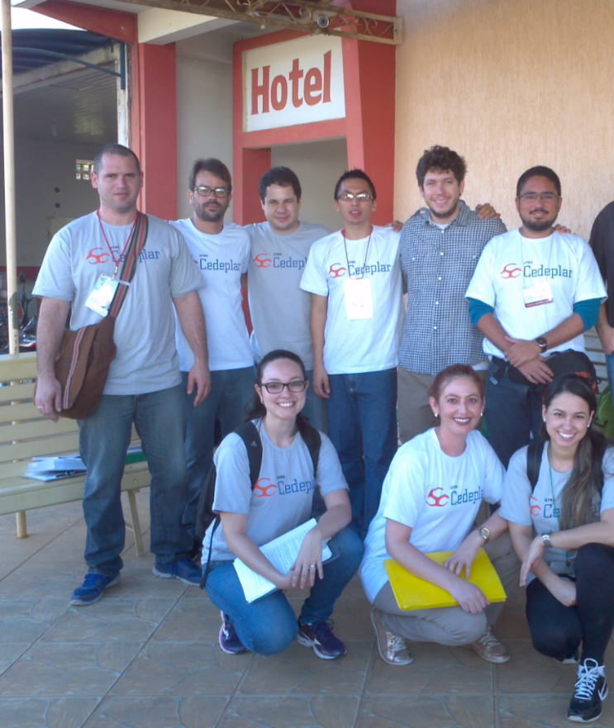
Capacity Building
Overall, LUCIA has provided interdisciplinary training to 77 students
  2 Postdoctoral
  22 Doctoral
  22 Masters
  31 Undergraduate
Notes:
Mention leveraging of Bass Connections in Peru -- $40m training program at Duke

Slide 9

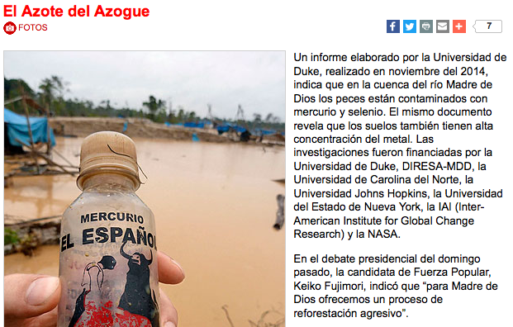
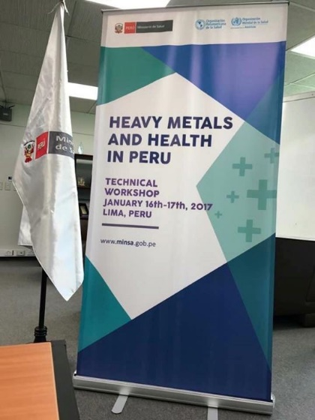
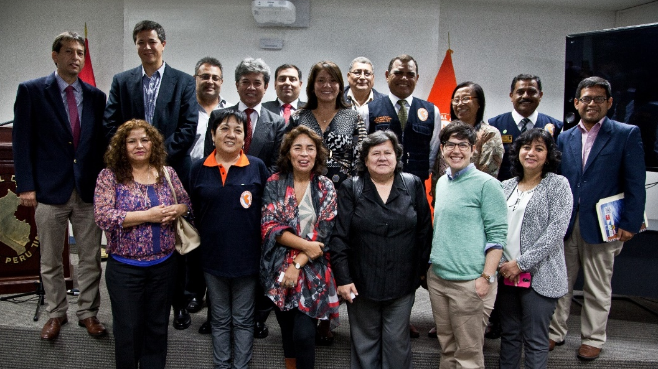
Community & Government Engagement
Bringing science to communities
  Participation in local conferences, holding meetings with community leaders and residents
Engaging regional & national governments

Slide 10
Lessons
Interdisciplinary science does not equate to interdisciplinary policy
  Government departments are largely in competition and in silos. Hard to navigate science communication
Science impacts do not need to wait for publications
Better cross-border communications are needed
  Academicians should not be a policy bridge between governments – we need to create better forums for open scientific policy discussions to recognize joint benefits
Full-team annual meetings with entire program will benefit learning across the groups

