Slide 1


Sensing the Americas’ Freshwater Ecosystem Risk (SAFER) from Climate Change
IAI – CRN 3038

Slide 2
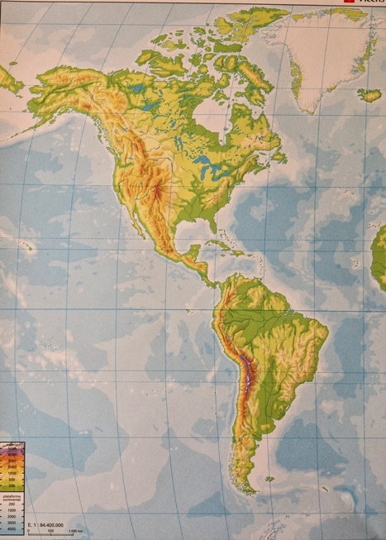

OBJECTIVES
SAFER is actually interested in HOW THE FRESHWATER ECOSYSTEM INFLUENCE THE PEOPLE LIVING AND/OR RELATED TO THEM, AND VICEVERSA, HOW THESE PEOPLE INFLUENCE THE ECOSYSTEMS
Employ freshwater ecosystems as “sentinels” or “sensors” of climate variability and watershed processes and investigate their interaction with other multiple stressors to assess risks to ecosystem services in the Americas
Determine management and mitigation strategies which are both technically and economically feasible as well as culturally aceptable
Reach the integration of stakeholders and decision makers into the learning arena with the natural and socioeconomic researchers

Slide 3

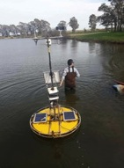
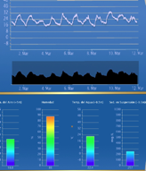
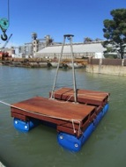
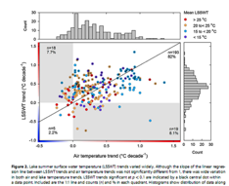
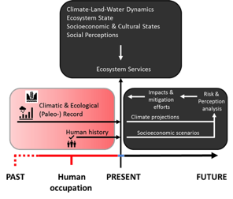
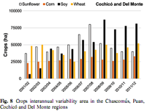
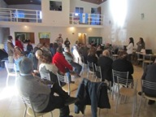
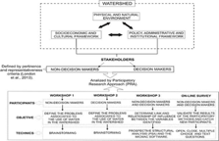
What kind of research uptake was developed?
DATA / INFORMATION AND METHODS
https://eng.ucmerced.edu/snsjho/files/SAFER_Digital_Library

Slide 4

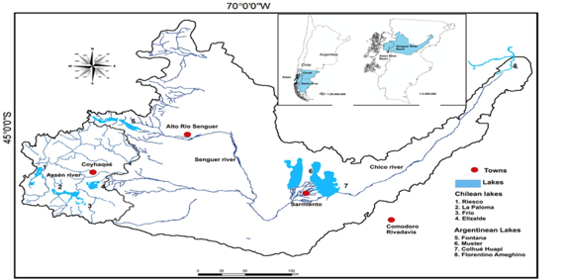
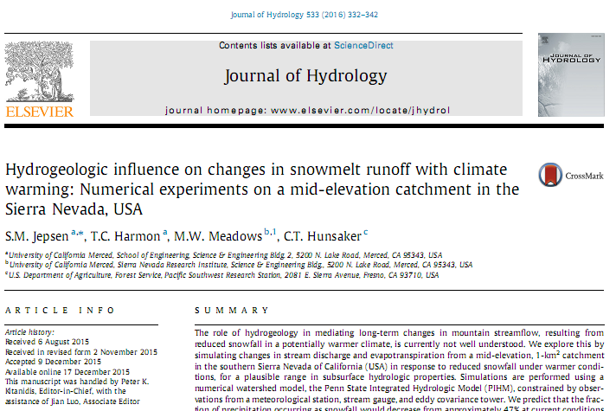
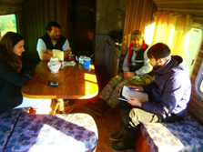
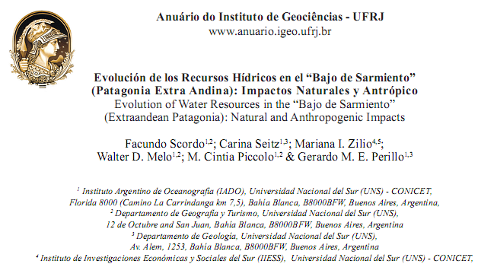
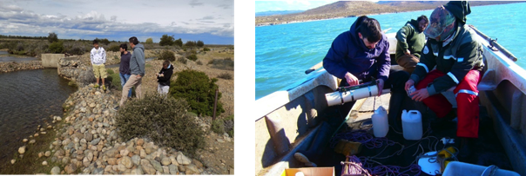
HYDROLOGY

Slide 5
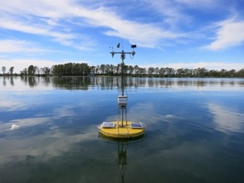
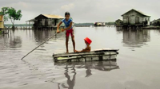
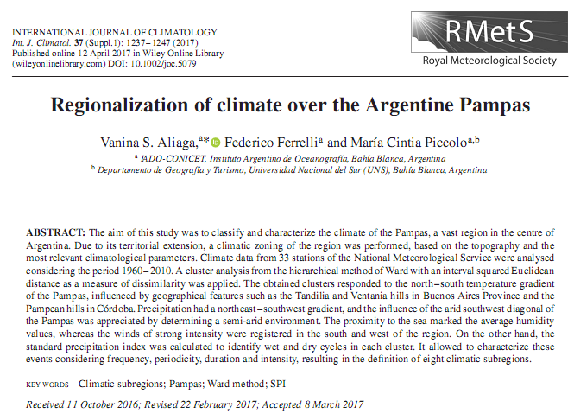
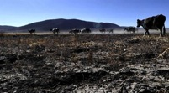
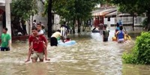
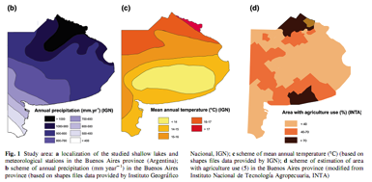
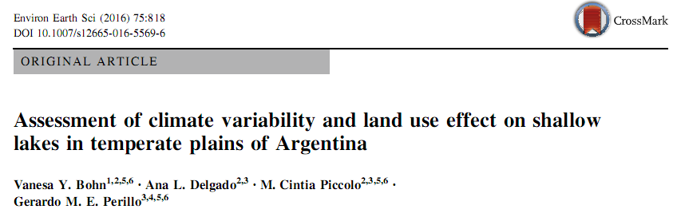
CLIMATOLOGY
HUMAN DIMENSION

Slide 6

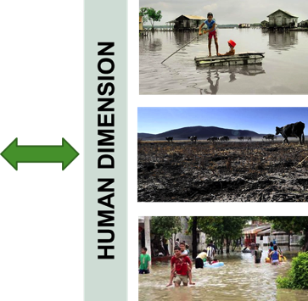

Slide 7
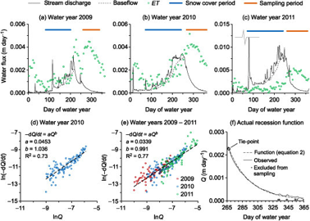
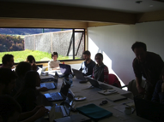
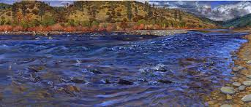
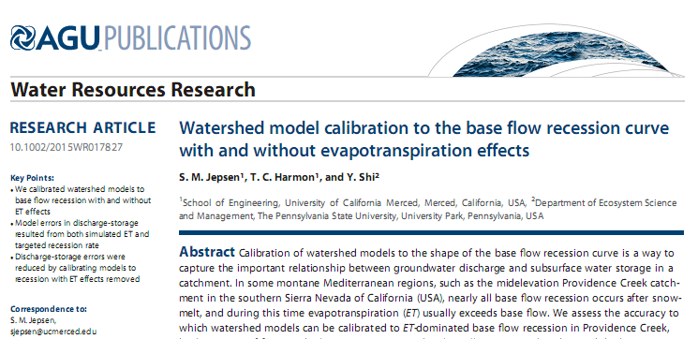
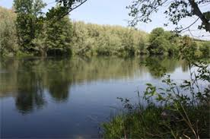
MODELING

Slide 8
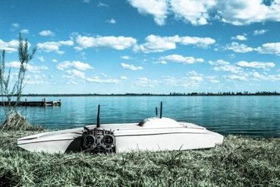
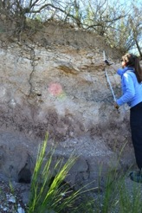
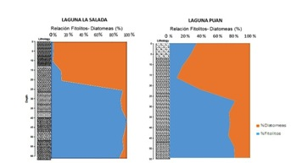
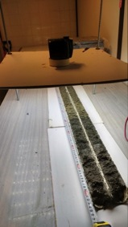
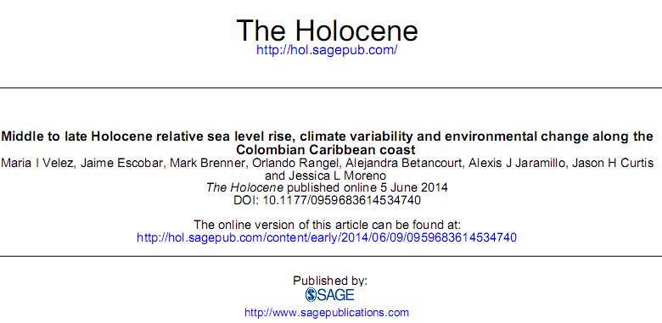
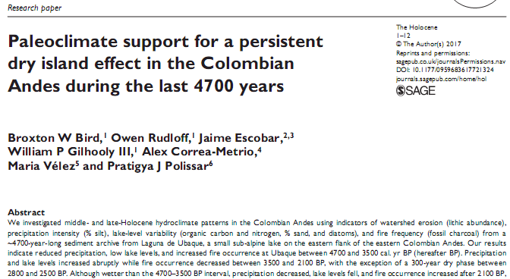
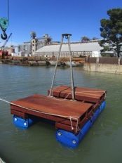
PALEOLIMNOLOGY

Slide 9
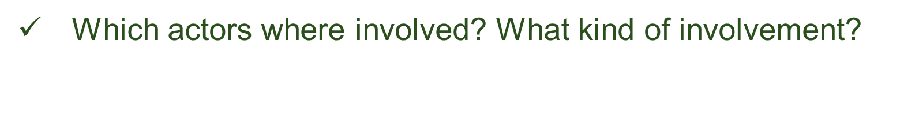
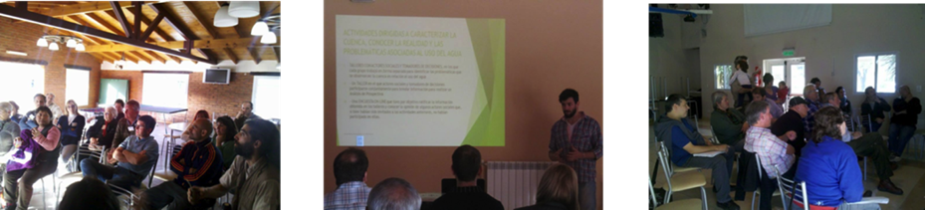
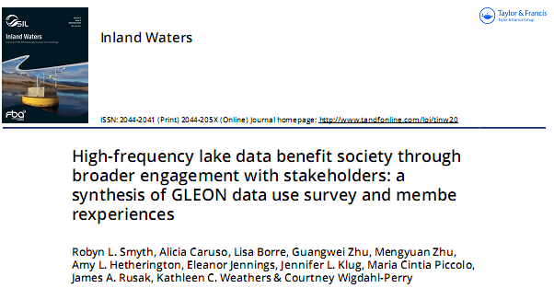
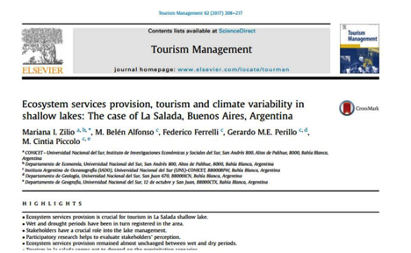
SOCIO-ECONOMIC

Slide 10
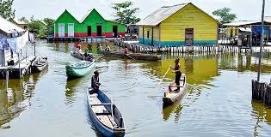
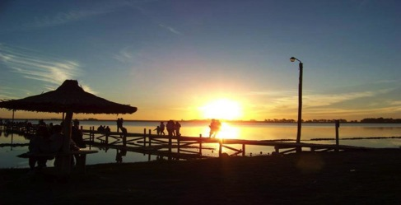
Two examples of successful involvement
CIÉNAGA GRANDE DE SANTA MARTA
No links between researchers and stakeholders before SAFER
LA SALADA SHALLOW LAKE
Fluent and collaborative interaction between researchers and SH generated new concerns about the health of the lake

Slide 11
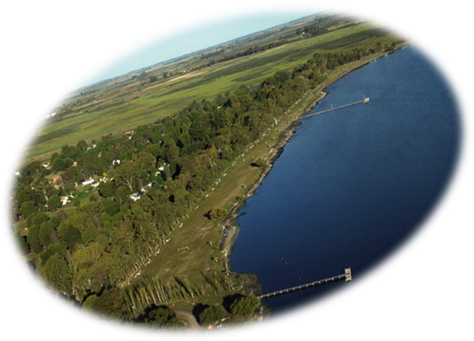
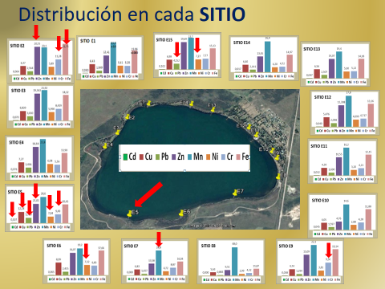
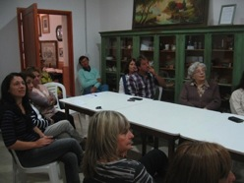
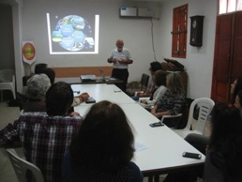
SCREENING IN LA SALADA
Metals
Organochlorine pesticides (OCs)

Slide 12
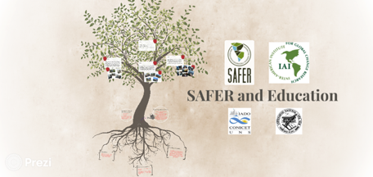

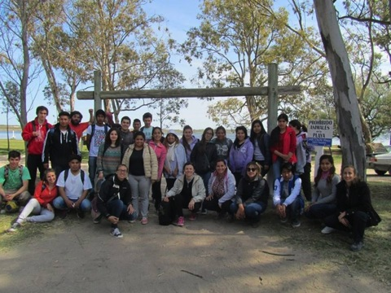
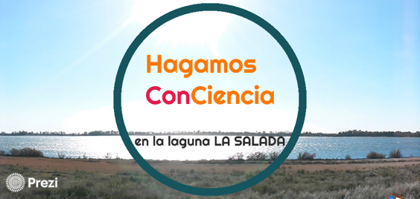
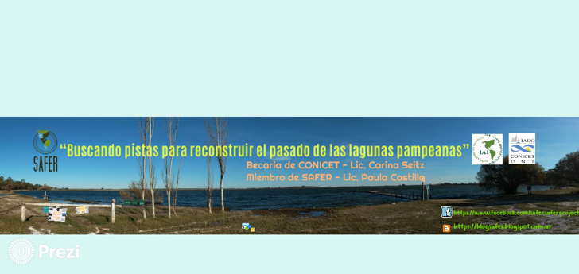
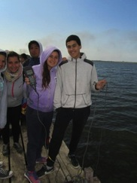
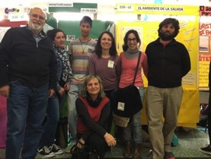

Slide 13







Slide 14


BOOKS
The Pink Brush
A. C. Harmon & Safer Project Team
El cepillo rosado
A. C. Harmon y el equipo SAFER
https://www.amazon.com/Pink-Brush-C-Harmon/dp/1329342879/ref=sr_1_1?s=books&ie=UTF8&qid=1491343661&sr=1-1&keywords=The+Pink+Brush

Slide 15



Water thieves
V. Perillo & the SAFER team

Slide 16




CAPACITY BUILDING
  1. SAFER FELLOWSHIPS
2. COURSES
3. STUDENTS NETWORK

Slide 17


1. SAFER FELLOWSHIPS
2. COURSES

Slide 18


3. STUDENTS NETWORK
Consensus of team work at the international level
Learning new techniques and approaches
Only students papers
GSP (Graduate Student and Postdoctoral Association of the IAI)

Slide 19





SISTER LAKES PROGRAM

Slide 20

SOCIAL SCIENCES
CONTRIBUTION
LESSONS LEARNED
CONVERSION OF RESULTS IN USEFUL INFORMATION

Slide 21




NEW DEVELOPMENT:
TREATMENT WETLANDS

Slide 22





LA SALADA SHALLOW LAKE

Slide 23
HIGHLIGHTS
A better understanding of place-based management and mitigation options in individual watersheds
A framework to bring stakeholders, scientists and policy-makers to engage in watershed management.
The consolidation and strengthening of a transdisciplinary network of researchers and students with a big potential for growth beyond the project boundaries
38 papers published in journals, 7 book chapters and 4 books, 44 oral and poster presentations
Currently 8 papers in press, 16 submitted, 19 papers in preparation (expected submission end 2017 / 2018)

Slide 24

NEW APPROACHES BASED ON THE PROJECT EVOLUTION
SOCIAL + EDUCATION
PALEOLIMNOLOGY + ECOSYSTEM SERVICES
TEMPORAL ANALYSIS + CLIMATE VARIABILITY
CLIMATE VARIABILITY + SOCIO-ECONOMICS

Slide 25

SAFER TEAM. Bogotá, June 2017

Slide 26
SAFER NUMBERS
TOTAL BUDGET | 902.100 | Share
Travel / Workshops | 284.500 | 31,5
Salaries por Students / Scholarships | 237.600 | 26
Research Expenses / Materials & Supplies | 127.000 | 14

Slide 27
SAFER COFINANCING
US National Science Foundation
National Science and Engineering Research Council (CAN)
IAI
IDRC
CONICET (ARG)
CONICYT – FONDECYT (CHI)
European Commission 7th Framework Program (COMET LA)
… among many others
1142 %

