Slide 1
Water Security in the Arid Americas, “Aguascapes”
CRN3056
Science Program &
Science-Policy Dialogues
University of Arizona - USA
Pontificia Universidad Católica - Chile
Univ. Nacional Cuyo/CONICET - Argentina
Colegio de Sonora - Mexico
Universidade Federal de Pernambuco - Brazil
(Centro de Competencia del Agua - Peru)

Slide 2
Network development
(Univ. Arizona & partners)
RISK & VULNERABILITY
- IAI Human Dimensions & Coop Resch Net CRN2
- NOAA Sectoral Apps SARP/ Clim-Soc CSI
- NOAA Climate of Southwest CLIMAS
- USGS Transboundary Aquifers TAAP
- Az Water Institute – Water-energy nexus
- WateReuse Foundation
RESILIENCE & ADAPTIVE MANAGEMENT
- NSF Resilient & Sustain Infrastruct RESIN
- NSF Coupled Natural-Human Systems CNH
WATER SECURITY
- AQUASEC, IAI Ctr of Excellence:
- IAI CRN3, SGPCRA
- Lloyd’s Register Fndn
- NSF PASI
- Andes-Himalaya links

Slide 3
Network development
(Univ. Católica Chile & partners)
Former projects
-Decision support System to Reduce Vulnerability to Climate Variability and Change (FONDEF, Chile)
Combination of weather information and remotely sensed data to analyze the variability of water footprint indicators at a basin scale (Fondecyt Chile)
Related projects
-Vulnerability and Adaptation to Climate Variability and Change in the Maipo River Basin (IDRC Canada)
WATER SECURITY
- AQUASEC, IAI Ctr of Excellence:
- MAPA
- EDUNEXUS. Education and Research Related to the Water-Energy and Food Security Nexus at a River Basin Scale
- Cologne Institute of Applied Sciences
- Global Water System Project (Sustainable Water System Programme)
- AgMIP

Slide 5
Researchers – Stakeholders Evolution
Univ. Arizona & Colegio Sonora-MX
IAI SGPHD
Univ. Católica Chile
IAI SGPHD
IAI,
Univ. Arizona, U. Católica CL, CONICET AR, Mexico, Brazil, Peru, 2011 Los Cabos MX
Az. Dept. Water Resources,
Central Az. Project,
City of Tucson,
US & Mex. NGOs,
Mex Com Nac Agua
Com. Nac. Riego, Dir. Gral. Aguas, Cmte. Vigilancia, Usuarios
IAI, Univ. Arizona,
UNESCO,
U. Católica CL, CONICET AR, IRI Columbia US Fn. Barriloche AR, Stockholm Env. Inst. RALCEA
Univ. Arizona, U. Católica CL, CONICET AR, Col. Sonora MX, UFPernambuco BR, UNM Sn Marcos PE, 2014 Fortaleza BR, 2014 Tucson USA
CRN3056
Stakeholder partners from CL, MX, US, BR, 2011 Los Cabos MX
CAZALAC-CL, Depto. Gral. Irrigación (DGI Mdza AR), Itaipu Binacional (BR-PR), partners & students from MX, PE, BO, EC, CO, NI, HN...
Stakeholders:
CL, MX, PE (national);
US, AR, BR (state-prov);
CL, MX (basin-level)
2014 Fortaleza BR
2017 IWRA Cancún MX
2007-11
CRN2
2007-11
IAI-Opportunity, AQUASEC
2012-13
IAI-Trg. Inst., NSF-PASI
2013-present
SGPCRA005,
CRN3056

Slide 6
CRN3056 design – 3 central tasks
assessment and projection of environmental and human dynamics and their inter-relations,
characterization of vulnerability, risk, and resilience in coupled systems terms, and
interactive identification of policy measures to enhance water security and adaptation.

Slide 7
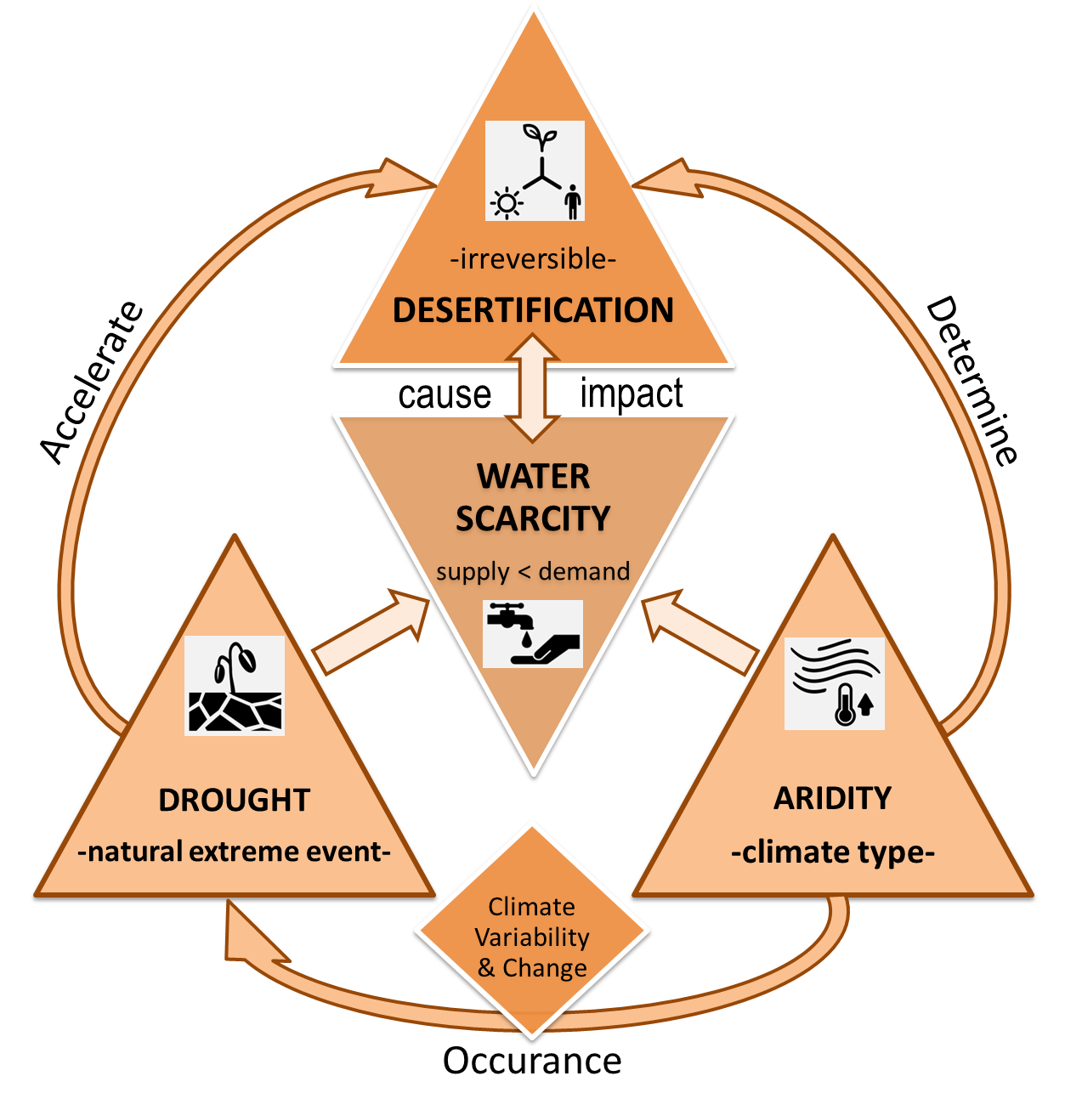
Improving operational drought definitions – Taking them to basin scale
Obstacles of current definitions
Confusion about related terms
Perception among the audience is related to the impacts of droughts
Perceptions change with time
Understanding differ between cultures

Slide 8
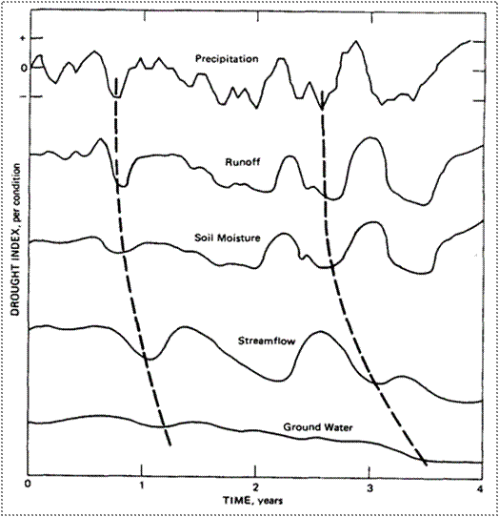
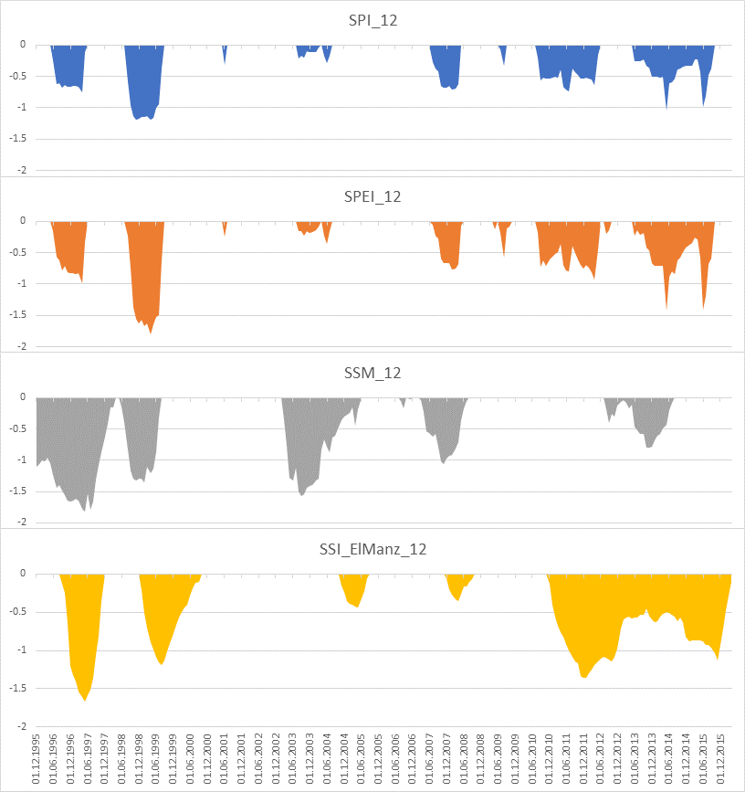
Can we “show” propagation of droughts?
“Happy 30th Anniversary Changnon”
Changnon 1987:
“Detecting Drought Conditions in Illinois” – Report on the definition and detection of drought in Illinois
Our Aim – Describe how drought propagates in semi-arid river basins
?
?
?

Slide 9
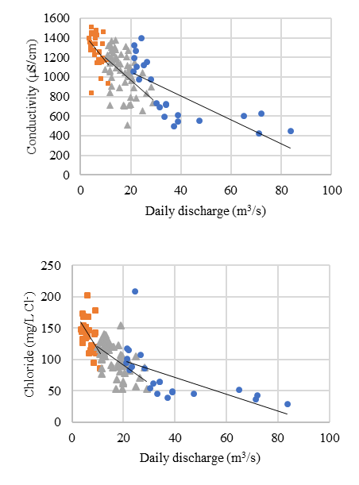
Drought Impacts
Maipo Basin, Chile

Slide 10
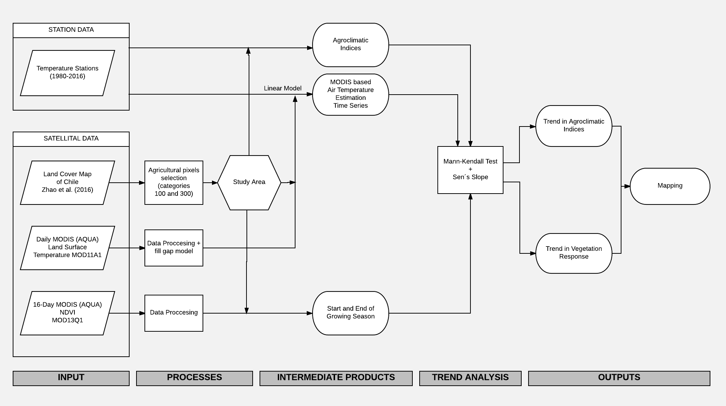
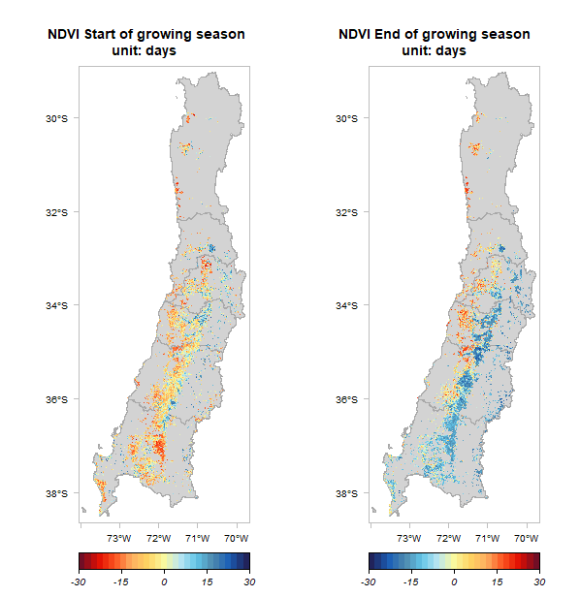
Monitoring Changes in AGRICULTURAL WATER USE

Slide 11
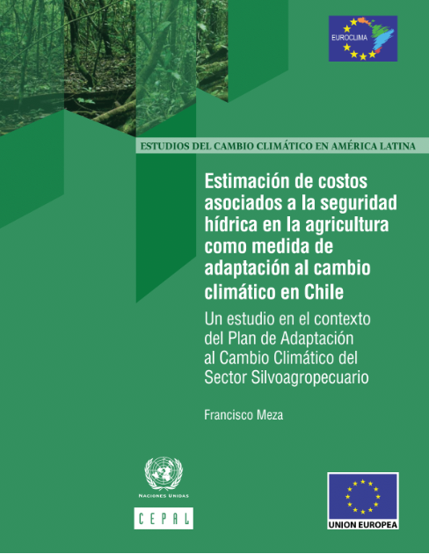
Assessing Adaptation Costs for
Water Security

Slide 12
Metrics for
Water Security
Special issue of Current Opinion in Environmental Sustainability (COSUST)
Genesis at 2014 IAI co-funded workshop in Tucson, "Metrics and Measurement of Adaptation: Advances in Water Research in the Arid Americas."
Issue title, "Environmental Change and Assessment” (issue No. 21, 2016)
13 papers by 39 authors
14 CRN3 team members
COSUST impact factor = 3.954

Slide 13
CRN3056 Comparative Assessment Across Arid Americas River Basins
(“analogue” basins are being driven toward conditions in principal basins)

Slide 14
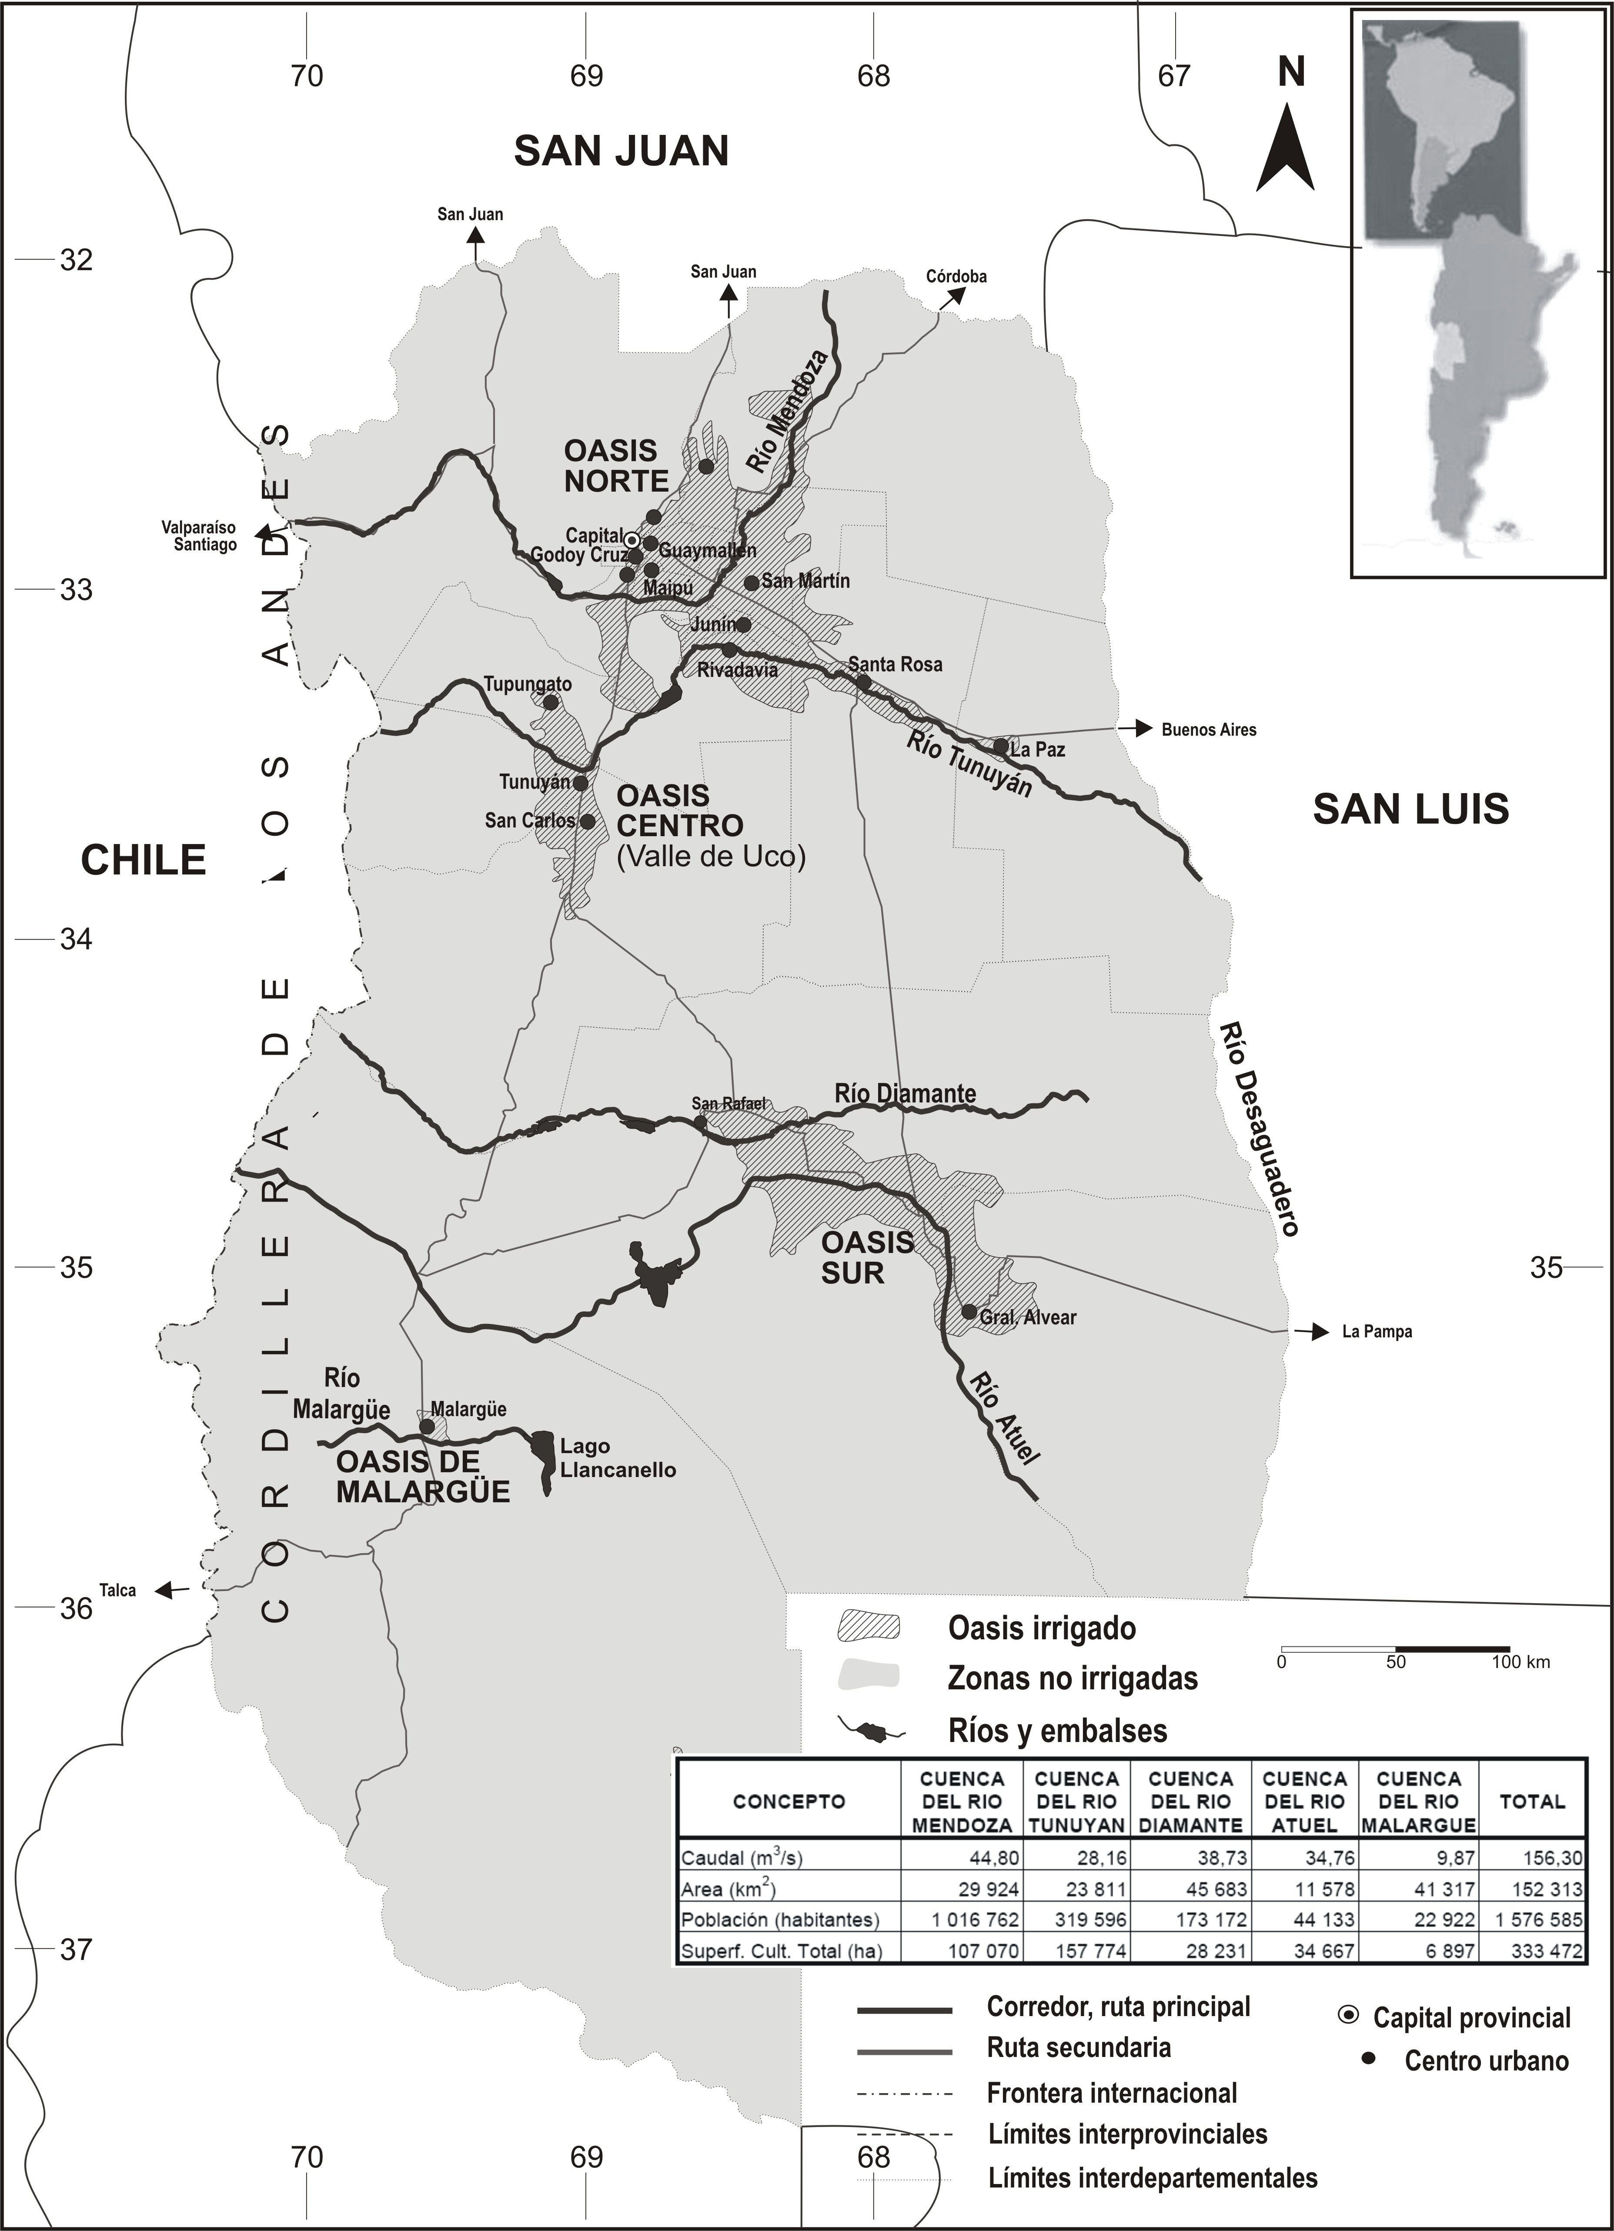
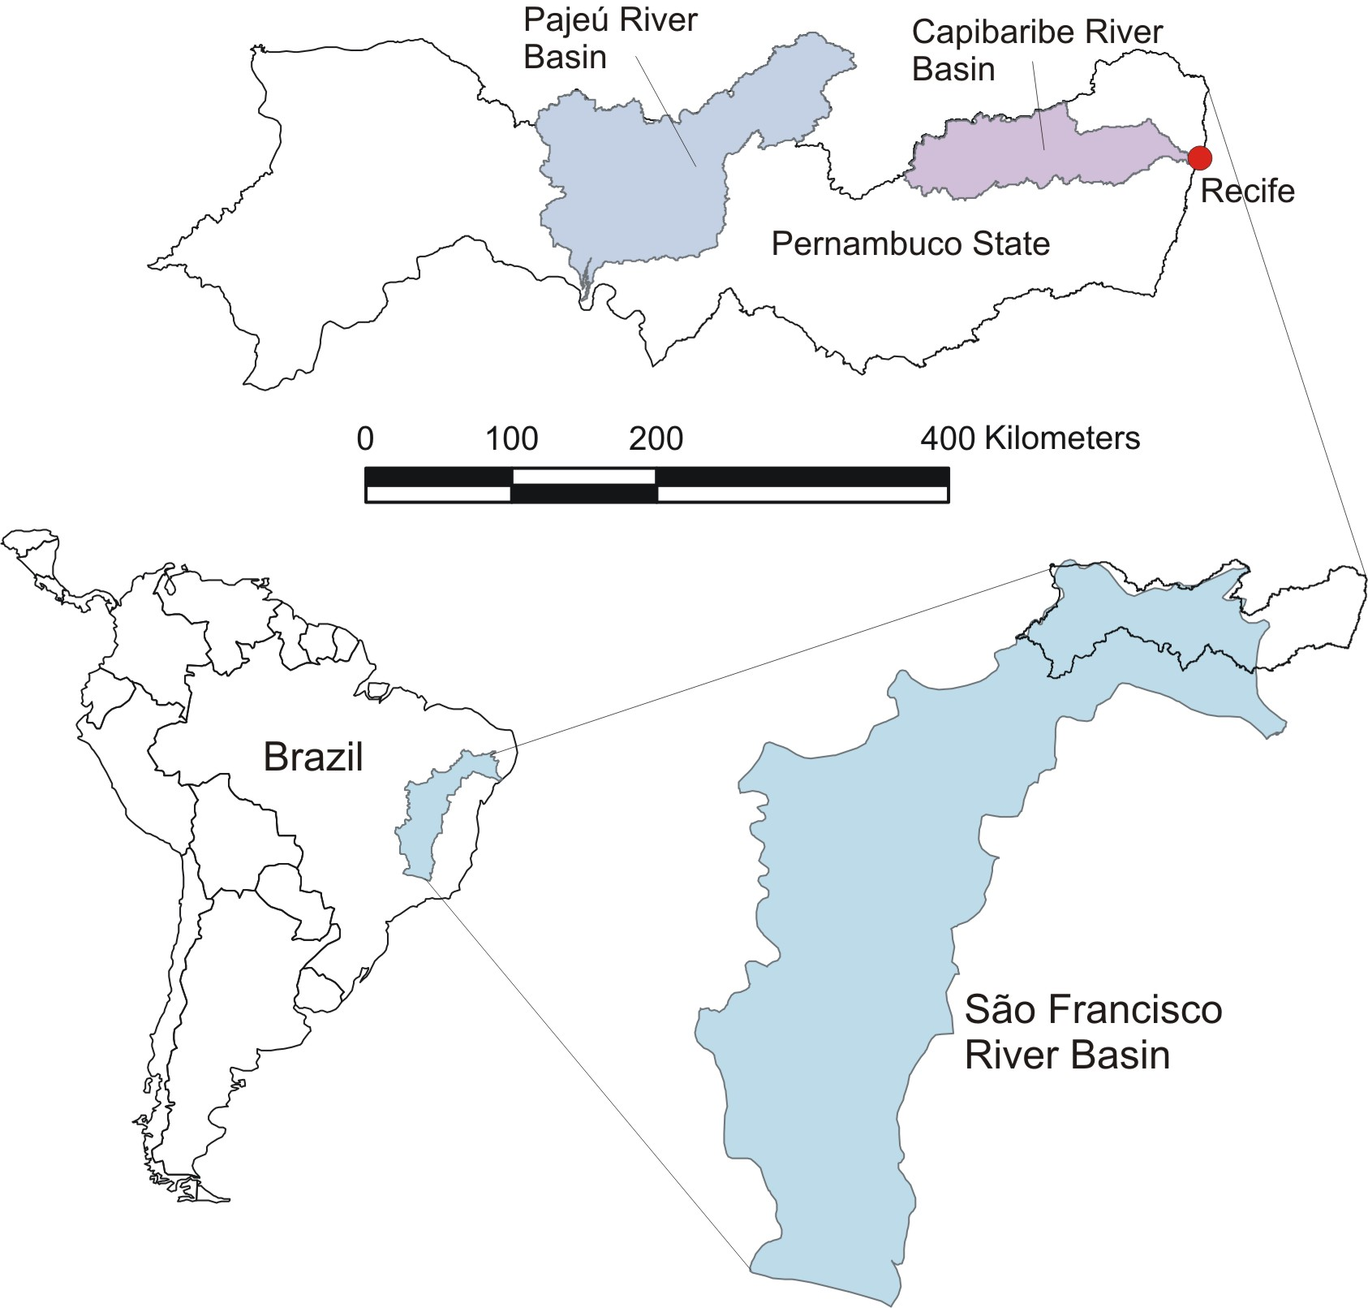

Slide 15
Progress/findings to date – Task 1
Land use/ land cover variability responds to climate signals, especially irrigated area
Groundwater increasingly important source of water for human use
Depleted streamflow has major ecosystem (and human) impacts
Climate change is acknowledged in most cases, but management organizations need tools to address current impacts and plan effectively for the future

Slide 16
Progress/findings to date – Task 2
Vulnerability, risk, and resilience are seen in coupled systems terms
“Water security” and “water-energy-food nexus” are gaining recognition (and acceptance) among decision-makers
Basin-specific index: policy makers could understand their regional drought vulnerability better
Basin-tailored index would be useful to develop basin-scale definitions → easier communication
Improved regional drought management
Supports emphasis of national plans

Slide 17
Progress/findings to date – Task 3
Interactive identification of policy measures to enhance water security and adaptation
  Based on our hypothesis: Current institutional capacities are unable to account for the medium- to long-term implications of global change
  Science-policy dialogue extends planning horizons from short- to medium-term
  Long-term uncertainty continues to undermine effective planning
  Effective adaptation is contingent on bidirectional science-policy communication)
Science-policy interaction spaces: production/use/governance of hydroclimatic information (basin water balances, climatic forecasts, information platforms, water management plans, training events, etc.)
Identification of key issues (policy measures)
  Local/regional climate change scenarios
  Infrastructure flexibility
  Demand-side management
  Waste/recycled water use
  Increasing of water use efficiency vs new vulnerabilities, low tech alternatives
  Ecological and recreational demands, education campaigns
Application of scenario planning/decision making systems/computational modelation with mutistakeholder contrastation and dialogues.
Next step
  Establish and pilot cross-regional dialogues

Slide 18
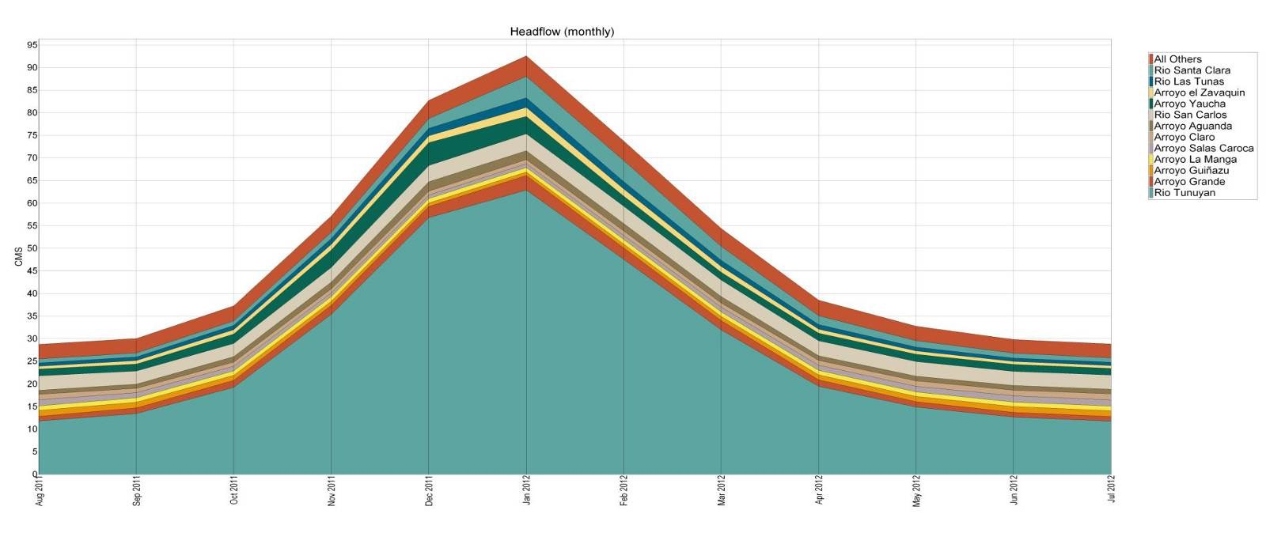
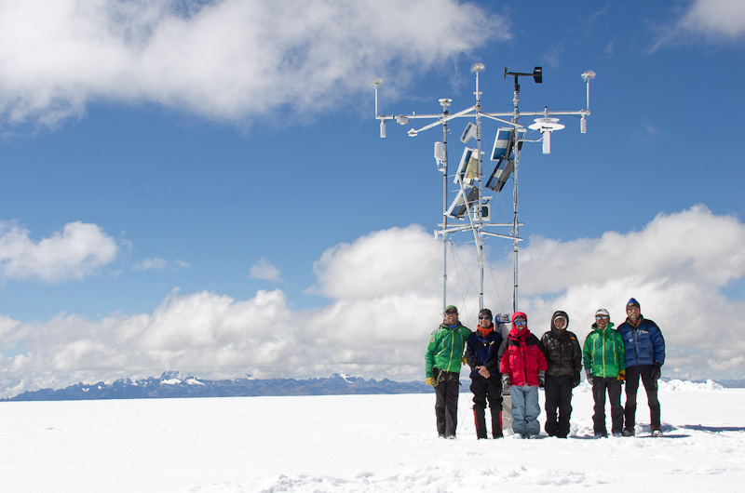
Science-Policy Dialogues: Regional to Global (1)
Main Knowledge Users
National/regional/local public water agencies (politicians, high-level technicians, basin authorities) and local water managers and users (water district coordinators and farmers)
Environmental National Agencies (Water Departments)
Expected Use
Formal/Public
Complement and check hydroclimatic data gathering and analysis
More effectively integrate hydroclimatic knowledge in decision-making
Better understand stakeholder’s information needs/ demand
Develop informed policies and programs in the areas of climate change and water security
Real/Hidden
Legitimize politics that are usuall not science-based (through reliance on academic prestige of scientists)
Externalize institutional cost and conflicts
Contact high-level academic institutions and networks
Provide training opportunities

Slide 19
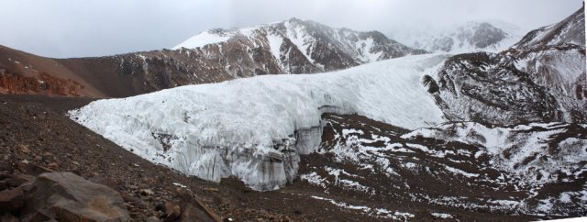
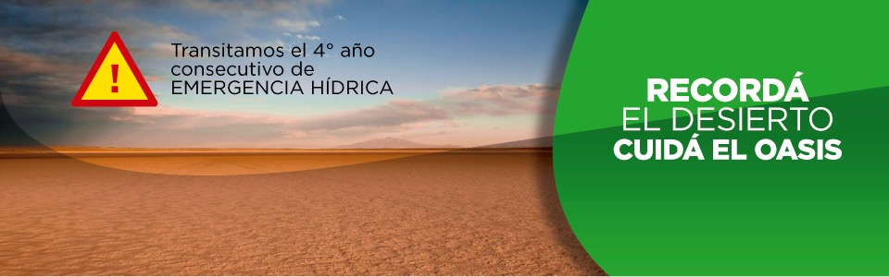
Science-Policy Dialogues: Regional to Global (2)
Involvement with regional and international institutions
FAO, UNESCO, CEPAL, RALCEA, RIGA, Stockholm Environment Institute, International Water Security Network, among many others
Types of involvement
Research development and academic collaboration
Training networks
Intergovernmental Governance and Agendas
Expert or specialized agencies

Slide 20
Thank you.
Questions?
Chris Scott, cascott@email.arizona.edu
Francisco Meza, fmeza@uc.cl
Bob Varady, rvarady@email.arizona.edu

