Slide 1
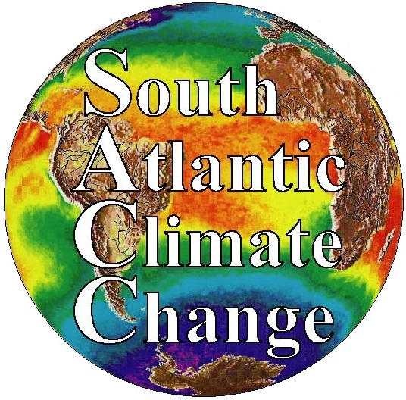







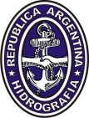





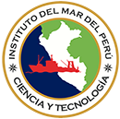
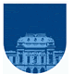

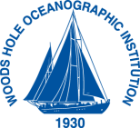
Variability of Ocean Ecosystems Around South America
VOCES – CRN3070
Goal
To assess the impact of climate variability on the Humboldt, Patagonia, and South Brazil Large Marine Ecosystems
Who?
13 PIs + 31 collaborators
10 Research and academic institutions
6 Countries
SHN UBA INIDEP USP FURG UDEC IMARPE UdelaR/ OSU WHOI
DINARA

Slide 2
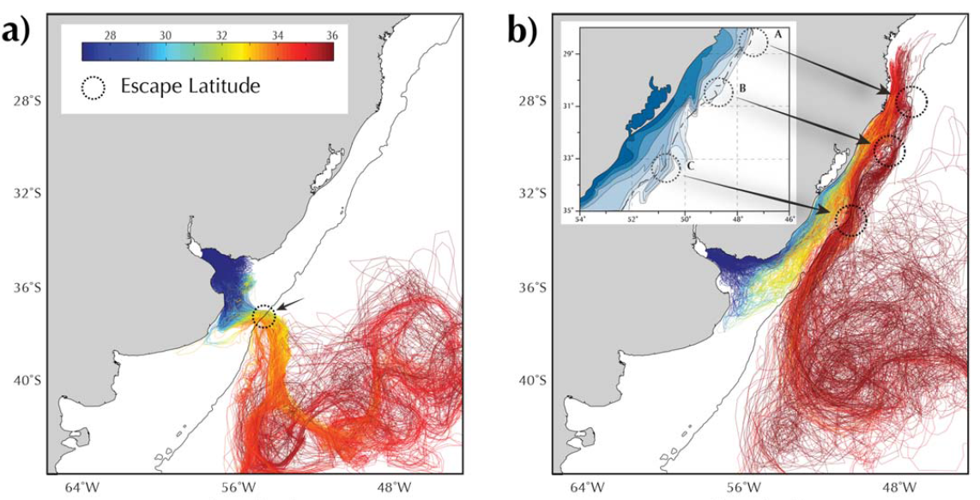
CRN3070 (VOCES) Most Relevant Scientific Contributions I
Piola et al. in review
The Malvinas Current is organized in distinct jets (Piola et al., JGR-O, 2013). First observational evidence of shelf break upwelling reported (Valla and Piola., JGR-O, 2015)
Construction of the first observationally based circulation throughout the PSLME at regional scale (Ruiz Etcheverry et al., JGR-O, 2015)
Shelf waters are expelled offshore along the axis of the Brazil/Malvinas Confluence (Meinen et al., Oce. Sci., 2013; Guerrero et al., JGR-O, 2014; Matano et al., JGR-O, 2014; Strub et al., JGR-O, 2014)
The offshore detrainment of SASW impact the success of fishing in Argentina, Uruguay and Southern Brazil, Franco et al., in prep.)
Matano et al. 2014
Notes:
Sediment analyses indicate episodic productivity events in response to changes in upper ocean circulation, possibly associated with Holocene changes in intensity of El Niño/Southern Oscillation. These changes in AAIW/MC circulation strength are coupled with changes in the strength of Southern Hemisphere westerly winds
Climatological modeling of the Peru Chile Undercurrent reveals a direct relation between poleward subsurface transport and the seasonal variability of dissolved oxygen (DO) has been established.

Slide 3
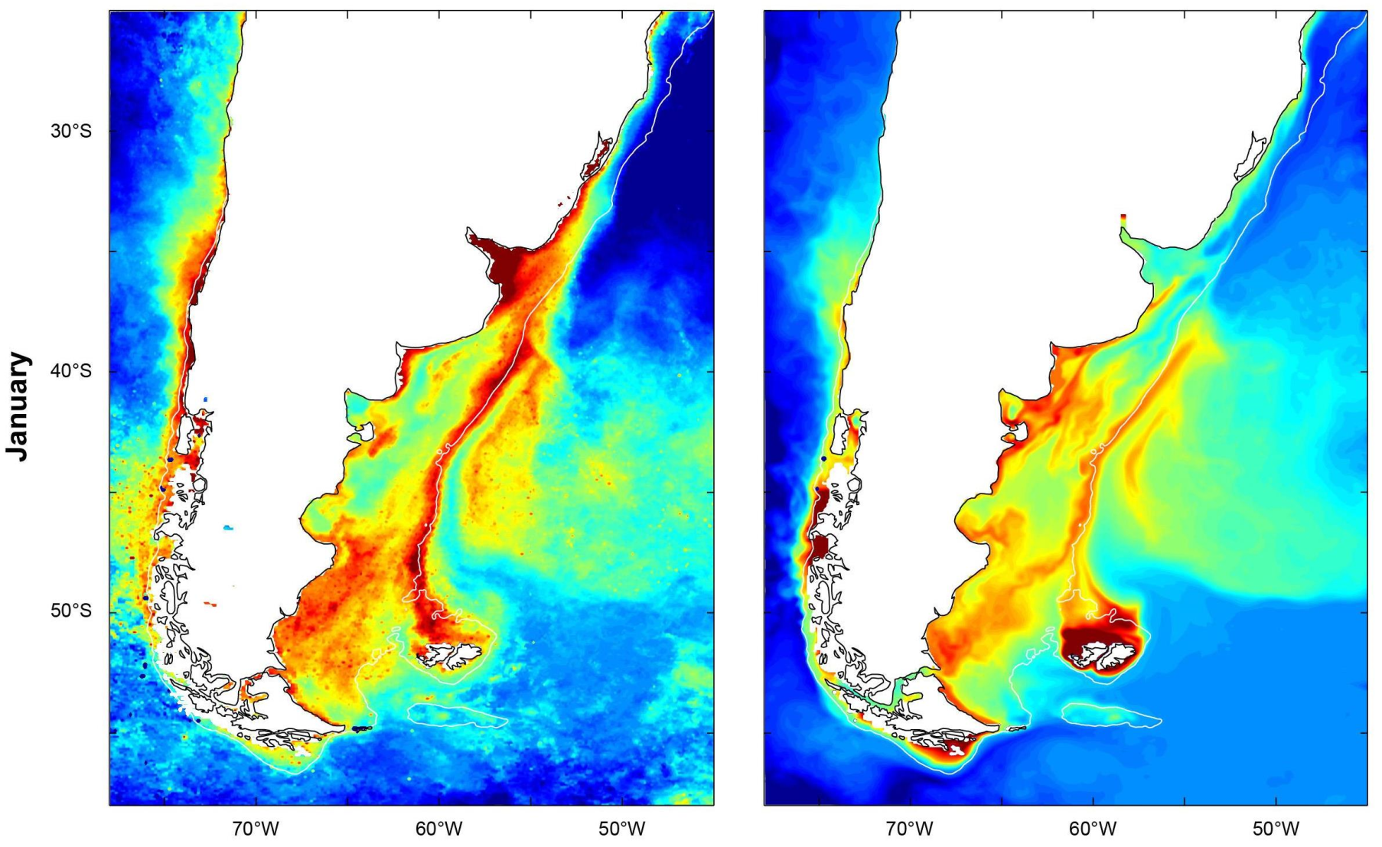
CRN3070 (VOCES) Most Relevant Scientific Contributions II
Satellite radiometer Model
Low-frequency variability of PSLME is largely controlled by the variability of the Malvinas Current transport. Spring blooms are sustained by shelf-break upwelling and tidal mixing. The observed blooms in summer requires the injection of iron from atmospheric sources (Matano et al., in prep.; Spitz et al., in prep.). The wind modulates high-frequency and cross-shelf variability (Carranza et al., JGR-O, 2017).
Strong CO₂ uptake in the PSLME is linked to biological activity, while the outgassing in coastal regions is mostly thermodynamically driven (Kahl et al., Cont. Shelf Res., 2017; Piola et al., in review).
Matano et al. in prep
Kahl et al., 2017

Slide 4
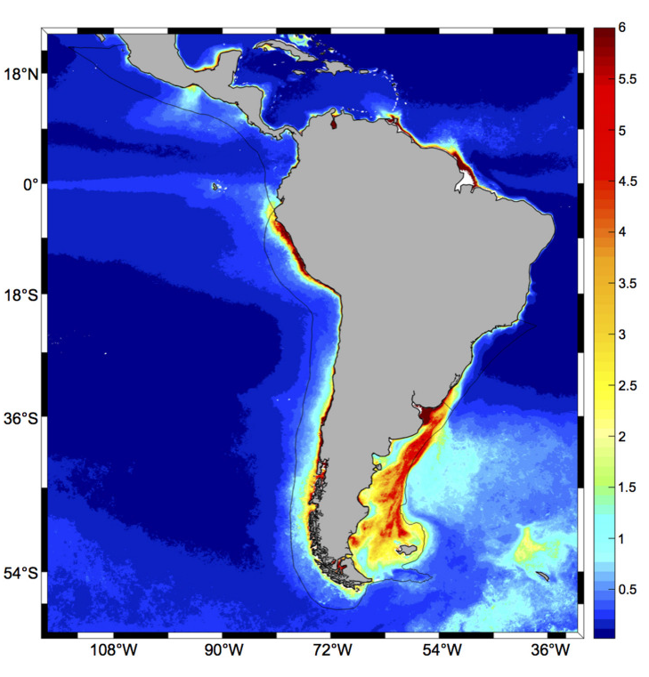
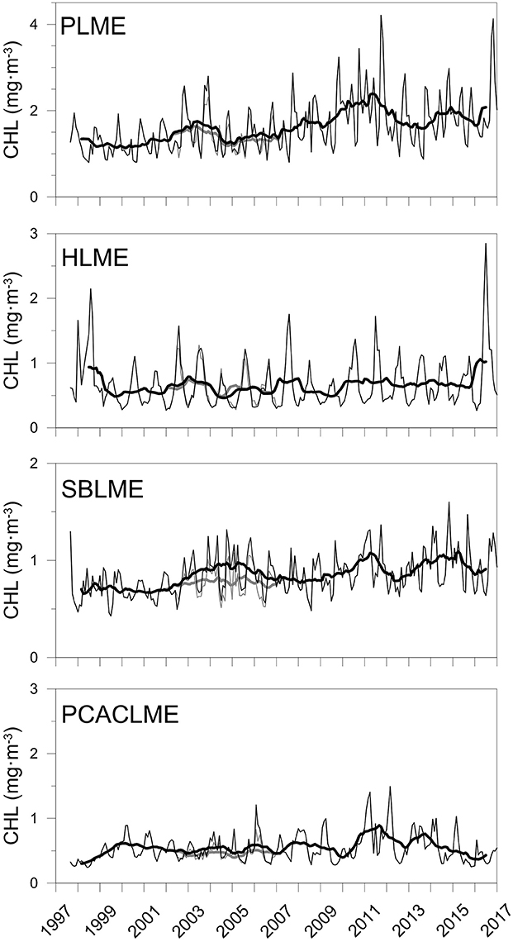
CRN3070 (VOCES) Most Relevant Scientific Contributions III
First report of positive trends in chlorophyll-a in the nursing grounds of Argentine hake (Marrari et al., Remote Sens. Env., 2016), which is now confirmed to be widespread increase over the PSLME (Marrari et al., Front. Mar. Sci., 2017). The chl-a trends are not associated with sea surface temperature trends (Muller-Karger et al., IGMET Rep., 2017).
85% of the chlorophyll-a in the PSLME shelf-break below the upper mixed layer may reach the seabed, favoring the development of epibenthic communities and the formation of seed diatom banks and organic iron-rich sediments (Carreto et al., Progr. Oceanogr. 2016).
+13%
+26%
+43%
+78%
Marrari et al. 2017

Slide 5
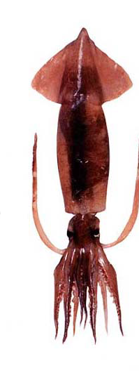
CRN3070 (VOCES) Most Relevant Scientific Contributions IV
Marine fronts are important fishing areas. The strong association between fishing activities and marine fronts indicate the aggregation of commercially significant species, and presumably higher catches (Alemany et al., J. Sea Res., 2014).
There are few small spatially stable areas of high trawling effort in the PSLME. The annual trawled area is < 7% of the continental shelf, with no direct relationship with fronts (Alemany et al., Fish. Oceanogr., 2016)
The PSLME shelf-break provides several ecosystem goods and services and should be included in the development of an ecosystem based management of the Argentine Sea (Martinetto et al., in prep.)
The main services are: primary productivity, CO2 sequestration and fisheries (Martinetto et al., in prep.)
Alemany et al. 2014
Multiple goods and services
Several local and global benefits
Concentrates Ecosystem Services in the region

Slide 6
CRN3070 (VOCES) Most Relevant Scientific Contributions V
Climate change influences abundance, individual size and body abnormalities in the yellow clam (Ortega et al. M. Ecol. Prog. Ser., 2016)
High abundance of yellow clam is associated with cold and salty waters and onshore wind anomalies on the Uruguayan Atlantic coast. High and low abundance tends to occur along with La Niña and El Niño events coast (Manta et al., J. Coast. Res., 2017) The concurrent role of climate variations and fishing explained the long-term dynamics of the ecosystem (Lercari et al. 2018).
Implementation of EAF/Co-M led to stabilization of landings at low levels, increased abundance, CPUE, unit prices and revenues per unit of effort (Gianelli et al. Mar. Pol., 2015, Defeo et al., Global Change Mar. Sys., 2018)
Market: increase in quality of traceable products to restaurants, with technical advice by the Academy and the government (Gianelli et al. 2015, Gianelli and Defeo, 2017; Defeo et al. 2018)
Manta et al., 2017
Ecosystem Approach
Gianelli et al., 2015, Defeo et al., 2018
Notes:
Ecosystem Approach to Fisheries (EAF)
Composite associated with: (a) high and (b) low annual values of Mesodesma mactroides abundance in Barra del Chuy (Uruguay) for the
period 1986–2008. Mean sea-surface temperature anomalies (SSTA) are shown in shades (8C) and mean wind stress anomalies (WSA) in arrows (N
m2). Bold contours enclose significant SSTA regions (p , 0.05). Only high abundance cases are significantly related to environmental anomalies over
the shelf. No significant regions are observed for WSA. SSTA and WSA data from SODA.

Slide 7
CRN3070 (VOCES) Most Relevant Scientific Contributions VI
Oxygen section - Summer
Seasonal changes off central Chile modulate the upwelling and transport of low- DO water from the slope onto the continental shelf (Pizarro et al., BAMS, 2014).
High jellyfish discard in the Peruvian anchovy fishery has a strong economical impact (Quiñones et al., Fish. Res., 2013).
High jellyfish (C. plocamia) population is associated with El Niño events occurring during warm “El Viejo” regimes. Massive blooms are associated with zooplankton, sardine/anchovy larvae, and Chl_a concentrations, with presumably negative effects on fisheries (Mianzan et al., Jelly. Blooms, 2014, Quiñones et al., Mar. Biol., 2015; ICES J. Mar. Sci., submitted
0 1 2 3 4 5 6 7
jellyfish abundance
Anchovy landings
Regime Indicator
Notes:
Top. Section of dissolved oxygen for the transects carried out in austral summer
Bottom Time series of jellyfish (Chrysaora plocamia) abundances for the period 1972–2013 expressed as kg jellyfish 1000 m−3; abundances were log-transformed (a); Anchovy (Engraulis ringens) landings expressed in million tons, and number of fishing trips (1972– 2011) (b); Peruvian Oscillation Index (POI) time series (1972–2012) (c) and Regime Indicator Series (RIS3) (1972–2009) (d)

Slide 8
CRN3070 (VOCES) Science – Policy Interface - National
Marine Protected Areas, Argentina, Legislation passed for Burdwood Bank/Namuncurá MPA - Ley 26875, 2013
Additional coastal, shelf and deep-sea MPAs being considered by the Federal Administration, Ley 27037, 2014
2ª Atualização das Áreas Prioritárias para Conservação, Uso Sustentável e Repartição dos Benefícios da Biodiversidade da Zona Costeira e Marinha
Pampa Azul, Argentina, Legislation passed by Argentine Congress, Promar Ley 27167, 2015
Programa Brasileiro de Mudanças Climáticas, Brasil, Base Cientifica das Mudanças Climáticas.
Notes:
MPAs
The CBDs Aichi Target 11 calls for 10% of coastal and marine areas to be conserved by 2020.
Argentina hoy esta al 2,65 % hoy. En el congreso ya esta el proyecto de ley para declarar dos áreas protegidas q lo suben entre el 8 y el 9%.
1) la colaboracion interinstitucional (gob-academia-usuarios) que ha llevado a mejorar la toma de decisiones y a generar conciencia de temas antes no mencionados (e.g., cambio climatico y efectos en mareas rojas).
2) el desarrollo de community-based data collection programs y de participacion de los usuarios en evaluaciones del recurso junto con la agencia de gobierno y la academia
3) el empoderamiento de la comunidad a traves de un mayor rol en el consejo (consultivo) de pesca
4) el impacto concreto de las investigaciones en la toma de decisiones (decretos de pesca) y legislacion (ley de pesca). Un slide de los que te mande puede servir.

Slide 9

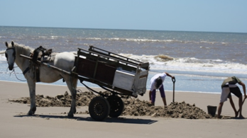
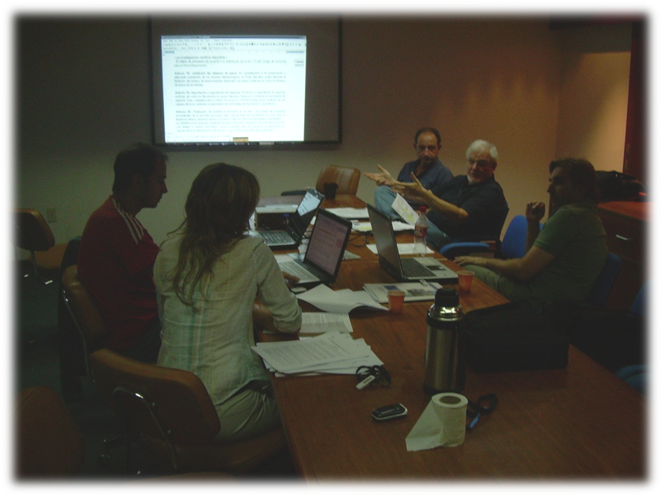
CRN3070 (VOCES) Science – Policy Interface - National
Artisanal yellow clam fisheries, Uruguay, Development of Ecosystem Approach to Fisheries (EAF) and co-management strategies, resulting in legislation, advancing gender equity, human rights, community empowerment, and subjective wellbeing within the fishery
Pelagic fisheries, Argentina, Development of technical reports for hake and squid fisheries management at INIDEP
Anchovy fisheries, Peru, 60+ rules for anchovy fishery management and discard implemented based on IMARPE advice as a direct result of the turtle and jellyfish research-fisheries interaction
FISHER
POLICY MAKER
LAWYER
SCIENTISTS

Slide 10




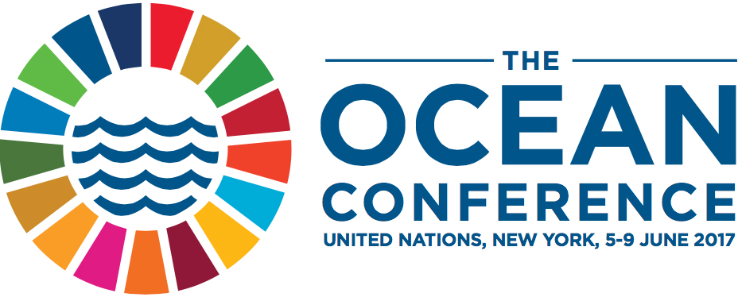
CRN3070 (VOCES) Science – Policy Interface - International
OceanObs 09, Ocean Information for Society, common vision for the provision of routine and sustained global information on the marine environment sufficient to meet society’s needs, Venice 2009
UN Framework Convention on Climate Change
Conference of the Parties 17, Durban 2011
Subsidiary Body for Scientific and Technological Advice, Bonn 2012
Symposium on Biodiversity and Climate Change, Lima 2014
Bonn Climate Change Conference, Bonn 2017
UN World Ocean Assessment, Pool of Experts of the Regular Process for Global Reporting and Assessment of the State of the Marine Environment, 2015
Future of the Oceans and its Seas: a non-governmental scientific perspective on seven marine research issues for the G7 Ministers of Science. ICSU/SCOR, 2016
UN Ocean Conference, Scientific knowledge and implementation of national action plans on climate and human-induced changes, New York 2017

Slide 11
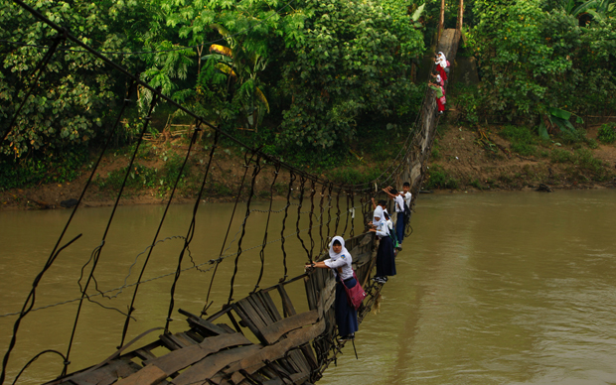
We are building an interdisciplinary bridge
It’s a dangerous bridge and it requires a lot of work to maintain operational …
We must cross it to effectively communicate our science to policy and to move to a sustainable use of natural resources
Ed Allison´s (UW) bridge

Slide 12
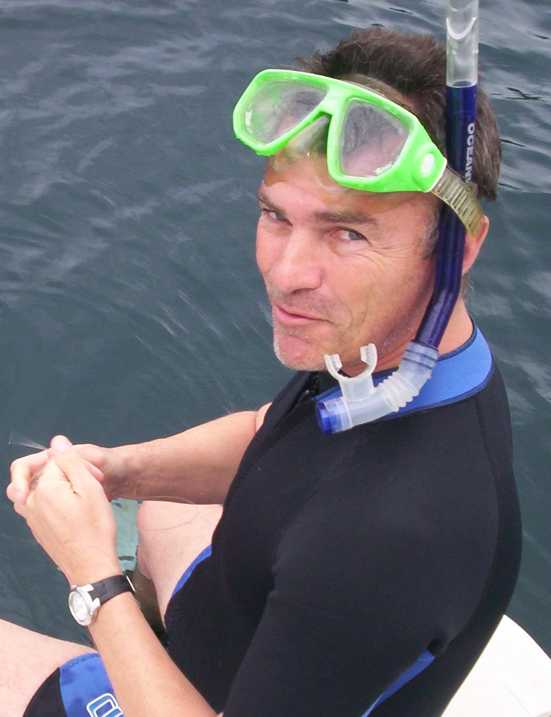
Hermes W. Mianzan
“… the only important things are fronts. The rest is just water for fishes to travel from one front to another”

Slide 13
Extra slides

