Slide 1
Effects of Habitat Perturbation on Rodent Population Dynamics and Risk of Rodent-borne Diseases
RAICES
Daniel Bausch
Daniel.bausch@phe.gov.uk
Claudia Guezala
maria.c.guezala.fn@mail.mil

Slide 2
RAICES
Red Americana de Investigación de Cambios en la Ecología y Salud (American Network for Investigation of Changes in Ecology and Health):
www.raices-ecochangeresearchnet.com
Bolivia, Ecuador, Peru & the U.S.
Study: assess the ecology and societal vulnerabilities to rodent-borne diseases due to global change and man-made disturbance

Slide 3
Objectives
Evaluate the effect of man-made landscape changes on the dynamics of rodent communities
To develop low-tech, locally adaptable survey tools to assess real and perceived societal impacts and vulnerabilities to habitat perturbation
To establish a multinational and multidisciplinary network to study the effects of habitat perturbation on rodent dynamics, rodent-borne diseases and other zoonoses:
→ aid shaping policies and prevent negative impacts on human health

Slide 4
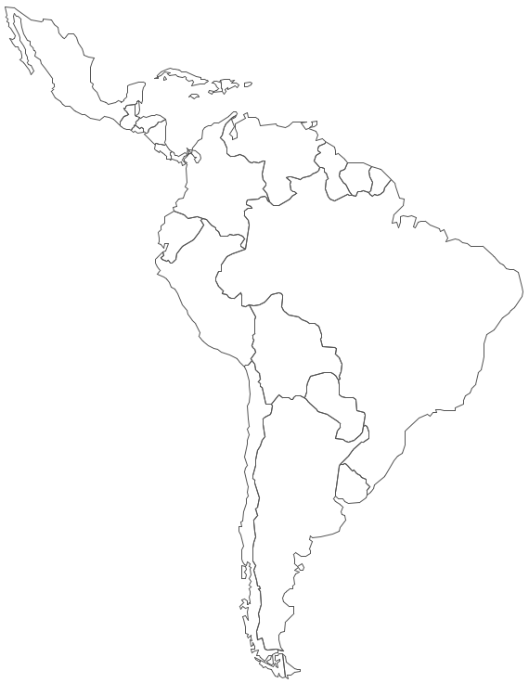
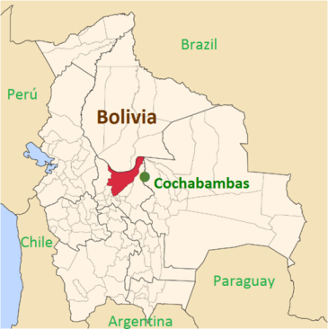
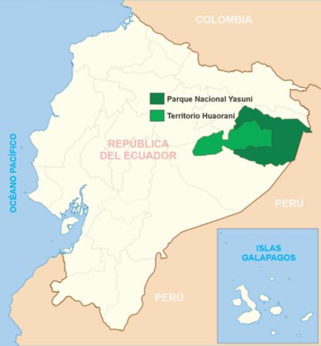
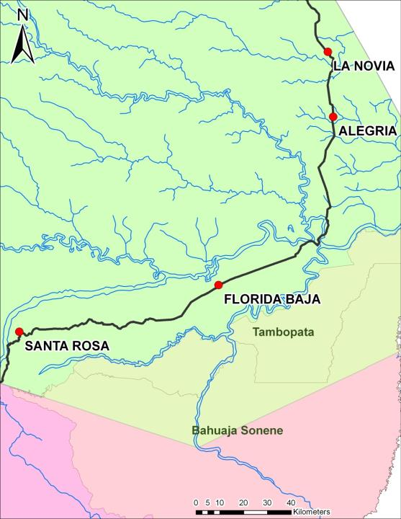
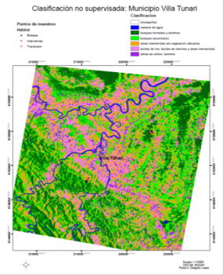
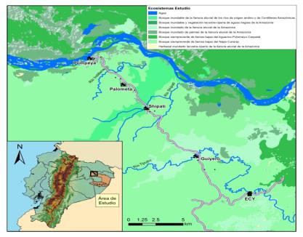
South America
Peru
LEGEND
ECUADOR
Maxus Highway
Inter – Oceanic Highway (IOH)
Study Area
BOLIVIA
Villa Tunari – San Ignacio Moxos Highway
PERU
Inter-Oceanic Highway, Southern Amazon
1
2
3
4

Slide 5
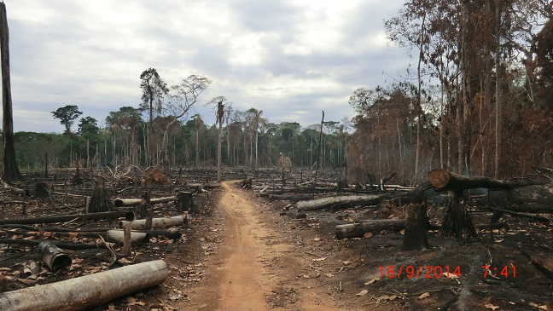
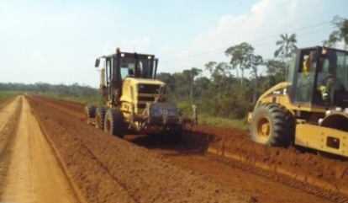
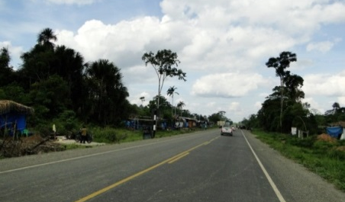
Study Components
Land use changes along the construction of highways
Animal (rodents) surveys
Peru: 3 samplings per year, 4 study sites, 3 different levels of disturbance
Bolivia & Ecuador: 2 samplings per year, 1 site
Human (social) surveys
Peru: 4 study sites
Interviews, focus groups

Slide 6
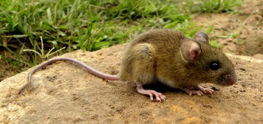
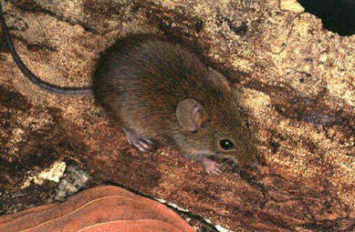
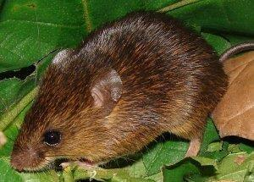
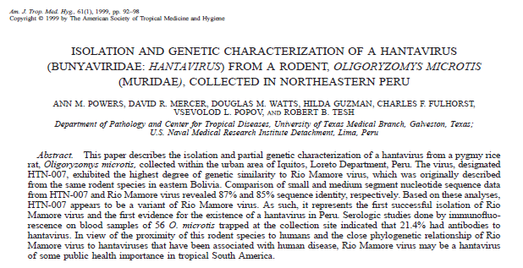
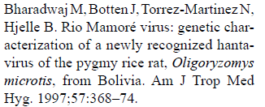
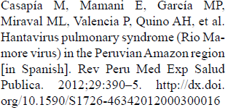
Animal component
Genus and species | Total captures | Individual animals | % recapture | % of total animals captured
Oligoryzomys microtis | 612 | 525 | 14.22 | 45.67
Necromys lenguarum | 195 | 137 | 29.74 | 14.55
Neacomys amoenus (ex Neacomys spinosus) | 53 | 44 | 16.98 | 3.96
Razuri H, et al.; Andes hantavirus variant in rodents, southern Amazon Basin, Peru. Emerging infectious diseases. 2014 Feb;20(2):257.
Oligoryzomys microtis
Necromys lenguarum
Neacomys amoenus
Andes and Rio Mamore Hantavirus in Peru → Madre de Dios

Slide 7
Science: Animal component (I)
PERU:
Land use changes happened fast: mainly slash and burn for agriculture
18 different species trapped, many known pathogen reservoirs
Rodents known as carriers of zoonotic pathogens were present in higher numbers in edge and disturbed habitats, mostly found during dry season.
Villagers spend more time in the forest during dry season, potentially increasing contact between humans and rodents and risk of pathogen transmission and disease.

Slide 8
Science: Animal component (II)
ECUADOR & BOLIVIA:
Extensive inventories of small rodents of medical importance, now associated with the zoonotic diseases they may carry
Interdisciplinary: Joint collaboration between ecology and health professionals
Presence of rodents linked to man-made disturbance and risk of pathogen transmission
Local expertise now available for future studies

Slide 9
Science: Human component (I)
Perception of communities after the construction of the road:
Less availability of natural products from the forest: fish and meat, timber, fruits and vegetables
Arrival of migrants (positive and negative)
More job opportunities
Change in health risks and access to health services
More access to variety of products (fresh produce)
Notes:
Also for this: look up health and Wb poster.
Change in health risks and access to health services: more traffic accidents (no safety infrastructure i.e.. Speed bumps, use of helmets, etc.), more access to health care facilities, also going to Puerto is a risk for DENV transmission (poster from Bill Pan)
For the migrant issue: it was noted that they could learn things from people coming from other áreas, but there was also the idea that with more people they had more crime

Slide 10
Science: Human component (II)
There are consequences for the environment
Slash and burn for agriculture
Soil depletion
Decrease in biodiversity
Flooding in some areas
“Before, everything was natural, papayas and all… you could get them naturally. Now they put agrochemicals to the land” (01/03)
“We are indifferent to our environment. We do not see what is happening to our environment” (01/03)
Notes:
Road infrastructure caused flooding in Florida Baja

Slide 11
Science: Human component (III)
Perceived health risks / threats:
~ 30% have no access to health insurance
Dengue: 40%.
Road accidents: 7%
Diarrhea: 3%
90% think rodents transmit diseases, but they don’t know how, or how to prevent these
Health services lack basic diagnostic/treatment tools

Slide 12
Science: Human component (IV)
Health is important to locals; and nutrition is important to keep them healthy
They need health strategies tailored for the local individuals/families
Communities are optimistic, trusting more in local authorities
Notes:
Poster on health and well-being has a nice graph on this. We sent it on PDF, could send in ppt, but it was big.

Slide 13
Nested Studies
Fogarty Fellow: Leptospirosis
Thesis dissertation: Land fragmentation and rodent diversity
UPCH Kuskaya Fellows: Land use change and human health
Tulane and Virginia Commonwealth University students
Migration
Well-being
Chicago Field Museum: Collaboration with anthropologist to develop vulnerability assessment tool
Notes:
- Leptospirosis (NIH fellowship)
- Land fragmentation and rodent’s diversity (Thesis dissertation)
- Kuskaya fellowship: NIH Fogarty funded, at UPCH university. Title of paper: ““Critical linkages between land use change and human health in the Amazon region: A scoping review”. Submitted last week.
-Tulane and Virginia Commonwealth University students worked with study data for two posters and manuscripts on migration and well-being
Migrant paper: Small scale migration along the IOH in Madre de Dios, Peru: An exploration of community perceptions and dynamics due to migration. Revise and resubmit

Slide 14
Training
Workshop: Trapping, sampling, and processing of small mammals for pathogen testing = San Simon U students & Bolivian Ministry of Health staff (~ 50 people) - Bolivia
Workshop: Morphologic and molecular species identification of small mammals-Ecuador
Biosafety for animal fieldwork and Laboratory (BSL3) - Ecuador
Research ethics
Spatial analysis - Bolivia

Slide 15
Science Capacity Building
New infrastructure for research:
Trained team of professionals from different disciplines/backgrounds
PUCE: New niche for research in land-use change and disease transmission
Creation of new BSL-3 laboratory in Yasuní scientific station
San Simon U: Collaborative work within different research centers / disciplines (Biology, Ecology, Health sciences)
Notes:
PUCE: new niche for research in Land-change and Disease Transmission →
Creation of new BSL3 laboratory in Yasuní scientific station
San Simon U: collaborative work within different research centers / disciplines (Biology, Ecology, Health sciences)
Setting up of a trained team of professionals from different disciplines/backgrounds that is now able to respond to their countries needs
To achieve aim 2: Collaboration with anthropologist (Chicago Field Museum) to develop vulnerability assessment tool

Slide 16
Science Policy
Seminar nested in Conservation Biology congress introducing the One Health concept to conservationists (Peru: BIOCON)
Climate and Health Summit 2014 – The Global Climate and Health Alliance (Pre-COP meeting): Initiative for joint work between Peruvian Ministries of Health and Environment
RAICES researcher participates in the IPBES (UN) Assessment for the Americas: Inform policy and decision makers in ecosystem services and its usefulness in conservation of habitats
American Society of Tropical Medicine and Hygiene
Meetings in USA and Peru
Notes:
IPBES: Inter-governmental Panel of Biodiversity and Ecosystem Services Assessment
Climate and Health Summit 2014 – The Global Climate and Health Alliance (Pre-COP meeting): initiative for joint work between Peruvian Ministries of Health and Environment: just remember that for this, although there was an interest and it actually came from MINAM and MINSA, they never followed through (despite insistence).
Land use change and human movement: most of migrant populations coming in to MdD through the IOH are from Andean areas with pre-conceptions about agriculture and farming that are not sustainable in the rainforest, hence the use of slash and burn, soil depletion, the need for agrochemicals. Also, current existing legislation promotes this kind of activities or is not clear at best on how to penalize this use of the forest outside of natural protected areas. There is no real comprehensive, multi-sector policy intended to promote development in this area outside of the usual parameters employed in other regions, that may not necessarily apply here, or some initiative may be good but it is unilateral, from one agency and therefore unsustainable.

Slide 17
Next Steps
Complete the land-change characterization using Remote Sensing techniques →
Complete longitudinal and by-species analysis to assess how changes in land and climate affect rodent assemblages
Pathogen testing: Serology (IgG) and PCR against known rodent-borne pathogens
Construct a prediction model using environmental, climatic and diagnostic data → describe associations between land use changes and disease emergence
Follow up in same study sites 5- 10 years from now to assess longer-term changes
Publish vulnerability assessment tool and health and well-being manuscript
Feedback to communities and Ministries of Health and Environment

Slide 18
Limitations
Pathogen testing on rodent samples in process
No human testing was performed in association with the animal study to explore one-health related interactions of disease exposure or transmission
Researchers’ salary is not supported: Problems with full time commitment to study’s activities

Slide 19
Limitations and Insights in Bridging Science and Policy
Project conceived by scientists in scientific, not policy, framework
Objectives largely set by investigators, not government or community
Policy interactions largely functional and/or post-hoc
No policy makers on team or regular forum for communication and input
Challenges of longitudinal studies: Patience for data and conclusions
New territory for IAI
Socio-economic, legal, and security implications of project

Slide 20
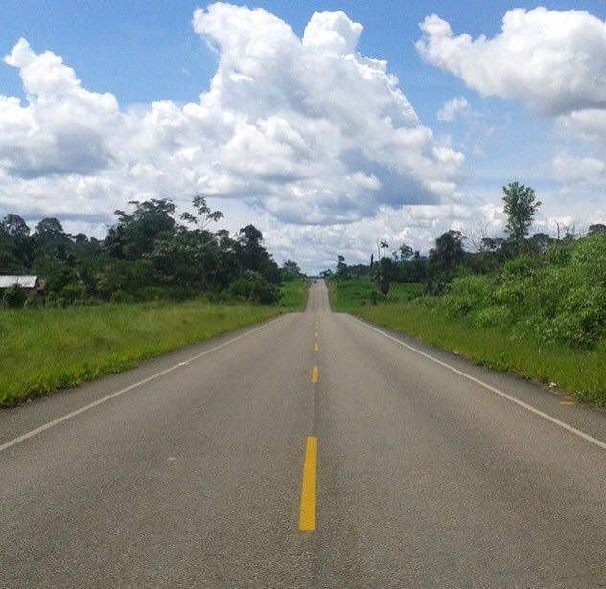
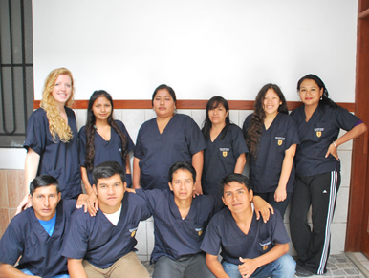
www.raices-ecochangeresearchnet.com

Slide 21
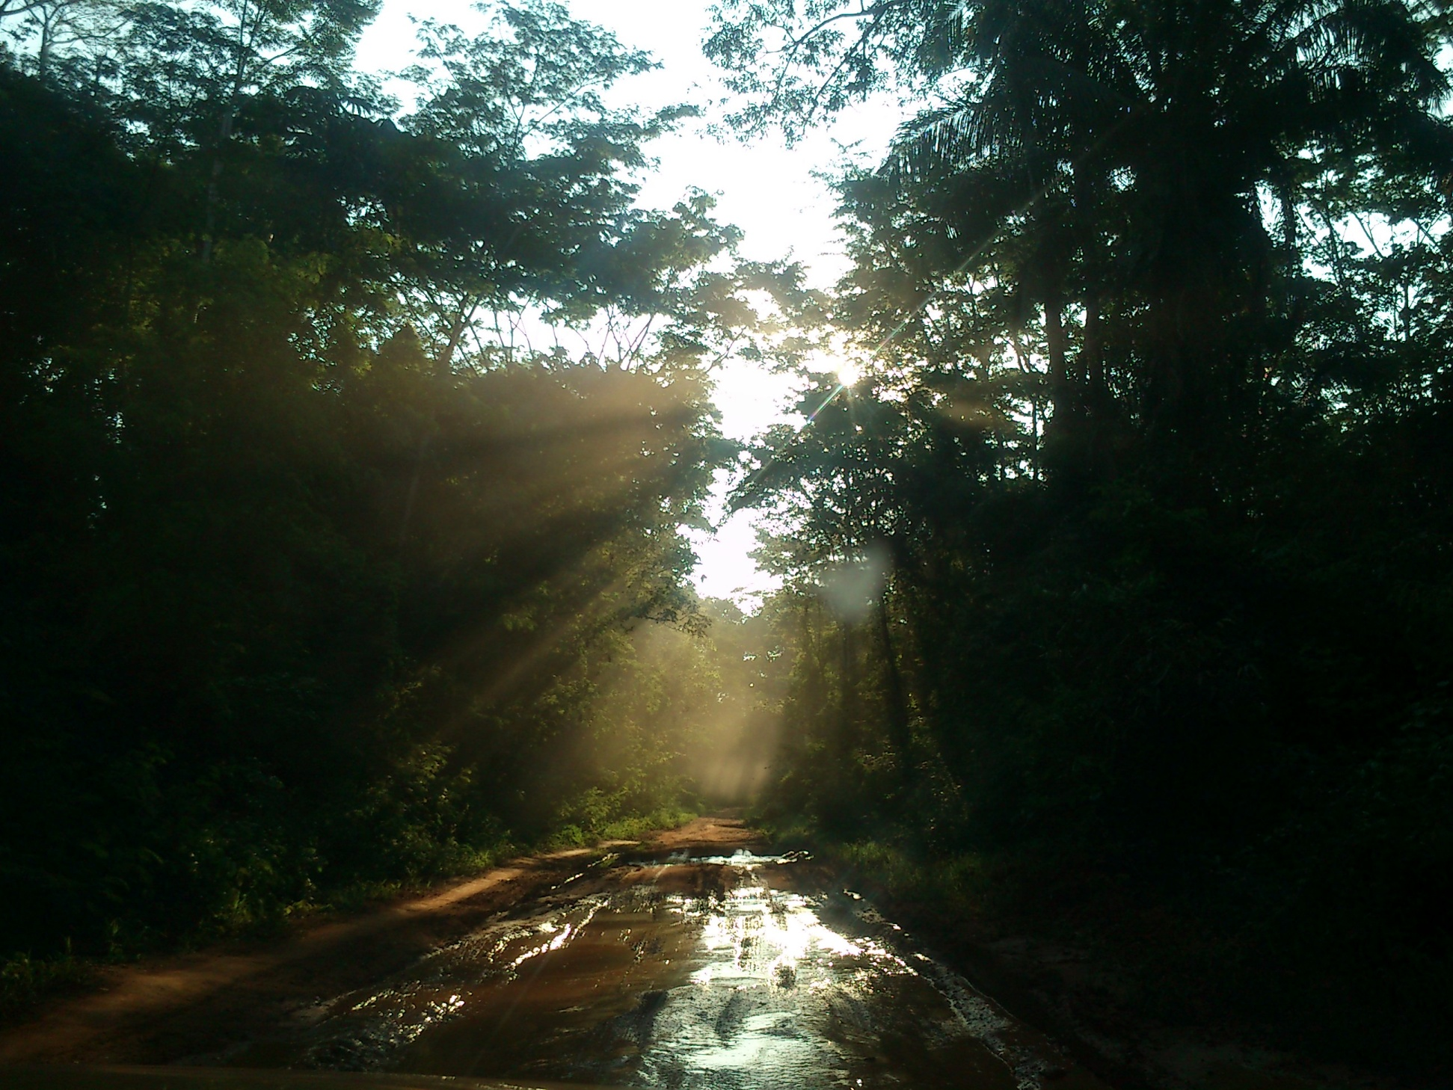
GRACIAS

Slide 22
Rodent component
Genus and species | Total captures | Individual animals | % recapture | % of total animals captured
Oligoryzomys microtis | 612 | 525 | 14.22 | 45.67
Necromys lenguarum | 195 | 137 | 29.74 | 14.55
Neacomys amoenus (ex Neacomys spinosus) | 53 | 44 | 16.98 | 3.96
Razuri H, et al.; Andes hantavirus variant in rodents, southern Amazon Basin, Peru. Emerging infectious diseases. 2014 Feb;20(2):257.
Oligoryzomys microtis
Necromys lenguarum
Neacomys amoenus
Andes and Rio Mamore Hantavirus in Peru → Madre de Dios

Slide 23
Results:
Captures by season

Slide 24
Results:
Captures by habitat

Slide 25
Results:
Captures by habitat
Genus species / habitat | Disturbed | Edge | Non Disturbed | Total
Oligoryzomys microtis | 27% (167) | 72% (439) | 1% (4) | 612
Necromys lenguarum | 45% (87) | 55% (108) | 0% (0) | 195
Neacomys amoenus | 6% (3) | 60% (32) | 34% (18) | 53
Total | 30% (257) | 67% (579) | 3% (22) | 100% (860)
Chi² , P = 0.000

Slide 26
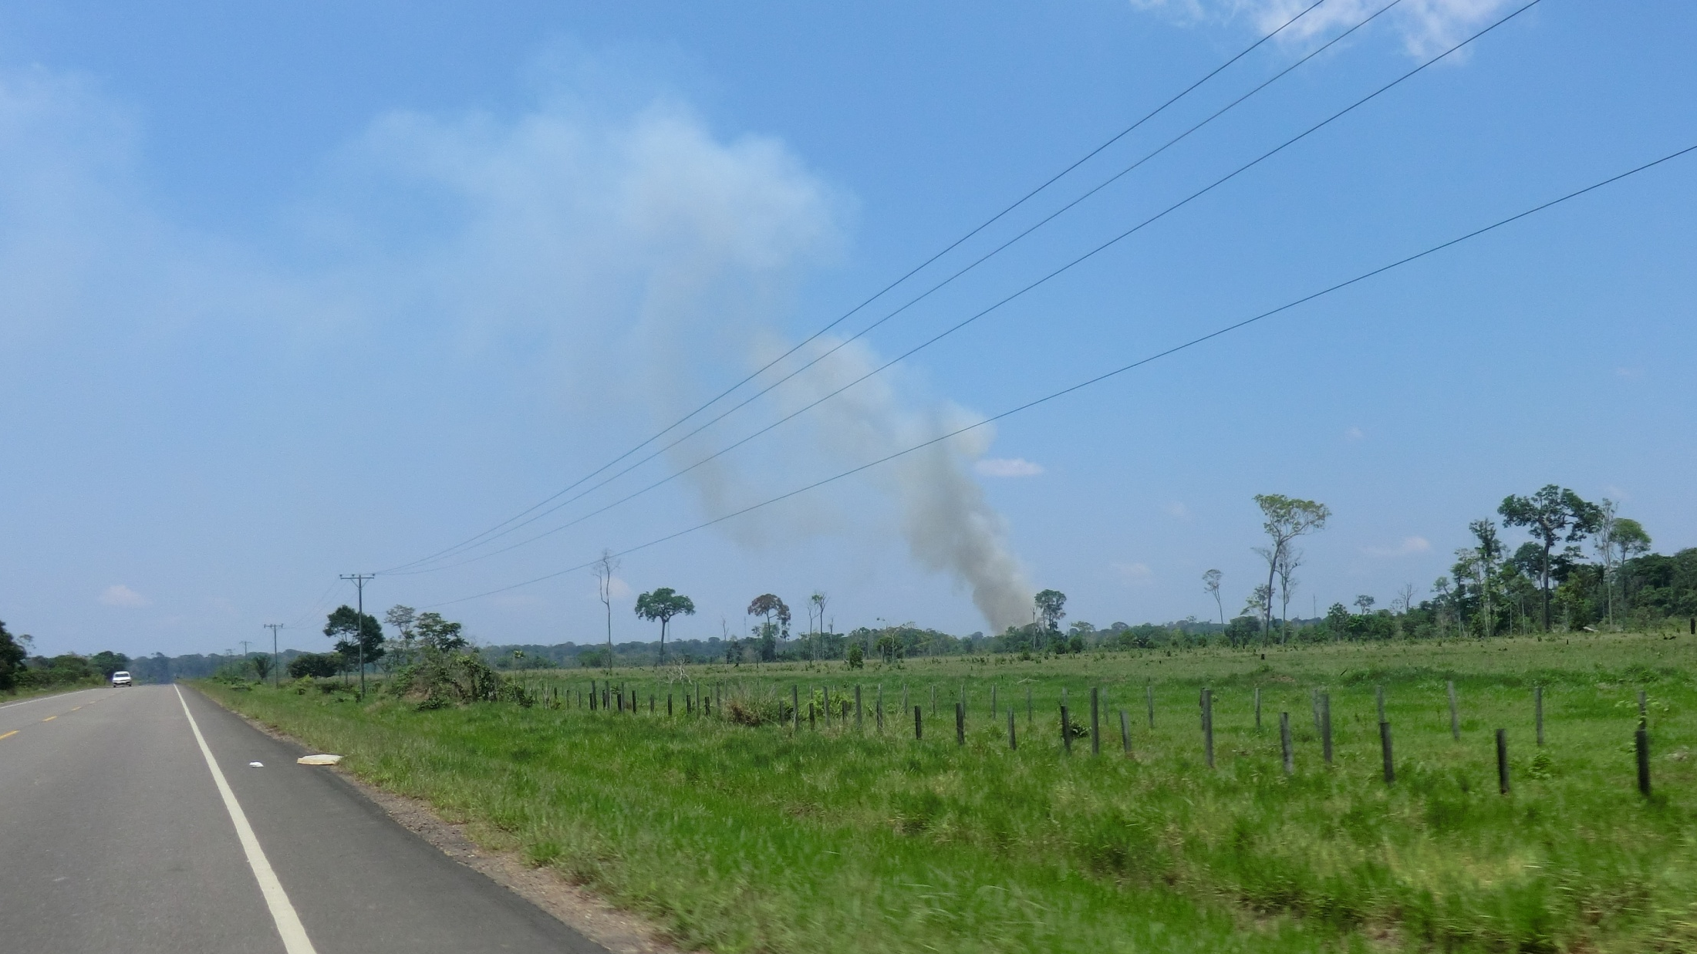
Background
Peru: Southern Amazon forest is subject to heavy deforestation due to logging, illegal mining, agriculture and construction of roads
Inter-Oceanic Highway (IOH) → Human migration: changes in land cover
2010: pilot study recorded rapid changes in land use and first evidence of Hantavirus in rodents in Madre de Dios region
Razuri H, et al.; Andes hantavirus variant in rodents, southern Amazon Basin, Peru. Emerging infectious diseases. 2014 Feb;20(2):257.

Slide 27
Background
Most emerging diseases are zoonotic in origin:
Drivers: changes in land use (migration, urbanization, agricultural expansion) → Habitat destruction
Rodents are estimated to be reservoirs for numerous zoonotic pathogens
South America: Hantavirus, Arenavirus, leptospira.
Biodiversity loss
Agricultural expansion
Wildlife &
Natural Habitats
Human migration
People
Pathogens transmission
Vectors / reservoirs distribution
Razuri H, et al.; Andes hantavirus variant in rodents, southern Amazon Basin, Peru. Emerging infectious diseases. 2014 Feb;20(2):257.

Slide 28
Casapía M, Mamani E, García MP, Miraval ML, Valencia P, Quino AH, Álvarez C, Donaires LF. Hantavirus pulmonary syndrome (Rio Mamore virus) in the Peruvian Amazon region. Revista peruana de medicina experimental y salud publica. 2012 Sep;29(3):390-5.
Powers AM, Mercer DR, Watts DM, Guzman H, Fulhorst CF, Popov VL, Tesh RB. Isolation and genetic characterization of a hantavirus (Bunyaviridae: Hantavirus) from a rodent, Oligoryzomys microtis (Muridae), collected in northeastern Peru. The American journal of tropical medicine and hygiene. 1999 Jul 1;61(1):92-8.
Powers AM, Mercer DR, Watts DM, Guzman H, Fulhorst CF, Popov VL, Tesh RB. Isolation and genetic characterization of a hantavirus (Bunyaviridae: Hantavirus) from a rodent, Oligoryzomys microtis (Muridae), collected in northeastern Peru. The American journal of tropical medicine and hygiene. 1999 Jul 1;61(1):92-8.
Razuri H, Tokarz R, Ghersi BM, Salmon-Mulanovich G, Guezala MC, Albujar C, Mendoza AP, Tinoco YO, Cruz C, Silva M, Vasquez A. Andes hantavirus variant in rodents, southern Amazon Basin, Peru. Emerging infectious diseases. 2014 Feb;20(2):257.

Slide 29
Results
Trapping success and inventory completeness
Site (Village) | Habitat | S Mean (runs) | Chao 2 Mean | Completeness
A | ND | 10 | 11.46 | 87.26
A | E | 11 | 11.99 | 91.74
A | D | 9 | 9.96 | 90.36
FB | ND | 5 | 5 | 100.00
FB | E | 9 | 9 | 100.00
FB | D | 4 | 4 | 100.00
LN | ND | 8 | 13.91 | 57.51
LN | E | 8 | 8.99 | 88.99
LN | D | 2 | 2 | 100.00
SR | ND | 8 | 10.93 | 73.19
SR | E | 11 | 11 | 100.00
SR | D | 6 | 7.46 | 80.43
Trapping effort:
70634 trap-nights

Slide 30
Results:
Habitats classification
Initial habitat classification:
3 categories, 6 grids per site
 | December 2013 | September 2016
Grid | Initial Habitat / Village: | SR | FB | A | LN
I | Non Disturbed | ND | ND | ND | ND
II | Non Disturbed | D | ND | D | ND
III | Edge | E | D | E | E
IV | Edge | E | E | E | D
V | Edge | E | E | E | E
VI | Disturbed | D | D | D | D

Slide 31
Results:
Captures by season
Species / Season | Rainy | Rainy-Dry | Dry | Dry-Rainy | Total
Oligoryzomys microtis | 21% (131) | 14% (86) | 21% (267) | 21% (126) | 610
Necromys lenguarum | 14% (27) | 25% (48) | 50% (97) | 12% (23) | 195
Neacomys amoenus | 42% (22) | 11% (6) | 45% (24) | 2% (1) | 53
Total | 21% (180) | 16% (140) | 45% (388) | 17% (150) | 100% (858)
Chi2 , P = 0.000

