Slide 1


ASSESSMENT OF MARINE ECOSYSTEM SERVICES AT THE LATIN-AMERICAN ANTARES TIME-SERIES NETWORK
CRN3094
Kampel, Milton*; Lutz, Vivian; Sinisgalli, Paulo; ANTARES Group
CRN3 Researchers Meeting 2017, Cancun

Slide 2
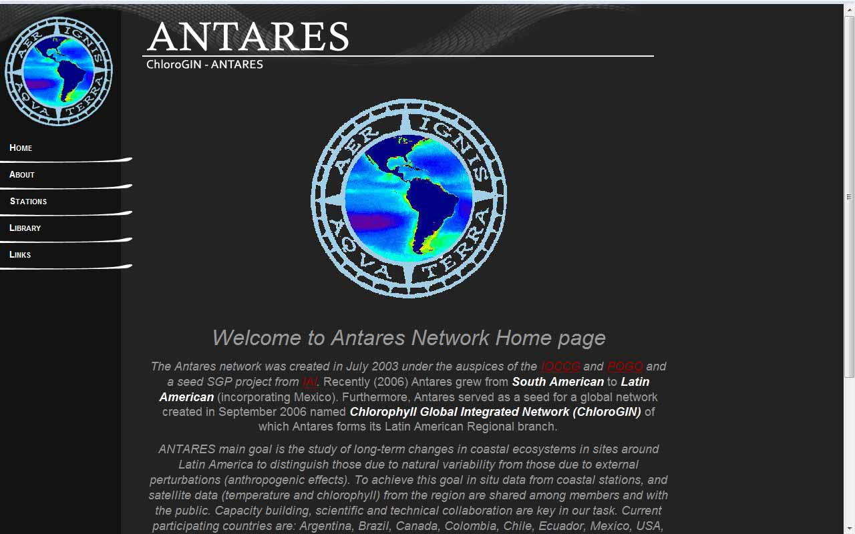
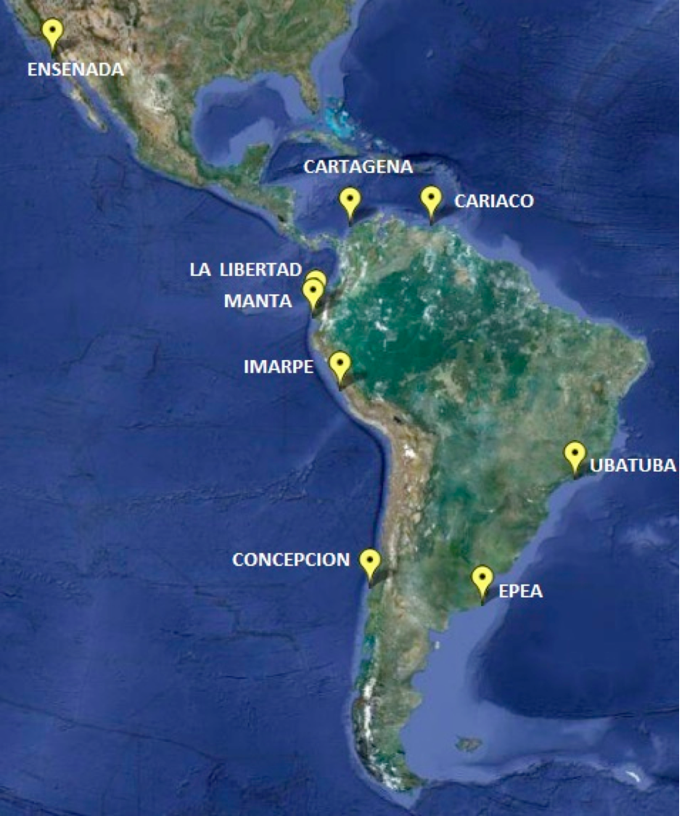
Who we are? ANTARES
Objective to observe long-term changes on coastal waters around Latin America, with the main approach of developing time-series of in situ oceanographic measurements integrated with remote sensing data, products and modeling.

Slide 3
Participants
PI: Milton Kampel, Instituto Nacional de Pesquisas Espaciais, Brazil, milton.kampel@inpe.br
Co-PIs:
Argentina
  Vivian Lutz, Instituto Nacional de Investigación y Desarrollo Pesquero (INIDEP), Consejo Nacional de Investigaciones Científicas y Técnicas, Argentina, vlutz@inidep.edu.ar
  Martina G. Chidiak, Universidad de Buenos Aires, Facultad de Ciencias Económicas (ECON-UBA), Argentina, martinachidiak@gmail.com
  Rubén Mario Negri, INIDEP, Universidad Nacional de Mar del Plata Facultad de Ciencias Exactas y Naturales, Argentina, negri@inidep.edu.ar
  Brazil
  Paulo Sinisgalli, Universidade de Sao Paulo, Escola de Artes, Ciências e Humanidades (EACH-USP), Brazil, psinisgalli@usp.br
  Frederico Brandini, Instituto Oceanográfico - Universidade de Sao Paulo, Brazil, brandini@usp.br
  Alexander Turra, Instituto Oceanográfico - Universidade de Sao Paulo, Brazil, turra@usp.br
  Pedro Roberto Jacobi, Universidade de São Paulo, Faculdade de Educação (FE-USP), prjacobi@usp.br

Slide 4
Participants
Co-PIs:
  Chile
  Rubén Escribano, Centro de Investigación Oceanográfica en el Pacífico Sur-Oriental (COPAS), Departamento de Oceanografía de la Universidad de Concepción, Chile, rescribano@udec.cl
  Mexico
  Eduardo Santamaría-del Ángel (Antares Coordinator), Facultad de Ciencias Marinas, Universidad Autónoma de Baja California (FCM-UABC), Mexico, santamaria@uabc.edu.mx
  Adriana González-silvera, Facultad de Ciencias Marinas, Universidad Autónoma de Baja California (FCM-UABC), Mexico, adriana.gonzalez@uabc.edu.mx
  Peru
  Jesus Ledesma, Instituto del Mar del Perú (IMARPE), Peru, jledesma@imarpe.gob.pe
  Luis Escudero Herrera, Instituto del Mar del Perú (IMARPE), Peru, lescudero@imarpe.gob.pe
  USA
  Robert Frouin, Scripps Institution of Oceanography, University of California-San Diego (SIO-UCSD), USA, rfrouin@ucsd.edu

Slide 5
Participants
Co-PIs:
  Venezuela
  Jaimie Rojas-Marques, Fundación La Salle de Ciencias Naturales, Estación de Investigaciones Marinas de Margarita (EDIMAR-FLASA), Venezuela, jaimajo2000@gmail.com
  Colombia and Ecuador – Collaborators
  7 (+2) Countries:
  Argentina, Brazil, Chile, Mexico, Peru, USA, Venezuela (Colombia, Ecuador)
  Time series starting in 1995 (CARIACO, CALLO) for the oldest and 2008 for the youngest (CARTAGENA).

Slide 6


Antares
(Coordinadora:
A. Dogliotti IAFE - Argentina)
Evaluación de los Servicios Ecosistémicos Marinos en las Estaciones de Serie de Tiempo
de la Red Latinoamericana Antares
LA-NANO
(Coordinador:
J. Ledesma – IMARPE - Perú)
IAI-CRN3094
(PI: M. Kampel, INPE)
Web-Master:Ezequiel Cozzolino (INIDEP)
[ISTS]
R. Escribano
R. Negri
[Sat]
M. Kampel
[NatMod]
R. Frouin
[SEES]
M. Chidiak
[ID/TD-1] Support
M.Kampel – I. Carcioffi
[ID/TD-2] Regulation
R. Negri – V. Lutz

Slide 7
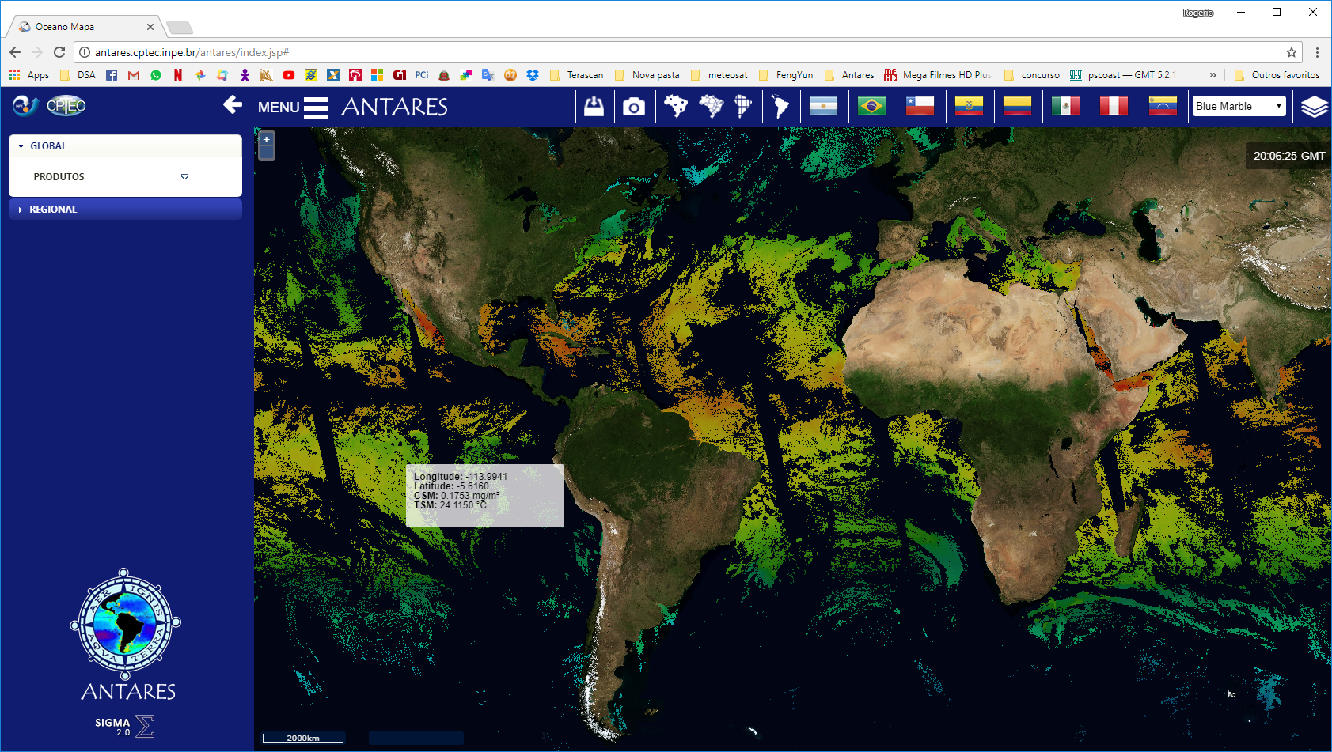
SIGMA-ANTARES

Slide 8
Modelling
Yearly averaged NEMO ORCA2/PISCES primary production, new production , ΔpCO2 during 1968-2007. .

Slide 9
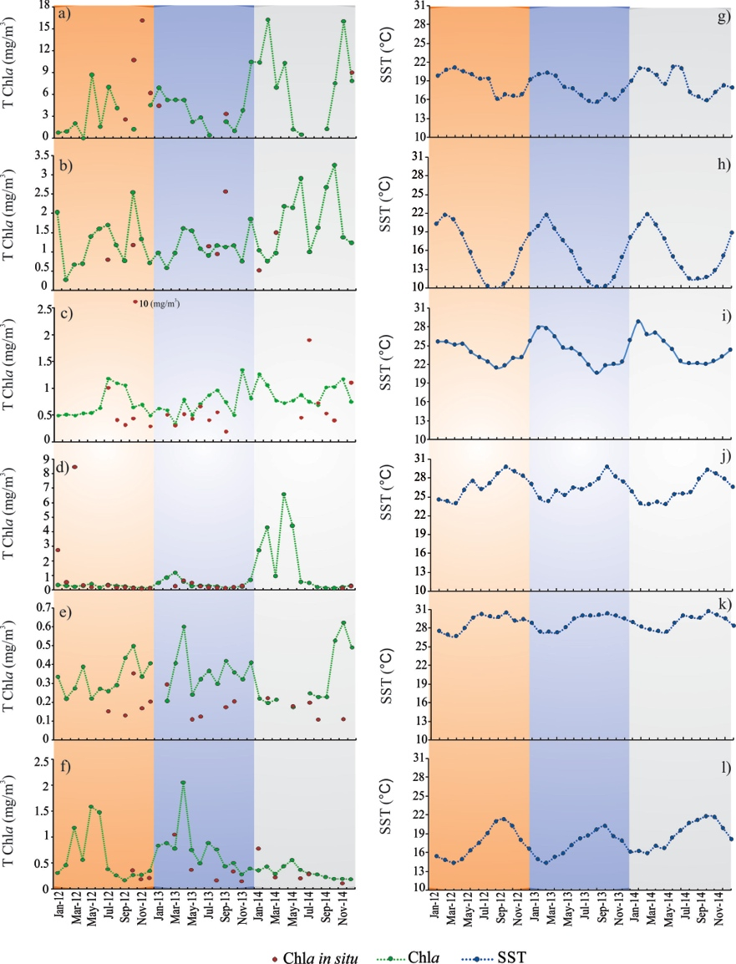
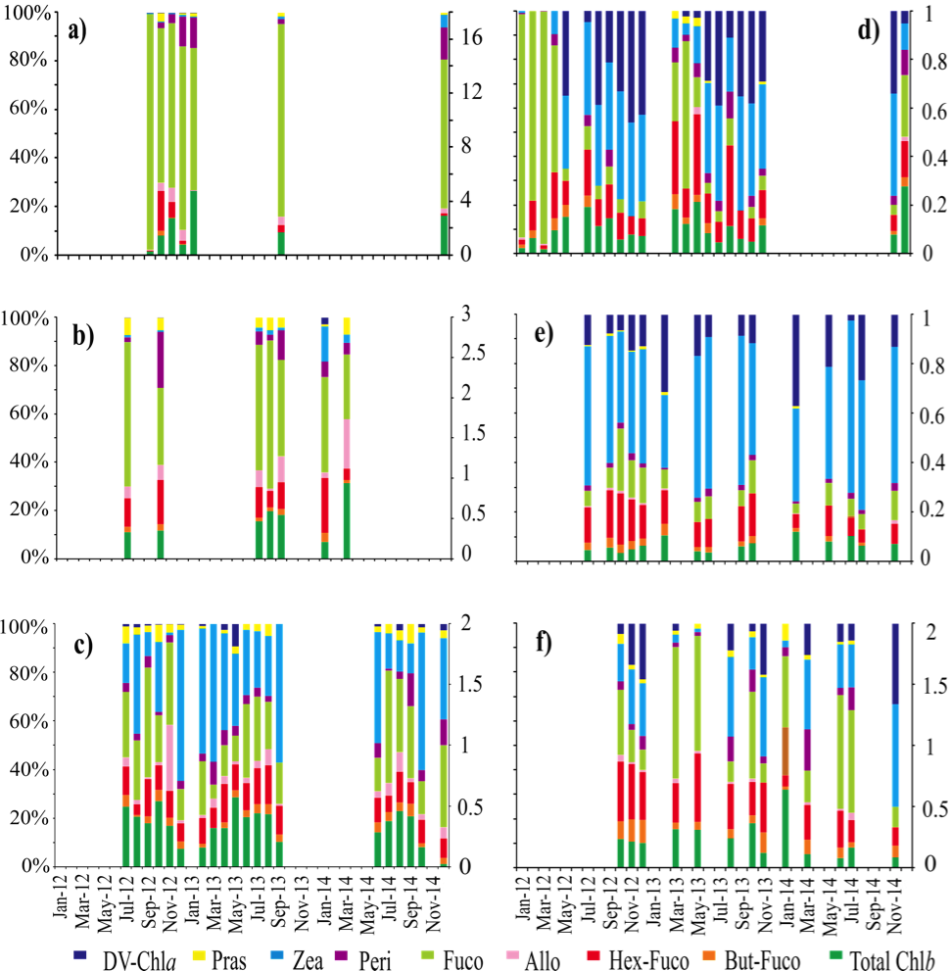
IMARPE
CARIACO
IMARPE
EPEA
EPEA
Cartagena
Ubatuba
CARIACO
Ubatuba
Ensenada
Cartagena
Ensenada
Diagnostic phytoplankton pigments at Antares stations (2012-2014)
Article submitted to Oceanography Magazine in 2017: Phytoplankton pigment variability and community structure around Latin America coastal time series stations: the ANTARES network.
Authors: Adriana Gonzalez-Silvera, Roberto Millán-Núñez, Eduardo Santamaria-del-Angel, Liseth Arregoces, Avy Bernales, Mary Luz Cañón-Paez, Salvador Gaeta, Milton Kampel, Jesús Ledesma, Mayza Pompeu, Jaimie Rojas, María Guillermina Ruiz, Natalia Rudorff, Ricardo Silva, Abraham Saavedra-Garcia.

Slide 10
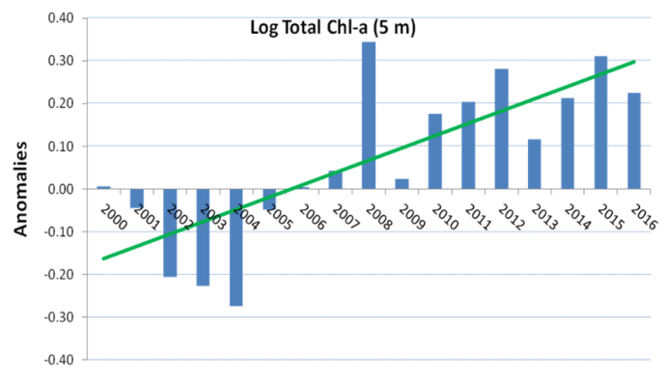
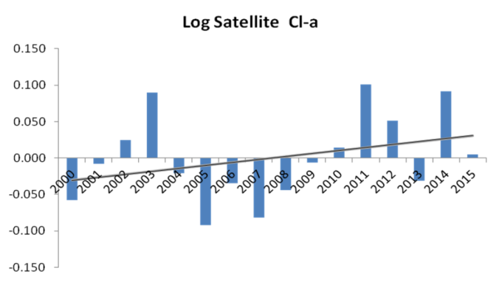
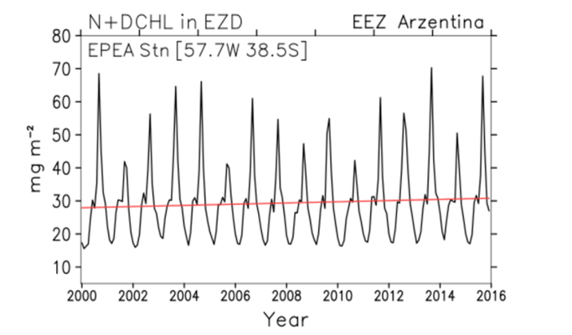
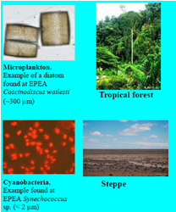
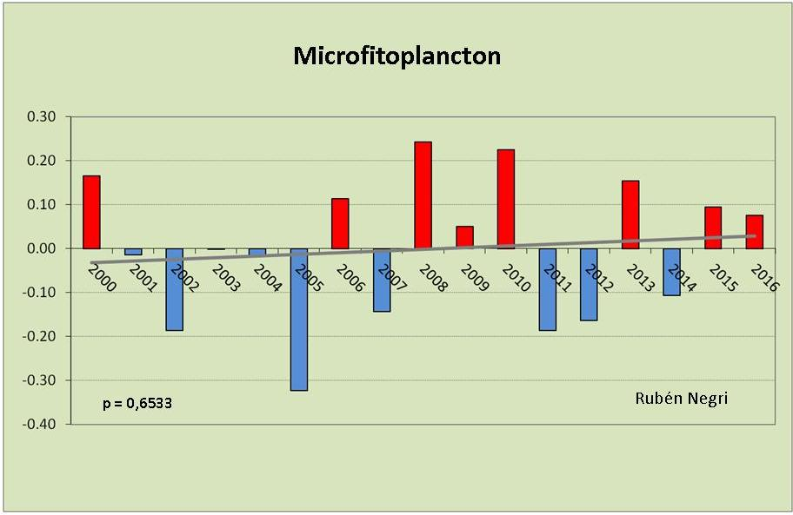
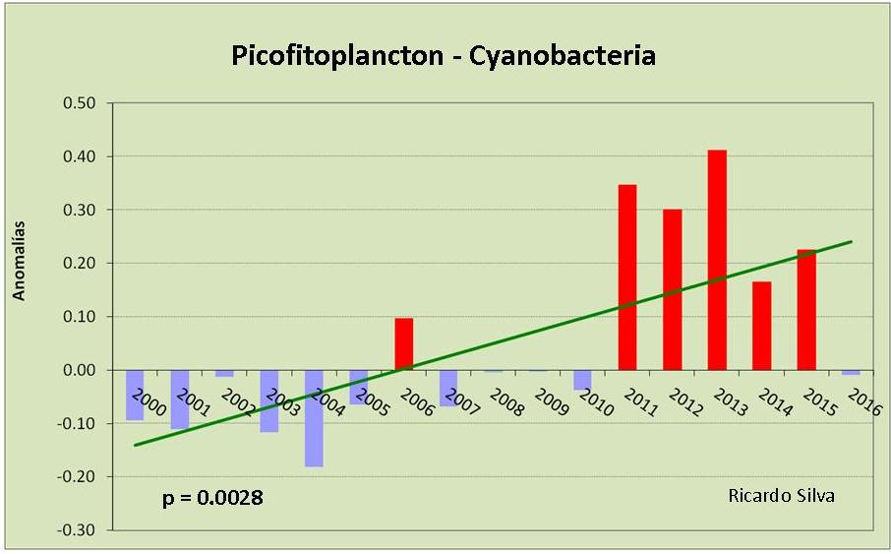
Ecosystem Service of Regulation at Antares Sites– Socioeconomic Implications
Case study: Phytoplankton changes at EPEA
Trends in surface Chlorophyll-a as index of phytoplankton biomass (2000-2015)
Three independent sources (in situ, satellite and modeled) indicate an increase in chlorophyll-a.
Anomalies in surface phytoplankton abundance (2000-2015)
The trend to increase in microphytoplankton was slight and non-significant. The increase in Cyanobacteria (picofraction) was marked and significant.
Significance:
Not all plants are the same. We are acquainted with the fact that on land it is not the same to have a rain forest or a steppe with hard plants. In the same way in the ocean it is not the same to have phytoplankton communities composed mainly by large cells (usually more efficient in sequestering CO2), than small cells (usually less efficient in sequestering CO2).

Slide 11
Ecosystem Service of Regulation at Antares Sites– Socioeconomic Implications
Lutz, V. (INIDEP), Chidiak, M. (ECON/UBA), Frouin, R. (SIO/UCSD), Filipello, C. (ECON/UBA), Negri, R. (INIDEP), Silva, R. (INIDEP), Ledesma, J. (IMARPE), Escudero, L. (IMARPE), Rojas, J. (EDIMAR), Kampel, M. (INPE), Pompeu, M. (USP), Santamaria, E. (UABC), Gonzalez-Silvera,A.(UABC), et al.
Objective/Approach. Interdisciplinary work using data/information from all the components: in situ, satellite, modelling, socio-economical. Analyze changes in CO2 Fluxes in the ocean, discuss those according to changes in phytoplankton, and contrast to land emission inventories. How these changes may affect the countries involved.

Slide 12
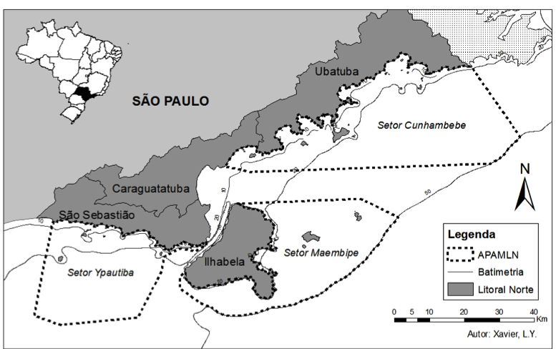
Marine Protected Area
North Coast of São Paulo, Brazil
23º44’S
45º00’W
316000 hectars
Beaches
Mangroves
Islands
Rocky coasts
Tidal flats

Slide 13

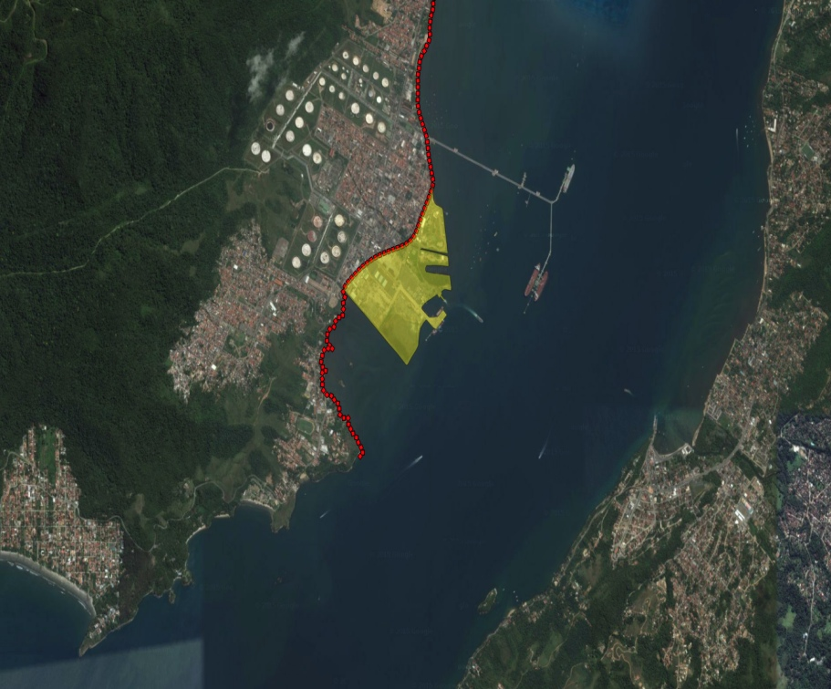
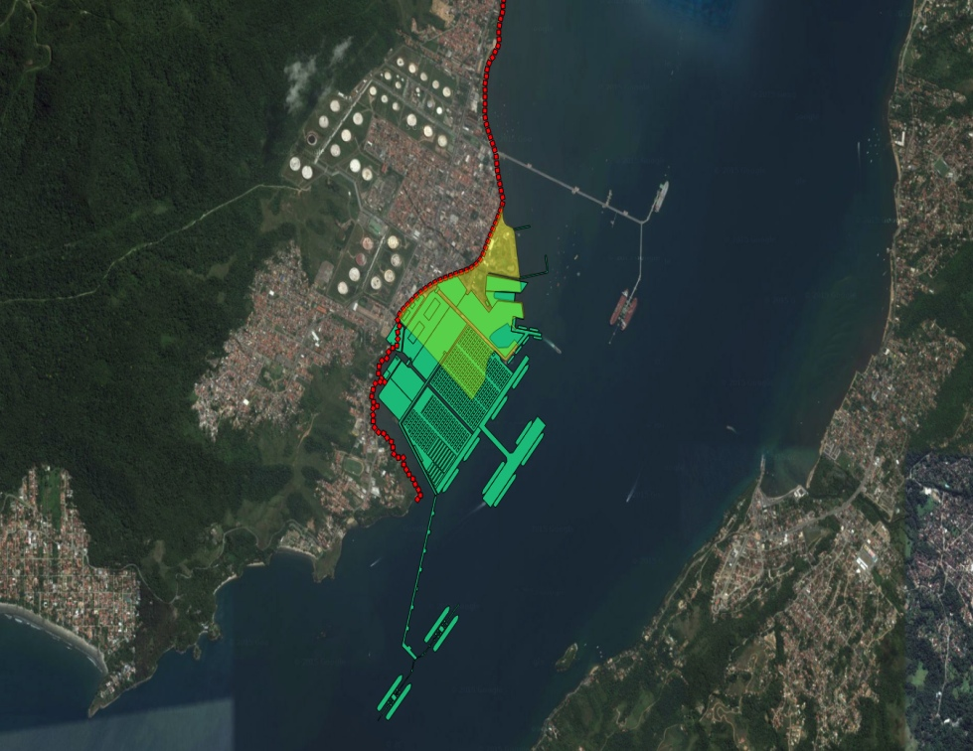
The Araçá Bay
The Araçá Bay (São Sebastião, SP, Brazil) has a significant environmental importance and has been facing strong pressures from human activities: port activities, oil transportation and increase in human occupation.

Slide 14
Tourist Perception
Section | Question | Objective
Tourist profile | Gender Age City/State of origin Average household income | To investigate the profile of the tourists who visit Ubatuba
Travel details | How long visits Ubatuba How often visits Ubatuba | To investigate the profile of the tourists who visit Ubatuba
Perception of marine ecosystem services | Which benefits the sea provides to you? | To identify the ecosystem services perceived by tourists.
Activities on the beach and what is consulted before going to the beach | Kind of activities What is important to realize activities Verification of weather/water quality characteristics | To investigate the activities performed at the beach and the importance of water quality and weather conditions for the tourists. Also, if it is fundamental for travel planning.
Water quality assessment | Changes to Ubatuba marine ecosystem Factors that tourists believe to change seawater quality in Ubatuba | To evaluate perceived changes in marine ecosystem and the factors associated to them.
Willingness to visit the beach after environmental changes | What would you do if the color of the seawater was different (muddy aspect)? What would you do if the seawater had lots of seaweed? | To verify how water quality disturbance influences beach choice.

Slide 15
Willingness to Pay
 | Minimum of tourists Carnival (COMTUR) | Maximum tourists Carnival (COMTUR)
 | 300,000.00 | 800,000.00
WTP total - 1 day | R$7,440,000.00 | R$19,840,000.00
WTP total - 4 days | R$29,760,000.00 | R$79,360,000.00
WTP total – Year (33,6 days) | R$180,932,677.41 | R$482,487,139.75

Slide 16
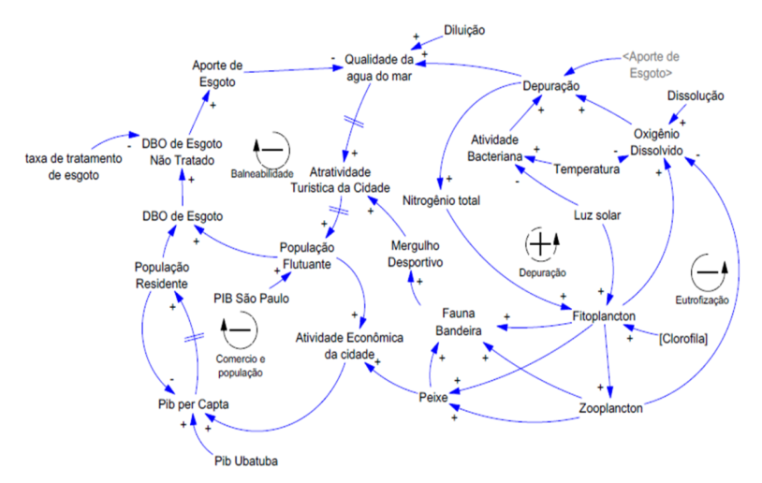
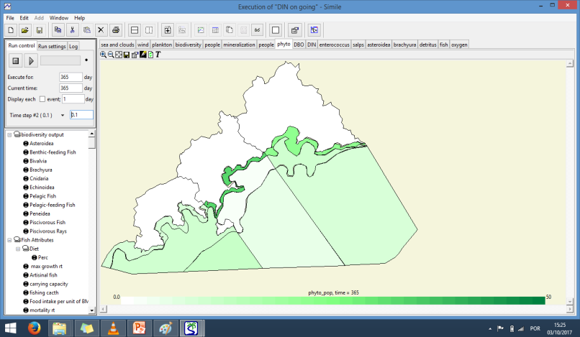
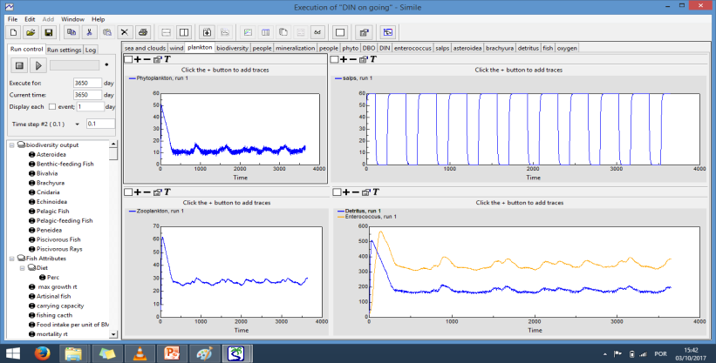
MIMES UBATUBA
Objectives:
Build some ecological economics dynamic models focused on integration of knowledge regarding ecosystem functioning and ecosystem services provision, considering human wellbeing perspective;
Development and application of new valuation techniques adapted to the common nature of most ecosystem services and also integrated in the model;
Delivering the integrated model to several types of potential users
Conclusions:
Overall conclusion is that the model has huge capacity of integration of social, economic and environmental characteristics of the system. With full development it is clear that it can enhance the results of ANTARES project regarding local ecosystem based management and then be replicated to other regions.

Slide 17
Working Group “Socio-economic & Ecosystem Services”
Climate Change and Economics of Fisheries I
Ignacio Carciofi and Isabela Sanchez Vargas (FCE-UBA)
Main Questions:
Which are standard indicators to measure the aggregate (macroeconomic and social) impacts of the fisheries’ sector ?
Note: expected/actual changes in these estimates apply as climate change vulnerability indicators (impacts of “exogenous” changes –as seen from the economic system- in fishing potential due to climate change)
What are the effects of considering the structure of fish-processing industries in different countries?
Method: Estimate indicators for 4 Latin American Countries (Argentina, Chile, Mexico and Peru) using common economic approaches based on Input-Output Matrix and Official National Statistics. Indicators selected: Value added – Production – Jobs . Both direct (fisheries only) and indirect (including effects in upstream and downstream sectors) impacts considered
Publications
MSc in Economics Thesis by ISV (subm. Sep 2017) Oral presentation expected by Dec 2017
Paper by IC – ISV: to be submitted –after thesis approval- to IIEP (UBA-Conicet) as part of the centre’s working paper series
Main Results
Fisheries’ sector has diverse socioeconomic impact on employment, production (ton) and share of value added (GDP) in Argentina, Chile, México and Peru (Table1).
Macroeconomic impact of the fisheries’ sector usually neglected when only primary activities (i.e. excluding industrial processing) are considered (as shown in Table 1, the highest share is 1.4% of GDP). When considering industrial processing, fisheries share in GDP and in the total value of production of the economy may double. Higher economic impact is found when considering the whole production chain. Fisheries’ sector also exhibits high multiplier effects through its demand and supply relationship with other sectors/industries (Table2).
Table 1. Main indicators
Country | Fisheries Production | GDP share | Direct Jobs
Argentina | 1.5 mill ton | 0.14% | 16000 (primary fisheries) 10000 (processing ind.) 26000 (total)
Chile | 4.2 mill ton | 1.05% | 76000 (primary and aquaculture) 42000 (processing ind.) 118000 (total)
México | 1.6 mill ton | 0.1% | 200000 (total including aquaculture)
Perú | 7.1 mill ton | 1.4% | 121000 (primary fisheries) 24000 (processing ind) 145000 (total)

Slide 18
RESULTS (continued) Table 2. Multiplier effect estimates per sub-sector (range of estimates according to different indicator methodologies derived from input-output matrixes).
If demand or production in one subsector increases by 1 unit, aggregate output value/aggregate value added/total employment in the economy will increase by….
 | COUNTRY | Total production multiplier | Multipliers of
 |  |  | Value added | Employment
FISHING | Argentina | 1.71-4.93 | 1.75-4.48 | 1.78-5.46
 | Chile | 1.61-3.04 | 1.38-2.24 | s/d
 | México | 1.73-3.03 | 1.64-2.65 | 1.16-1.44
 | Perú | 1.64-3.29 | 1.57-2.89 | 1.39-2.95
FISH PRODUCTS | Argentina | 2.27-3.29 | 3.72-9.24 | 2.76-6.64
 | Chile | 3.1-4.67 | 4.67-8.73 | s/d
 | México | 1.9-3.02 | 2.43-3.9 | 3.64-5.23
 | Perú | 1.91-4.68 | 2.24-4.42 | 3.67-9.97
FISHMEAL AND OIL | Chile | 2.37-3.77 | 3.15-5.15 | s/d
 | Perú | 1.88-3.55 | 1.88-3.88 | 7.01-20.14
Multiplier effects are relatively higher for industrial activities (as compared with primary fishing).
Production multipliers exhibit a minimum of 1.6 for primary fishing in Chile and a maximum of 4.68 for fish products in Peru.
Value added and employment multipliers are generally higher, in particular for industrial subsectors (fish products and fishmeal and oil), ranging from 1.38 to 20.14
Results on Interindustrial linkages: An increase in demand from the fish processing industry has higher than average macroeconomic (interindustrial) stimulus effects in all 4 countries considered. The linkage effects are stronger with upstream sectors (suppliers) than with downstream (user) sectors.
All of the above implies that an increase or decrease in production of the fisheries’ sectors with higher industrial processing are likely to have higher macroeconomic impact. And that considering the whole production chain is quite important to assess macroeconomic and socioeconomic vulnerability indicators.

Slide 19
Working Group “Socio-economic & Ecosystem Services”
^{Ocean Governance}
Cecilia Filipello, MA International Economic Relations Thesis (Facultad Cs.Economicas, UBA) “Ecosystem Services in Ocean Governance: Argentinean Case Study on the contribution of national and regional science programs”
(to be submitted by April 2018)
Main Question: How do initiatives intended to generate scientific knowledge contribute to the incorporation of ecosystem services into national and international policies?
Methodology: Argentinean case study of two scientific initiatives aimed at improving our knowledge on the ocean ecosystems : SABIA-Mar (satellite) mission (Brazil-Argentina) and Pampa Azul initiative (of Min. Science in Arg).
Goal: Understanding the contribution of science programs to improved ocean governance through semi-structured interviews of relevant actors. Representatives from public sector (Ministry of Environment; Fisheries Secretariat and Ministry of Agroindustry) - involved in ocean-related policies -, researchers involved in the programs, NGOs and international organizations‘ local staff (e.g. UNDP). The interviews aim at assessing the expected impact of these long term initiatives, based on two indicators/criteria:
addition of new scientific knowledge on natural systems and human-natural coupled systems
knowledge transfer from science to policy - use of scientific information for policymaking processes.
Preliminary Conclusions (fieldwork still ongoing):
• Both programs are perceived to have high potential to provide:
- tools/data to assess interactions between human activities and ecosystem services
- information necessary to improve ocean sustainability.
• To date, the management plan for the marine protected area Banco Burdwood is the only case identified where research results from Pampa Azul campaigns feed into policy mechanisms specifically aimed at sustainability .
• So far, at Pampa Azul initiative (fostered by the Ministry of Science and Technology) there is no specific mechanism to promote the use of research results in policy decision-making, formulation, and implementation in other Ministries. At the moment, the only connection among different Ministries occurs through the involvement of their staff in Pampa Azul thematic working groups and the steering committees .
• The approach and potential impact of Pampa Azul on “knowledge transfer” from science to policy is still to be evaluated/identified through the pending interviews.

Slide 20
Working Group “Socio-economic & Ecosystem Services”
^{Ocean Governance (FCE-UBA)}
“Scientific knowledge and sustainable ocean policies: An analysis of a complex relationship” paper by M. Chidiak & C.Filipello. Draft presented at COLACMAR, Camboriú, Brazil, 16 Nov 2017
Preliminary Lessons: Those responsible for developing and implementing scientific programs –e.g. in context of SDG14 should consider existing “gaps” in knowledge creation:
need to “translate” scientific information into a format suitable for policy debate and decisionmaking
need to train and include such “translators” either as scientific staff or within policymakers teams
need to develop/disseminate tools to facilitate the feed-in of new scientific results into policymaking processes involving many ministries. Challenge to include complex information about “invisible” processes such as marine ecosystem services.
Main Questions:
More scientific knowledge, means better policies?
Which are the main processes/ barriers for the incorporation of scientific knowledge in national policymaking processes? (inspired by preliminary results from CF MA Thesis)
Methodology: literature review and interviews with decisionmakers and researchers - an Argentinean case study. Goal: to understand how policymakers incorporate new scientific information in their policy decision/revision processes (fieldwork still ongoing). Evidence from other international experiences is also analyzed.
Preliminary Results - Factors limiting Science-Policy interactions for sustainable policies
Lack of time and human resources | Different visions and missions
Decision-makers: Too busy with daily management activities, to keep up and incorporate increasing flows of new knowledge. | Decision-makers: researchers and institutions are reluctant to share scientific results/data. Interested in general trends (information from scientific papers has to be processed).
Scientists: Too busy with own deadlines/research agenda to participate in science-policy dialogues and intra-governmental coordinating meetings | Scientists: Scientific projects only move forward if they are seen as related to some political objective (“pull factor”). If political priorities change, years of work and effort can seem pointless at the stroke of a pen.

Slide 21
Science communication and diffusion of IAI-Antares
Inside IAI-Antares team
Evaluation of knowledge production and internal learning processes inside IAI-Antares project and how the interactions between the members in this process occur as a network. Based on interviews and workshop.
Outside diffusion of science knowledge produced by IAI-Antares
Adequacy of scientific language to decision makers, policy makers, local residents, students, fishermen, tourists and other interested parties.
Promote activities with these parties in order to raise awareness their active role in supporting the formulation and implementation of public policies aimed at integrated management of ecosystem resources and services.
Produce material for science dissemination such as news, reports, videos, images and others. Also we intend to use social media, mainly Facebook, for exchanging knowledge among members in a closed group and then creating a fanpage to publish and discuss research results with all publics.

Slide 22
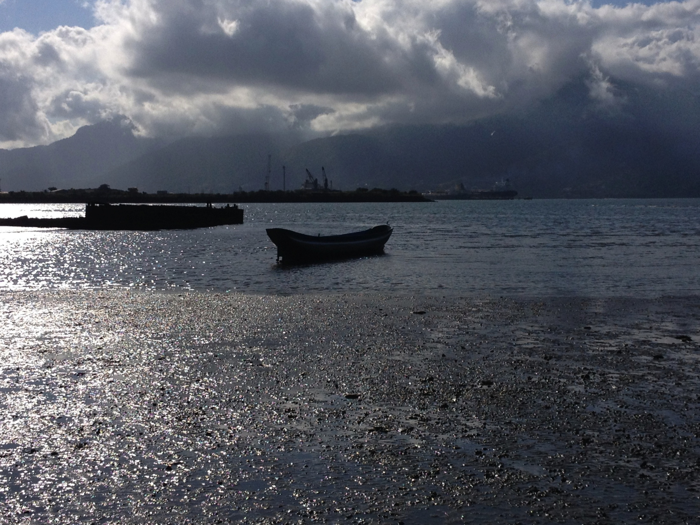

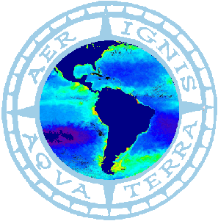



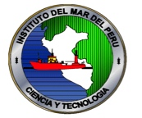

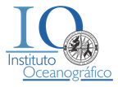






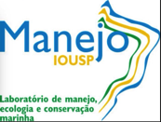




P.Sinisgalli

