Slide 1



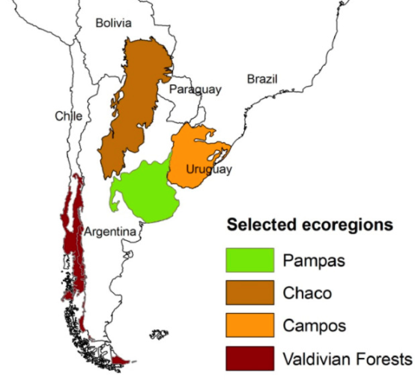





Bridging Ecosystem Services and Territorial Planning
IAI-CRN 3095
José Paruelo
Laboratorio de Análisis Regional y Teledetección
IFEVA-Facultad de Agronomía
UBA - CONICET

Slide 2















Slide 3
Conceptual Frameworks of BEST-P

Slide 4

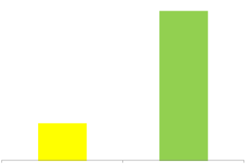

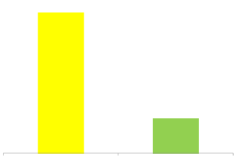
Political, cultural,
social, institutional, economic &
technological context
SYSTEM WITH A ‘NORMAL’ STRUCTURE AND FUNCTIONING
Benefits
S
TAKEHOLDERS
Private
Public
Stress
Disturbances
Enjoyers
Affectors
Restoration
External events
Benefits
SYSTEM WITH AN ‘ALTERED’ STRUCTURE AND FUNCTIONING
Private
Public
Notes:
Version 1

Slide 6
What we did?
Describing the changes
Building hypotheses on the drivers of land use/land cover changes
Quantifying the consequences
Notes:
Evaluation of feedbacks needs the construction of scenarios

Slide 7
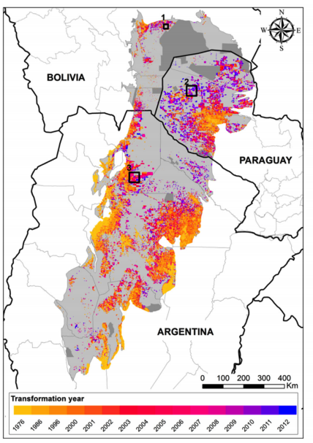
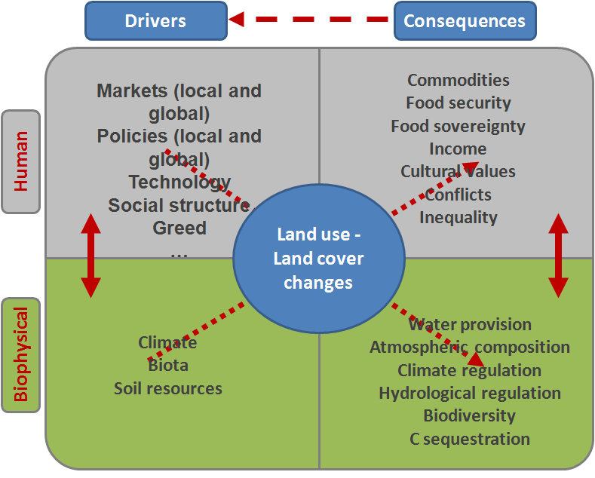

Vallejos et al. 2015. Journal of Arid Environment

Slide 8
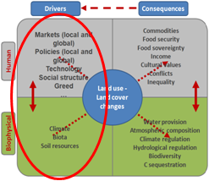
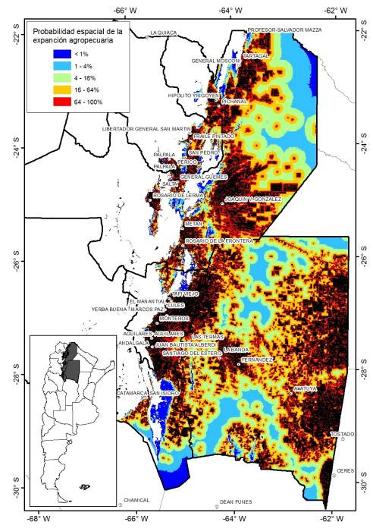
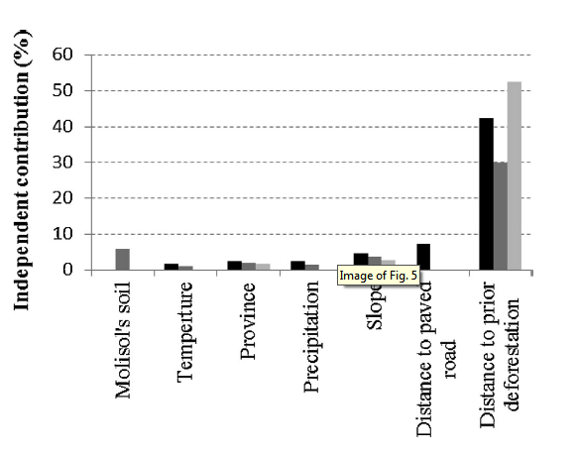
Deforestation
Volante et al. 2016. Land Use Policy

Slide 9
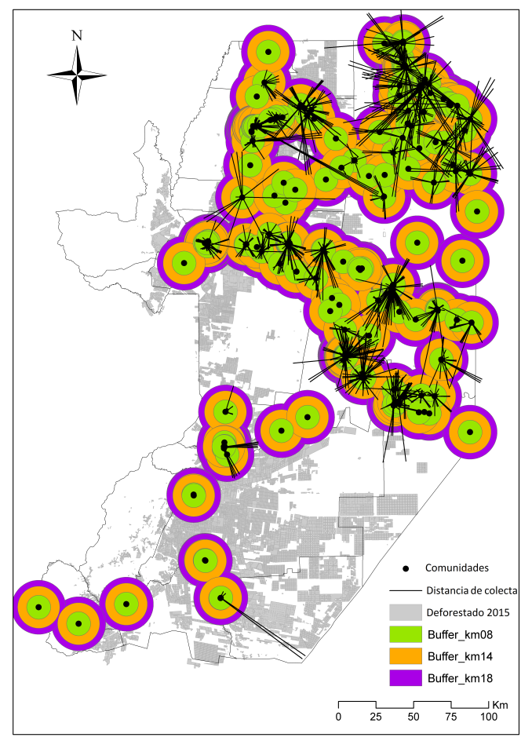

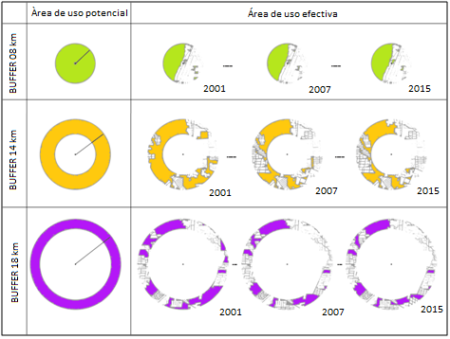
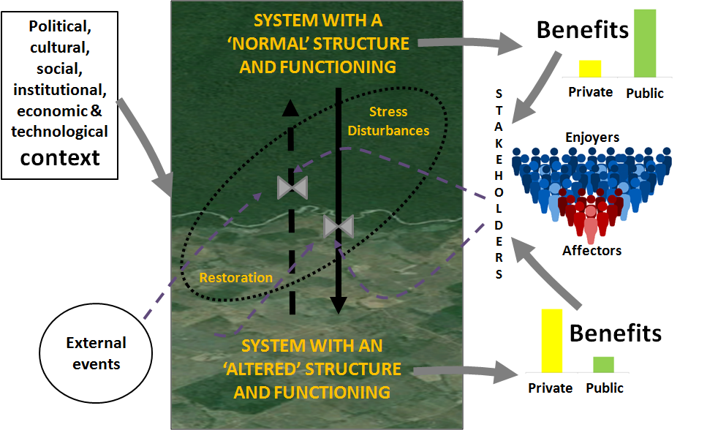
Vallejos 2017, PhD thesis

Slide 10
Quantifying Ecosystem Services
- Direct Measurements
- Models
- Impact functions
Land Use and
Land Cover change
Impact
Notes:
General structure of a production function. Examples for agronomy. Examples for ecology

Slide 11
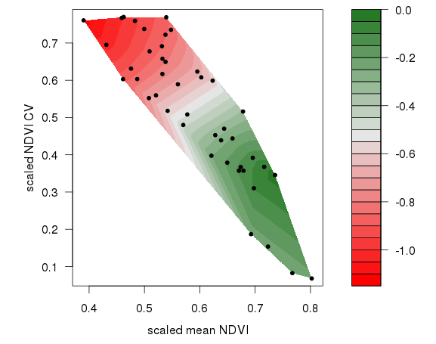
Production functions
Mapping functions
Mechanistic models
Ecosystem
Services (ES)
provision
estimates
ES
Field measurements
Map of ESPI trends 2000-2014
ESPI
ESPI = (NDVI_{mean})^{x}(1-NDVI_{CV})
2000
2014
Paruelo et al. 2016. Ecol Indicators

Slide 12
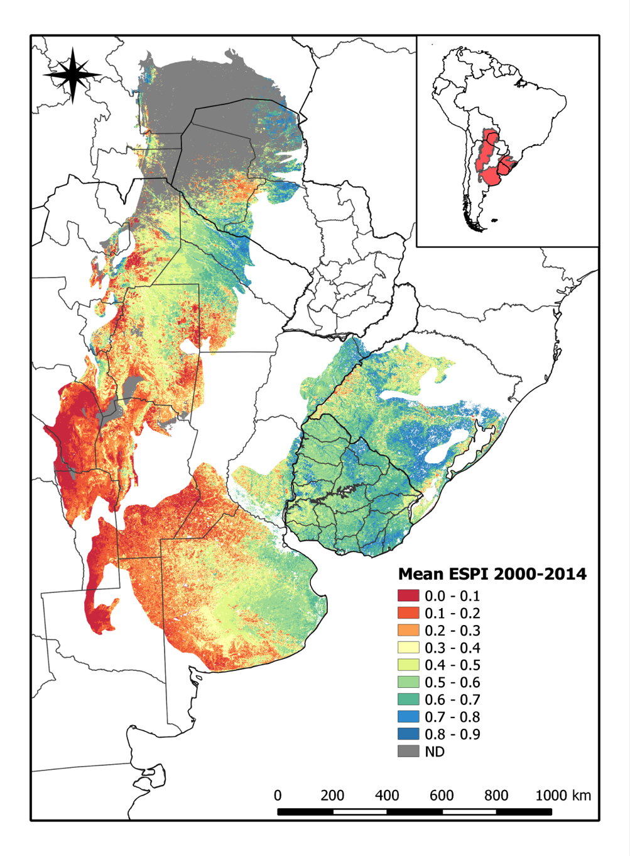
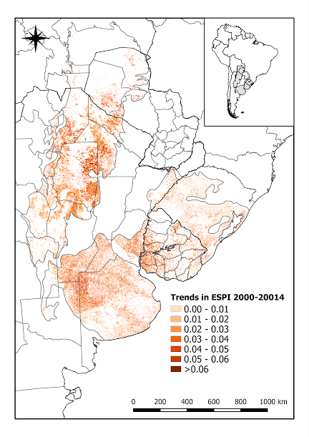
Paruelo et al. 2016. Ecol Indicators

Slide 13
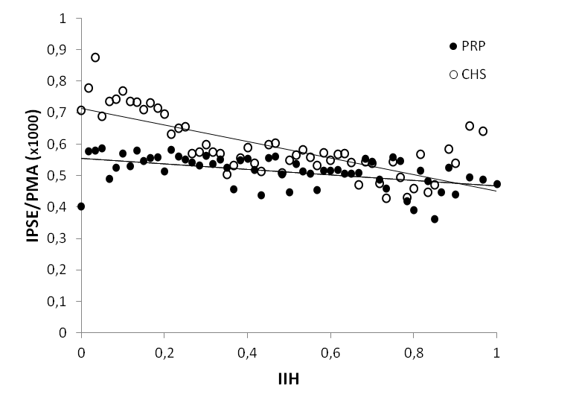
RPG
Chaco
ESPI/MAP (x1000)
Human Influence Index

Slide 14
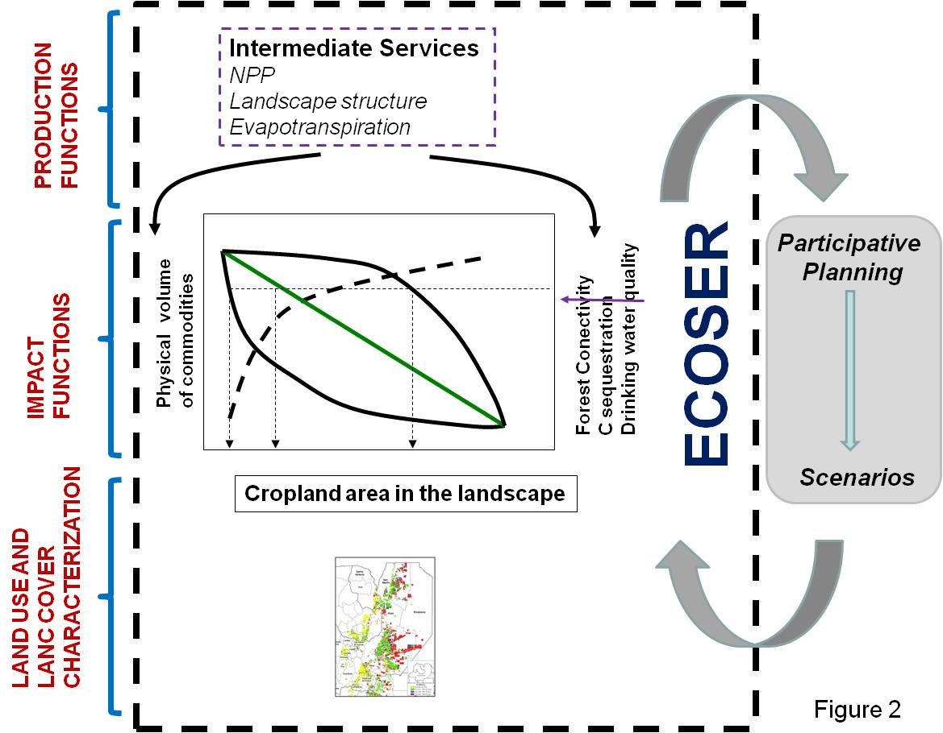

Slide 15
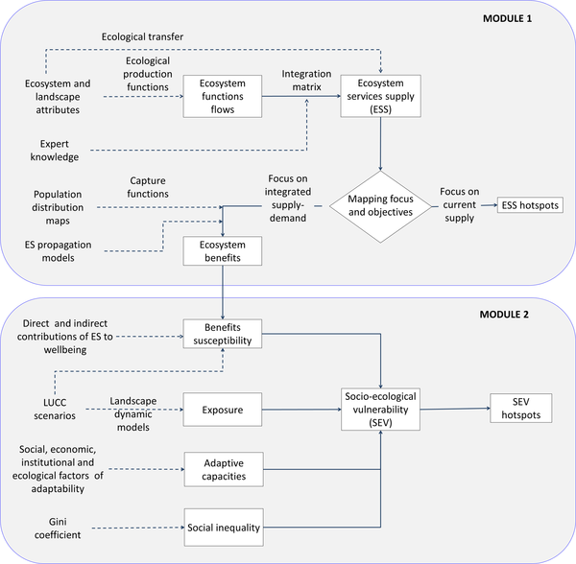

Fig 1. ECOSER 2.0 flow chart.
Laterra P, Barral P, Carmona A, Nahuelhual L (2016) Focusing Conservation Efforts on Ecosystem Service Supply May Increase Vulnerability of Socio-Ecological Systems. PLOS ONE 11(5): e0155019. https://doi.org/10.1371/journal.pone.0155019
http://journals.plos.org/plosone/article?id=10.1371/journal.pone.0155019

Slide 16
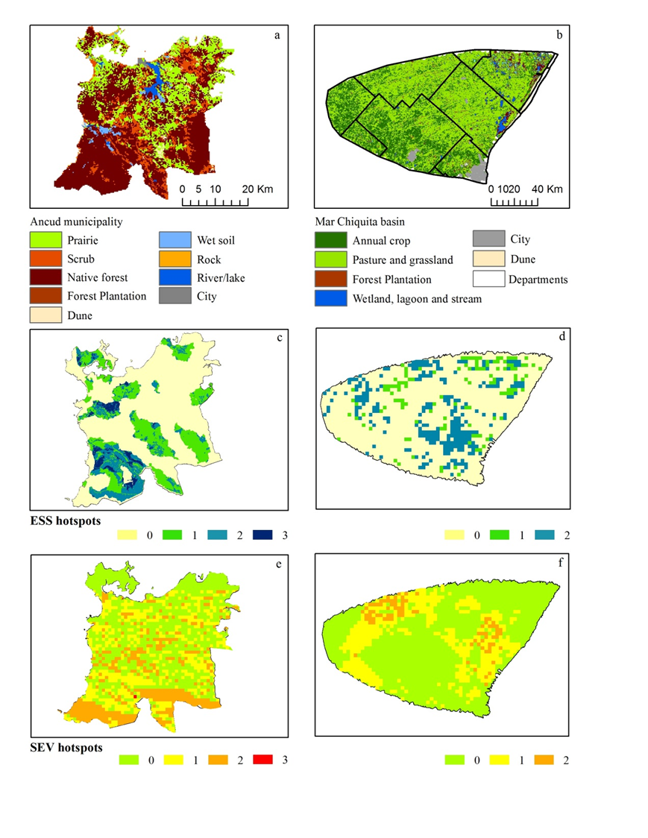
Ancud, Chiloe, Chile
Mar Chiquita, Buenos Aires, Argentina
Focus on SEV hotspots (scenario-based planning)
Focus on ESS hotspots (supply maintenance)
Laterra P, Barral P, Carmona A, Nahuelhual L (2016) Focusing Conservation Efforts on Ecosystem Service Supply May Increase Vulnerability of Socio-Ecological Systems. PLOS ONE 11(5): e0155019. https://doi.org/10.1371/journal.pone.0155019
http://journals.plos.org/plosone/article?id=10.1371/journal.pone.0155019
Notes:
Tomado de: Laterra, P. P. Barral, A. Carmona, L. Nahuelhual, 2016. Focusing conservation efforts on ecosystem service supply may increase vulnerability of socio-ecological systems. PLOS One, http://dx.doi.org/10.1371/journal.pone.0155019
En este paper se presenta ECOSER 2.0 (mayormente como Info Suplementaria) y se muestra una aplicación a dos casos de estudio, donde los de ES supply vs. hotspots de vunerabilidad socio-ecológica prácticamente se excluyen entre sí (o sea que priorizando las áreas de conservación según su supply o provisión, no estamos necesariamente asegurando ese flujo donde la gente más lo necesita ….)

Slide 17
Policy relevance -Outreach

Slide 18
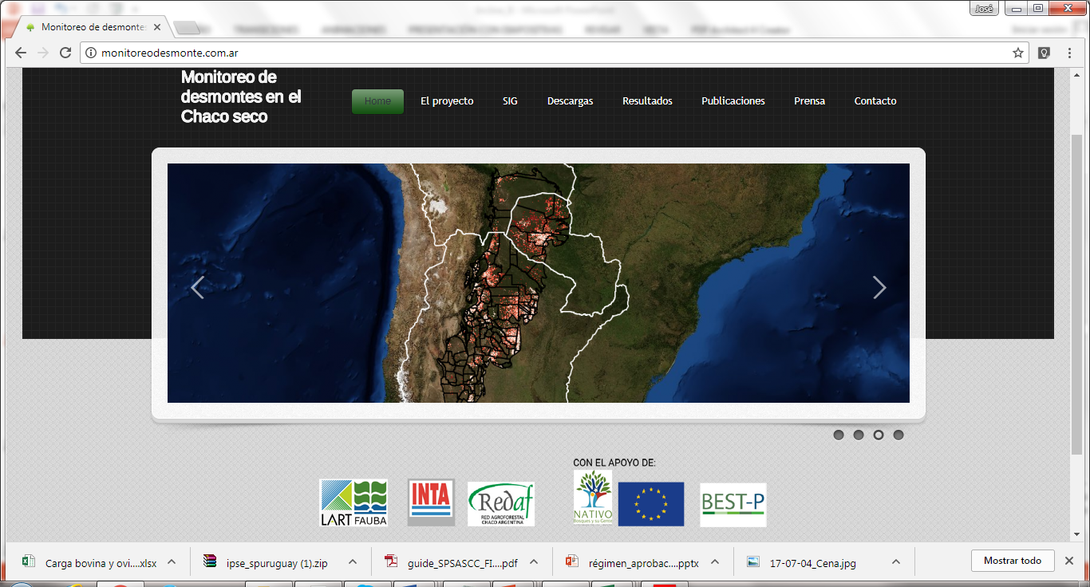
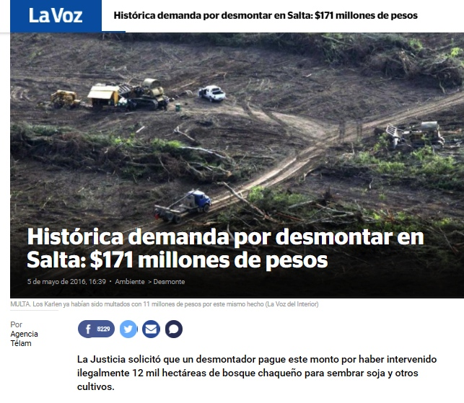
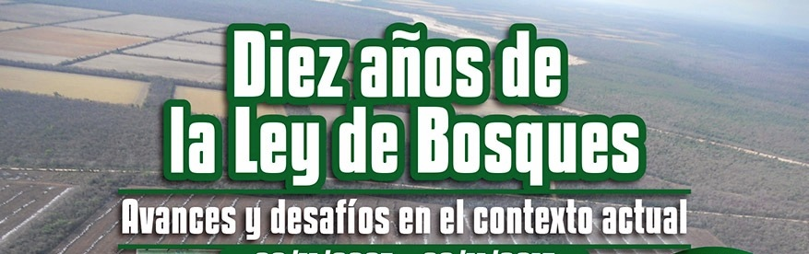

Slide 19
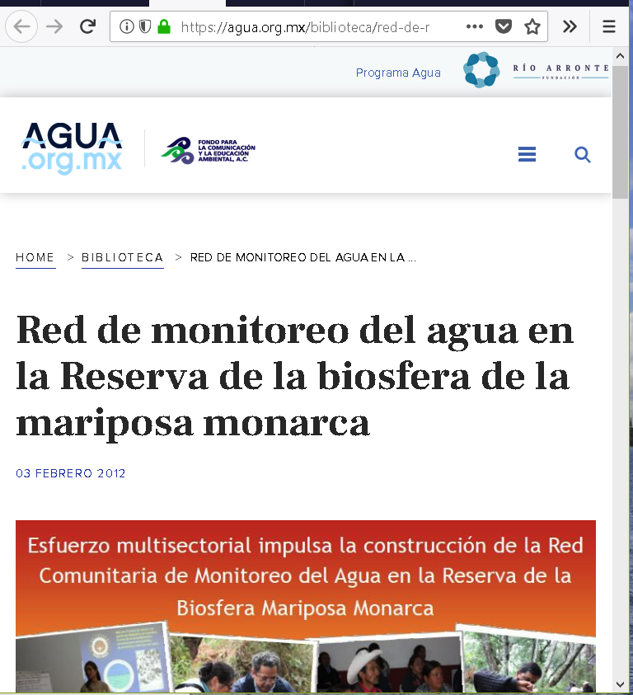
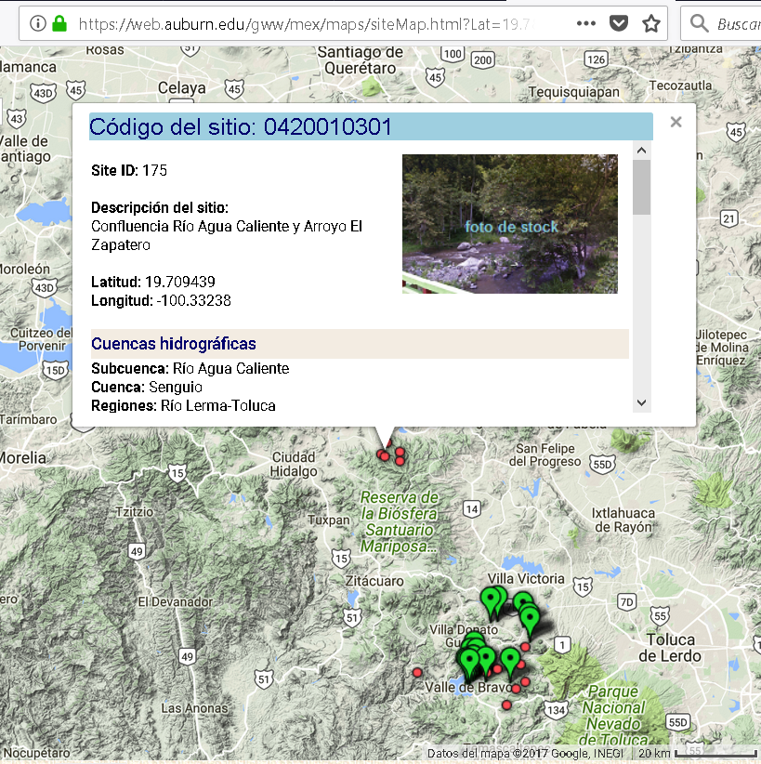

Slide 20

















Slide 21


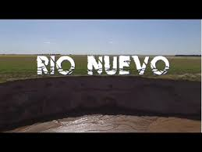

Slide 22
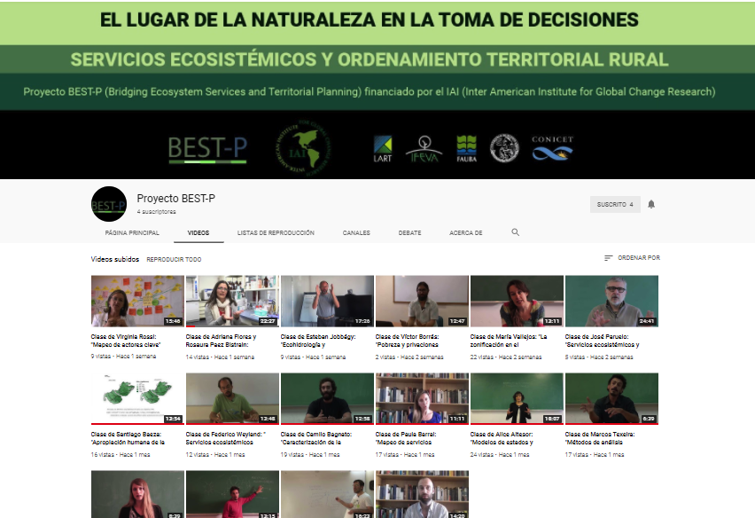

Slide 23
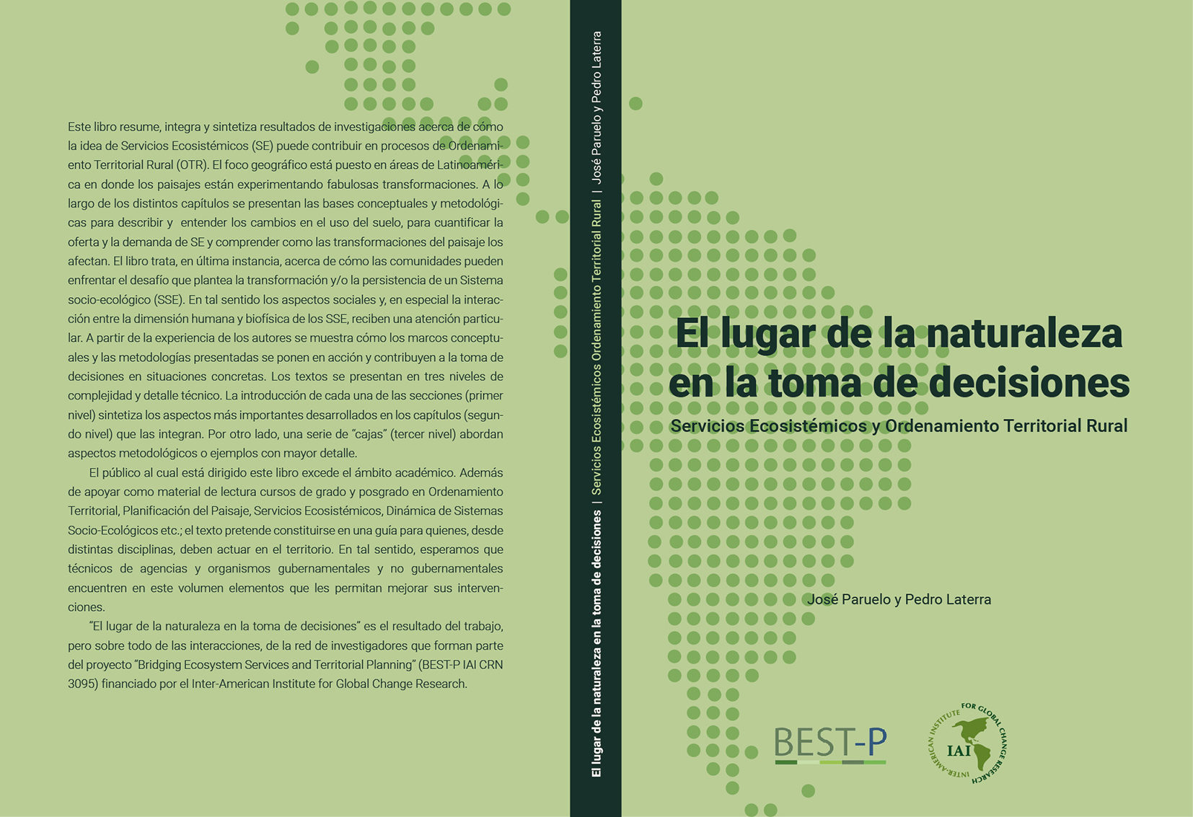

Slide 24
The network…

Slide 25
