Slide 1
BIOPIRE: Trans/interdisciplinarity and Forest-related Bioenergy Development across the Americas by Kathy Halvorsen and Erin Pischke

Slide 2
BIOPIRE project
BIOPIRE 2011-2018
IAI CRN3 2014-2017
NSF PIRE, RCN, IREU; NSERC; FAO, USAID PEER etc funds

Slide 3
BIOPIRE
Six countries: Argentina, Brazil, Canada, Mexico, Uruguay, and the United States
130+ social, natural, and engineering scientists, students, plus other sector collaborators –
Decisionmakers - NGO (CI), industry (Agropalma, Biopalma etc.), government at various levels, communities, participants in ID/TD skill training courses, online class, IAI PDS workshops
Four subteams: Socioeconomic, Ecosystem, Metrics, and Policy

Slide 4
BIOPIRE Research questions
How is Pan American forest-related bioenergy development impacting socioecological systems, and associated ecosystem services, and how can those impacts best be measured, modeled, and mitigated?
What is effective in terms of inter/transdisciplinary teamwork skill development?

Slide 5
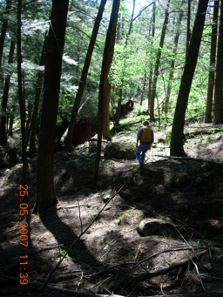
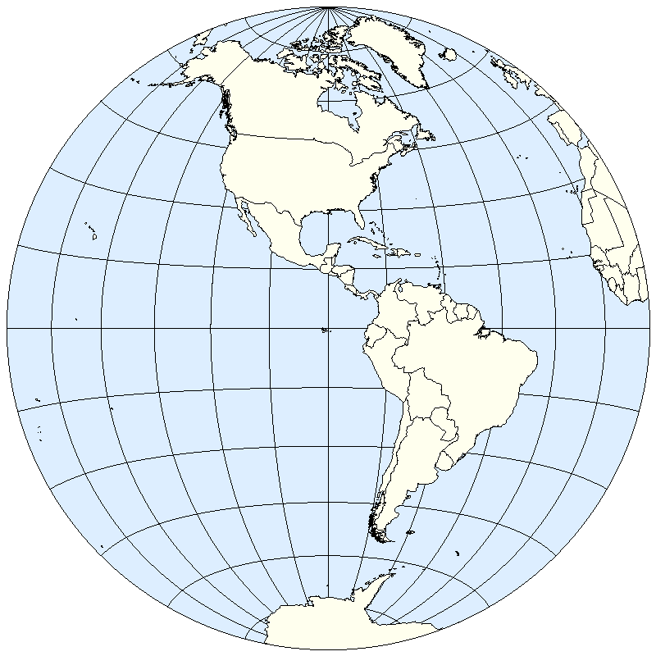
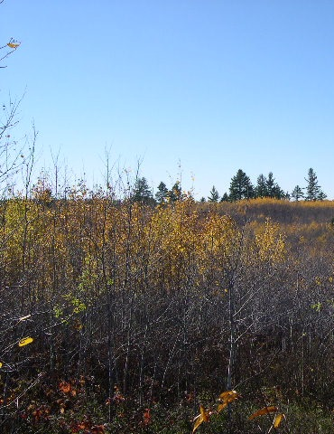
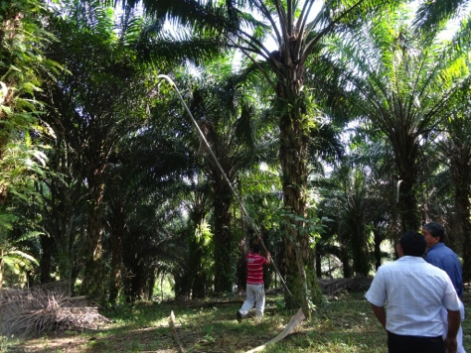
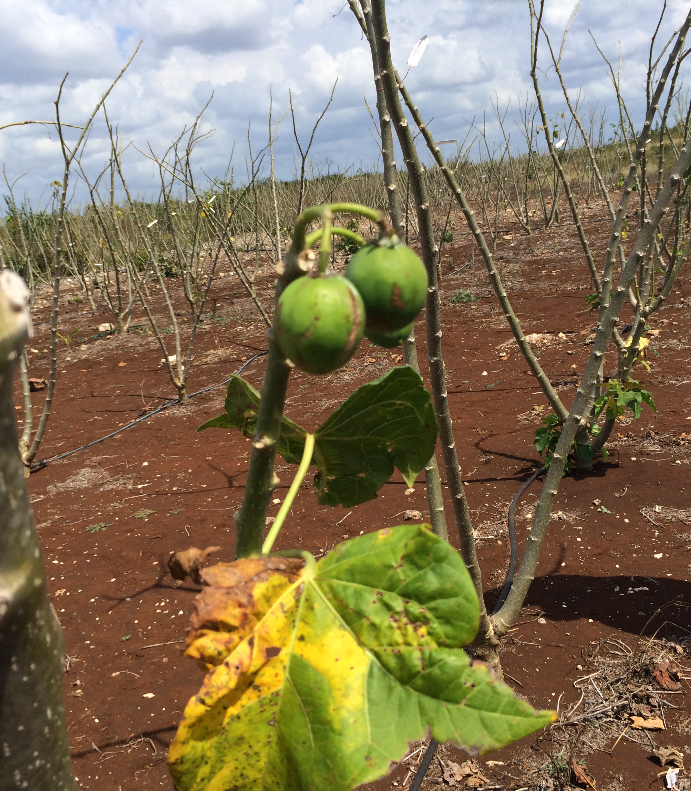
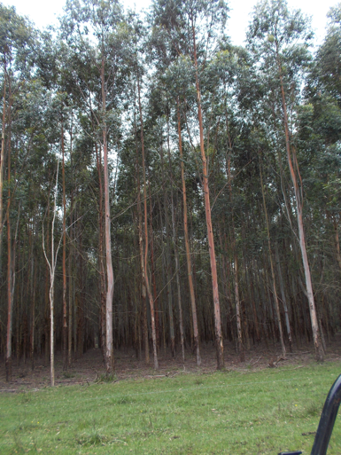
BIOPIRECases and foci
Northern Hardwoodand Aspen spp.
N. Hard-
woods
Jatropha
Oil Palm
Eucalyptus

Slide 6
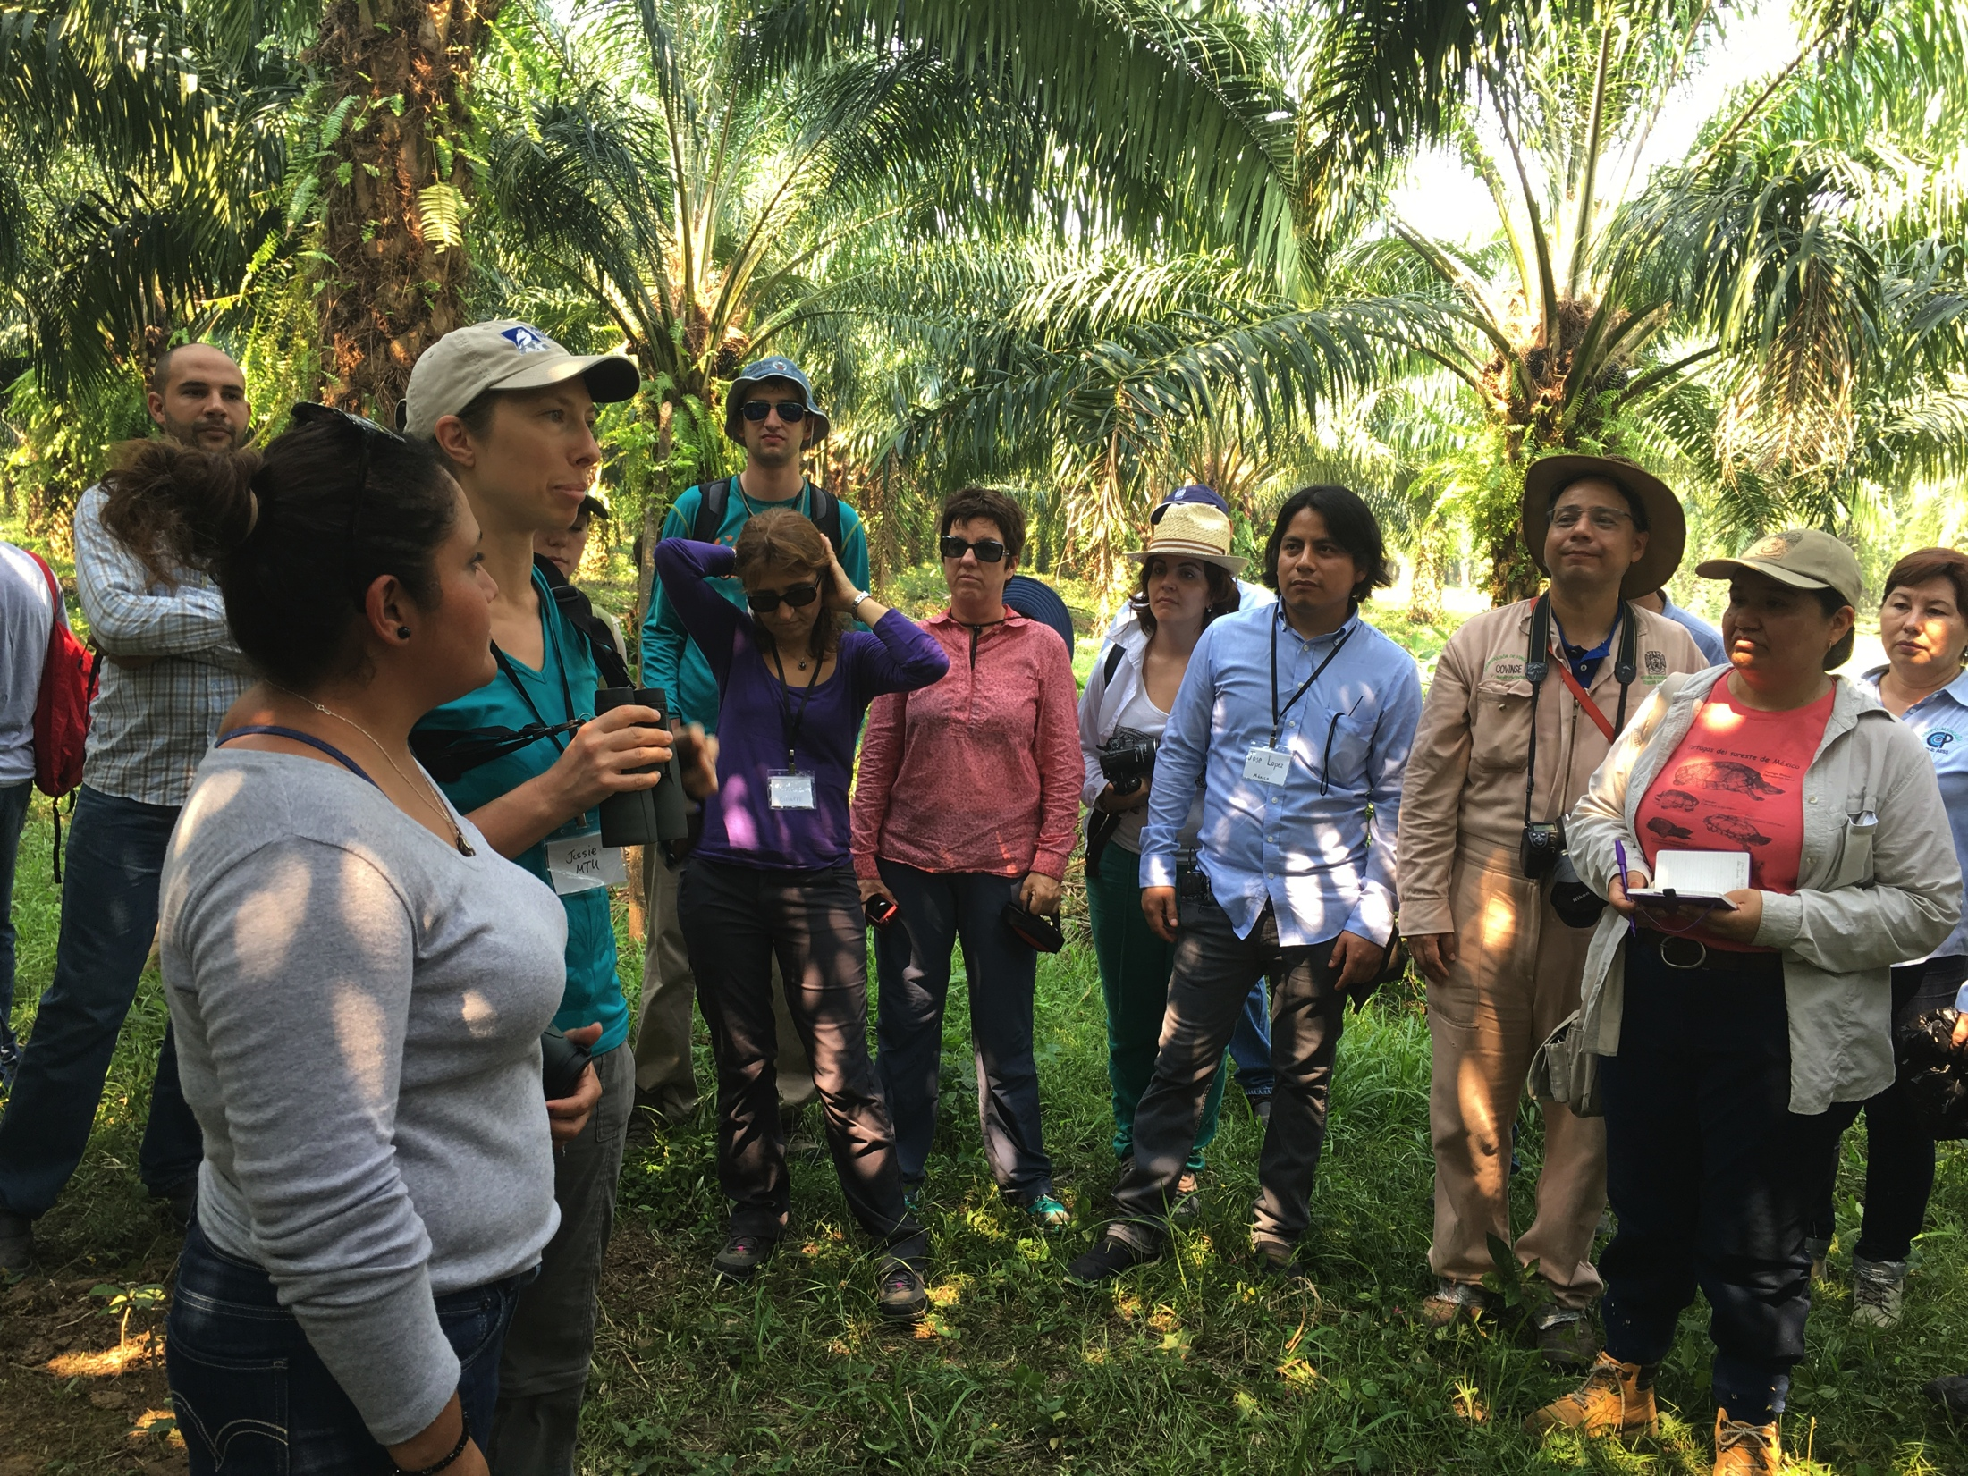
BIOPIRE policy context
Private policies – forest, biofuel certification programs
Public policies – national, state/provincial bioenergy incentive, regulatory requirements; forest policy

Slide 7
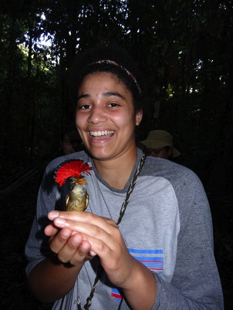
BIOPIRE policy-related findings
Public perceptions - mixed
Policy is piecemeal – focus on one stage
Need to incorporate feedstock landscape design

Slide 8
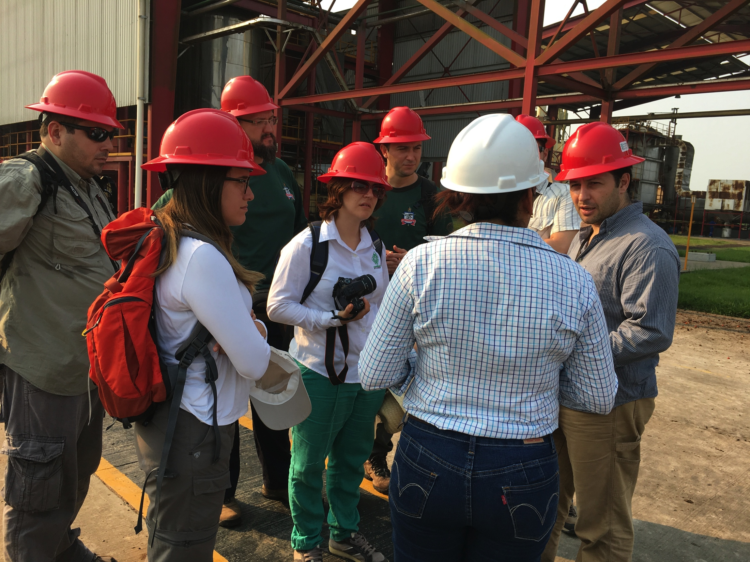
BIOPIRE Forest-related Bioenergy Science-policy activities
RCN conferences
Policymaker, NGO, industry collaborators, sources, dissemination
Recommendations to certification bodies, communities

Slide 9
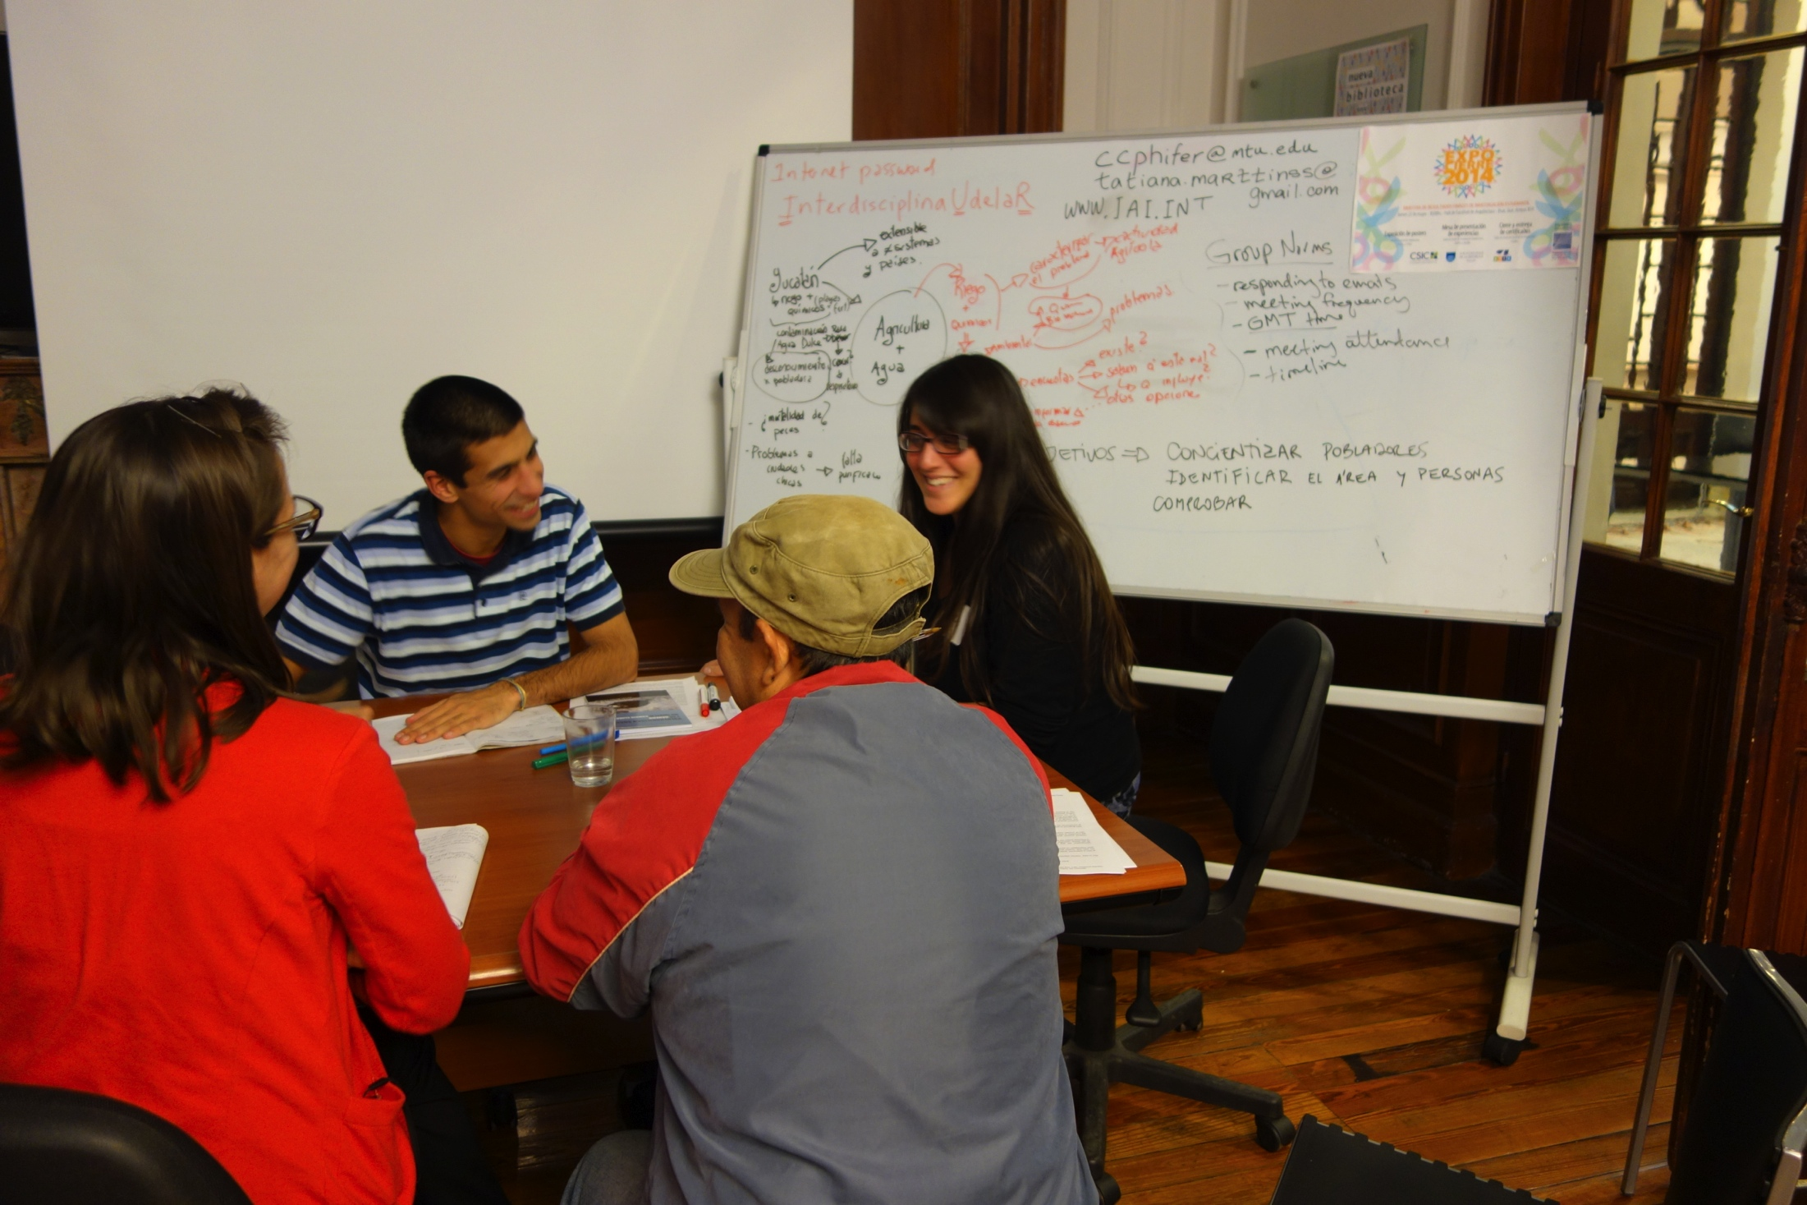
BIOPIRE trans/id teamwork skills policy context
National environmental assessment laws, planning
Global change-related science funding agencies

Slide 10
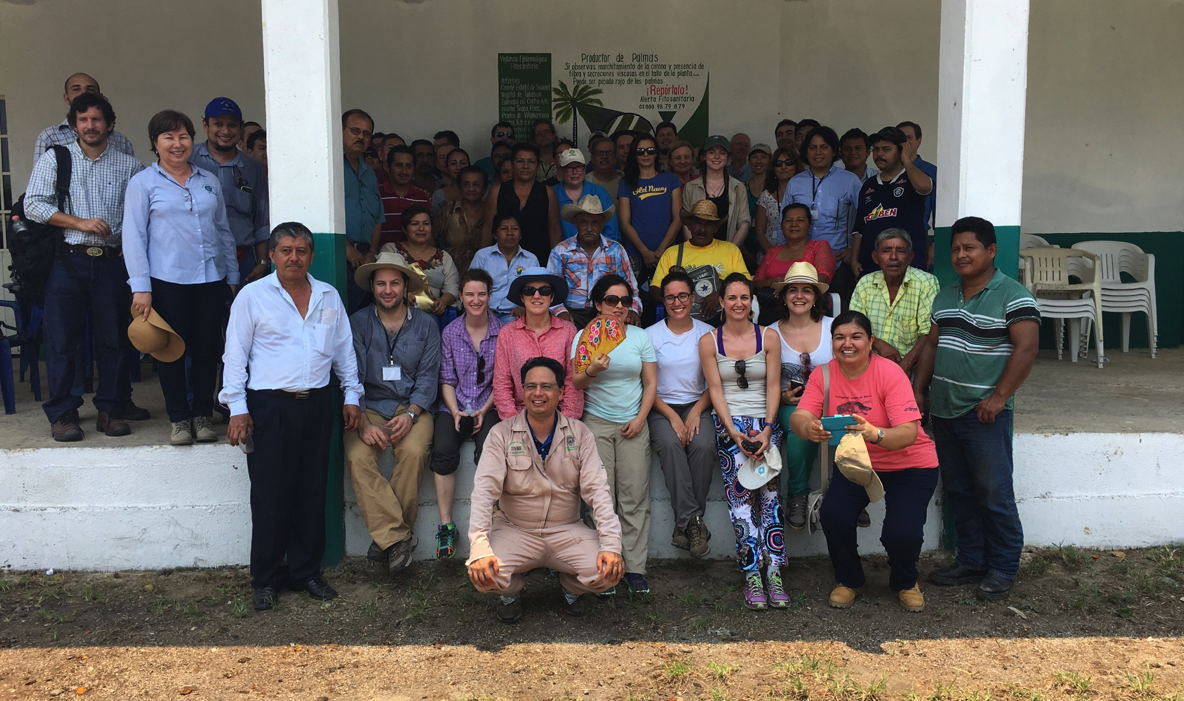
BIOPIRE trans/id teamwork skills findings
Successful training is possible
Sufficient time is needed – 4-12 months
Uneven impacts

Slide 11
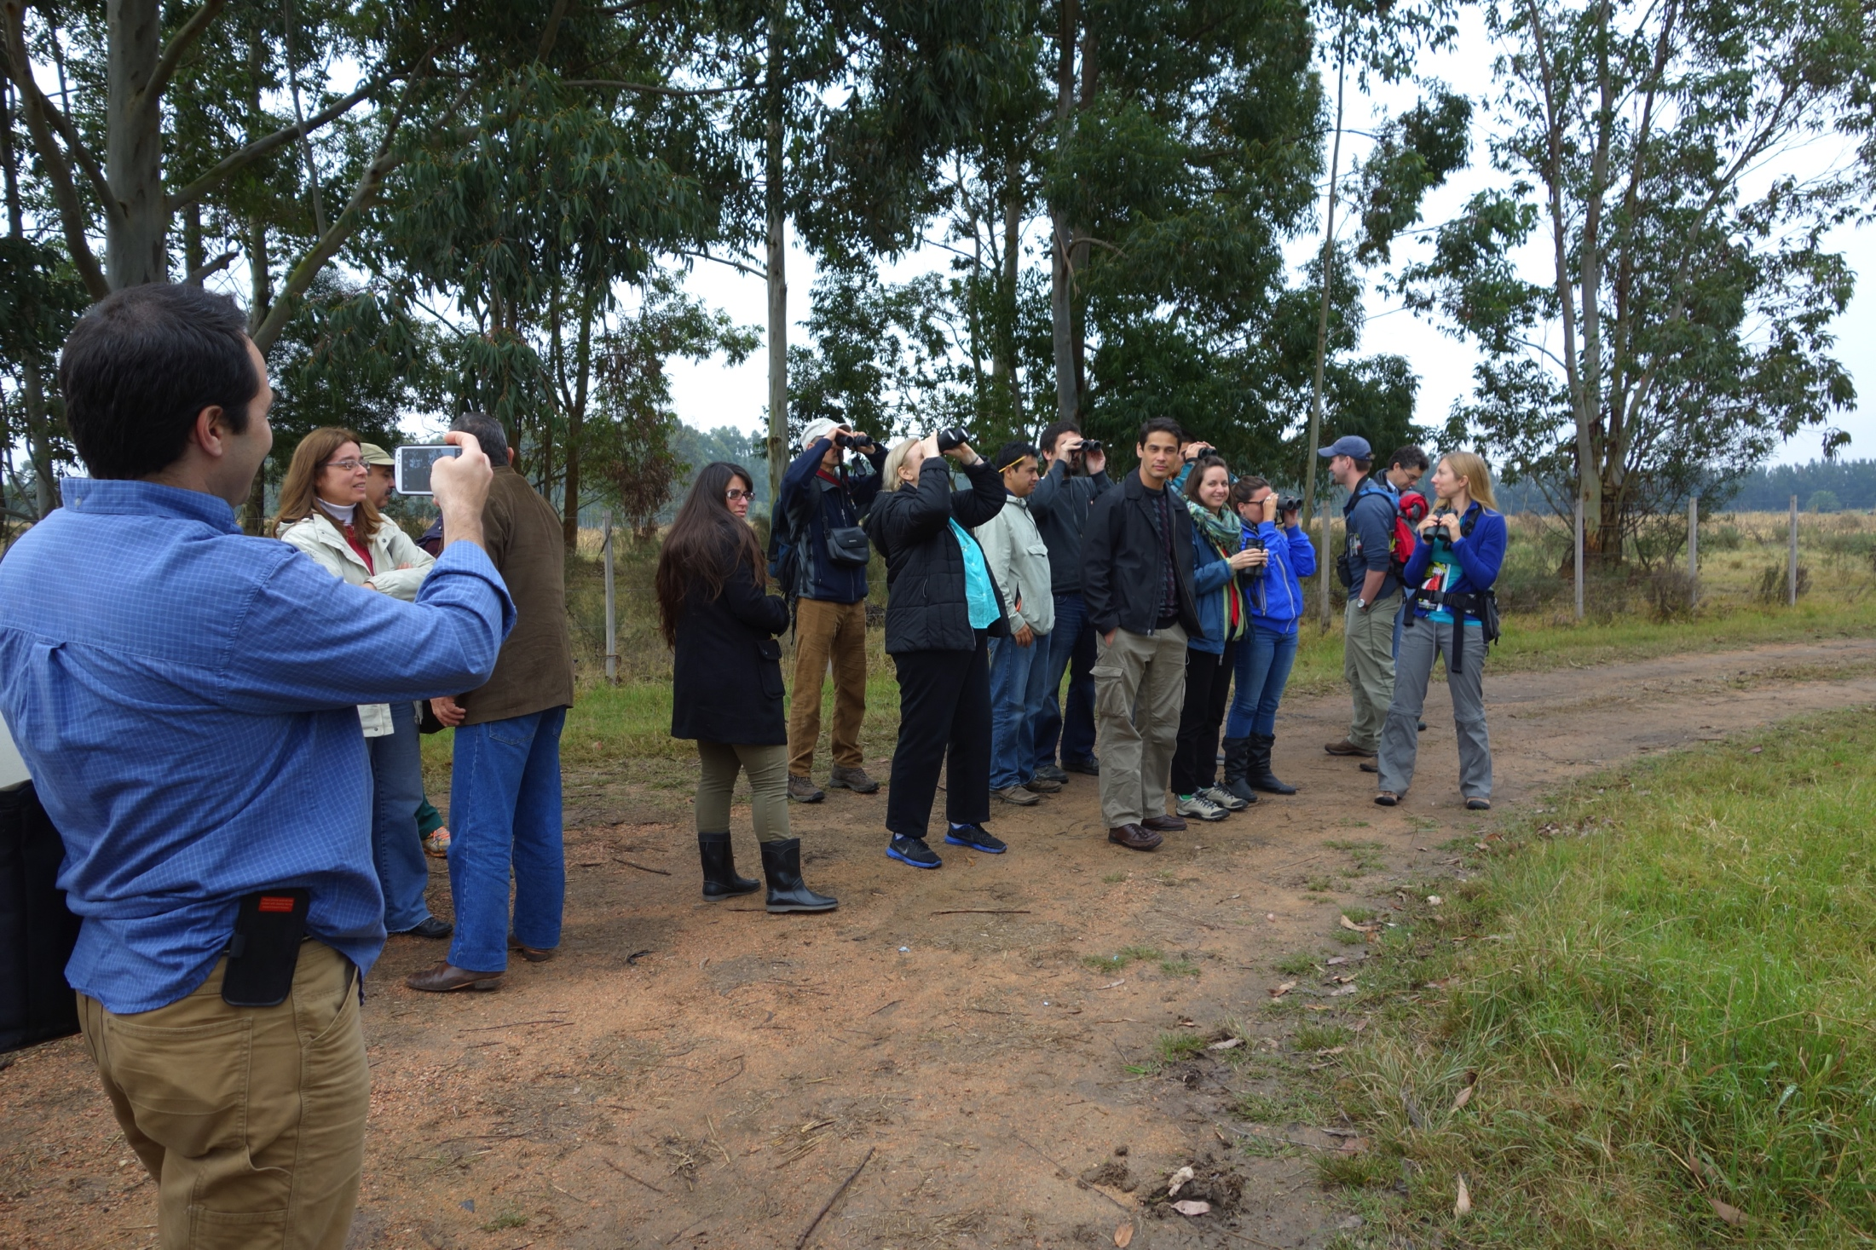
BIOPIRE trans/id findings policy activities
Six international training activities TD groups
BIOPIRE website
Communications to IAI, NSF; PDS exercises, webinars

Slide 12
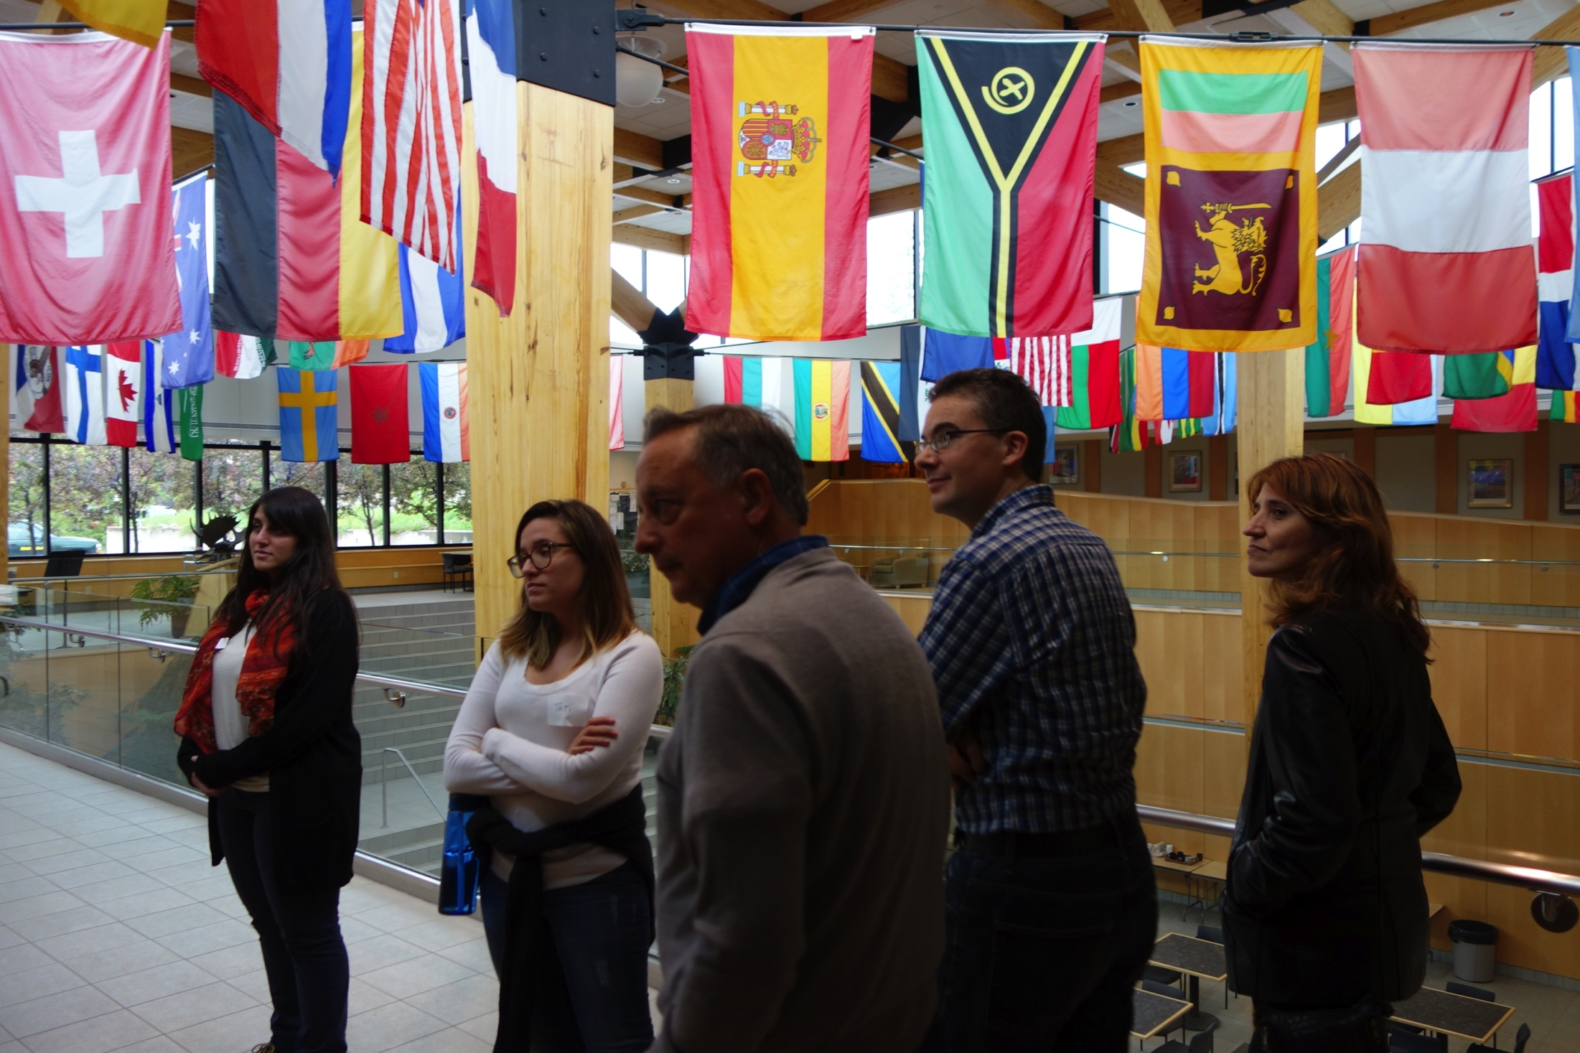
What did being ID/TD allow us to do?
Allowed big picture
Could not have created ID/TD trainings
Allowed understanding of policy impacts on social, ecological systems

Slide 13
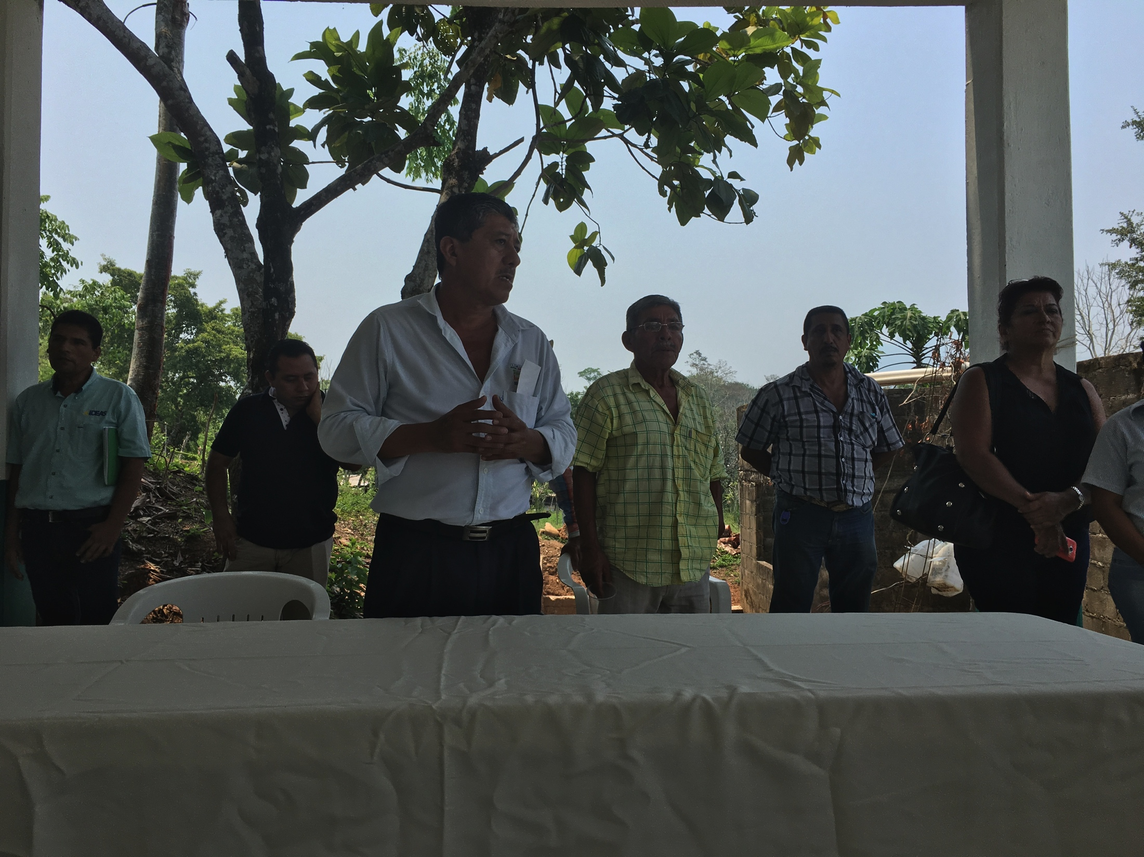
Lessons learned, next steps
Lessons: Include policymakers on research team at proposal stage on, truly ID/TD pubs are hard
Next steps: Publish integrated pubs, policy recommendations
NSF INFEWS, CNH RCN

Slide 14
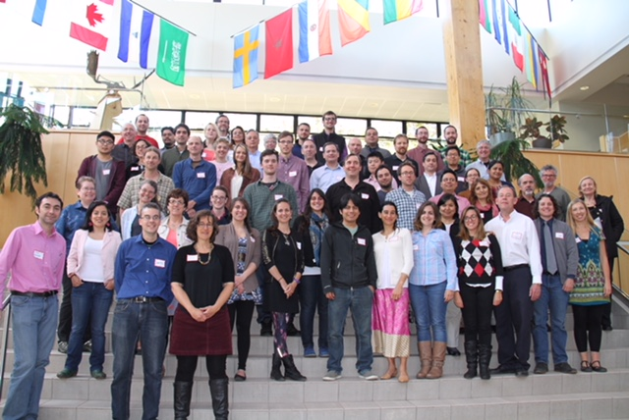
Questions?

