Slide 1



Transferring climate knowledge
in the science-policy interface
for adaptation to drought in Uruguay
IAI CRN3106
Gabriela Cruz
Centro Interdisciplinario de Respuesta al Cambio y Variabilidad Climática y
Facultad Agronomía (UdelaR)

Slide 2
Research Findings
1
The use and the development of climate information have evolved positively in recent decades in Uruguay, resulting in greater adaptation to agricultural droughts than in the past.
This evolution is explained by:
- the creation of specific research groups that address the issue, and by social learning at different levels
- the implementation of public policies for the sector (Ministry of Livestock, Agriculture and Fisheries)

Slide 3
1988-89 | 1999-00 | 2008-09 | 2015
16 months W-S-S | 4 months S-S | 9 months S-S | 7 months S-O-W
1
Perception
Low frequency event
First factor of change
(NW-Small farmers)
Export of live animals
Extention of credit lines
Affected areas are
Prioritized (INIA)
Creation of an Agricultural Emergency Fund (information from INIA-GRAS and DNM)
Declaration of drought agricultural emergency
Food rations available for small farmers
Government
Without a specific
institutional framework
Creation of the
Commission of
Drought
SINAE
Descentralization
(MDR)
Registry of
Family Farmers)
SNRCC
SNIA
INUMET
Pilot test of
insurance
Precipitation deficit
(Fcien)
INIA Proyects
IRI collaboration
CIRCVC
GRAS-INIA (monitoring NDVI, BH)
Climate forecast
Applied research
(UdelaR)
IRI advice to MGAP
(SNIA)
Science

Slide 4
Research Findings
2
The production of useful, relevant and legitimate information is linked to the elaboration process itself
The impact of this type of process is translated into bringing collective learning to a new level (in addition to the information generated)

Slide 5
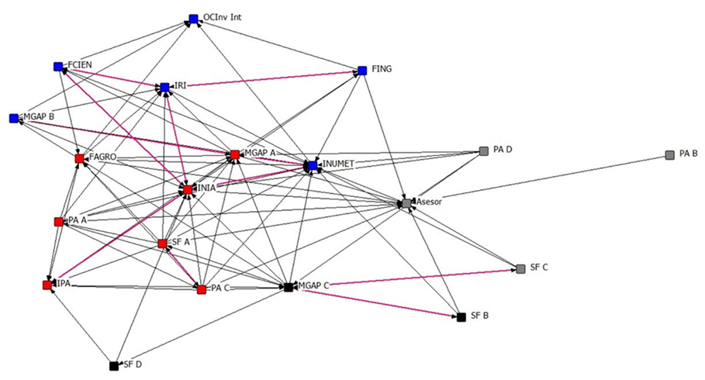
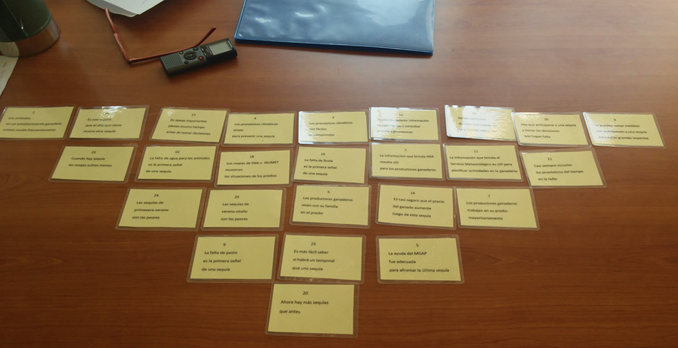
Research Findings
3
For some livestock farmers, their decisions are not well informed by available climate services
Q Methodology
4 profiles were found:
Convinced, Pragmatic, Pessimist and Skeptic
Network

Slide 6
Research Findings
4
There was consensus on taking measures prior to droughts, which is why it is suggested to focus on the development of climate services oriented towards prevention
The context of academic development and the current political will favor the creation and application of climate services for the agricultural sector in Uruguay
NONE OF THE PREVIOUS RESULTS WOULD HAVE BEEN ACHIEVED WITHOUT INTERDISCIPLINARITY

Slide 7
Science – Policy
Actors
Academia
UdelaR, INIA, UNIFESP, UNRC, U. Miami, IRI, UBA
Public Policy
IPA, MGAP, INUMET, SNRCC
Farmers
Rural Organizations, Individual Livestock Farmers
Southeast of Uruguay

Slide 8

Science – Policy
Case1
Academia
Coproduction
+
Public Policy
Thirty years of multi-level processes for adaptation of livestock production to droughts in Uruguay
Cruz, G.; Baethgen, W.; Bartaburu, D.; Bidegain, M.; Giménez, A; Methol, M.; Morales, H.; Picasso, V.; Podesta, G.; Taddei, R.; Terra, R.; Tiscornia, G.; Vinocur, M.

Slide 9
Science – Policy
Case 2
Public Policy
+
Academia
Farmers
Provision of data/information
+
Academia

Slide 10
Posibles impactos a futuro
Case 1: Interinstitutional agreement about the past, to continue adapting to droughts (need to translate and publish in another format)
Case 2: Potential of development of climate services differentiated by regions and by type of user

Slide 11
Oportunities
The context of specific academic development and current policy, favor the creation and application of climate services for the agricultural sector in Uruguay
Contacts and collaborations
Environment for interdisciplinary knowledge creation (Interdisciplinary Space, CIRCVC-UdelaR)

Slide 12
THANK YOU

