Slide 1
Climate Resilient Planning: Interdisciplinary Research to Improve Information Provision for Decision Making (CRN3107)
Anna Muller, PhD
IAI CRN3 Meeting, Cancún, Nov. 29 – Dec. 1, 2017
Notes:
Foto prensalibre Guatemala
Dry corridor gtm
Traditionally dry spells during the year. BUT patterns change and challenge farmers traditional agricultural practices and coping mechanisms. Earlier start or longer dry spells have effects on agricultural production and thus food security of people.

Slide 2
Introduction and Background

Slide 3
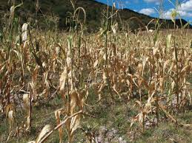
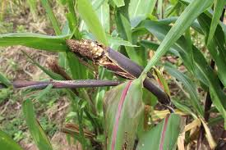
Drought in Guatemala - climatic patterns change
Notes:
There have always been periods of drought in Guatemala. This has been part of the agricultural production cycle. But climatic patterns change – drought starts earlier/later, lasts longer/recovery time shoterns etc. And this challenges traditional coping mechanisms.
In the last drought period in 2015/2016 extended drought severly damage 50-100% of basic grain production.
Acute undernutrition among kids under 5 in Guatemala rose to worrysome levels in the drought prone regions (last time in 2014/2015). Emergency situation: acute undernutrition can lead to death if not treated in time.
But the governmen of Guatemala did not declare an emergency situation. One reason was clearly the political situation (election year…) but also due to missing or bad quality data.

Slide 4
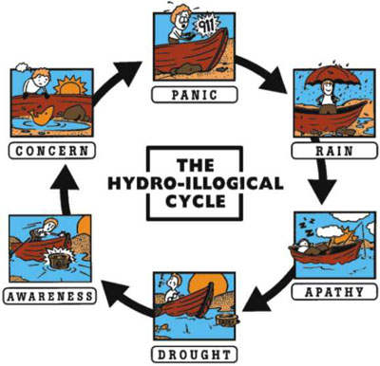
Information availability vs use in public decision making and planning
Source: http://drought.unl.edu/Planning/HydroillogicalCycle.aspx
Notes:
In Guatemala, there is information available on drought and foos security. But it is rarely used for decision making and climate risk managemtn.
In Guatemala, we see a reactive approach to drought and food security management. Nicely described by this hydro-illogical cycle: nothing is done until the sitution is
But in the face of changing climatic patterns: agro-climatic information is critical for breaking this cycle and to improve decision making and emergency respone

Slide 5
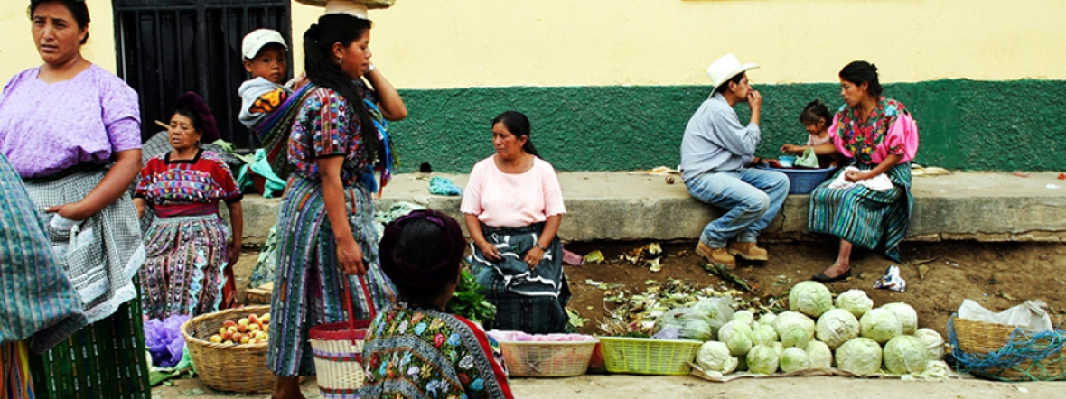
Drought and diversified impacts in the communities
Notes:
Picture: ACF
One of the reasons for not using agro-climatic information in a decision making context is its inadequate scale: most information is available at the country/regional level.
But: Not all communities are affected equally by drought: some experience more damages than others due to micorclimatic patterns, agricultural practices or socioeconomic vulnerability/resilience.
Some experience more undernutrition than others.
So it is not only about having information but having information that allows to see the diversified impact of droughts in the communities to guide response and prevention.
For public and international institutions to intervene in a timely and effectvie manner it is essential to understand which communities or regions are more affected tan others / or will be more affected than others. They need info to decide on where to bring all their resources.

Slide 6
Challenge: bridge the gap between information and decision making
Decision maker (in ministry, NGO, municipalities)
Community
Notes:
Dry corridor (circle)
But most of the relevant decisions are made at the central level (Star). For example budget alllocation, whether to declare an emergency, food aid etc.
So the question is how we can bring the information from the local level to decision makers to improve decision making and planning?

Slide 7
Our approach: focus on “fit” of agro-climatic information, information systems and decision making
Information
Information system
(1)
Understand decision making, decision making context and information needs
(2)
Co-design an information and decision support system by integrating user and decision maker into solution finding process
Decision making
Notes:
In order to bridge this gap, we focus in our work on the fit between information, information sistems and decision making.
For this end we aim to:
Understand the relevant decisions and the decision making context
Understand which information decision maker need to make their decisions
Understand how to present information that it can be understand by stakeholder
Integrate user and decision maker into solution-finding process
Identify bottlenecks to information use and information system uptake

Slide 8
Most relevant scientific results

Slide 9
Understanding institutional planning and preparedness for extreme climatic events (droughts)
What did we do?
Qualitative data collection: semi-structured, stakeholder and key expert interviews to understand annual planning and budget processes in the Ministry of Agriculture (MAGA) and selected municipalities of the dry corridor
Emergency drills to evaluate institutional preparedness for drought response
Secondary data for quantitative analysis of the influences of political parties on fertilizer distribution in Guatemalan municipalities

Slide 10
Understanding institutional planning and preparedness for extreme climatic events (droughts)
Little consideration of agro-climatic information in public planning and budget allocation processes:
Decision making on public planning happens at the central level and does not allow for flexibilities at the local level to plan and react for extreme climatic events
Scepticism against agro-climatic information, especially forecasts, low climate literacy
Data unavailable or not at the necessary scale, quality and time
Little standardized information on local vulnerability and resilience
Political dimension of agro-climatic information: clientelistic vs needs based planning
Low levels of institutional preparedness to respond to extreme climatic events
Drills as a tool to evaluate preparedness to slow-onset events (drought)
Political and institutional context hinders organizational learning processes

Slide 11
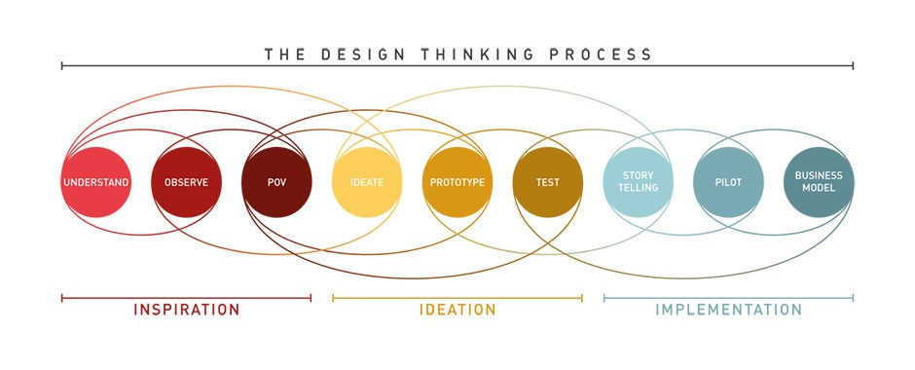
Towards an integrated information and decision support system
What did we do?
Participatory and iterative co-design process
Workshops, expert and stakeholder meetings, survey, choice experiment, qualitative interviews, participatory observation, prototyping and pilot implementation
Source: Interaction Design Foundation
Notes:
https://www.interaction-design.org/literature/article/design-thinking-a-quick-overview

Slide 12
Towards an integrated information and decision support system
Co-design of an information system to guide decision making and bridge the gap between local communities and decision makers
Integration of the system in an existing, institutionalized format: Municipal Councils for Food and Nutrition Security (COMUSAN)
Definition of socioeconomic and agroclimatic indicators to be evaluated on a monthly basis
Tool to analyze data
Web interface connected to Smart-pone data collection tool
Information product for decision makers
Piloting, testing, scaling

Slide 13
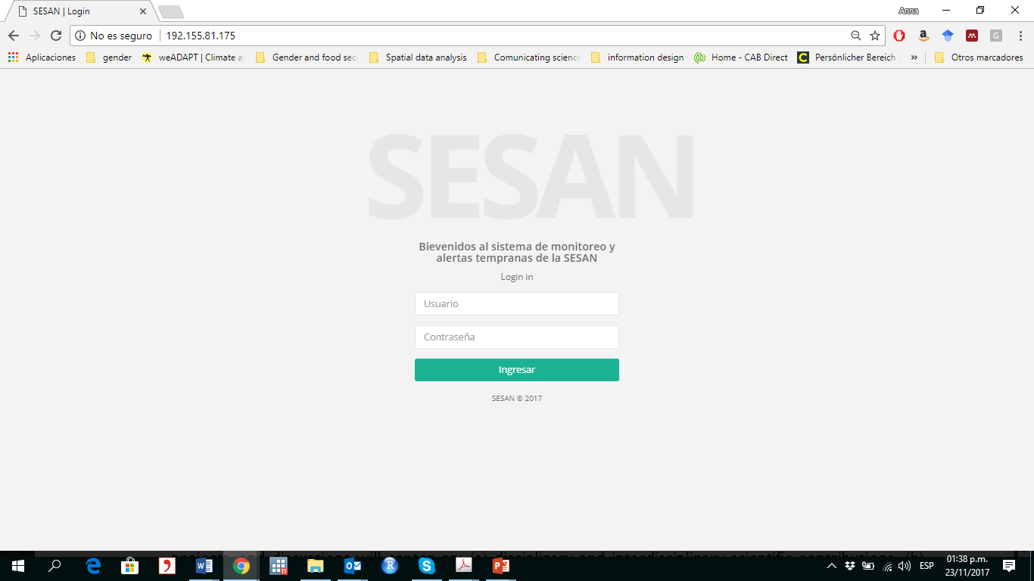
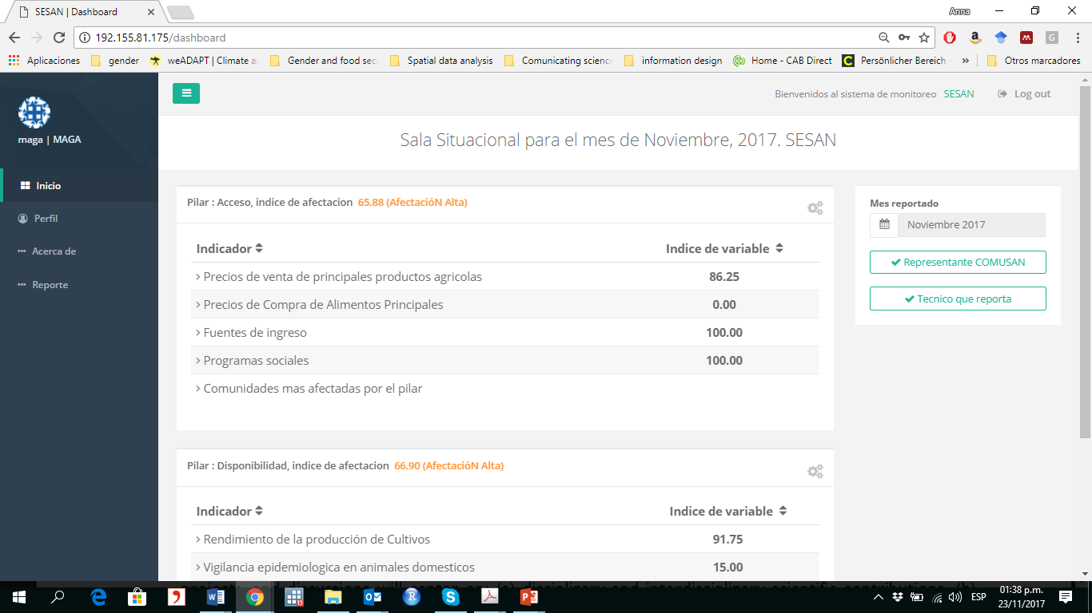
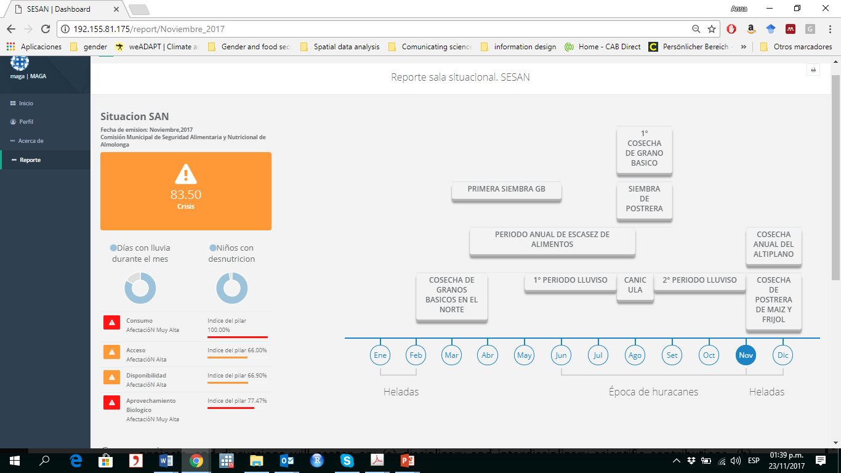

Slide 14
Disciplinarity and Interdisciplinarity

Slide 15
Good data is not automatically used Good data does not necessarily lead to good decisions
IS research and solution finding is only working with an interdisciplinary and multi-stakeholder perspective
Informatics, Information Science, User-Interaction Designer
Information
Information system
Meterology, Climatology, Economics, Agronomy
User Stakeholder
Decision making
Economics, Ethnography, Psychology
Notes:
What is the disciplinary impact and which outcomes wouldnts have been achieved without interdisciplinarity
Finding the fit between information, IS and the decision making context requires involvement of scientists from different disciplines and stakeholders.
Participatory design approaches to increase adoption and use of IS systems
Only if we manage to integrate the disciplines and actors into the system it will be adopted and used

Slide 16
Science-Policy

Slide 17
Science-Policy orientation of the project
Close collaboration with policy actors from the beginning
MAGA, SESAN, CONRED
Different degrees of involvement:
Joint development of research approach (emergency drills with MAGA)
Participant in the research and design process (SESAN, municipal actors, MAGA)
Future implementation and use of products (SESAN)
Integration of development actors (ACH, CATIE)
Benefit from their experience in policy and development work
Strong synergies with CGIAR CCAFS AgroClimas Project
Strengthen the research and policy orientation of the CRN3 project

Slide 18
Challenges…
Method
Participatory design is a purely democratic and open-ended process
Clashes with institutional realities in Guatemala:
hierarchical, democratic instability, short-term planning horizon, value of expert knowledge, avoidance of failure, person-centered leadership

Slide 19
and lessons learnt
Communicate the method from the beginning
method workshop, training etc.
What is the optimal choice of participatory and “traditional” methods
2) Be flexible, patient and persistent
Accept and adapt to institutional and political situation
Engage with strategic partners that support your cause
Notes:
What I would have done differently

Slide 20
Anna Muller
a.muller@cgiar.org
Notes:
THANK YOU/FINAL SLIDE

