Slide 1
Coping with hydrological risk in megacities: Collaborative planning framework for the Mexico City Metropolitan Area (CRN 3108)
Luis A. Bojórquez-Tapia, LANCIS
Hallie Eakin, SOS-ASU
Cancún, México
CRN3 2017
Nov. 29 – Dec. 1

Slide 2
How sustainable Mexico City is?
Science

Slide 3
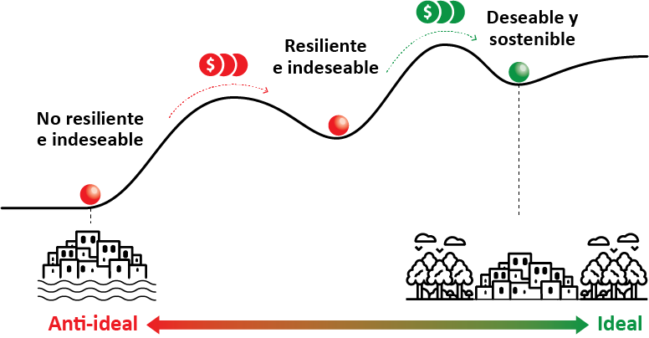
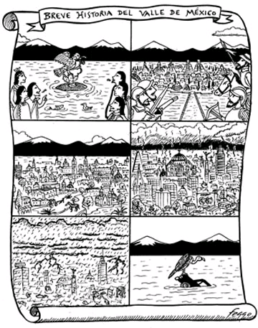
Vulnerability in the Megalopolis
How do interacting climate, land cover, and hydrologic processes in the natural and built environment shape the nature and distribution of hydroclimatic risk in Mexico City?
How do the decisions of social actors – city land and water managers, business owners and residents – endogenously influence vulnerability outcomes in the city?
What is the relative role of exogenous (e.g., climatic change) and endogenous drivers (e.g., land-use decisions) on the state of vulnerability?
How can the MEGADAPT dynamic model of sociohydrological vulnerability serve as a decision tool to evaluate current policy trajectories and future vulnerability outcomes in the city
Fuente: Marco Adrián Ortega Guerrero. Las inundaciones en Chalco, La Jornada, 12 de junio de 2000.

Slide 4
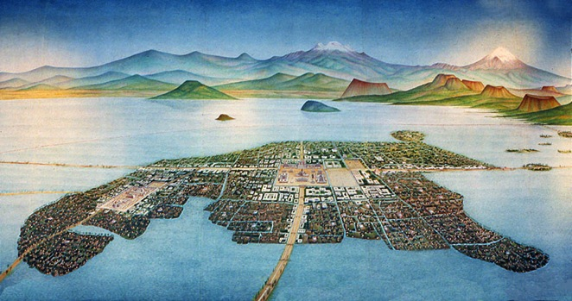

Slide 5
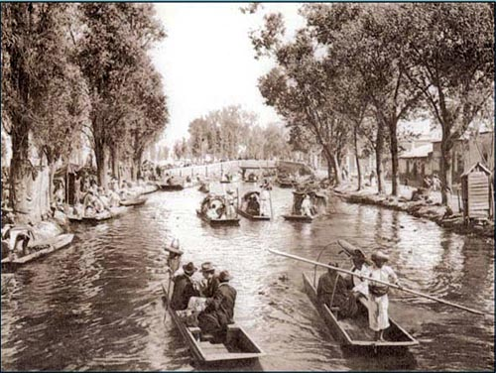
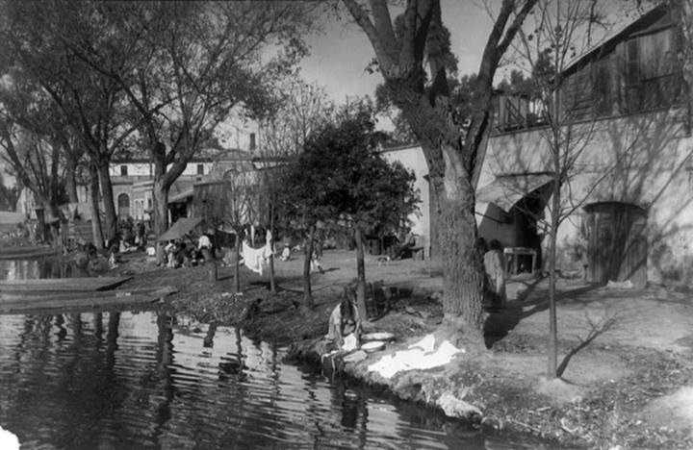
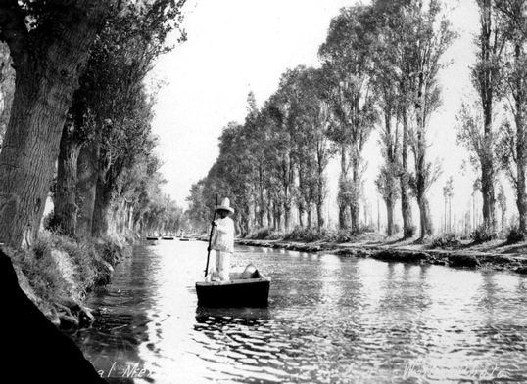
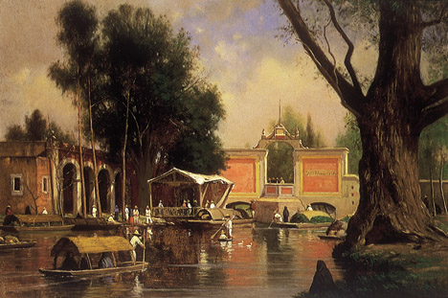

Slide 6
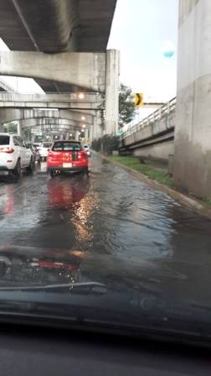
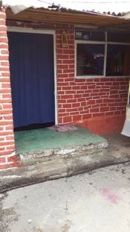
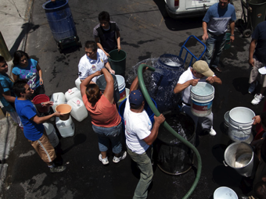
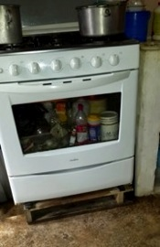
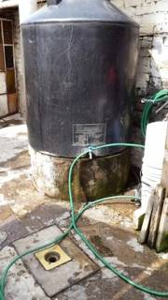
Adaptation & coping

Slide 7
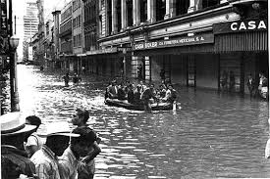
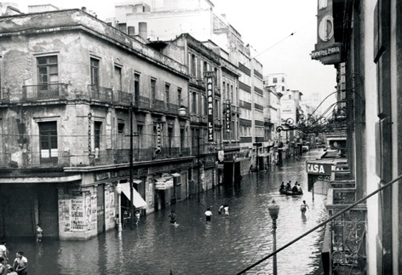
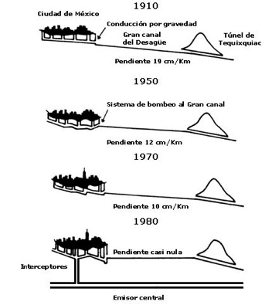
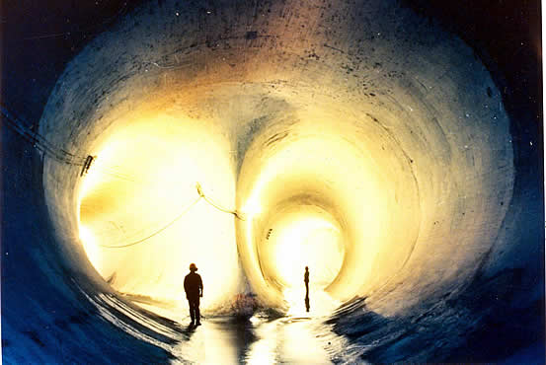

Slide 8
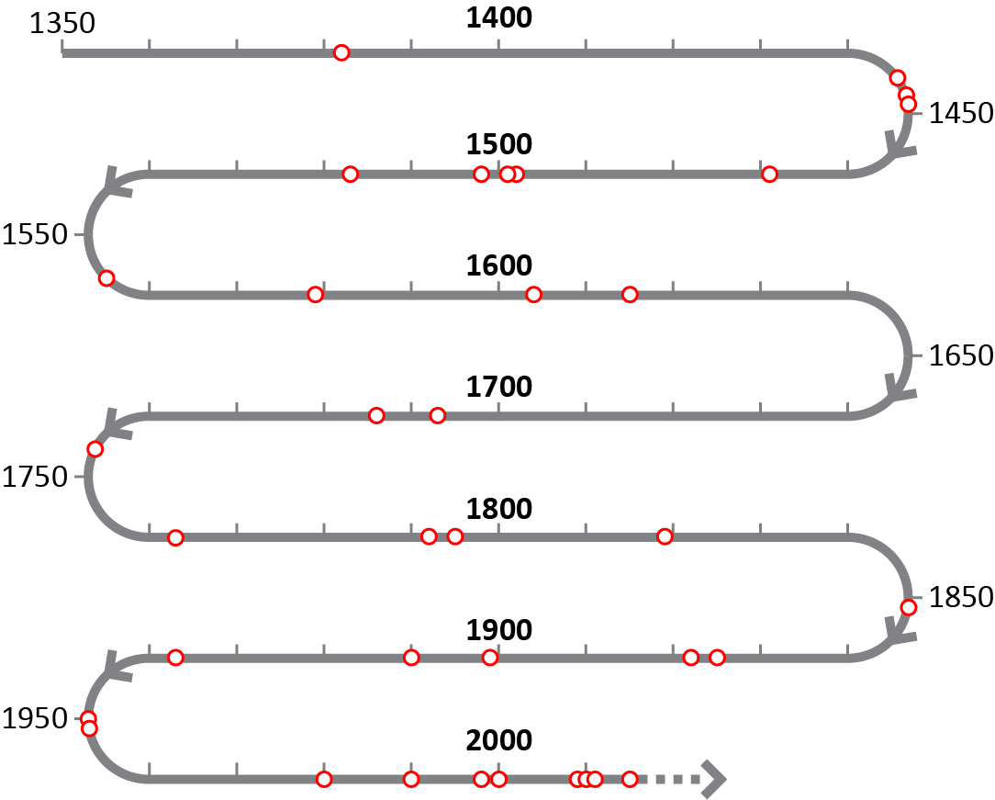
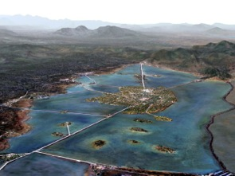
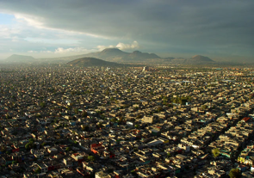
Inundaciones

Slide 9
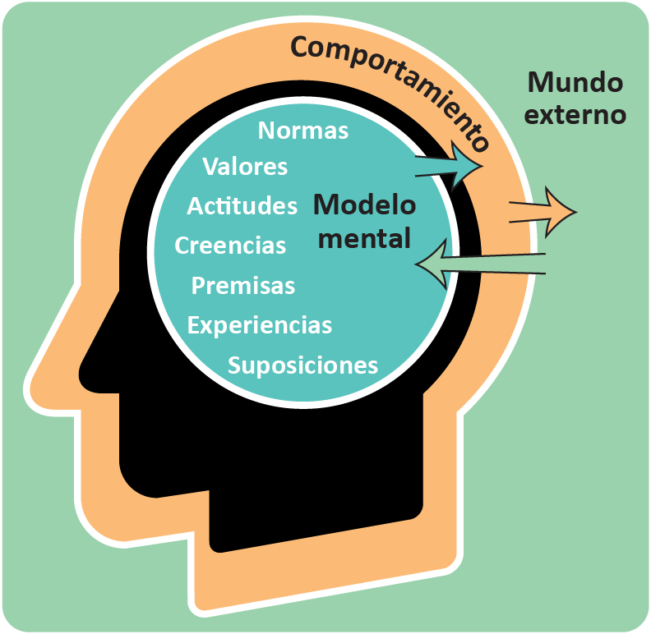
Vulnerability
Emergent property
Socio-political process
Mental models matter
The social and political norms, values,
rules, and relationships that undergird and structure the myriad decisions made by public and private actors— what we call “socio-political infrastructure”—are likely to be as influential in urban vulnerability dynamics as “hard” infrastructure and environmental management.

Slide 10
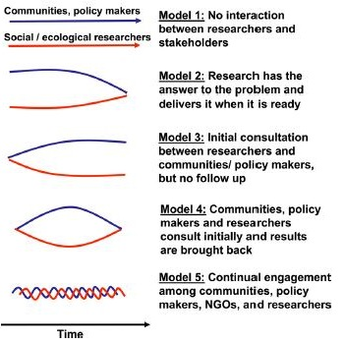
Evolution of collaborative models in sustainability science
Wicked problems
Disagrement
Linguistic imprecision
Boundary work
Boundary-objects
Boundary-spanning
Inconsistent descriptions
Multiple “solutions”
Boundary institutions
Communities of prarctice
Reid, et al., 2009, PNAS

Slide 11
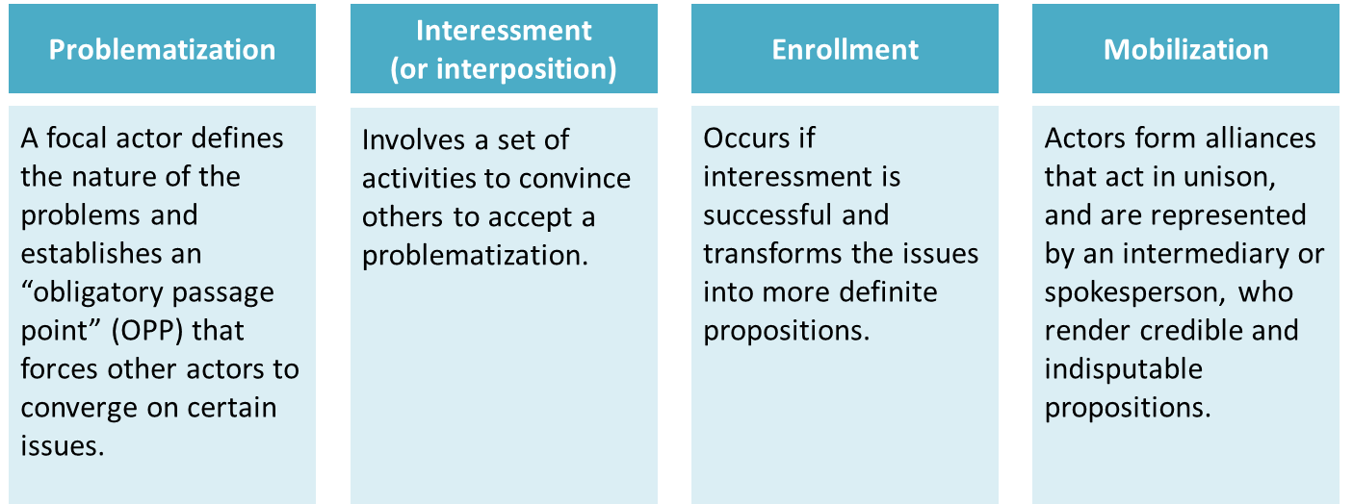
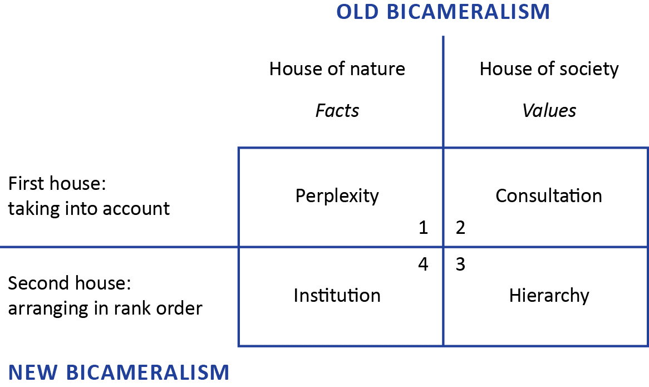
Translation (Callon 1986) & due process (Latour 2006)
Agnosticism: analytical impartiality between actors engaged in controversy
Generalized symmetry: use of an abstract or neutral vocabulary to understand conflicting viewpoints of actors
Free association: repudiation of a priori distinctions between the natural, the social, and the technological

Slide 12
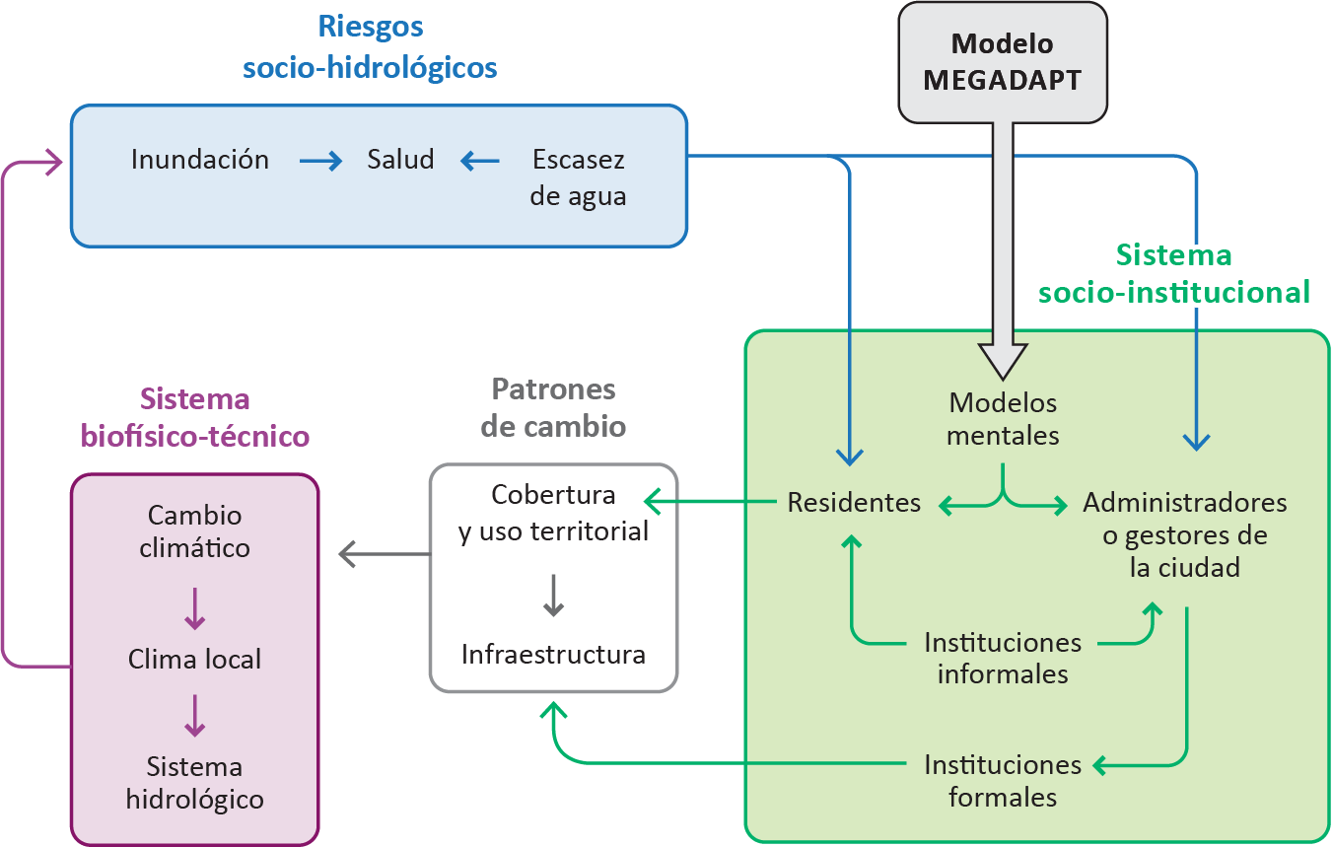
MEGADAPT
Sistemas socio-ecológicos acoplados

Slide 13
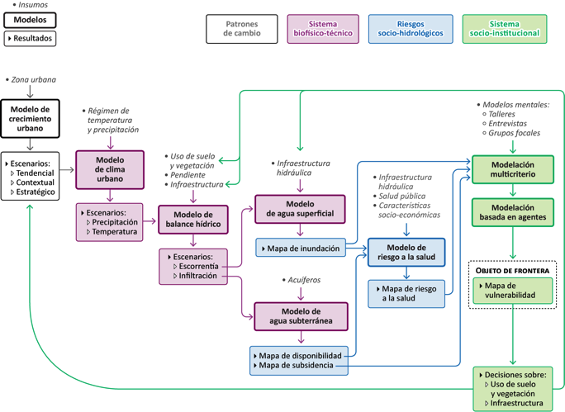
Método

Slide 14
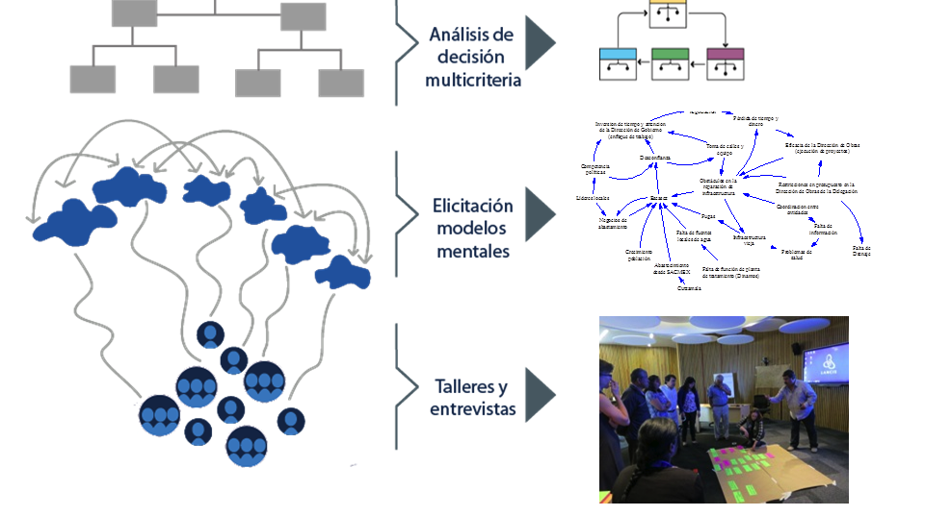
Mental Models
The process
Multicritiria decision analysis
Elicitation of Mental Models
Workshops
Interviews
Focus groups

Slide 15
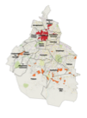
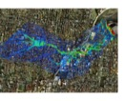
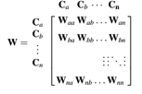
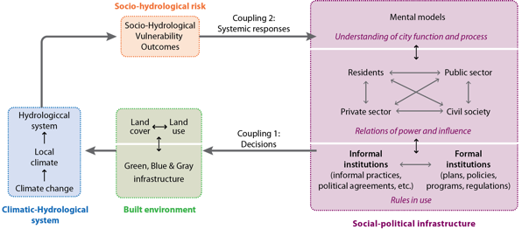
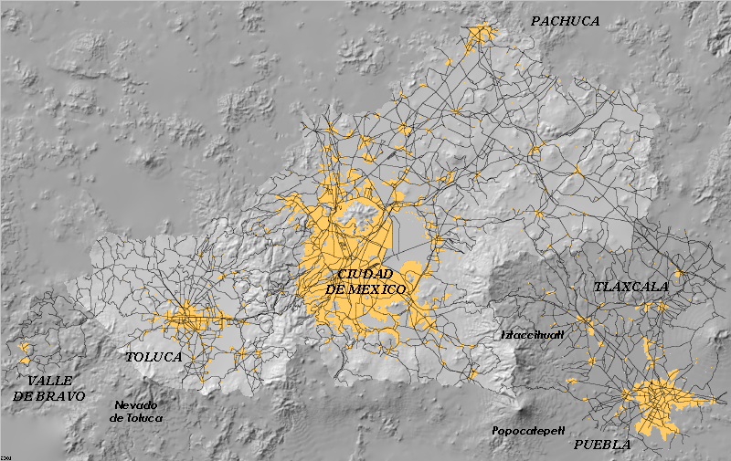
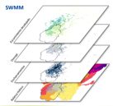
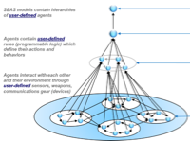
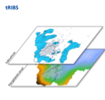
Computational framework

Slide 16
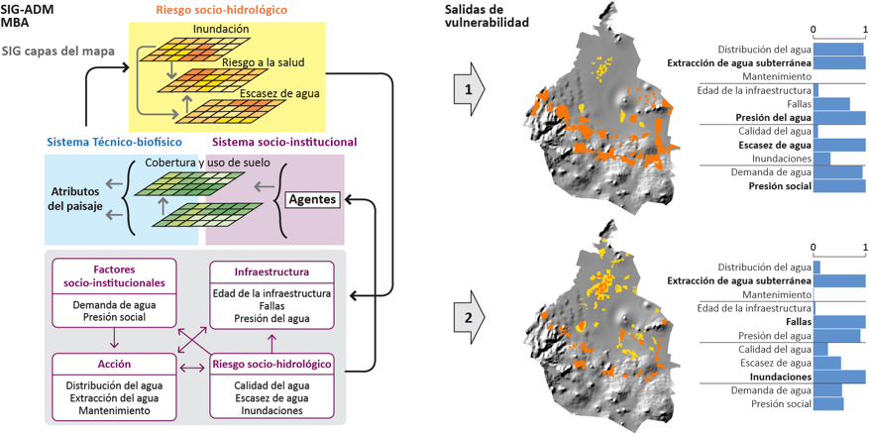
Simulación de vulnerabilidad en la megalópolis

Slide 17
How sustainable Mexico City is?
Science-Policy

Slide 18
Trade-offs
Results

Slide 19
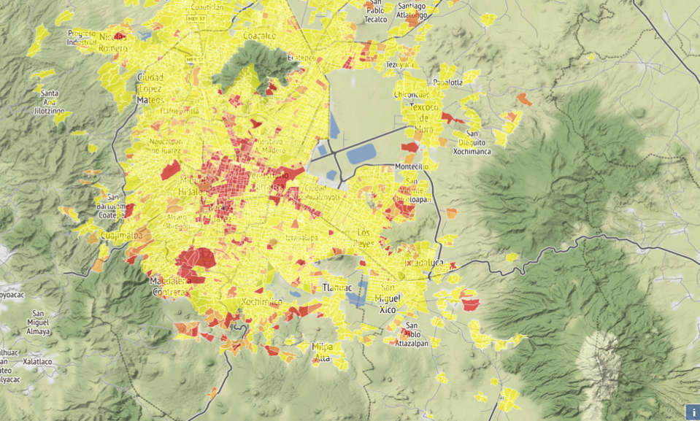
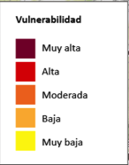
Scenario 1: Lack of infrastructure

Slide 20
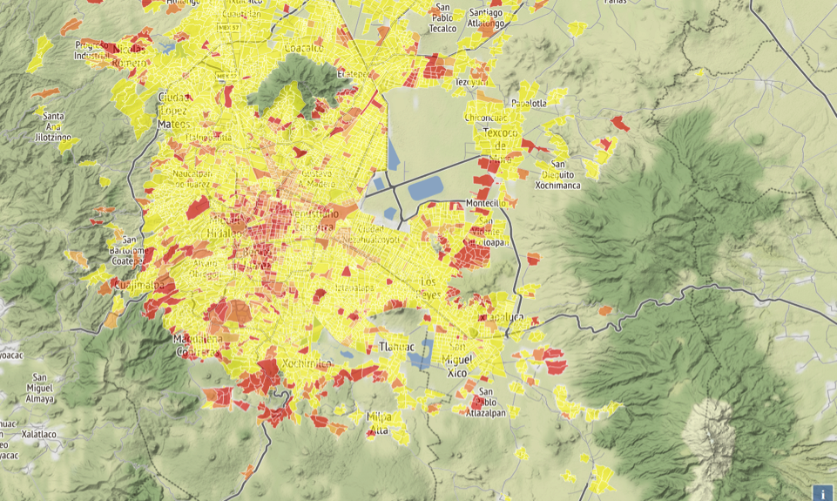
Scenario 2: Repair first

Slide 21
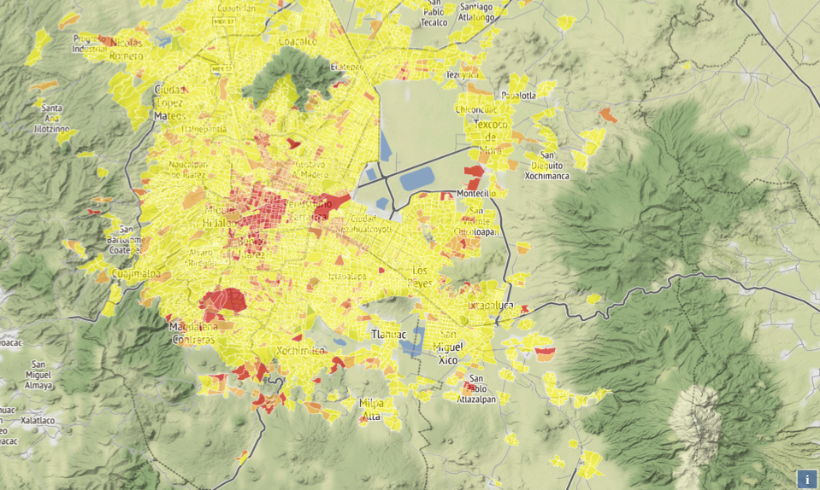
Scenario 3: Squaking wheel

Slide 22
Vulnerabilidad por exposición

Slide 23
Thresholds
Results

Slide 24
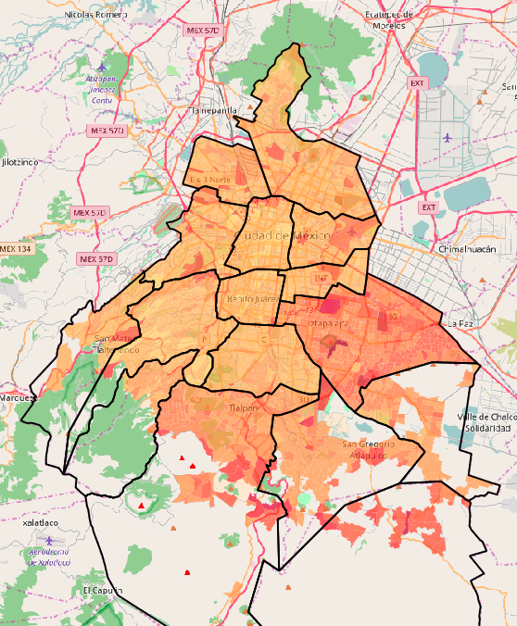
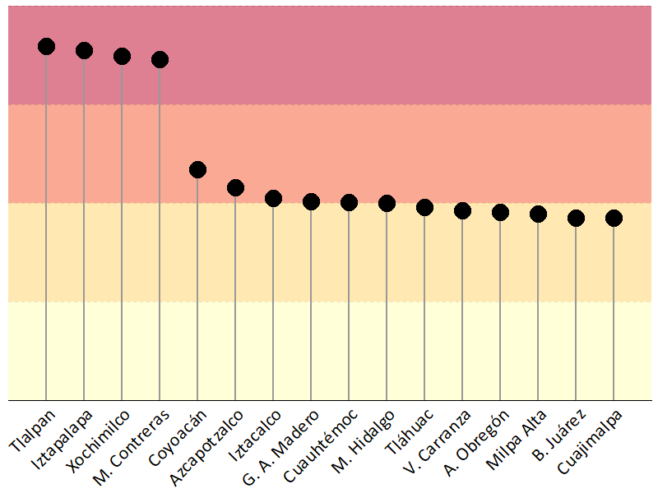
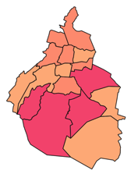
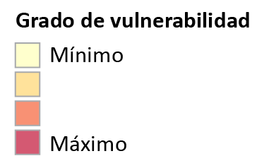
Vulnerabilidad a escasez: Presupuesto mínimo (10% del total de AGEB)

Slide 25
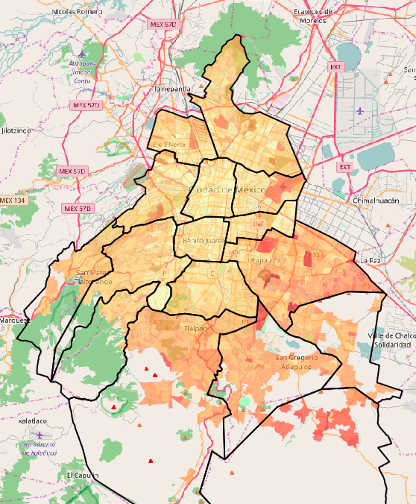
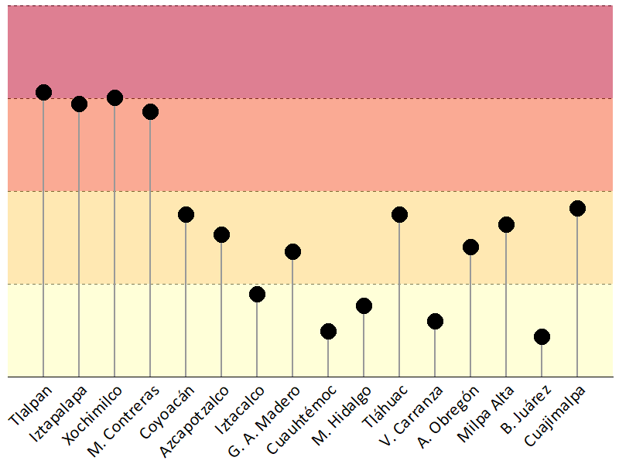
Vulnerabilidad a escasez: Presupuesto bajo (25% del total de AGEB)

Slide 26
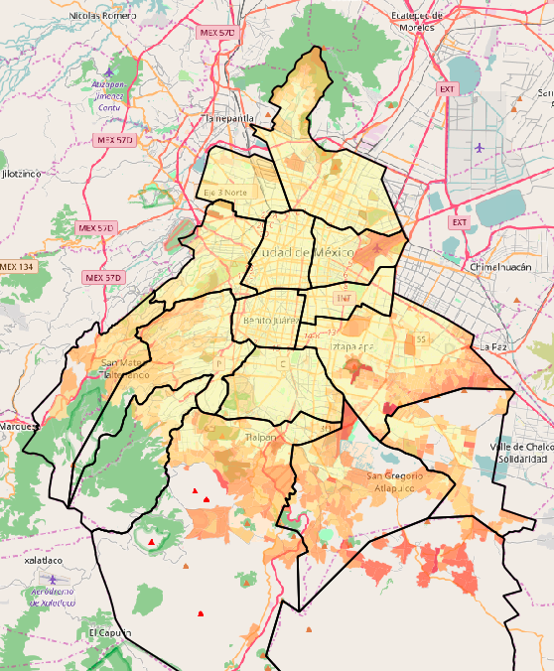
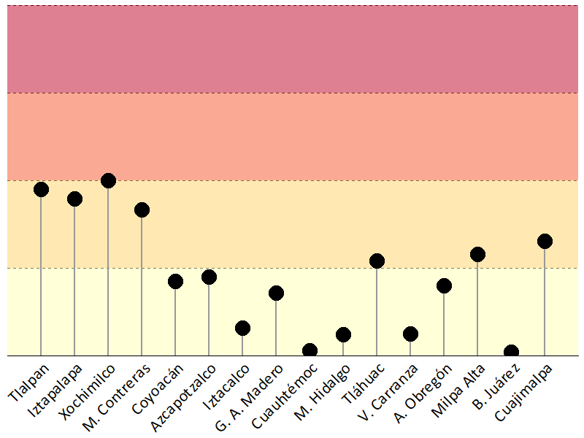
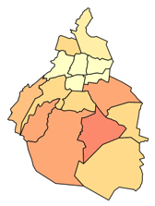
Vulnerabilidad a escasez: Presupuesto alto (50% del total de AGEB)

Slide 27
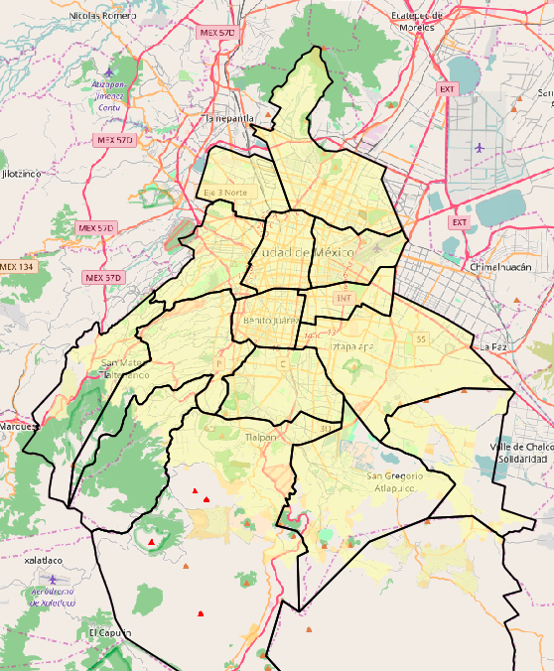
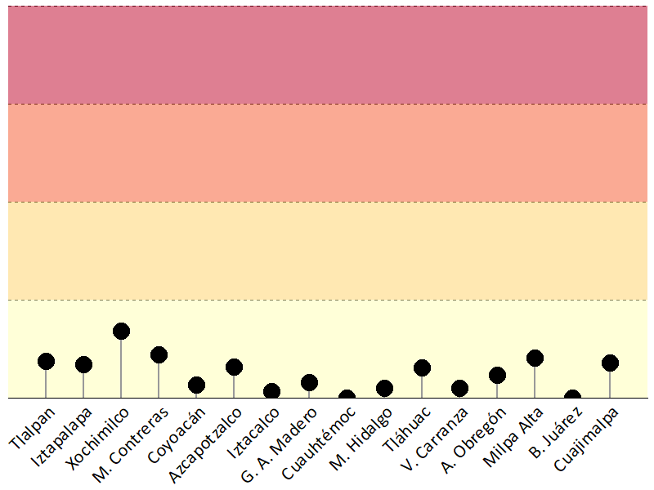
Vulnerabilidad a escasez: Presupuesto máximo (100% del total de AGEB)

Slide 28
Patterns
Results

Slide 29
Riesgo a la salud: Mapa base

Slide 30
Healt risk: Gastrointestinal deseases incidence

Slide 31
Health risk: Pondings and flooding

Slide 32
Health risk: Lack of infrastructure

Slide 33
Transdisciplarity
Final thoughts

Slide 35
Final thoughts: Science and policy
Academic barriers
Willful blindness of disciplinary thought
Boundary work vs. academic work
Transferring costs of participation
Leading edge research vs. policy-making paradox
Transdisciplinary engagement issues
Making the social and political processes that undergird urban risk dynamics tractable and transparent is a political act as much as a research challenge
Results may not be welcome in all spheres of decision making
Increasing burden of managing risk
Urgency of finding more sustainable pathways of urban development
Opportunities for more transparent and democratic decision making

