Slide 1
Module 7: Communicating Global Change
Módulo 7: Comunicación del cambio global
Transdisciplinary Proposal Writing Workshop SGP-HW Taller de formulación de propuestas transdiciplinarias

Slide 2
IAI Communicating Science to Policy Comunicación de la ciencia a las políticas
Why is communication so important?
Why so crucial for the IAI?
¿Por qué es tan importante la comunicación?
¿Por qué es fundamental para el IAI?

Slide 3
The IAI cannot deliver on its mandate without you: our research must guide, drive policy action by IAI´s Parties
Effective external communication can’t happen without effective internal communication
For your work to be relevant to a policy-maker & other stakeholders, your research team needs to have a clear comms plan
El IAI no puede cumplir su mandato sin ustedes: nuestra investigación debe orientar y guiar las políticas de las Partes del IAI
No puede haber comunicación externa efectiva sin una comunicación interna efectiva
Para que su trabajo sea pertinente para los formuladores de políticas y otros actores interesados, el equipo de investigación debe tener un plan de comunicación claro

Slide 4
Connecting people to Science - connecting the dots Conectar a la gente con la ciencia – unir los puntos
Manuel Pulgar-Vidal, former Minister of Environment of Peru and one of the lead negotiators of the Paris Agreement / Exministro del Ambiente de Perú y uno de los principales negociadores del Acuerdo de París || Marcos Regis da Silva, IAI Executive Director / Director Ejecutivo del IAI
Notes:
This is a photo taken at a recent meeting co-organized by the IAI, the UNFCCC (Convention on Climate Change) and the UN Office for South South Cooperation. In this photo, you see Manuel Pulgar-Vidal, former Minister of Environment of Peru, president of the Climate Change COP-20 at COP-21, which adopted the Paris Agreement. He was one of the lead negotiators of the Paris Agreement. To his right, Marcos Regis da Silva, IAI Director. At this meeting, Manuel said in his opening remarks: “We need to connect dots. Currently the most important action is the domestic implementation and for that to happen we need to work with all the multilateral frameworks, with UNFCCC, CBD, the UN General Assembly – to mainstream policy at the national level. Connecting the dots current trend – and that is what is needed for implementation of the Paris Agreement”.

Slide 5
Connecting people to Science - connecting the dots Conectar a la gente con la ciencia – unir los puntos
Six degrees of separation: where do you, your co-PIs, stakeholders, students fit in the [big] picture? You’re the reason behind it.
Seeing the big picture: “Connecting the dots is the new trend!”
Seis grados de separación: ¿dónde se insertan ustedes, sus co-PIs, actores interesados y estudiantes en el panorama [general]? Ustedes son la razón.
Ver todo el panorama: “¡Unir los puntos es la nueva tendencia!”
Notes:
This is a photo taken at a recent meeting co-organized by the IAI, the UNFCCC (Convention on Climate Change) and the UN Office for South South Cooperation. In this photo, you see Manuel Pulgar-Vidal, former Minister of Environment of Peru, president of the Climate Change COP-20 at COP-21, which adopted the Paris Agreement. He was one of the lead negotiators of the Paris Agreement. To his right, Marcos Regis da Silva, IAI Director. At this meeting, Manuel said in his opening remarks: “We need to connect dots. Currently the most important action is the domestic implementation and for that to happen we need to work with all the multilateral frameworks, with UNFCCC, CBD, the UN General Assembly – to mainstream policy at the national level. Connecting the dots current trend – and that is what is needed for implementation of the Paris Agreement”.

Slide 6
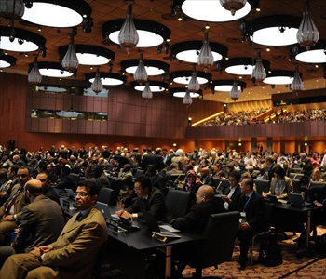
Communications is an important means to an end.
Help the IAI disseminate your work!
La comunicación es un medio importante para lograr un fin.
¡Ayuden al IAI a diseminar vuestro trabajo!
Notes:
The implications of climate change can seem overwhelming. How many of you have been to conferences where scientists talk about impacts, and the audience completely shuts down? Fortunately, there are some ways to navigate communication challenges.

Slide 7
Think of communications NOT as something ELSE
that you need to do BUT a powerful tool to make your voice heard!
What’s your strategy to communicate your work so that they can understand you clearly and act?
NO piensen en la comunicación como UNA COSA MÁS que deben hacer, SINO como una herramienta poderosa para hacer oír vuestras voces!
¿Qué estrategia tienen para comunicar vuestro trabajo para que otros puedan entenderlos claramente y actuar?
Notes:
The implications of climate change can seem overwhelming. How many of you have been to conferences where scientists talk about impacts, and the audience completely shuts down? Fortunately, there are some ways to navigate communication challenges.

Slide 8
Raising Awareness and Outreach La visibilización y la difusión
Raising awareness of the research is an important part of the comms effort
IAI’s Comms Strategic Plan: aims to communicate messages with like-minded organizations, coordinating news and use of social media to amplify messages with partners (joint press releases, joint side-events have proven to be a successful outreach practice)
Dar a conocer la investigación es una parte importante del esfuerzo de la comunicación
Plan de comunicación estratégica del IAI: tiene por objeto la comunicación de mensajes con organizaciones afines mediante el uso coordinado de las redes sociales para amplificar los mensajes de los socios (los comunicados de prensa y eventos paralelos conjuntos han resultado una práctica exitosa de difusión)

Slide 9
Raising Awareness and Outreach La visibilización y la difusión
Comms messages should support, link to regional & international agendas - specially the 2030 Agenda, SDGs
Timing & relevance: timely communication of research content should aim to link to current news
Los mensajes deben contemplar, la conexión con las agendas regionales e internacionales – en particular, la Agenda 2030, ODS
Tiempos & relevancia: la comunicación oportuna de la investigación debe orientarse a vincularse con las noticias actuales

Slide 10
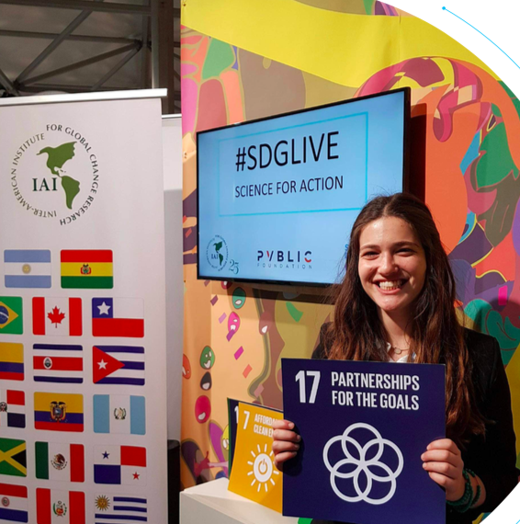
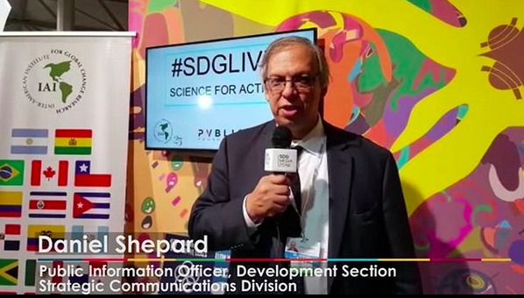
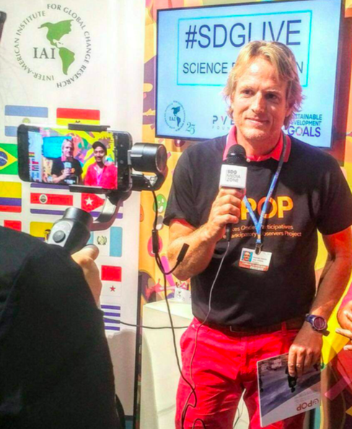
Hashtags, Campaigns & Branding Etiquetas, campañas y creación de marca
Hashtags, social media campaigns & branding will raise awareness of global change issues affecting people in the region (IAI’s #ScienceforAction social media campaign)
Los hashtags, las campañas en las redes sociales y la creación de marca ayudan a crear conciencia sobre los problemas del cambio global que afectan a los habitantes de la región (campaña del IAI en redes sociales #ScienceforAction)

Slide 11
Hashtags, Campaigns & Branding Etiquetas, campañas y creación de marca
Generating visibility & awareness: IAI collaborated with Project Everyone (2015). Video messages from scientists on the relevance of their research to the SDGs celebrated the adoption of the 2030 Agenda
In 2017, the IAI, Pvblic Foundation & SDG Media Zone at the UNFCCC COP-23, interviews on climate change comms:
2.5 million impressions on Twitter after just 5 days
Comms can create engagement and spur action!
Aumentar la visibilidad y la conciencia: El IAI colaboró con Project Everyone (2015). A través de Los científicos grabaron mensajes en video acerca de la relevancia de su trabajo para los ODS los científicos celebraron la adopción de la Agenda 2030
En 2017, el IAI, la Fundación Pvblic & SDG Media Zone en la COP-23 de la CMNUCC, entrevistas sobre comunicación del cambio climático:
2,5 millones de impresiones en Twitter en solo 5 días
¡La comunicación puede generar compromiso e incentivar a la acción!

Slide 12
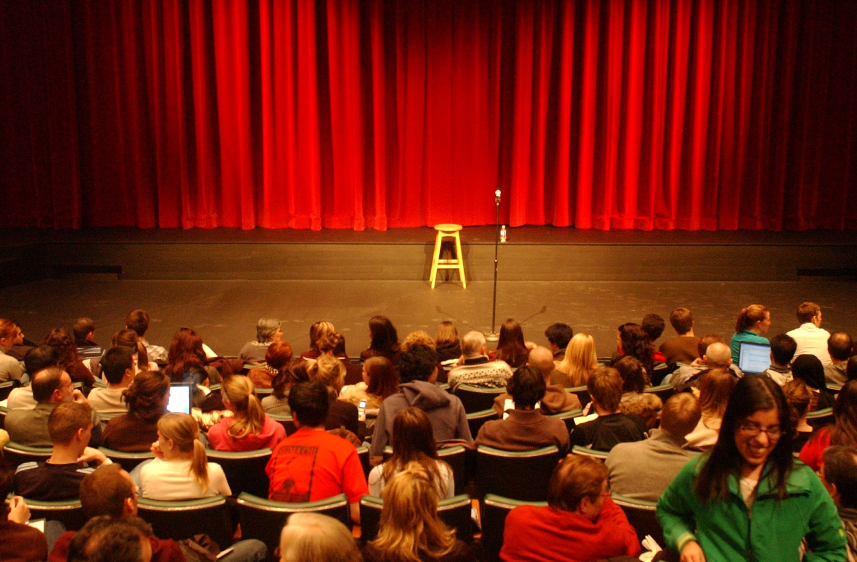
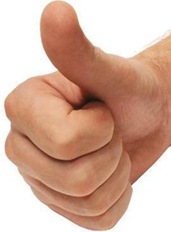
Communicating Global Change Best Practices
Buenas prácticas de comunicación del cambio global

Slide 13
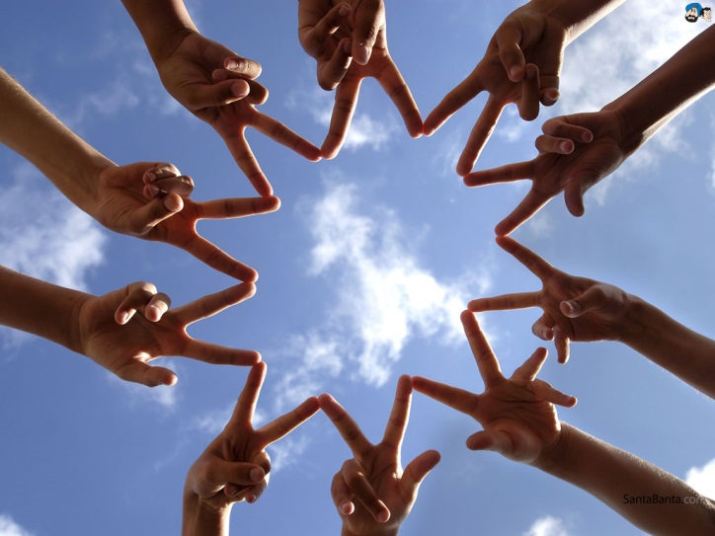
Distilling your Message Depurar el mensaje
Connect with Your Audience
What is their background?
Know your goal!
Conéctate con tu público
¿De qué ámbito provienen?
¡Conoce tu objetivo!
Notes:
I am going to provide you with some top tips for effective communication about climate smart conservation…
One of the first goals that you need to do is connect with your audience. Before you go into a meeting or meeting one on one…know your background – who are the people you are meeting – do you think they are going to be with you on your issue or oppose you. Convey the facts while also emphasizing shared cultural values to each unique audience, and think about/use someone who would be the most effective messenger for that audience (an avid angler, for example, in a forum for sportsmen).
What is you goal? Is it to get them to comprehend something or to accept something that you are doing? Balance urgency with hope. Address head-on the urgency and scientific basis for addressing climate change impacts on wildlife, habitat, and ecosystems coupled with the hope provided by climate-smart conservation actions for nature and people. But it is also important to talk about the fact that we can minimize the impacts through mitigation.
Junk the jargon. Translate confusing technical scientific jargon to easily communicated and remembered words and phrases.
In some cases the jargon problem is deceptively hard to address because we are not even aware that the words we are using might be misunderstood. For example, when scientists talk about “uncertainty” in terms of climate, the public thinks “ignorance”. Perhaps a better word for some audiences would be “range.” We are briefly going to practice on the next slide.
Richard Feynman was American theoretical physicist (1918-1988). Assisted in building the atomic bomb, quantanum electrodynamics, and cut to the heart of the challenger example.
Greatest communicator in the history of science. His contributions place him among the most influential scientists of the 20th century. Dubbed ‘The Great Explainer’, Feynman was able to convey complex ideas to both scientists and non-scientists with equal clarity.

Slide 14
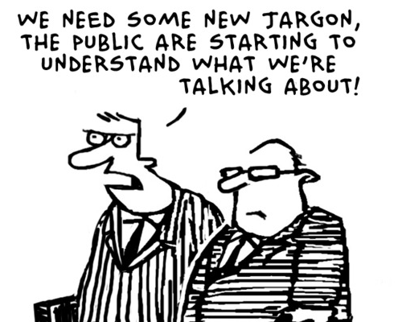
Distilling your Message Depurar el mensaje
Junk the Jargon / Desecha la jerga
Explain technical terms / Explica los términos técnicos
“If you can’t explain something to a six-year old,
You really don’t understand it yourself”
-Attributed to Richard Feynman
“Si no puedes explicarlo de forma sencilla, es que no lo has entendido”, atribuido a Richard Feynman
Necesitamos una jerga nueva. El público está empezando a entender lo que decimos
Notes:
I am going to provide you with some top tips for effective communication about climate smart conservation…
One of the first goals that you need to do is connect with your audience. Before you go into a meeting or meeting one on one…know your background – who are the people you are meeting – do you think they are going to be with you on your issue or oppose you. Convey the facts while also emphasizing shared cultural values to each unique audience, and think about/use someone who would be the most effective messenger for that audience (an avid angler, for example, in a forum for sportsmen).
What is you goal? Is it to get them to comprehend something or to accept something that you are doing? Balance urgency with hope. Address head-on the urgency and scientific basis for addressing climate change impacts on wildlife, habitat, and ecosystems coupled with the hope provided by climate-smart conservation actions for nature and people. But it is also important to talk about the fact that we can minimize the impacts through mitigation.
Junk the jargon. Translate confusing technical scientific jargon to easily communicated and remembered words and phrases.
In some cases the jargon problem is deceptively hard to address because we are not even aware that the words we are using might be misunderstood. For example, when scientists talk about “uncertainty” in terms of climate, the public thinks “ignorance”. Perhaps a better word for some audiences would be “range.” We are briefly going to practice on the next slide.
Richard Feynman was American theoretical physicist (1918-1988). Assisted in building the atomic bomb, quantanum electrodynamics, and cut to the heart of the challenger example.
Greatest communicator in the history of science. His contributions place him among the most influential scientists of the 20th century. Dubbed ‘The Great Explainer’, Feynman was able to convey complex ideas to both scientists and non-scientists with equal clarity.

Slide 15
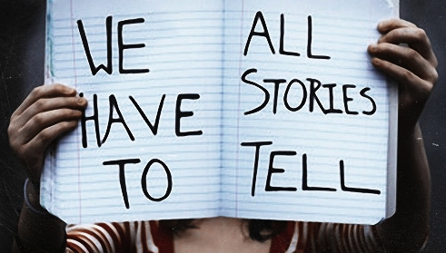
Distilling your Message Depurar el mensaje
Tell a story
Make it personal, local, timely.
Emphasize preparedness, risk reduction, healthy future
Use your examples
SO WHAT?
Cuenta una historia
Que sea personal, local, oportuna.
Pon énfasis en la preparación, la reducción de riesgos, un futuro saludable
Emplea ejemplos propios
¿POR QUÉ ES IMPORTANTE?
Notes:
5. Make it personal, local, and timely. Use local examples and storytelling to help your audience connect the dots between their own experiences, climate change, and response strategies.
Emphasize preparedness, risk reduction, healthy future - Capitalize on concerns about hazards, which are already a part of life
(Patty can tell a quick story about the Birdwatcher’s Guide and her mom).
Patty, one of the instructors, has a wonderful story about her mom. At one time, her mom did not believe in climate change. She was a backyard birder and was noticing that certain birds did not come to her feeder anymore. Patty talked to her mom about shifting bird ranges and migrations and this connected the dots for her mother.

Slide 16
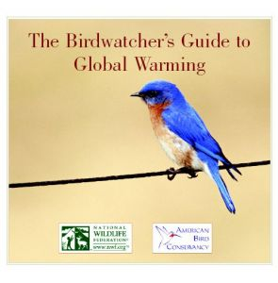
Distilling your Message Depurar el mensaje
Know when to elicit emotion…
Emotion is useful but be careful not to overdo it.
Saber cuándo apelar a las emociones…
Las emociones son recordables, pero evita exagerar.
Notes:
5. Make it personal, local, and timely. Use local examples and storytelling to help your audience connect the dots between their own experiences, climate change, and response strategies.
Emphasize preparedness, risk reduction, healthy future - Capitalize on concerns about hazards, which are already a part of life
(Patty can tell a quick story about the Birdwatcher’s Guide and her mom).
Patty, one of the instructors, has a wonderful story about her mom. At one time, her mom did not believe in climate change. She was a backyard birder and was noticing that certain birds did not come to her feeder anymore. Patty talked to her mom about shifting bird ranges and migrations and this connected the dots for her mother.

Slide 17
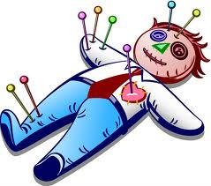
Distilling your Message Depurar el mensaje
The Curse of Knowledge
When you know something very well, it becomes hard to imagine what the world looks like to someone that doesn’t know it.
La maldición del conocimiento
Cuando conoces bien un tema, resulta difícil imaginar cómo ve el mundo alguien que lo ignora.
Notes:
Self explanatory

Slide 18
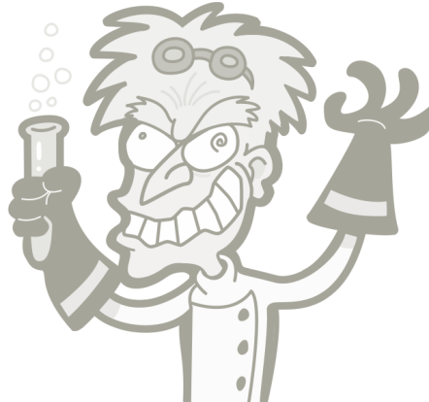
Scientist vs. Public Distillation Differences / Diferencias de depuración
Background
Antecedentes
Bottom
Line
Conclusión
Supporting Details
Detalles complementarios
Results
Conclusion
Resultados
Conclusión
So What?
¿Por qué es importante?
Supporting Details
Detalles complementarios
Somerville and Hassol. Phys. Today 64(10), 48 (2011); doi: 10.1063/PT.3.1296
Notes:
Most scientist see things differently than the general public. We are usually taught to give the background first, then the supporting details, moving on to results and conclusion. The problem in doing it this way is that you have lost 80% of the people before you even left background! Most of the public want to hear …bottom line first. Then what does this mean for me!! Who cares – then you can talk about the supporting details.

Slide 19
Class Discussion Discusión
Junk the Jargon Desecha la jerga
Can you think of a “better” way to frame the following scientific terms?
Piensa formas “mejores” de formular los siguientes términos científicos
Scientific Term Término científico | What the Public Thinks Qué piensa el público | Better Choice? ¿Opción mejor?
Positive feedback Retroalimentación positiva | Good response, praise Buena respuesta, elogio
Enhance Fortalecer/intensificar | Improve Mejorar
Bias Sesgo | Distortion, political motive Distorsión, motivación política
Notes:
Other examples – have participants try to come up with alternatives (below are examples).
Positive feedback = Vicious cycle
Enhance = Intensify, increase
Bias = Offset from an observation

Slide 20
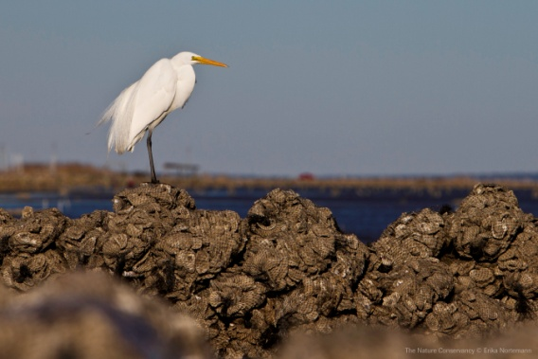
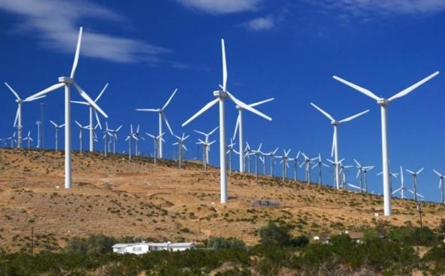
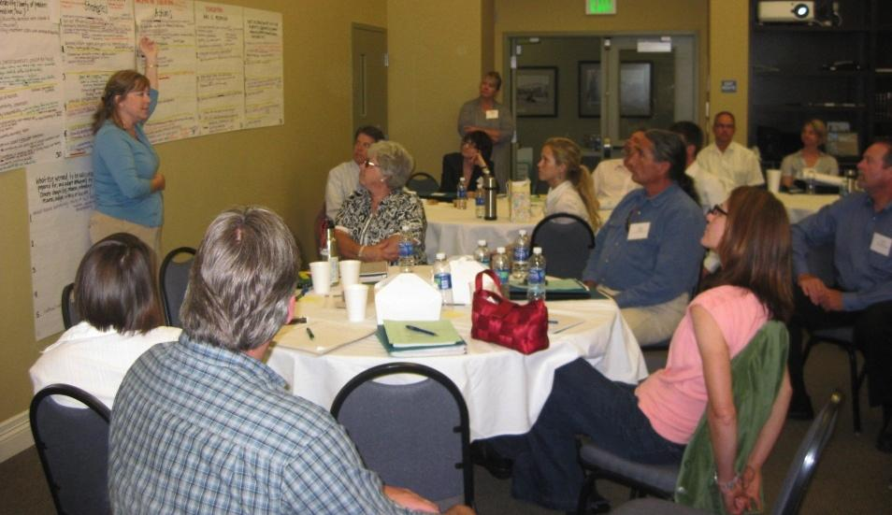
Climate Change Communication Comunicación del cambio global
Balance urgency and hope
Highlight solutions
Balance entre urgencia y esperanza
Poner de relieve las soluciones
Tailor communications to your audiences
Adecuar la comunicación a la audiencia
Convey facts while emphasizing shared cultural values to each unique audience
Comunicar hechos al tiempo que se enfatizan los valores culturales comunes a cada audiencia
Notes:
I am going to provide you with some top tips for effective communication about climate smart conservation.
Balance urgency with hope. Address head-on the urgency and scientific basis for addressing climate change impacts on wildlife, habitat, and ecosystems coupled with the hope provided by climate-smart conservation actions for nature and people. But it is also important to talk about the fact that we can minimize the impacts through mitigation.
Tailor communications to your audience. Convey the facts while also emphasizing shared cultural values to each unique audience, and think about/use someone who would be the most effective messenger for that audience (an avid angler, for example, in a forum for sportsmen).

Slide 21
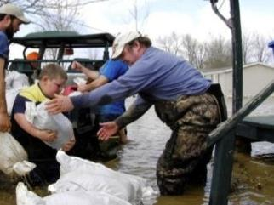
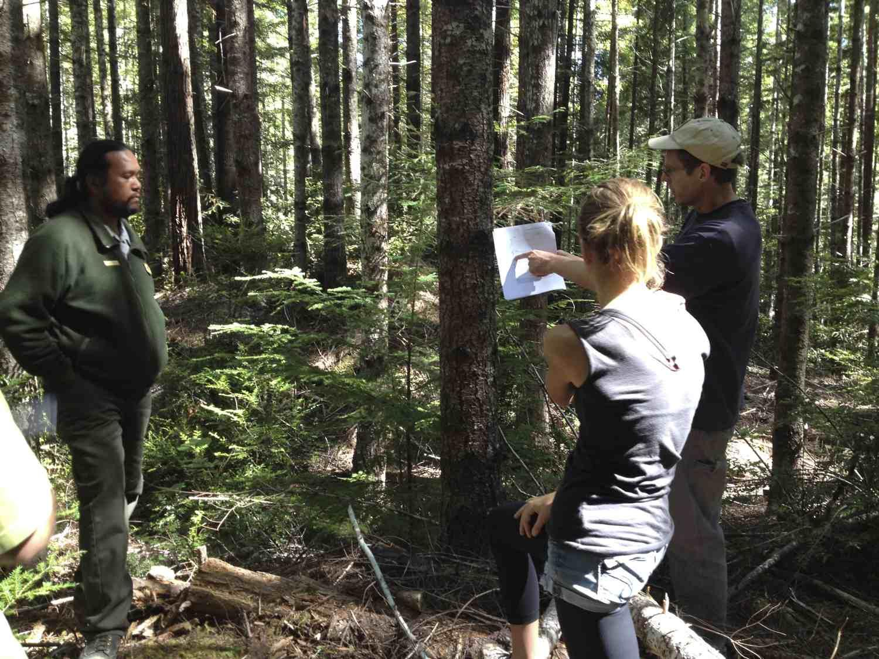
Climate Change Communication Comunicación del cambio global
Emphasize preparedness, risk reduction, healthy future
Address concerns about hazards, which are already a part of life
Poner énfasis en la preparación, la reducción de riesgos, futuro saludable
Responde a las preocupaciones por los peligros, que son parte de la vida
Notes:
3. Emphasize preparedness, risk reduction and a healthy future. Emphasizing being prepared as a means of reducing future risks and costs and the potential for securing a healthier future based on the climate-smart actions we take today.
4. Build on conservation expertise. Empower conservation professionals to make a difference by building on their past experience in managing natural resources while trying new climate-smart approaches.

Slide 22
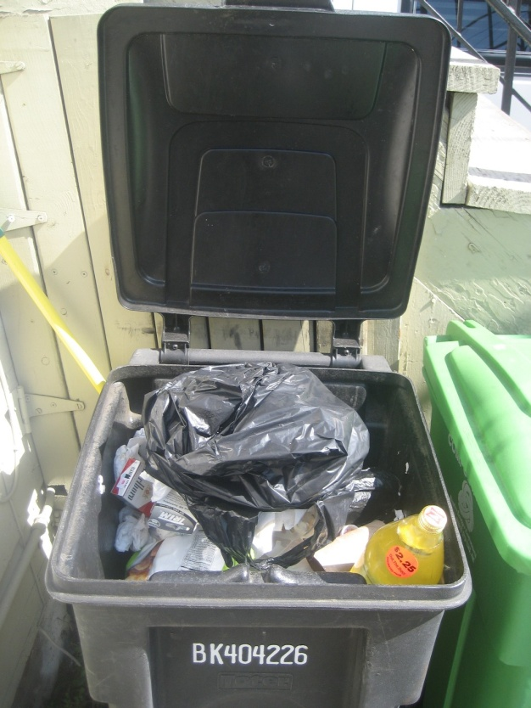
Climate Change Communication Comunicación del cambio global
Make it personal, local, and timely
Mensaje personal, local y oportuno
Junk the jargon
When scientists say “uncertainty,” the public thinks “ignorance.” Perhaps use “range” instead
Desecha la jerga
Cuando un científico dice “incertidumbre”, el público the public piensa “ignorancia.” Podría en cambio decir “rango”
J
A
R
N
G
O
Notes:
5. Make it personal, local, and timely. Use local examples and storytelling to help your audience connect the dots between their own experiences, climate change, and response strategies. (Patty can tell a quick story about the Birdwatcher’s Guide and her mom).
6. Junk the jargon. Translate confusing technical scientific jargon to easily communicated and remembered words and phrases.
In some cases the jargon problem is deceptively hard to address because we are not even aware that the words we are using might be misunderstood. For example, when scientists talk about “uncertainty” in terms of climate, the public thinks “ignorance”. Perhaps a better word for some audiences would be “range.”

Slide 23
Questions? ¿Preguntas?

