Slide 1
IAI Directorate Report to the Executive Council – 54
Capacity Building Report
15 November 2022 - Montevideo, Uruguay and Videoconference
Marcella Ohira, Deputy Executive Director & Director for Capacity Building
Kim Portmess, STeP Program Consultant, Manager
Anne-Teresa Birthright, IAI STeP Fellow (Science Diplomacy)

Slide 2
Science Diplomacy Center
Decision of the IAI Conference of the Parties: XXX/9. The Directorate is instructed to establish a steering committee, with the participation of Parties, the SAC and the SPAC, Associates, and experts on science diplomacy, to assist in and advise on the design and development of the IAI Science Diplomacy Center (SDC) and its programs and activities.
Science Diplomacy Advisory Board: 11 members, consisting of professionals from the Americas and abroad, including IAI Parties (Brazil, Chile, Costa Rica, USA), SAC/SPAC (2), science diplomacy experts, and representatives from policy, academia, and the private sector.
First in-person meeting of the SDC Advisory Board. (11-13 Nov. 2022)
Discussed the Vision, Mission, and Initial Ideas for SDC Implementation Plan for next 3 years.
Regional priority topics, Capacity Building programs/activities, Audience, Potential Impact, Visibility;
Funding strategy to secure resources for the Center’s short, medium and long-term sustainability;
Strengthen current and future partnerships and collaborations with other key national and international organizations to support the SDC visibility and its programs.

Slide 3
Science Diplomacy Center
Vision: The Science Diplomacy Center shall contribute to the maintenance of a peaceful and sustainable Americas through innovative transdisciplinary collaborations to address the region’s shared challenges and safeguard the livelihoods and well-being of future generations and the planet.
Mission: The Center shall enhance the capacity of Parties to meet the objectives of the IAI Strategic Plan and the Sustainable Development Goals by developing a science diplomacy knowledge hub and open, just, and equitable programs and activities for the Americas to meet the challenges of global change.
Goals: related to science in diplomacy
Strengthen the interface between science and policy
Build and sustain capacity
a. Offer regional training
b. Identify and foster a skill set necessary to develop an effective science diplomacy community
Develop a science diplomacy knowledge hub
a. Provision of SD information
Convene relevant communities
Raise awareness of current and emerging global change issues
Facilitate regional and international collaboration
Foster strategic communication
Promote open, just, and equitable science
Facilitate inclusion of traditional knowledge, Indigenous Peoples, and local communities with prior and informed consent

Slide 4
Science Diplomacy Center
SDC: Submission of an Implementation Plan to CoP XXXI (June 2023)
The Americas Science Diplomacy Initiative (ASDI) consortium (University of São Paulo-USP/Sci-Tech DiploHub) is developing training materials on science diplomacy related to Global Change in the Americas.
Other Regional Initiatives and Fundraising:
Consultancy funded by the Wellcome Trust: Latin America and the Caribbean Regional Landscape and Opportunities Analysis (October 2022-March2023)
Positions the IAI to coordinate future activities in the region in service to the Parties.
Improve IAI’s visibility with funders (i.e. Wellcome Trust) to establish programmatic and financial partnerships.
Strengthen IAI’s role in field of climate and health (including mental health).

Slide 5
Capacity Building Update
Special issue to increase knowledge transfer in the Americas. Open capacity building opportunity for early career scientists and policy makers including policy brief writing workshop and training webinars for prospective authors.
STeP Fellows receive communication training and eight science diplomacy groups will submit final products.
Collaboration with Sustainability Research and Innovation Congress 2023
UNEP SSFA funds for Phase 1 Completed (March-September 2022) Scoping and contextualization of EPIC Network to LAC.
Stakeholder map of over 300 university, local government, community contacts.
Over 20 focus group meetings and 2 virtual pre-training workshops were held for university/community pairs.
IAI active Steering Committee Member.

Slide 6
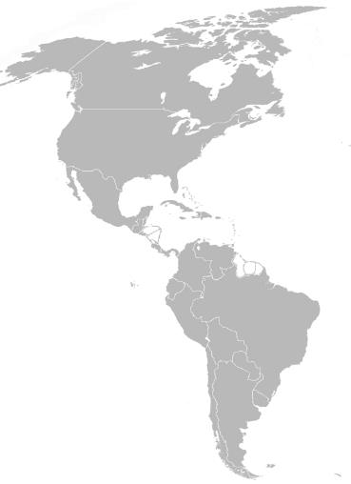
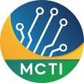
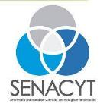
IAI Science Technology and Policy (STeP) Fellowship Program:
4. THE NEXT TD-SD GENERATION: IAI SCIENCE, TECHNOLOGY, POLICY (STEP) FELLOWS
Program updates held with all partners and associates (AAAS, Mitacs Canada) as Generation 1 finishes program in January 2023 and Generation 2 has been invited to extend for another year.
Recruitment for Generation 3 (2023-2025) includes potential new fellows in Brazil, Chile, Panama, US, Canada, Jamaica, Uruguay, Barbados
Professional development program underway with Generation 1 & 2. Includes first in-person workshop (12-15 Nov. 2022).
10
11
4
3
46 Inter-American Fellows:
8 Host Countries
12 males, 34 females
41 different advanced degrees/disciplines
30 public (executive and legislative branches) and private host institutions
2
8
4
3
15 - Nov - 2021
Notes:
Slide 6: The IAI - launched the STeP Fellowship Program in 2020, during the pandemic, as an innovative program in Latin America and the Caribbean (LAC), seeking to place local ECR scientists (Fellows) in public or private host organizations to research, inform and provide advice to decision-makers on global environmental change and national sustainable development issues. The host organizations you see listed here gain capacity to interpret and uptake science to support policy and decision- making processes. Fellows from LAC form part of an Inter-American Network through program partnerships with the AAAS Science & Technology Policy Fellowship in the U.S. and the Mitacs Canada Science-Policy Fellowship program.

