Slide 1
From Commitment to Action: UNCCD’s Role in Shaping Drought Resilience & Land Restoration
Daniel Tsegai, Ph.D​
Programme Officer​
UNCCD, Bonn, Germany​

Slide 2
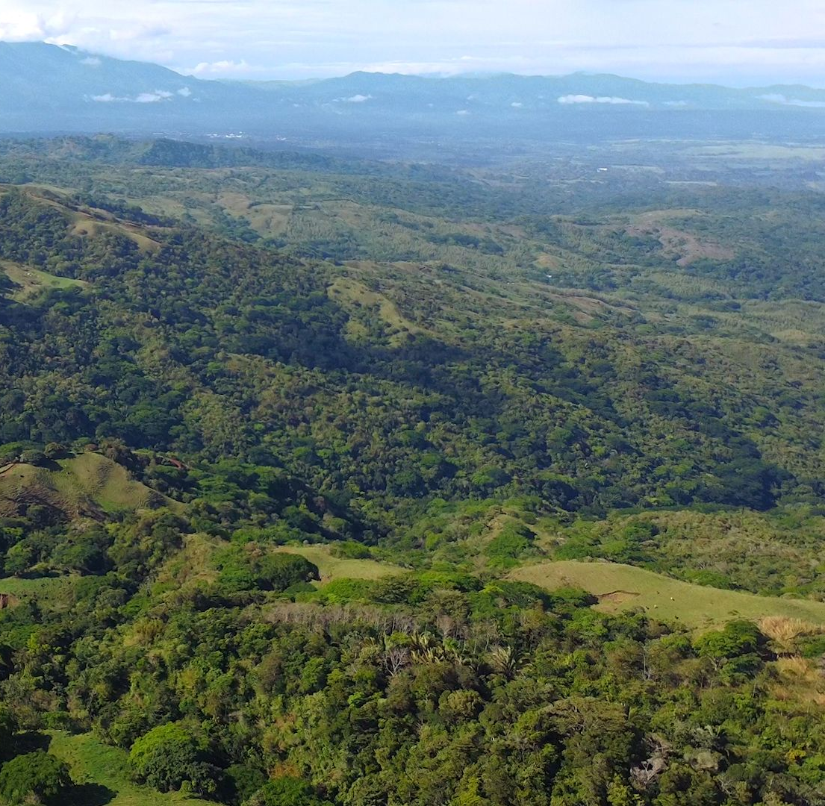
Background
About UNCCD
Why drought?
I
Initiatives
International Drought Resilience Alliance
International Drought Resilience Observatory
Community of Learning and Practice
II
III
The Future is yet to come
Pathways to impact

Slide 3
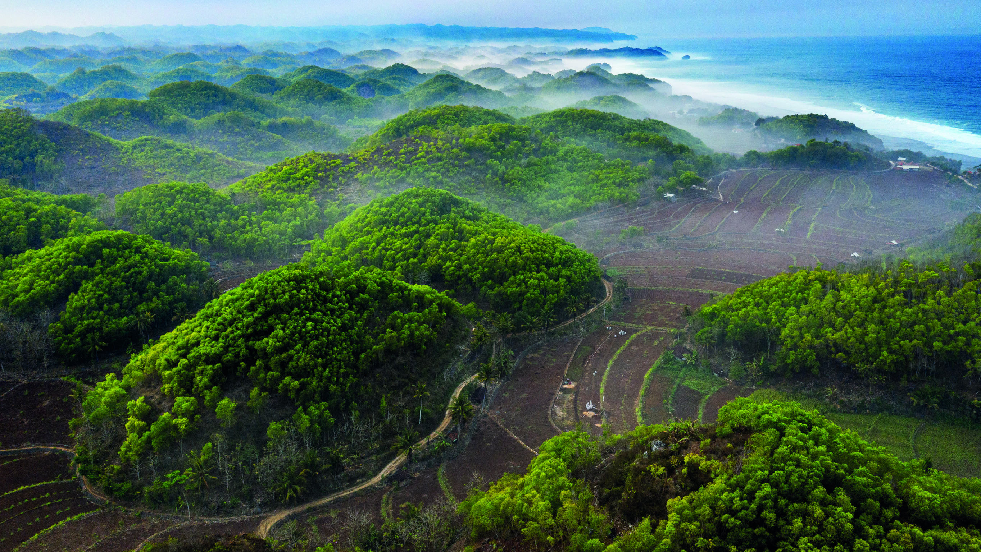
UNCCD is the global vision and voice for land

Slide 4
Brief overview of UNCCD​
The United Nations Convention to Combat Desertification (UNCCD):​
Adopted on 17 June 1994 ​
Entered into force in 1996​
The only legally binding framework set up to address desertification and the effects of drought. ​
197 Parties, including 196 countries and the European Union​
More about the Convention: https://www.unccd.int/convention​

Slide 5
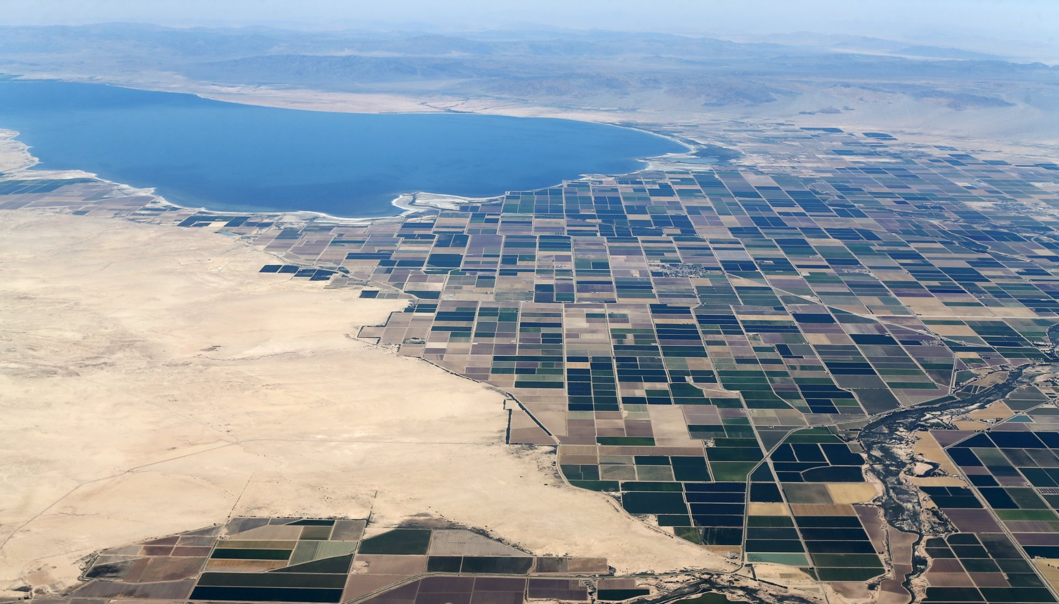
Drought: Why should we care?
What you need to know about drought…
1 in 4
People affected by drought globally in 2022-2023
85%
People affected by drought who live in low- and middle-income countries
29%
Increase in droughts since the year 2000
40%
Extent to which global freshwater demand is projected to outstrip supply by 2030
25%
Sand and dust storms driven by human activity, including human-made droughts
... and drought resilience
10x
Drought resilience investments have an up to tenfold return on investment
3x
For every USD 1 spent in building resilience there are up to USD 3 in benefits from avoided losses reduced need for humanitarian aid.
23k
Improving early warning systems could save 23,000 lives and up to USD 2 billion in developing countries every year.
5%
Percentage of official development assistance for disasters that was allocated to preparedness in the past decade
Notes:
start by acknowledging that drought is a global crisis.
Here in red, we can see the drought’s effect
And the green stats here highlight the benefits of drought resilience

Slide 6
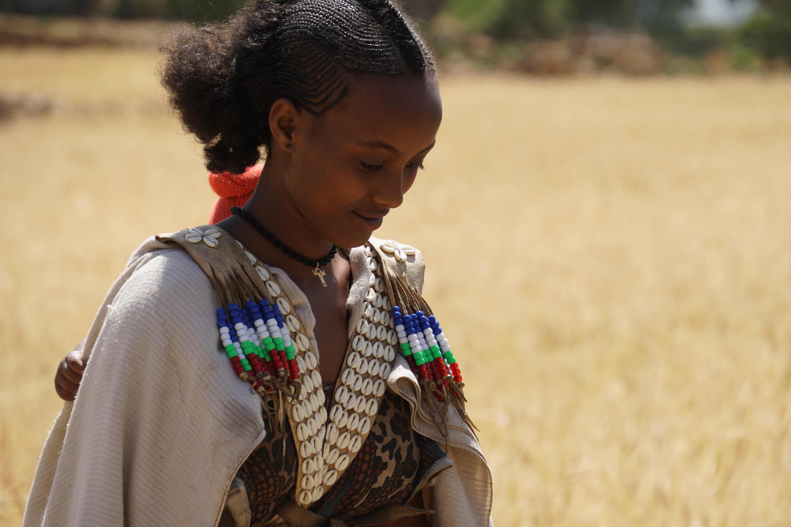
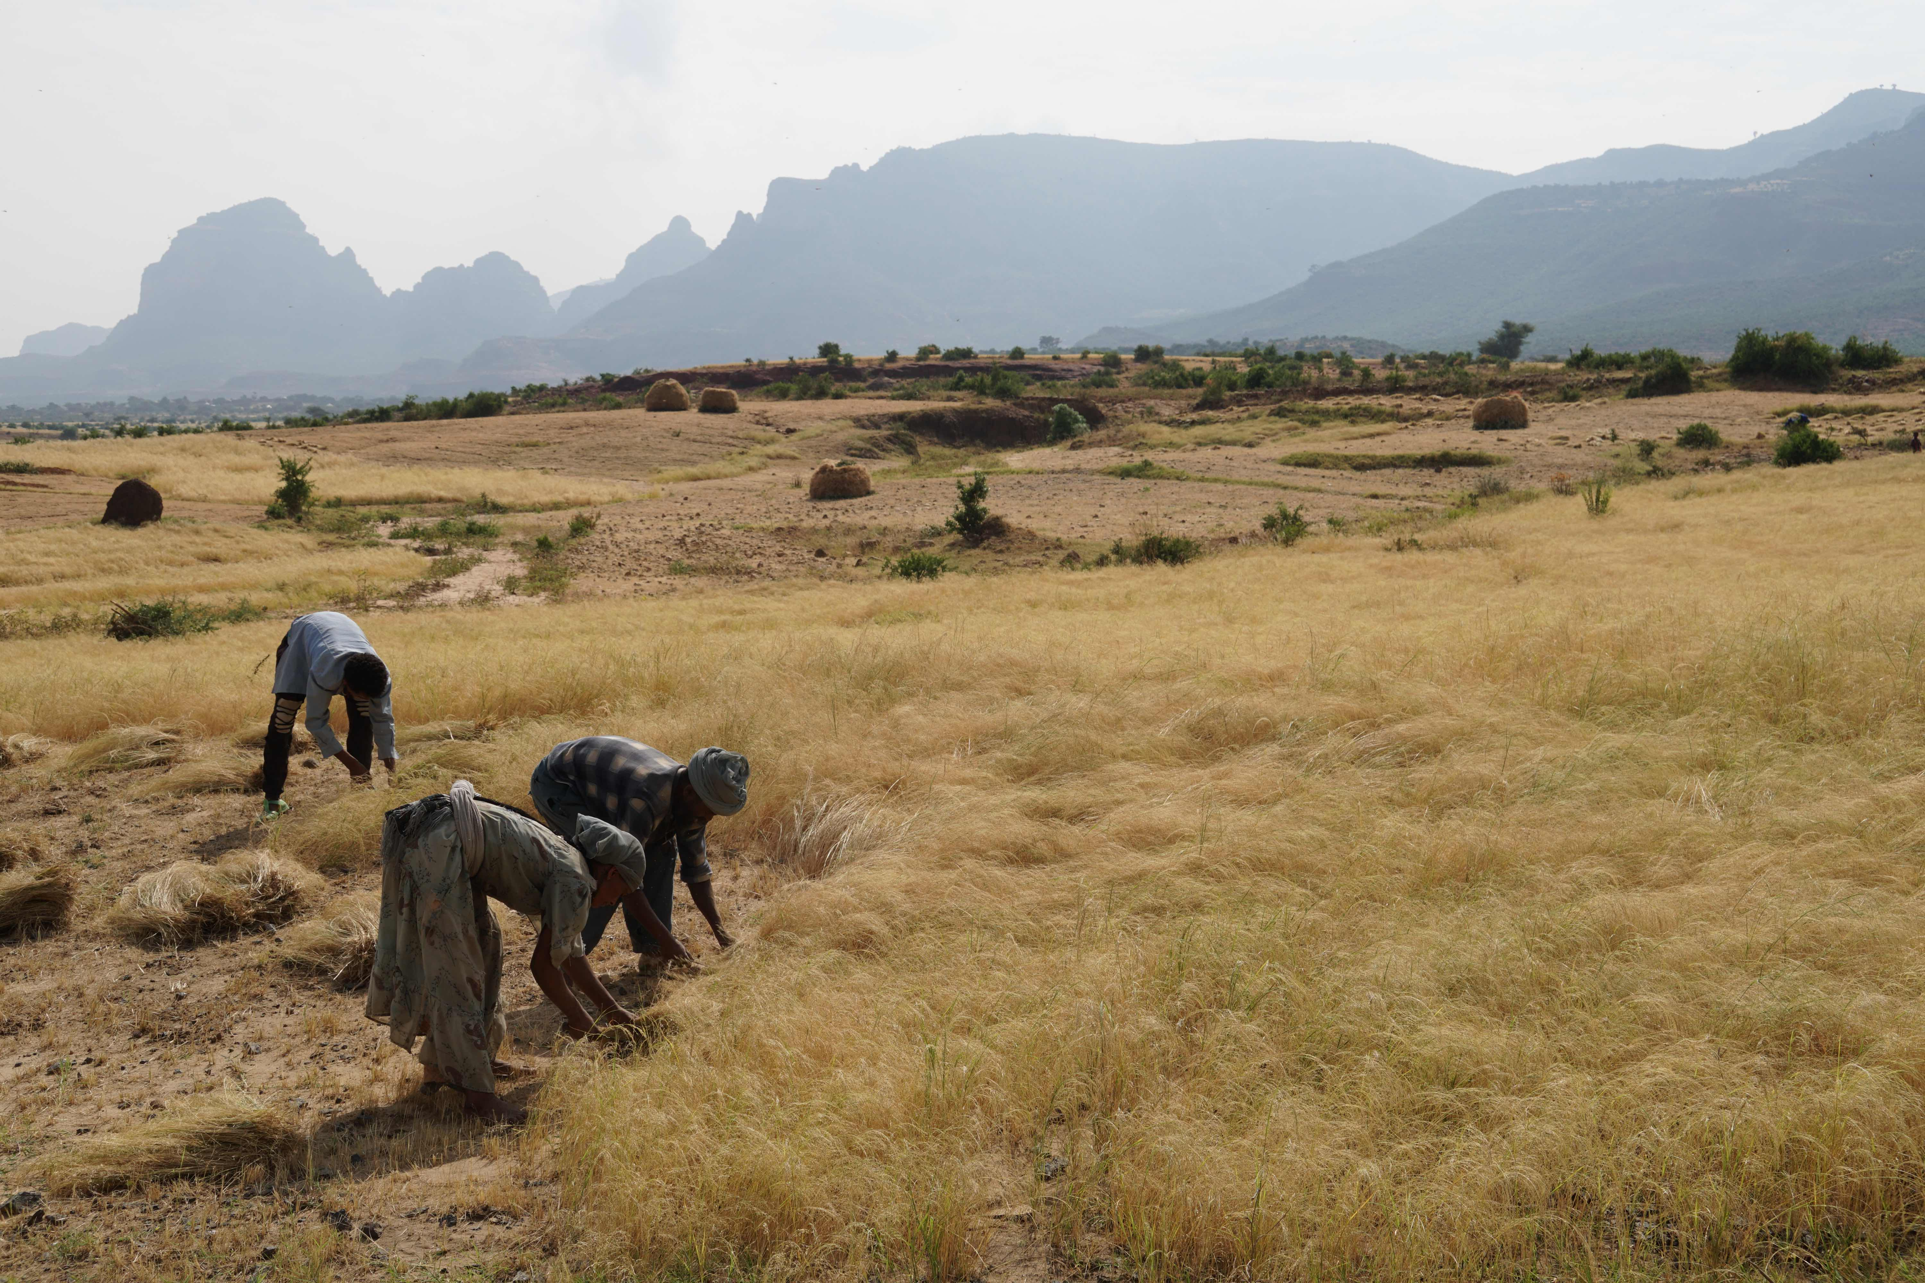
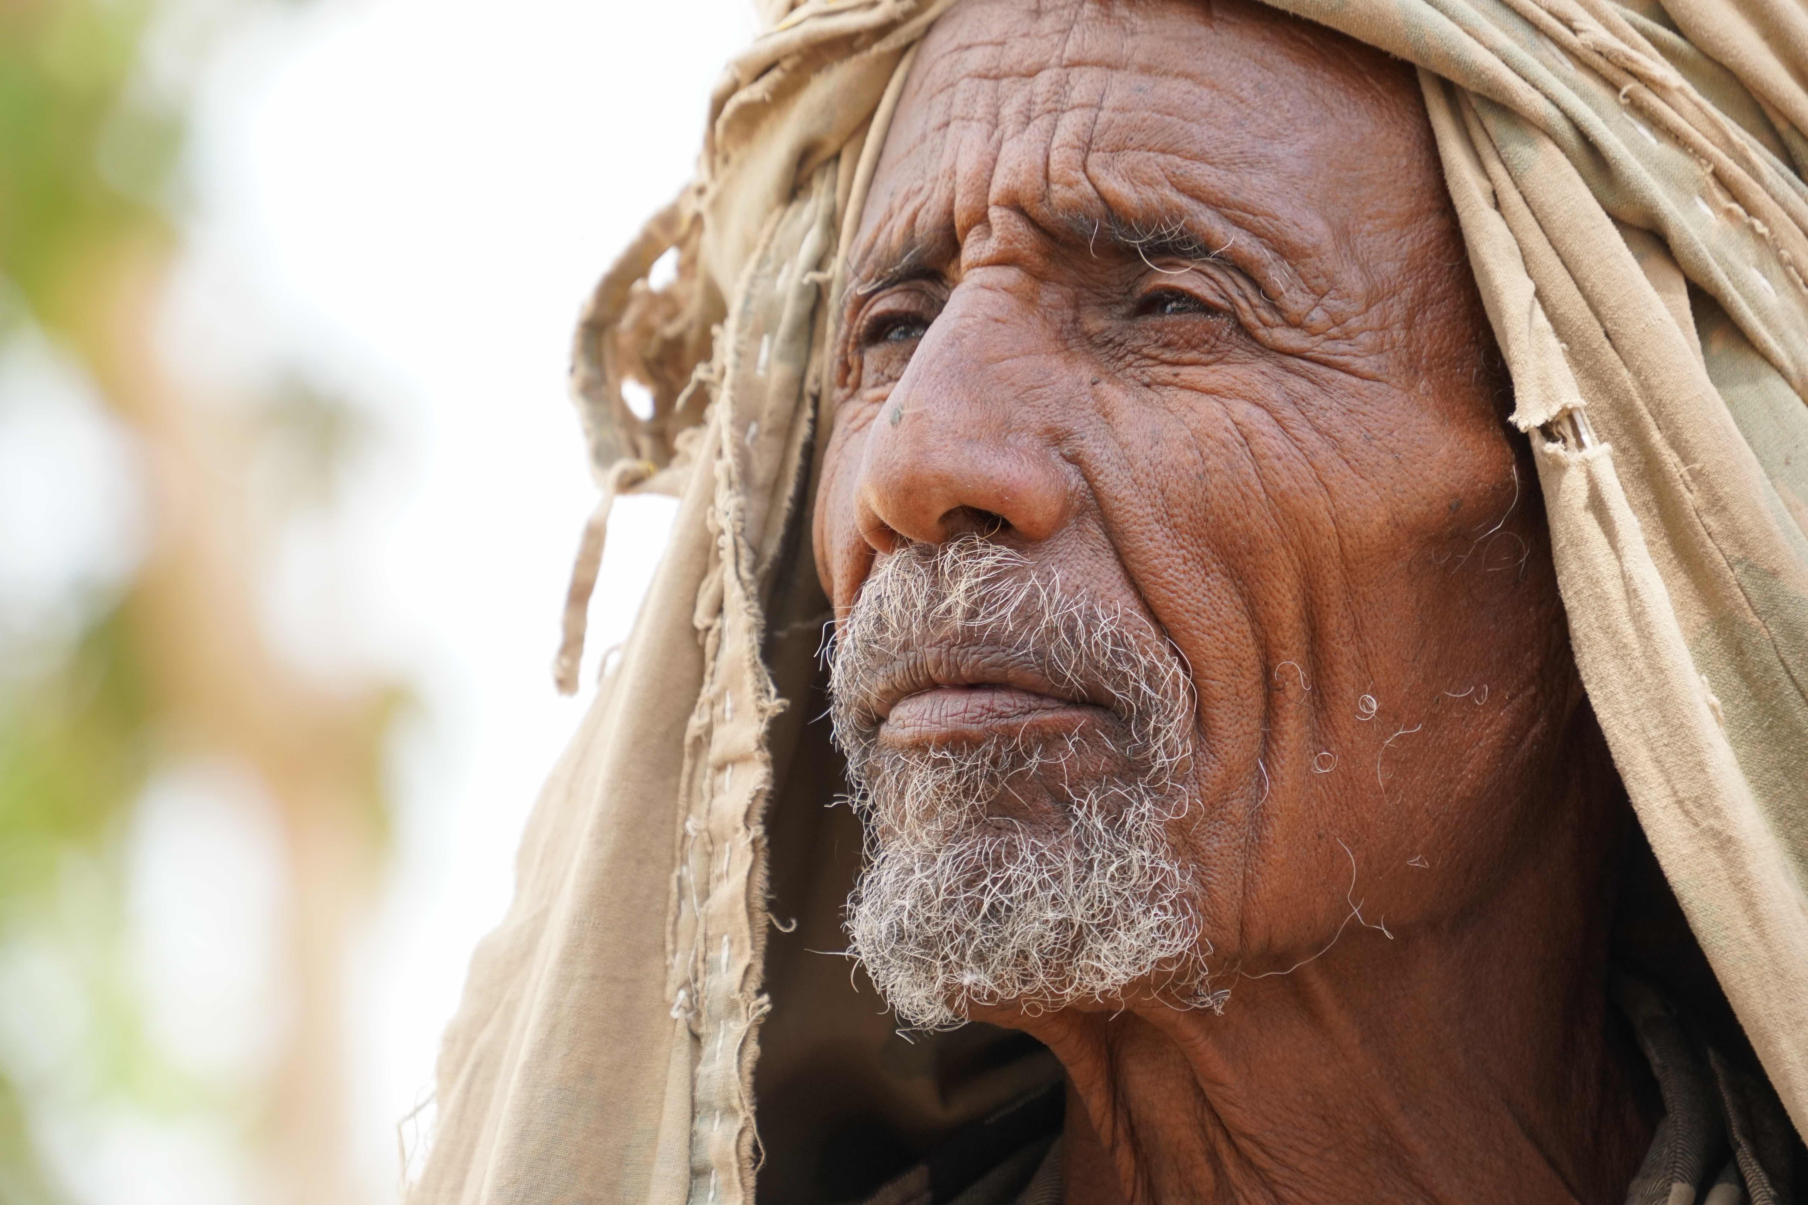
Drought: Why should we care?
Drought: Why should we care?
Drought is generally defined as a severe moisture deficit below expected levels that restricts some type of activity (Wilhite et al. 2006).
It is not aridity where low rainfall is a permanent feature of the climatic environment
It is also not desertification where a region of aridity shifts b/s of poor management
Drought is a complex natural hazard that occurs in every part of the world and adversely affects the lives of millions of people each year, causing significant damage to economies, the environment and property.
Drought has both a natural & social dimension.
In most cases, the social dimension is the factor that turns drought into a disaster.
Thus, drought is a complex phenomenon that should be seen from A multidimensional angle.
Increasing costs: US$128 bn (2000-2019), but more likely US$307 bn per year
Increasing cost of inaction and cascading impacts

Slide 7
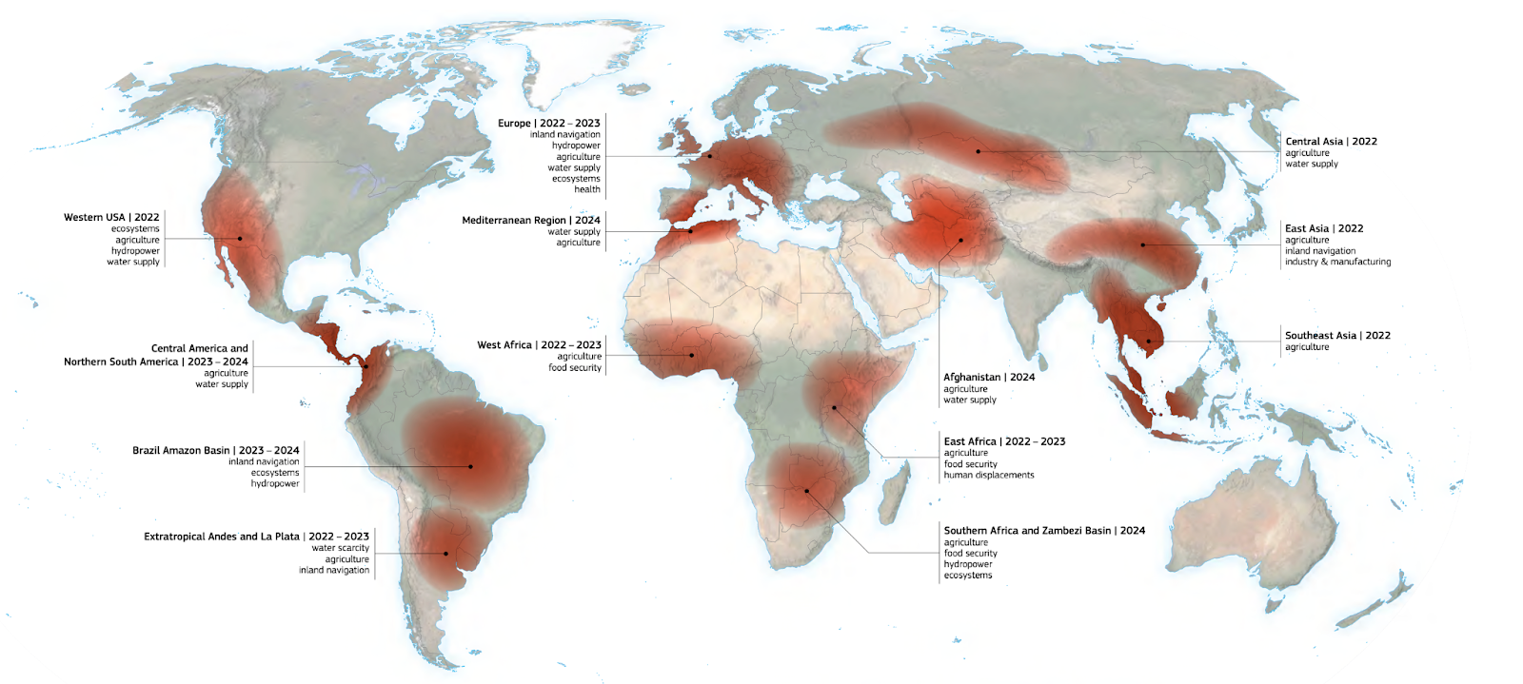
Major drought events and impacted systems (2022 - 2024)
Source: World Drought ATLAS (2024)

Slide 8
I
Background
About UNCCD
Initiatives
International Drought Resilience Alliance
International Drought Resilience Alliance
Community of Learning and Practice
II
III
The Future is yet to come
The bigger picture
Pathways to impact

Slide 9
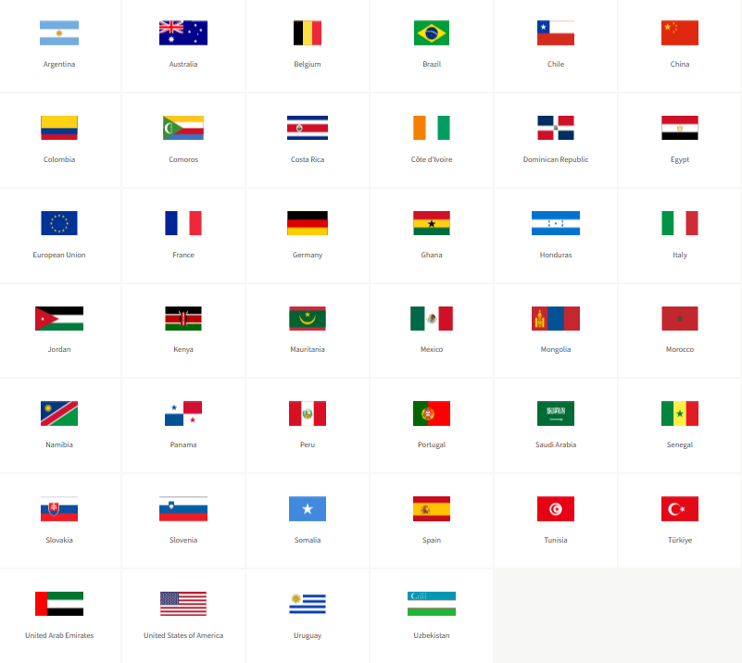
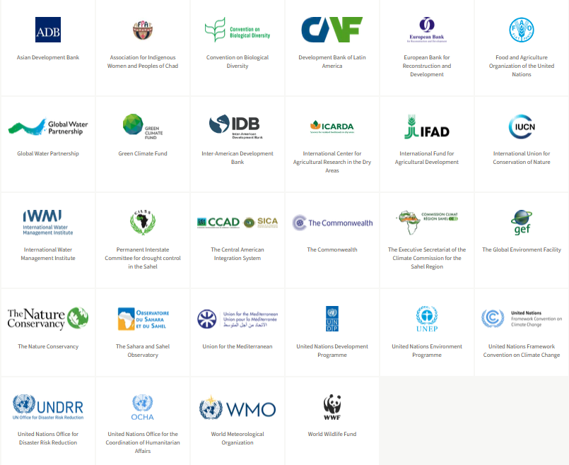
International Drought Resilience Alliance (IDRA)
IDRA is a global coalition that mobilizes political, technical and financial capital to enhance drought resilience in countries, cities, and communities – 40 countries & 28 Organizations

Slide 10
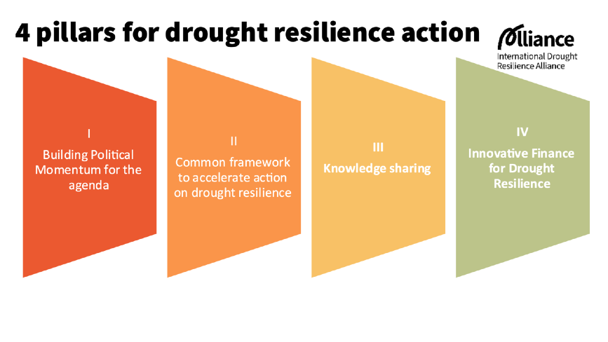
International Drought Resilience Alliance (IDRA)

Slide 11
IDRO emerges from
A groundbreaking initiative
championed by Spain and Saudi Arabia
to revolutionize Global Drought Resilience.

Slide 12
Zoom from Global to Local: Gain Precise Knowledge
Critical information is emerging on how to become resilient to the effects of drought.
However, the data and information are fragmented and scattered.
UNCCD Drought Toolbox
From 2022- 2023, Drought affected 1 in 4 people
(UNCCD, 2023)
Notes:
Critical information is emerging

Slide 13
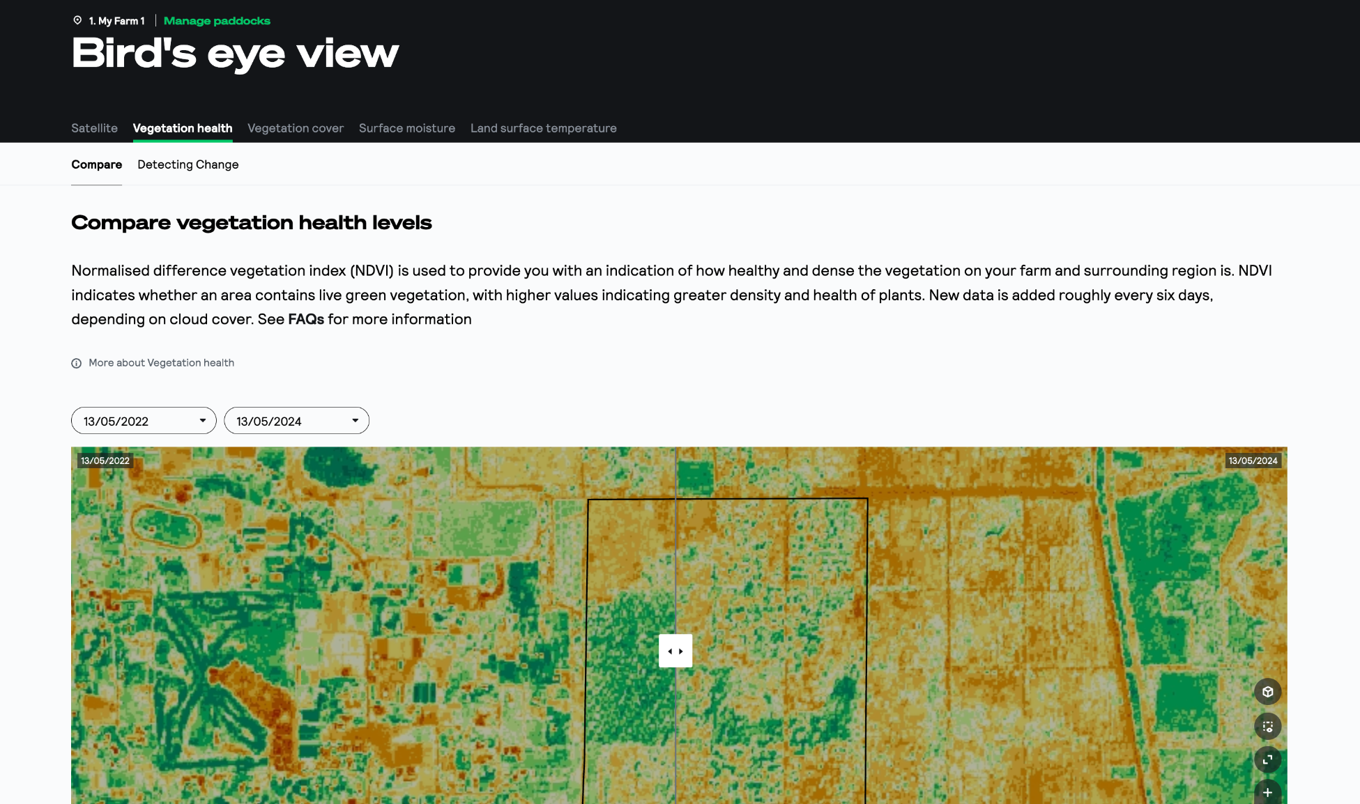
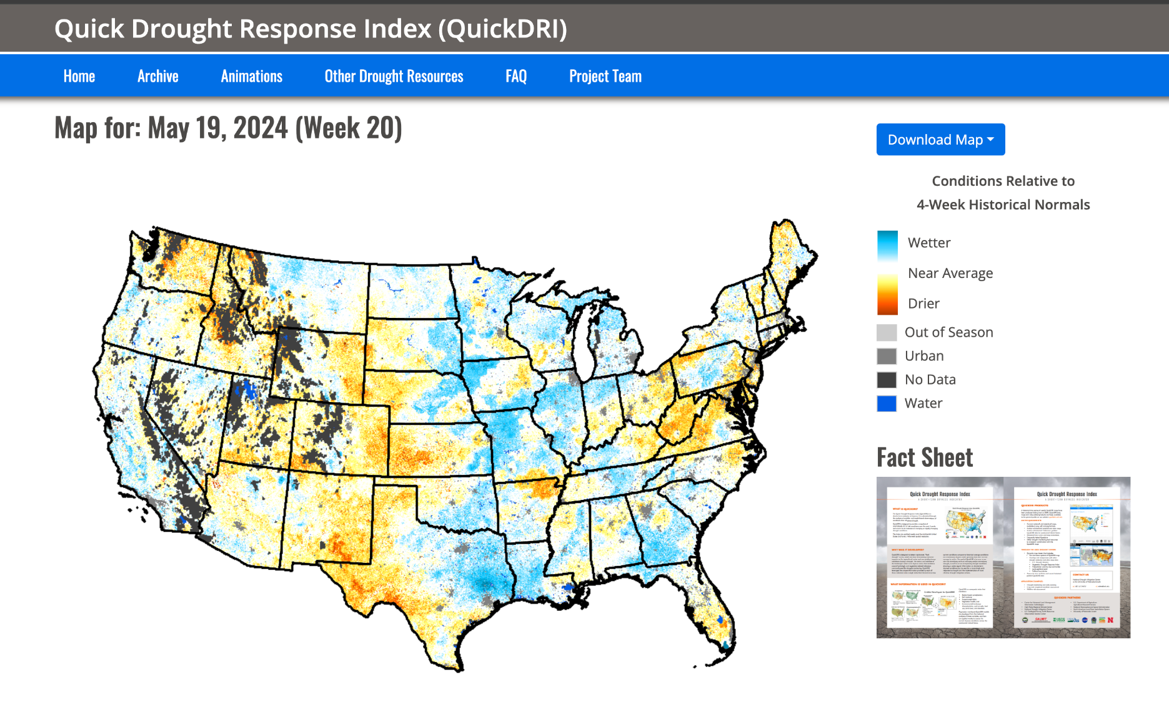
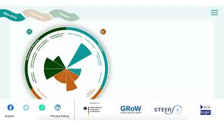
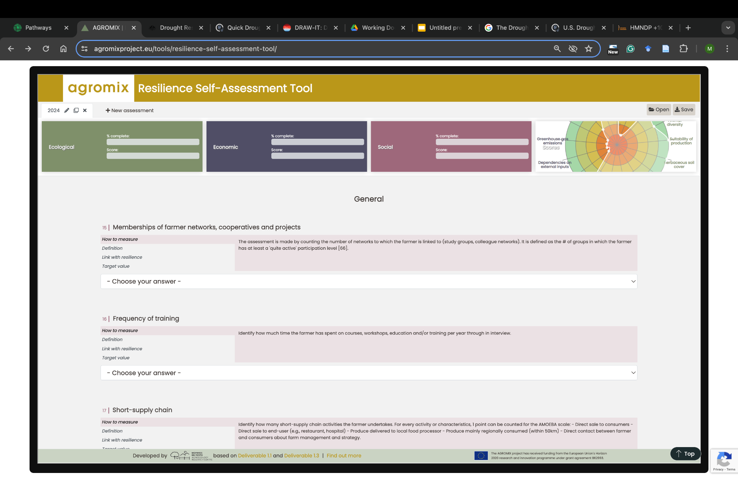
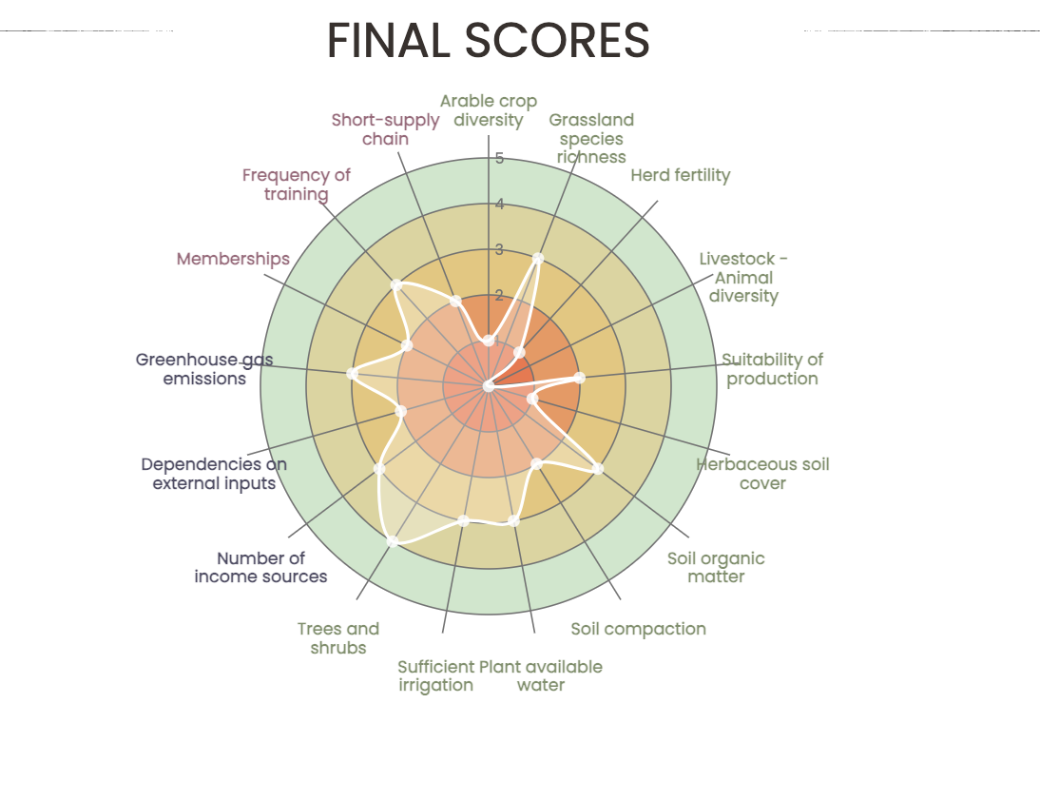
State-of-the-Art in Drought Resilience Monitoring
Tools
Drought Resilience Self-Assessment Tool
DR.SAT (Australia)
Quick Drought Response Index
(USA)
The Diagnostic Water Governance Tool (Germany)
Agromix: Resilience Self-Assessment Tool
Focus on agricultural resilience to climate changes
No aggregate data into regional projections of drought resilience
Require additional auditing by local authorities to check for data fitness
No aggregate data into regional projections of drought resilience
Require additional auditing by local authorities to check for data fitness
Limited to agriculture and farming
Limited to state-level data and not property or county-level indicators
Limited to rapid response situations and not longer-term resilience objectives
Diagnostic Water Governance Tool not on drought resilience
Limited to governance only
Limitations
Link
Quick Drought Response Index, USA: https://quickdri.unl.edu/State.aspx?AZ
The Diagnostic Water Governance Tool, Germany, EU: https://www.watergovernancetool.eu/
Agromix, Coventry University, UK & EU : https://agromixproject.eu/tools/resilience-self-assessment-tool/
DR.SAT, Australia: https://www.drsat.com.au/

Slide 14
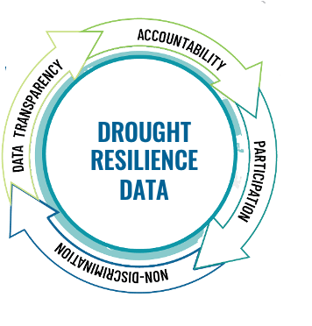
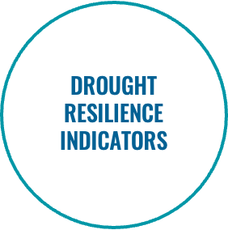
Prepare, Adapt, Mitigate & Anticipate.
Ecological Resilience
Water Related
Ecosystem Recovery
Soil Characteristics
Biodiversity
Social Resilience
Natural Capital
Economic Capital
Physical Capital
Social Capital
Human Capital

Slide 15
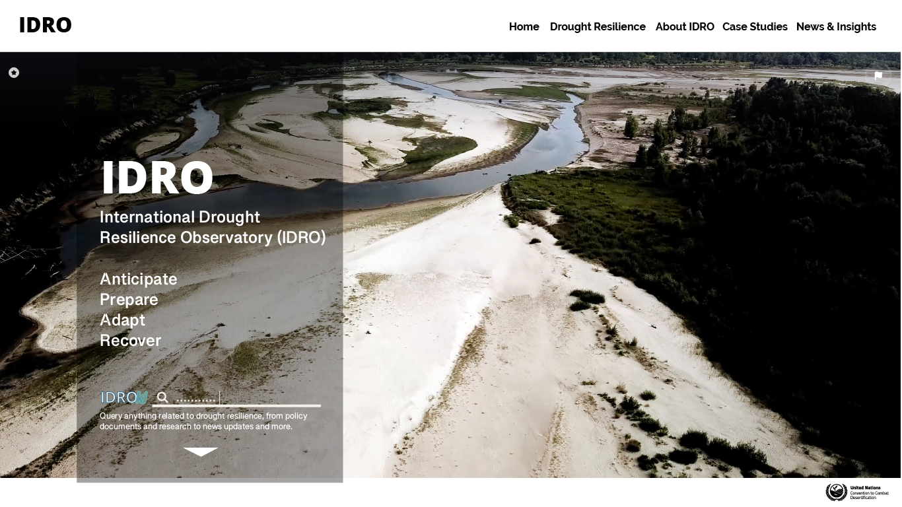
IDRO Core Features
IDRO will offer a wide array of functionalities with data analytics at its core.
#1 Data Search
#2 Analytics & Insights
#3 Artificial Intelligence
#4 Snapshots
#5 Reporting
# 6 Alerts

Slide 16
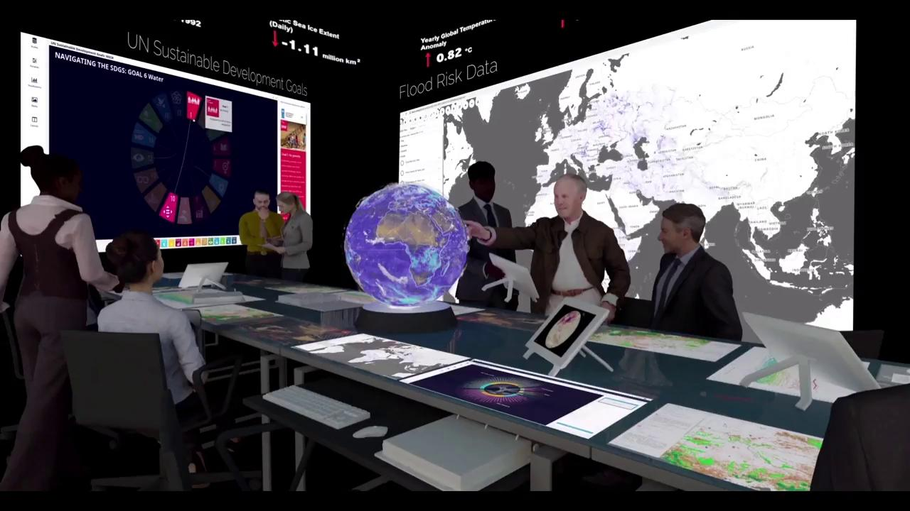
IDRO will have a ‘scholar’ feature that will leverage the latest AI for domain scientists around the world
Yale CEA BEEM LAB
Confidential not for distribution
Notes:
At Yale CEA we are developing new methods to analyze and share data and to enable diverse stakeholders to project the future impacts of their decisions.
Through our immersive environment here the BEEM Lab, you can see decision makers reviewing various types of data and information in order to build knowledge on actions for drought resilience.

Slide 17
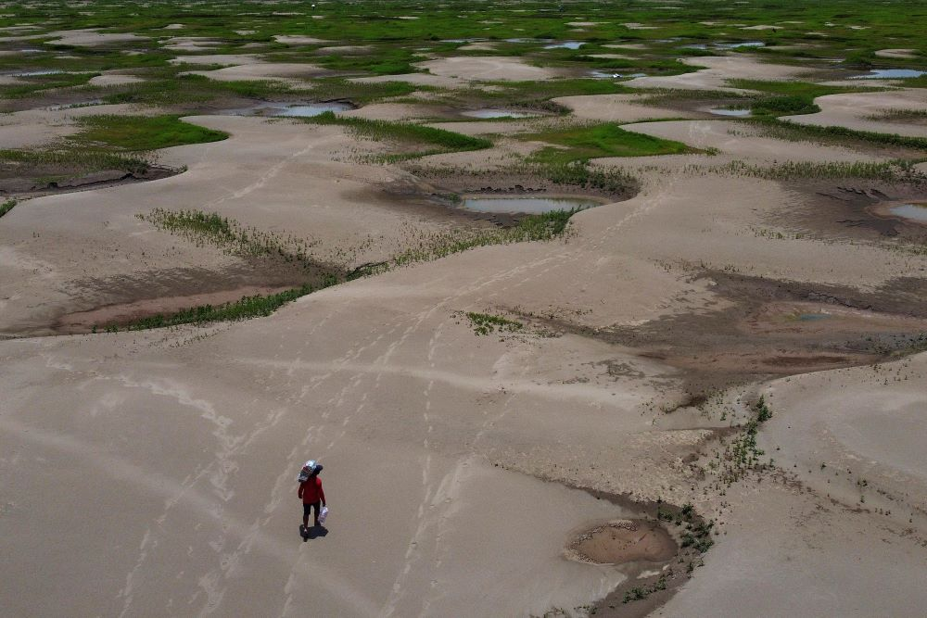
Key stakeholders (Phase 1)
National Center for Meteorology (NCM)
European - Commission / Joint Research Centre (JRC)
National Drought Mitigation Center/ University of Nebraska
National Oceanic and Atmospheric Administration (NOAA)
Consultative Group on International Agricultural Research (CGIAR)
⁠World Meteorological Organization (WMO)

Slide 18
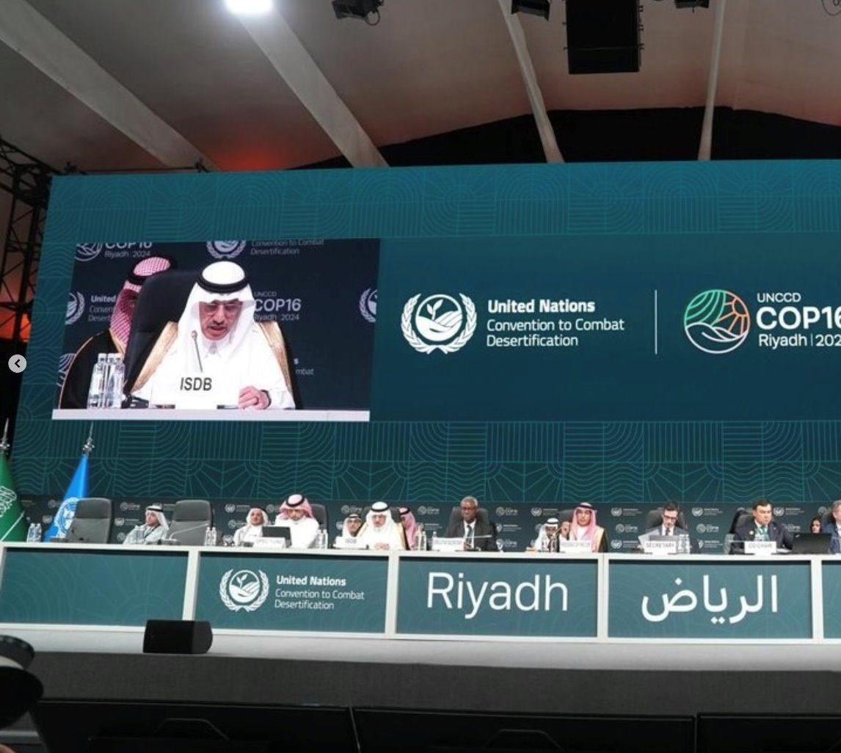
UNCCD COP 16 KEY OUTCOMES
Financial Legacy:
Riyadh Global Drought Resilience Partnership (RGDRP)​
KSA: USD 150 Million for the RGDRP to support 80 of the world’s most vulnerable countries on drought resilient efforts for the next 10 years​
OPEC fund: USD 1 billion​
ISDB: USD 1 billion to expand its project portfolio for drought resilience by 2030​
Arab Coordination Group (ACG) ​
USD 10 billion pledged by the Arab Coordination Group (ACG) to support drought resilient efforts and land restoration​
Great Green Wall Accelerator ​
Mobilized USD 14.6 million to strengthen coordination and implementation across 22 countries​

Slide 19
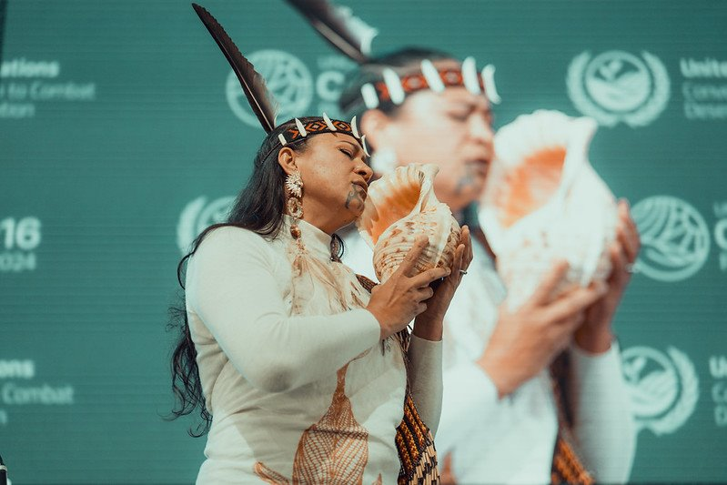
Inclusion & Representation
Empowering Communities​
First Indigenous Peoples’ Forum at UNCCD COP​
Landmark creation of Indigenous Peoples’ and Local Communities’ Caucuses​
Largest-ever youth participation; focus on youth-led initiatives​
Adoption of the Youth Engagement Strategy​
Emphasis on addressing gender discrimination in land policies

Slide 20
Strengthening Science​
Decision on the Future Science Policy Interface​
Launch of the International Drought Resilience Observatory (IDRO)​
Evidence-Based Decision-Making​
Reports released:
World Drought Atlas​
Economics of Drought ​
Stepping back from the precipice: Transforming land management to stay within planetary boundaries ​
​
The global threat of drying lands: Regional and global aridity trends and future projections ​
​
Investing in Land's Future: Financial needs assessment for UNCCD ​

Slide 21
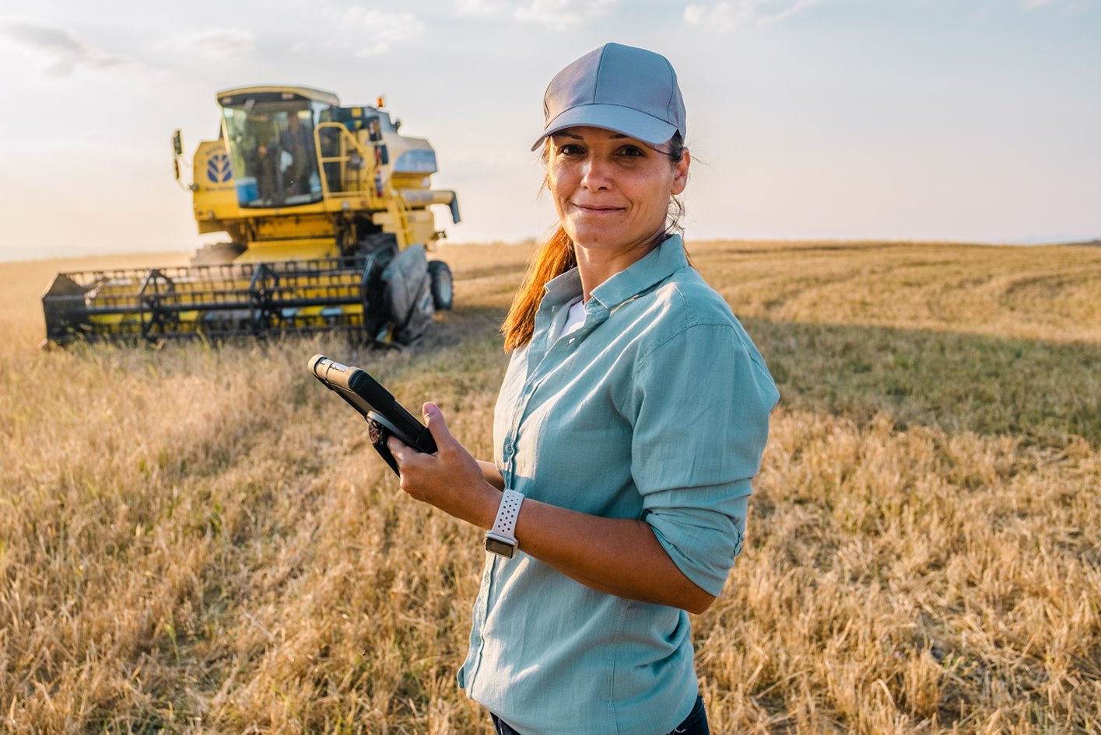
Engaging the Private Sector
Business4Land Initiative launched to increase private sector investment in land restoration and resilience​
Largest private sector participation in UNCCD COP history (400+ representatives)​
Collaboration across finance, fashion, agri-food, and pharmaceuticals sectors​
Emphasis on innovative financing models and advocacy for sustainable practices​
Aims to close the gap in funding for combating land degradation, currently only 6% of investments

Slide 22
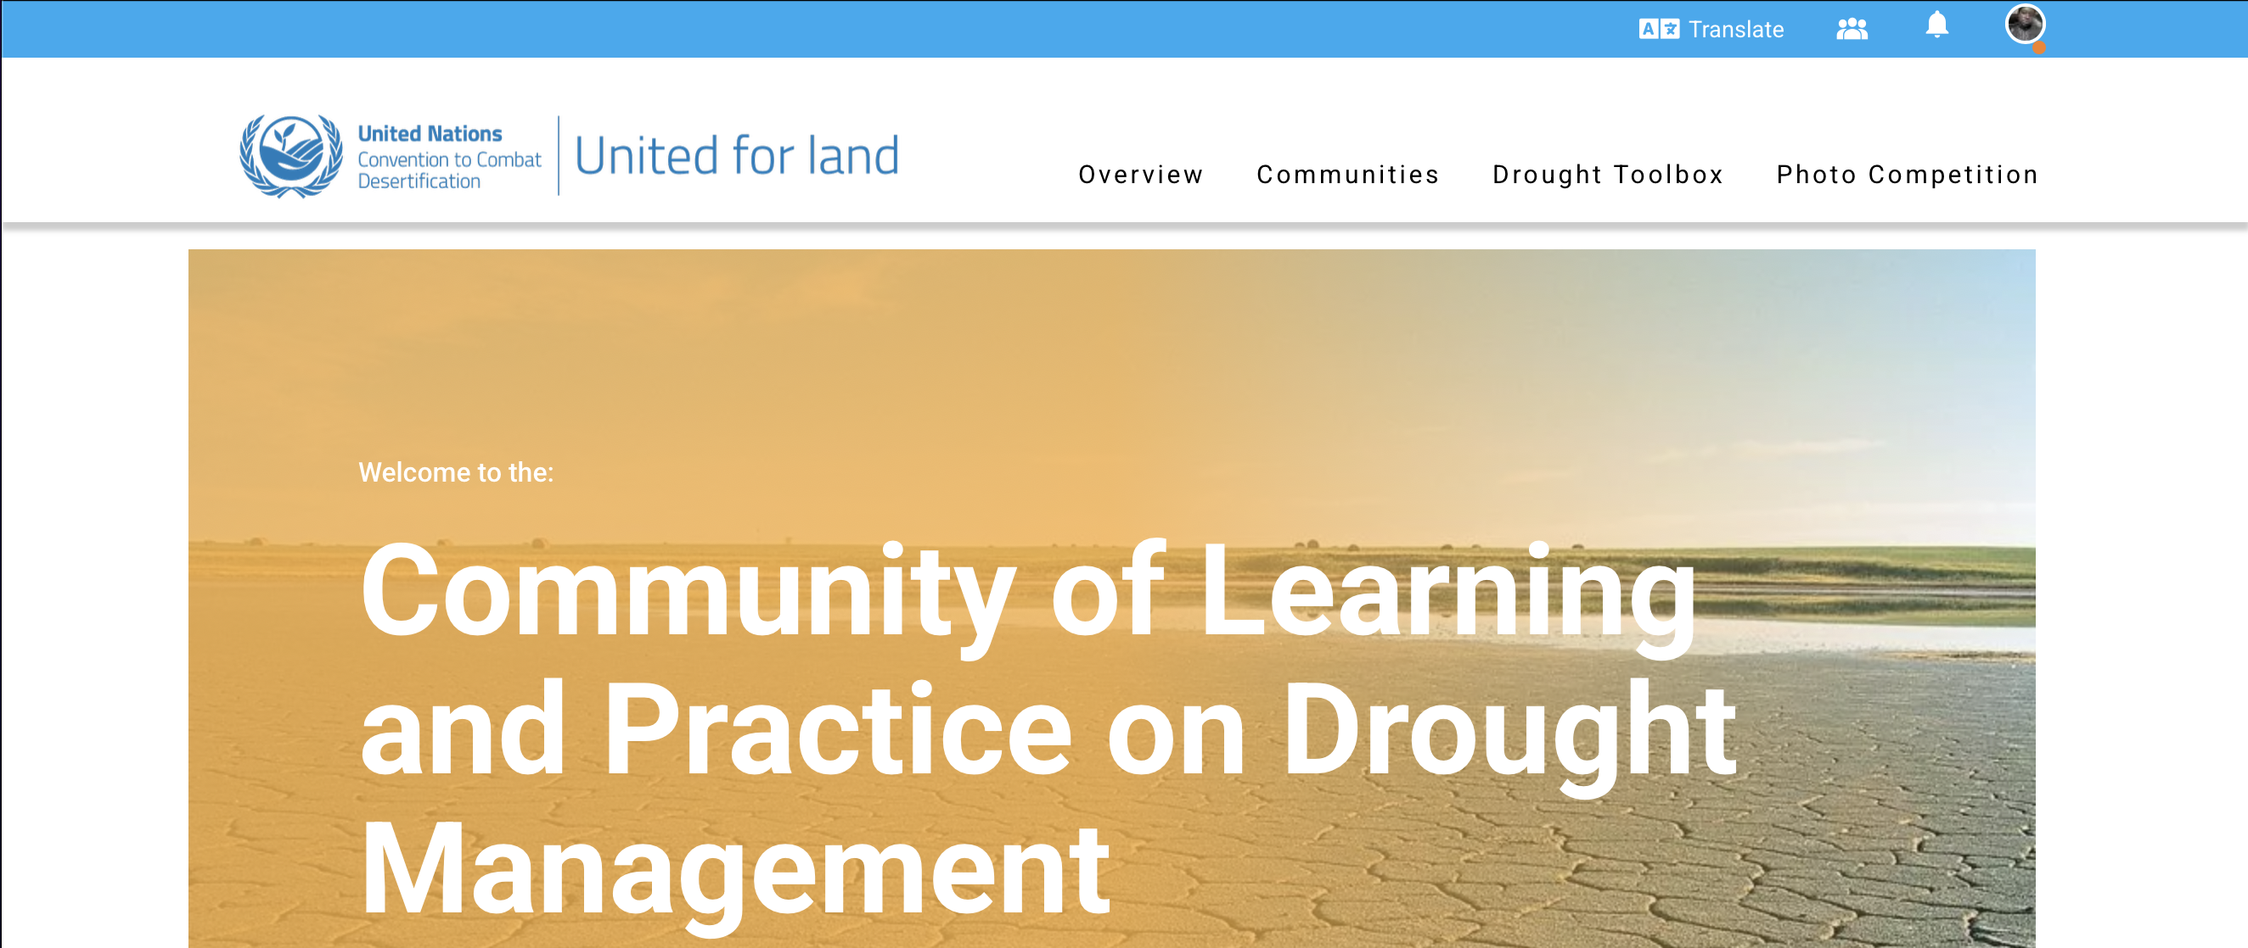
UNCCD Community of Learning and Practice (CLP)
Objective of CLP:
Enhance knowledge and Technical Capacities
Promote Adoption of Integrated Practices
Support Policy Development
Foster Collaboration and Trust
Encourage Proactive & Inclusive Approaches
Benefit for countries:
Enhanced Knowledge Sharing
Capacity Building
Networking Opportunities
Access to Innovative Solutions
Policy Support
Economic benefits & Reduced losses

Slide 23
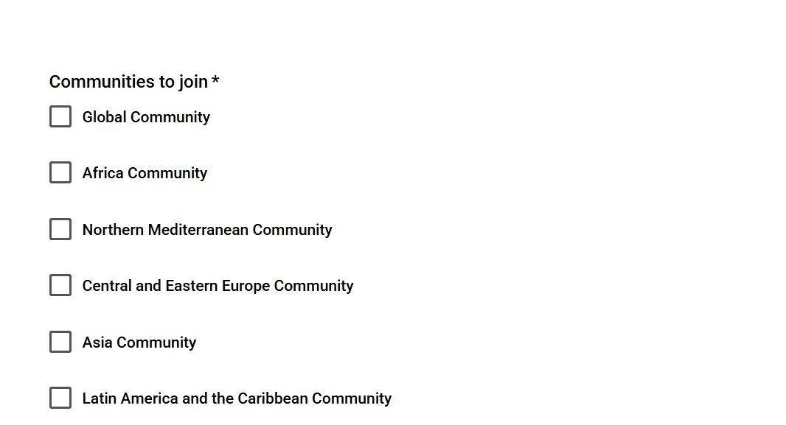
How to join the Community of Learning and Practice?
Option 1: Click and Automatically Join

Slide 24
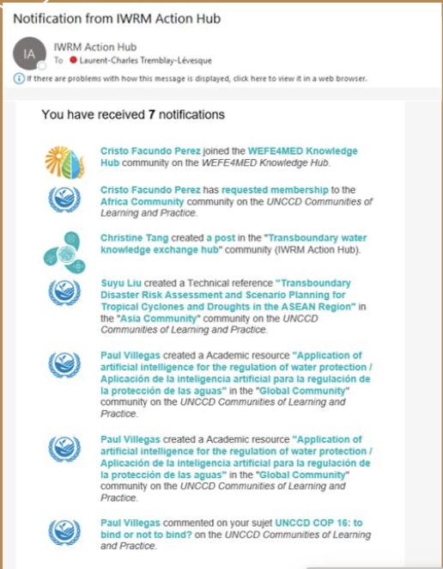
How to join the Community of Learning and Practice?
Option 2: Request to Join
1
2
3

Slide 25
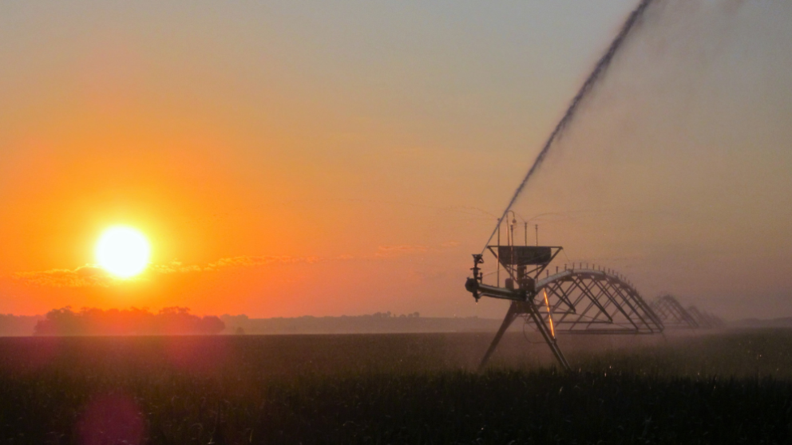
Thank you

