Slide 1
CLIMATE SCIENCE 2050: NATIONAL PRIORITIES FOR CLIMATE CHANGE SCIENCE AND KNOWLEDGE

Slide 2
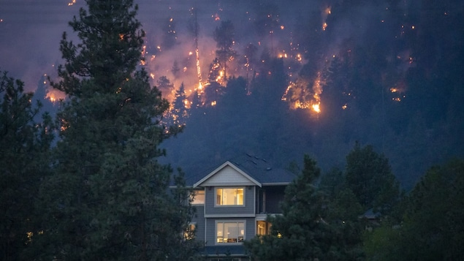
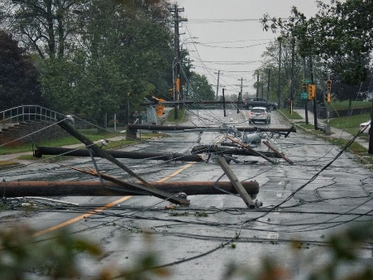
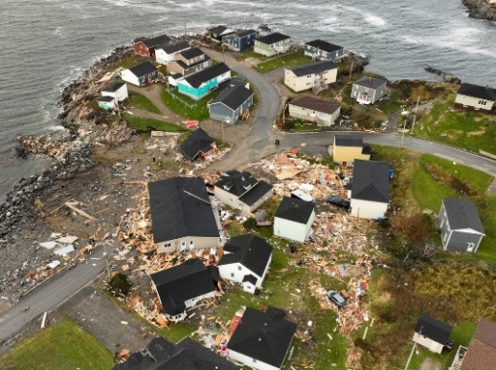
CONTEXT
Canadians are experiencing first-hand the impacts of climate change, through devastating wildfires, heatwaves, floods, hurricanes, and droughts
Frequency and magnitude are expected to increase significantly if GHG emissions are not reduced and the climate continues to warm
Foundational climate change science and knowledge is essential to:
Understand our changing environment
Identify current and future impacts
Make informed decisions
Take action to keep Canadians safe
Monitor progress

Slide 3
Background
In December 2020, GoC published Climate Science 2050: Advancing Science and Knowledge on Climate Change
A first-ever national synthesis to better understand the breadth of climate change science and knowledge needs
A vast number of science gaps and needs were identified
Given the urgency of addressing climate impacts – and time, capacity and resource limits – a second report was developed to prioritize the most critical science within various domains
Climate Science 2050: National Priorities for Climate Change Science and Knowledge (to be released in June 2024)

Slide 4
Developing The REPORT
From 2021-22, ECCC led extensive engagement to bring together multiple expert views on key scientific research activities in different domains
Including input from 7 expert roundtables co-led with various departments by themes
More than 500 climate program leaders and experts across governments, academia and National Indigenous Organizations
Engagement with 500+ Climate Leaders
Consensus with OGDs
Peer Review
National Priorities for Climate Change Science and Knowledge Report
Identification of science priorities across disciplines and OGDs
Priorities were reviewed and confirmed by OGDs who were also implicated
10 climate experts (external) reviewed and confirmed priorities
Academia, NGOs, NIOs to use report to guide future research and work
OGDs/Agencies to use report to set priorities internally and forward planning

Slide 5
Overview of The REPORT
Identifies priority action areas where climate change science nationally should focus for next 5-10 years
Recognizes Canada’s climate change science capacity is distributed across academia, governments, the private sector, NGOs and Indigenous organizations
Identifies need for better national coordination of climate change science research and knowledge
Indigenous science and knowledge
Supporting a strong Canadian economy
Climate Change Science and Knowledge
Resilient communities and built environments
Health and security of Canadians
Protecting nature and ecosystems
Getting to net-zero GHG emissions

Slide 6
PRIORITY science AREAS & Examples
Supporting a strong Canadian economy
Develop and track indicators of social-ecological resilience in natural resource sectors and communities
Build knowledge from social sciences and behavioural economics to inform decision-making and communication strategies specific to each sector
Examine the relationships among climate change, climate action, and sustainable development
Resilient net-zero communities and built environments
Generate climate data, predictions, and projections to inform risk assessment, adaptation, and actions to reduce GHG emissions from the built environment
Improve climate information and predictions and projections of extremes
Understand future water sustainability, including supply, demand, quality, and effects on human and ecosystem health

Slide 7
PRIORITY science AREAS & Examples (cont.)
Getting to net-zero GHG emissions
Improve GHG reporting by improving collection and monitoring of emissions and activity data and by reconciling complementary techniques for estimating emissions
Develop integrated atmospheric GHG monitoring systems
Understand socio-political, attitudinal, and behavioural processes in net-zero pathways and improve how these are integrated in modelling and analysis
Health and security of Canadians
Understanding the impacts of climate change on health and health systems, to advance effective, equitable, and feasible measures for health adaptation
Strengthen understanding of risks and drivers of change across the human, animal, plant, and environment interfaces
Study the risks and threat-multipliers of climate change for the operations of security institutions and for emergency preparedness

Slide 8
PRIORITY science AREAS & Examples (cont.)
Protecting nature and ecosystems
Better understand key ecosystem attributes, climate drivers, and responses influencing ecosystem and biodiversity resilience and change
Monitor carbon stocks to understand their responses to changing climate conditions and disturbances
Advance Earth system modelling to better represent processes in northern regions
Indigenous science and knowledge
Develop Indigenous leadership in climate change science and science networks
Support science and knowledge clusters and networks that actively build relationships with Indigenous Peoples in creating pathways that respect local grassroots climate science concerns and priorities
Braid and weave science planning and implementation with Indigenous governments, organizations, and citizens to craft approaches that are relevant to regions, based on distinctions, and uphold Indigenous rights and self-determination

Slide 9
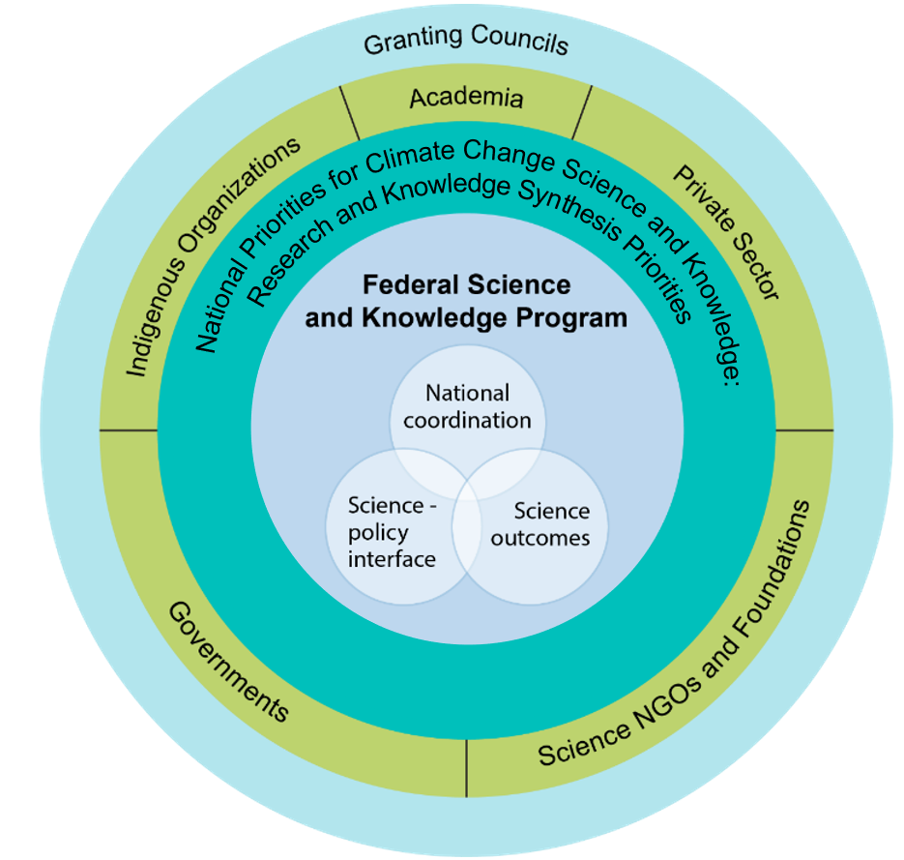
Need for Collaborative Efforts
Implementation of science priorities will be more effective and successful if accompanied with integrated, horizontal efforts
Academia, governments, the private sector, NGOs and Indigenous organizations all have a part to play in advancing climate change science
Federal leadership required for advancing key elements of the report
ECCC and federal partners will have a key role to play, not only conducting climate change science, but acting as a convener
Federal climate change science coordination supports:
Effective delivery and investment in GoC policies and programs
Development of collaborative research partnerships across government, academia and the granting councils
Policy and regulatory sector targeted climate science (e.g., oil and gas, health, forestry, agriculture, fisheries)
Cross-cutting environmental science for freshwater, biodiversity and sustainable development

