Slide 1
Communications, Website, Virtual Campus
Videoconference
14 November 2023

Slide 2


Communications
Notifications, courses and other events – in English and Spanish for the press.
New intern in the IAI communications area
24 bilingual press releases in AlphaGalileo – Science Summit at the 78th UN General Assembly

Slide 3

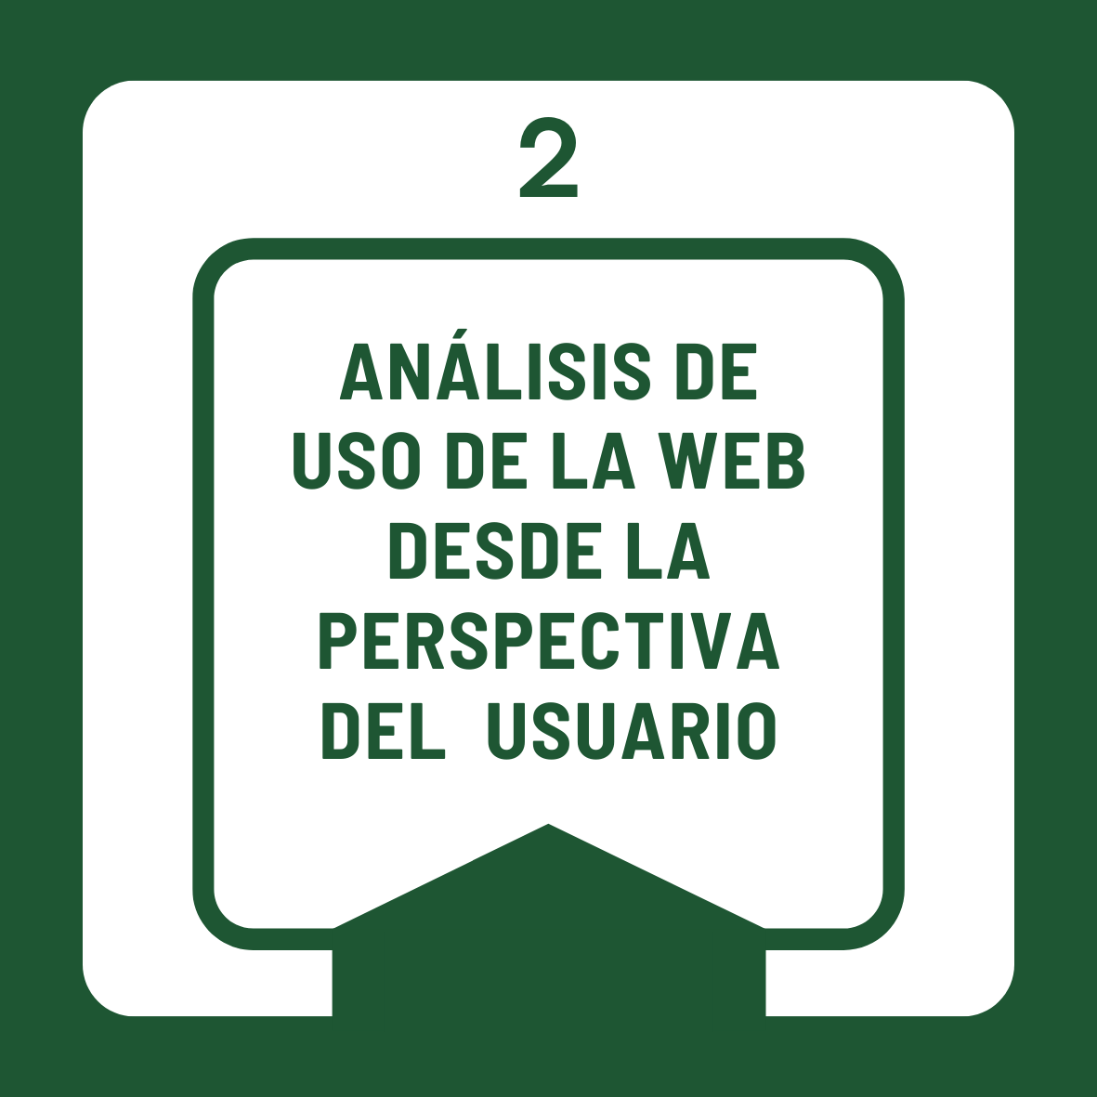
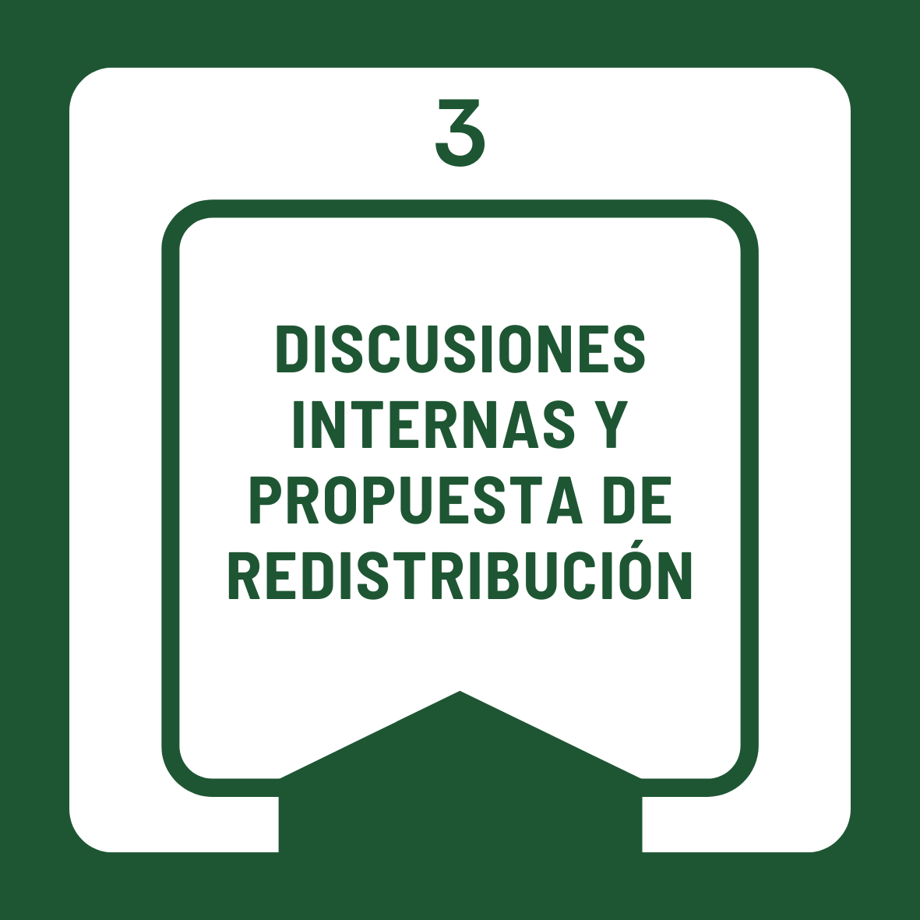
Website restructuring
Friendly, more accessible, with high indexing potential in search engines

Slide 4



Virtual Campus
.

Slide 5
