Slide 1
56th Executive Council Meeting
Marcella Ohira
Deputy Executive Director & Director for Capacity Building
14 November 2023 Videoconference

Slide 2
56th Executive Council Meeting
IAI Conference of the Parties 31 Decisions: THE SCIENCE DIPLOMACY CENTER - Directed to Parties
XXXI/18. The Conference of the Parties approves the creation of the IAI Science Diplomacy Center
and its work plan for the first three years based on the recommendations of the Science Diplomacy
Center Advisory Board.
XXXI/19 The IAI Directorate is instructed to develop and implement the activities under the Science
Diplomacy Center, as appropriate and subject to the availability of external financial resources, and
to report on its development at future meetings of the Conference of the Parties.
XXXI/20. The Parties are encouraged to work with the SDC Advisory Board with the support of the IAI Directorate in the development and support of the Center programs and activities.
XXXI/21. The Parties are encouraged to participate in the programs and activities of the SDC and contribute to the work of the Center with a view to fostering science policy dialogue and enhancement of collaboration related to global environmental change in the Americas.

Slide 3
56th Executive Council Meeting
Capacity Building: Science Diplomacy Training Program for Policy Makers in the Americas
Introduction to Science Diplomacy Workshop: Panama | 16-21 October 2023

Slide 4
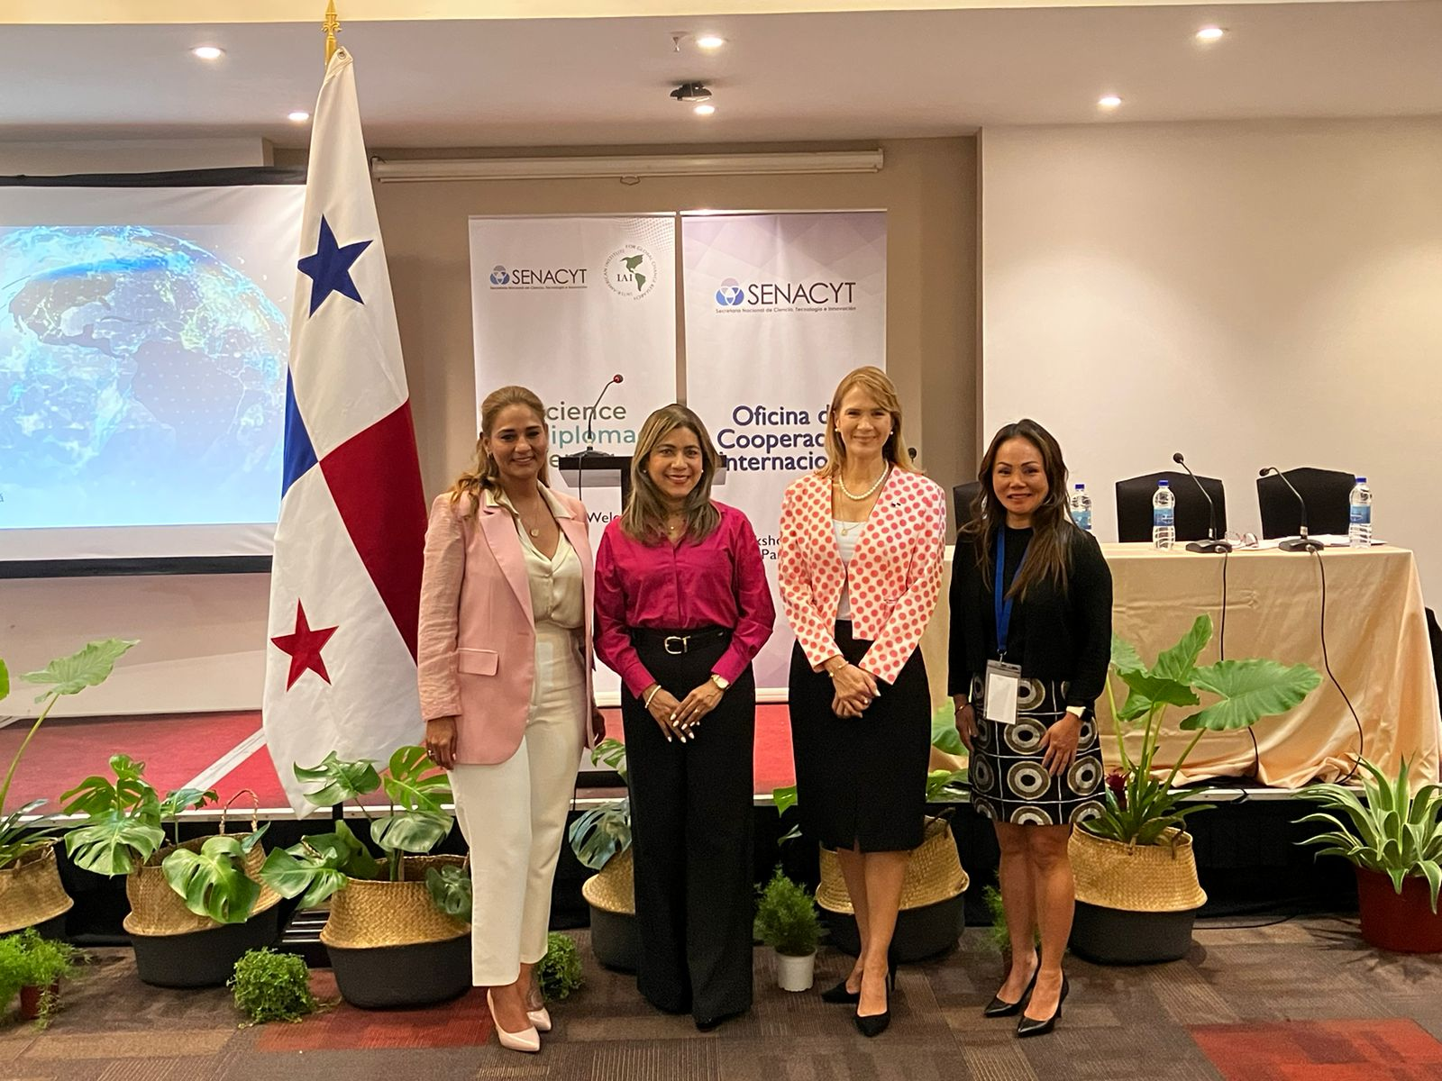
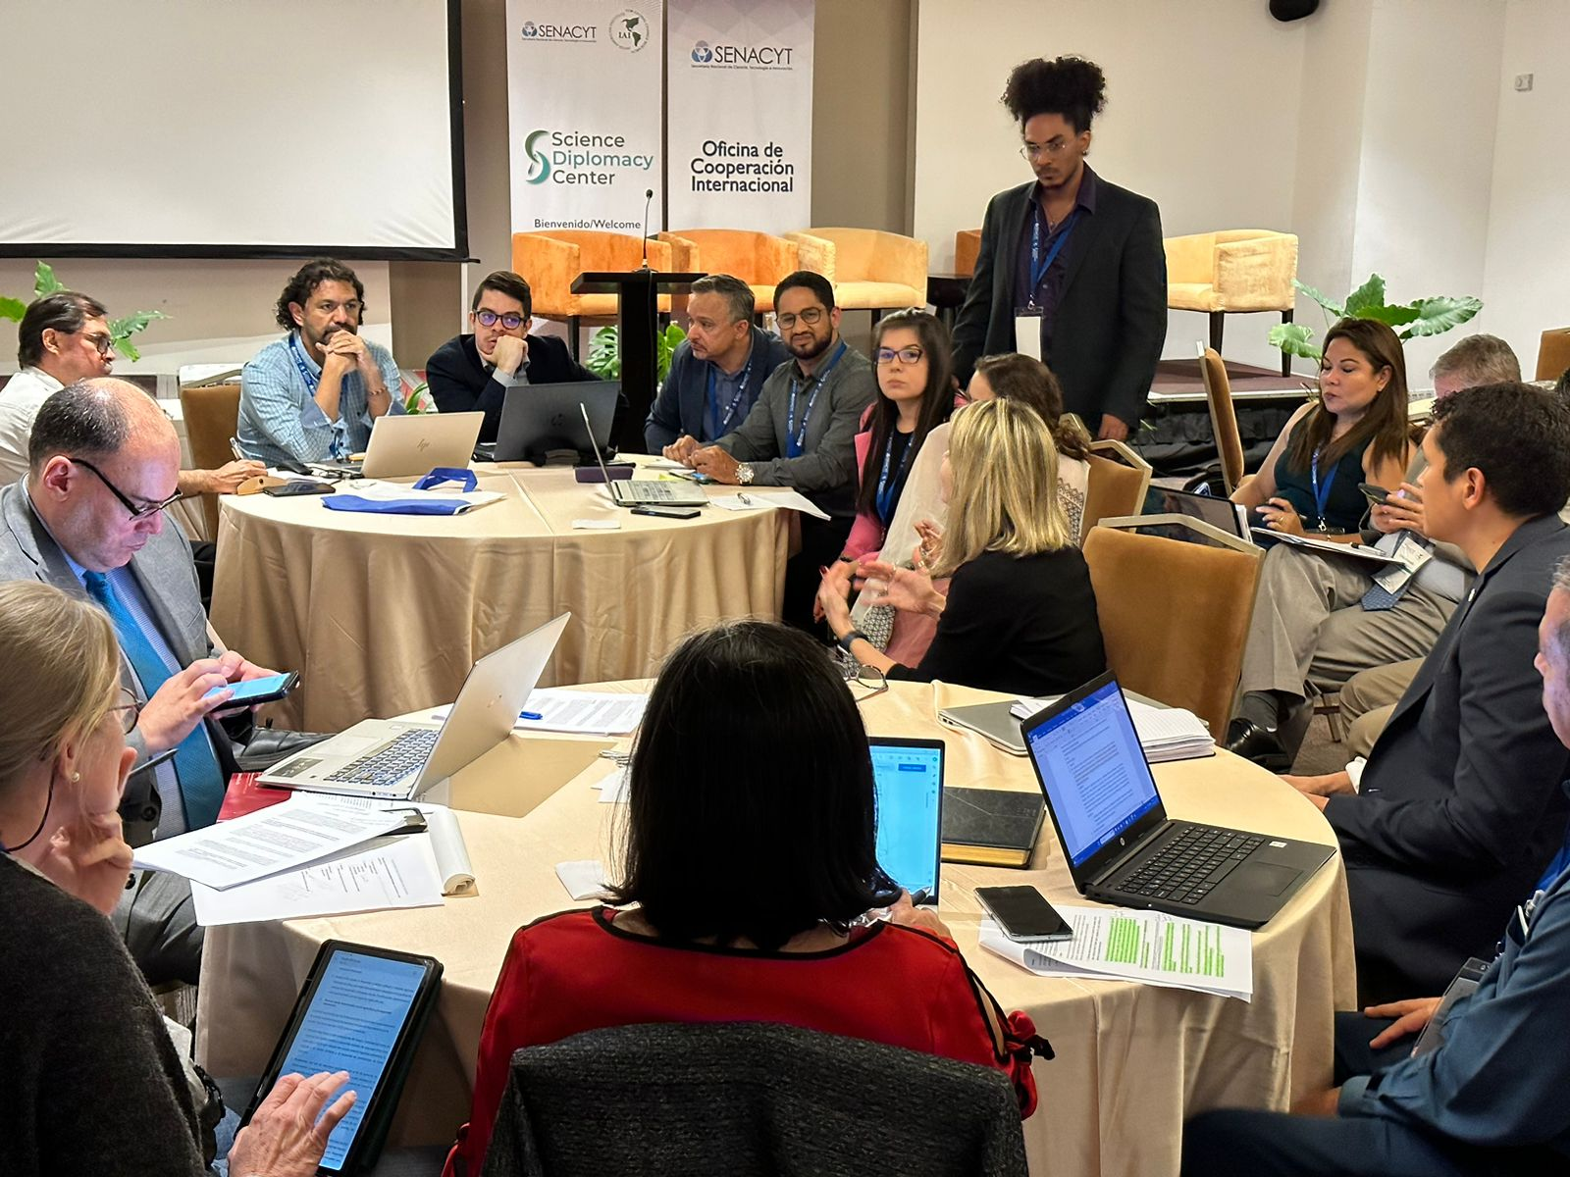
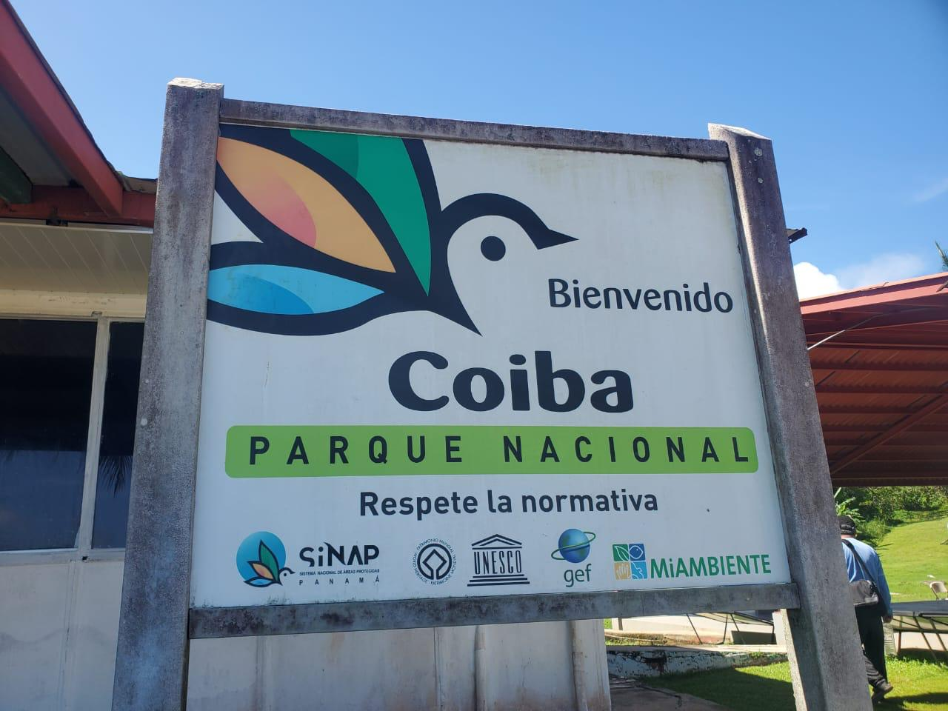
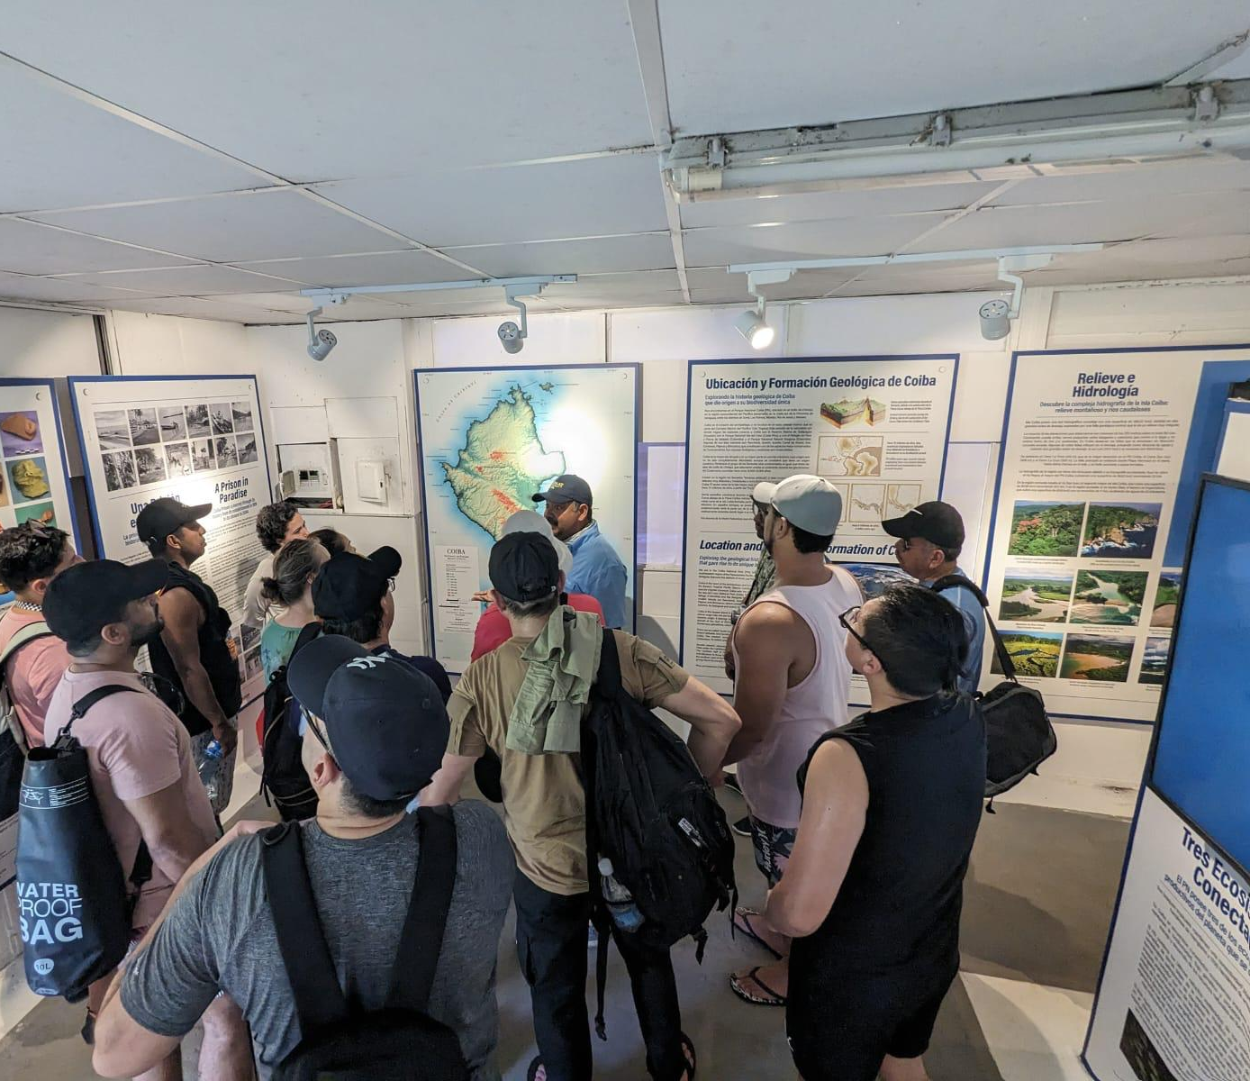
56th Executive Council Meeting
11 Countries 50 Govern. Officials IAI Focal Points Participation
Strengthen science diplomacy capacities and support key decision makers, and government officials.
Promote/facilitate regional dialogue for an Inter-American Science Diplomacy network and forge international cooperation.
Promote the role of science in policy priority areas for the region.
Workshop Structure:
Field Trip: Coiba Research Station
Science Diplomacy Forum
Science Diplomacy Workshop

Slide 5
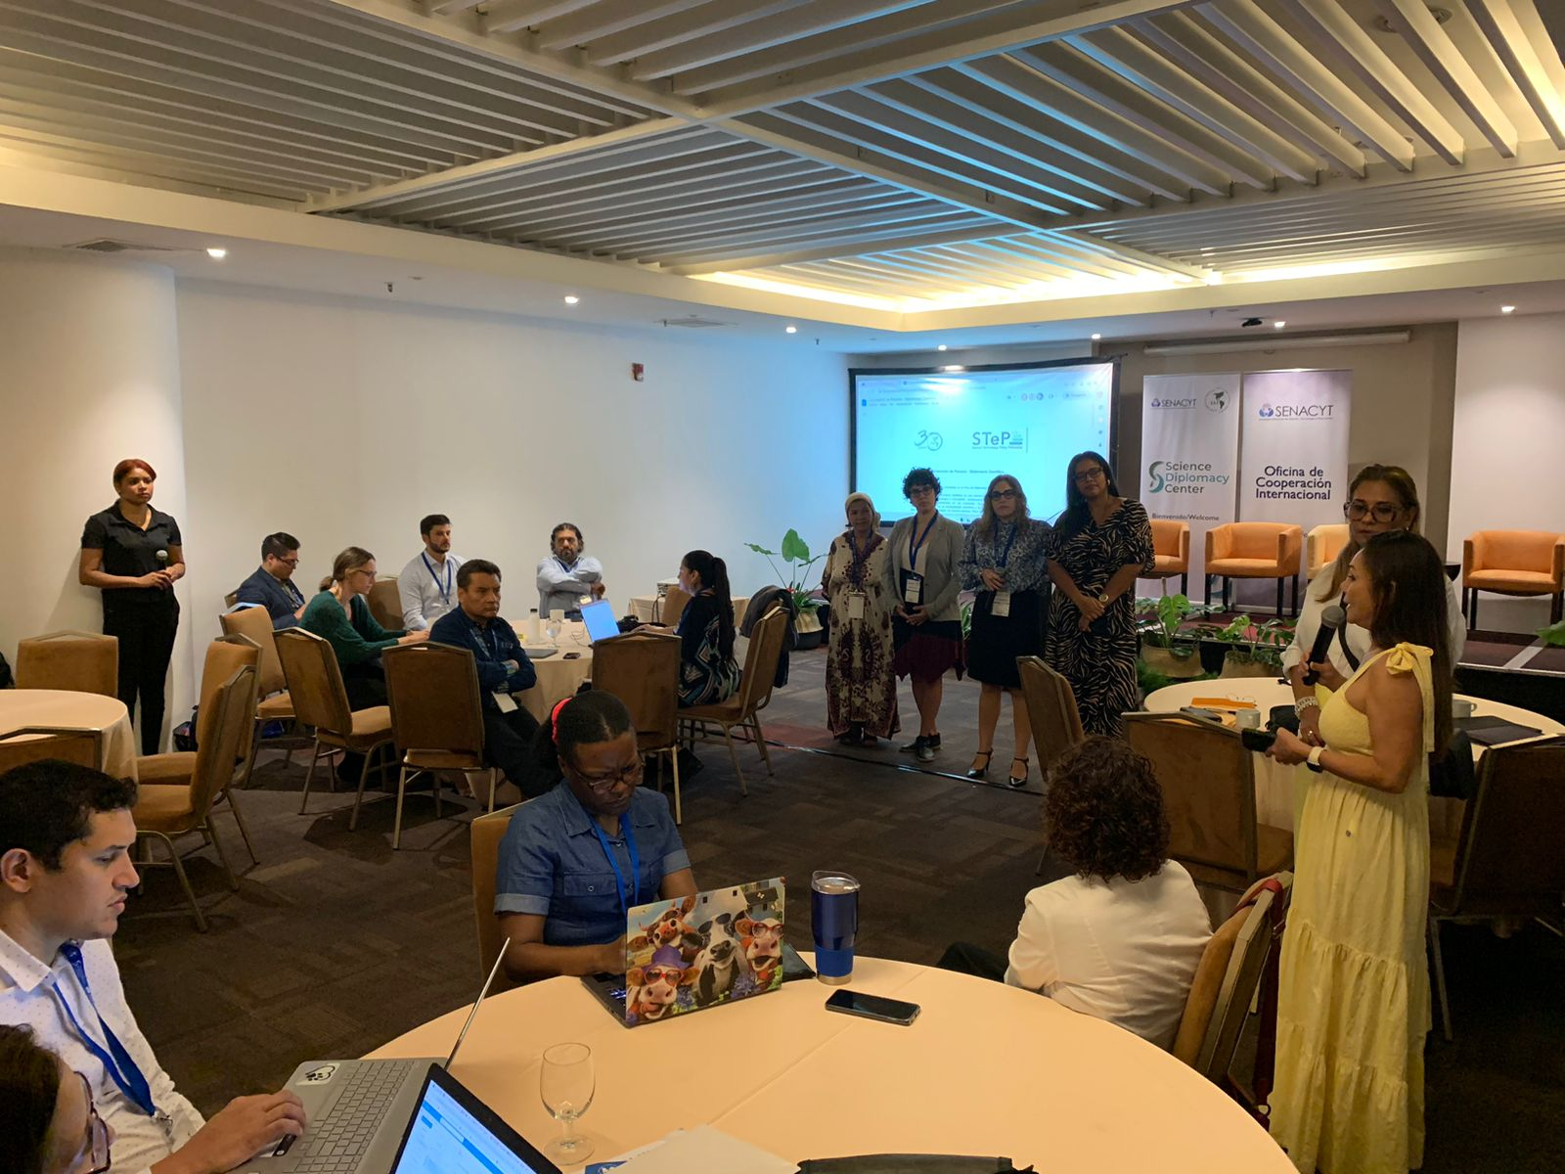
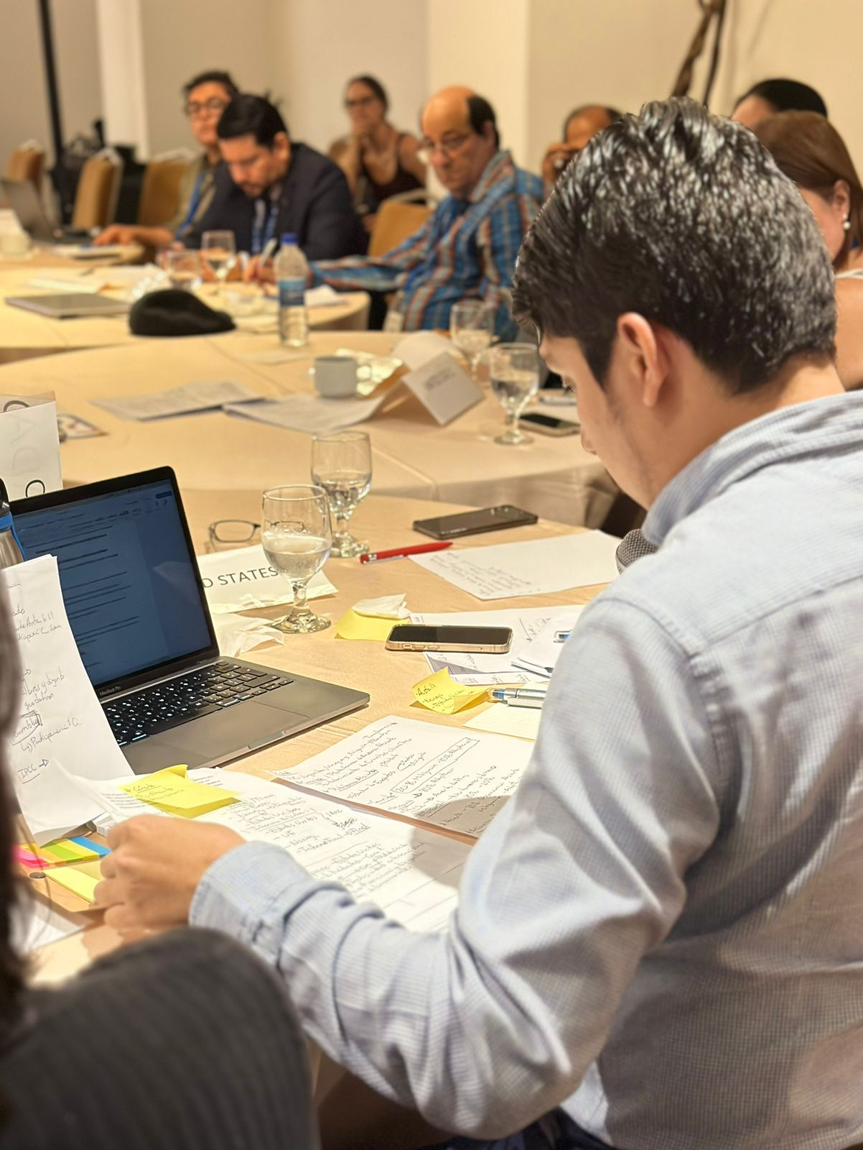
56th Executive Council Meeting
Workshop Content & Thematic Areas
Science Diplomacy concepts, instruments, regional examples
Science Diplomacy & Global Change in LAC
Intergovernmental processes relevant to GEC
National Science Diplomacy Strategies
Emerging/Evolving Issues in Science Diplomacy and Innovation
Science Advice to support policy processes
Science Diplomacy, Equity, Diversity, Inclusion-EDI
Climate Action, Biodiversity
Science Diplomacy skills: hands-on training/international negotiation - UNFCCC CoP

Slide 6
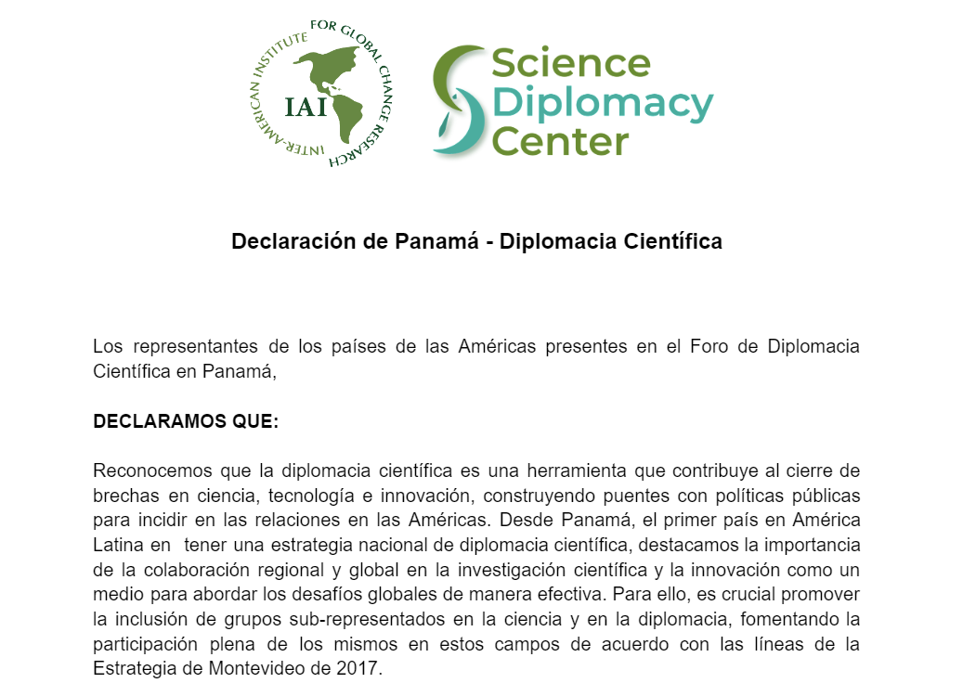
56th Executive Council Meeting
Main outcomes of the Panama Workshop
Panama Declaration: co-produced by government representatives + speakers at the Panama Workshop
https://docs.google.com/document/d/1YGVeZKaBox6K2apod1V9jhlNoKKb2-0BQ_1ADcv1Hrs
Itinerant workshops in 2024-2026: Expressions of interest for future Science Diplomacy events: Brazil, Paraguay, Chile.
Established SD national nodes
Sponsored by countries
IAI Science Diplomacy Center becoming regional reference & global connections:
Side Event at GRC Americas meeting (7-9 Nov 2023, Argentina)
Partnerships DiploCientifica, EU, GESDA

Slide 7
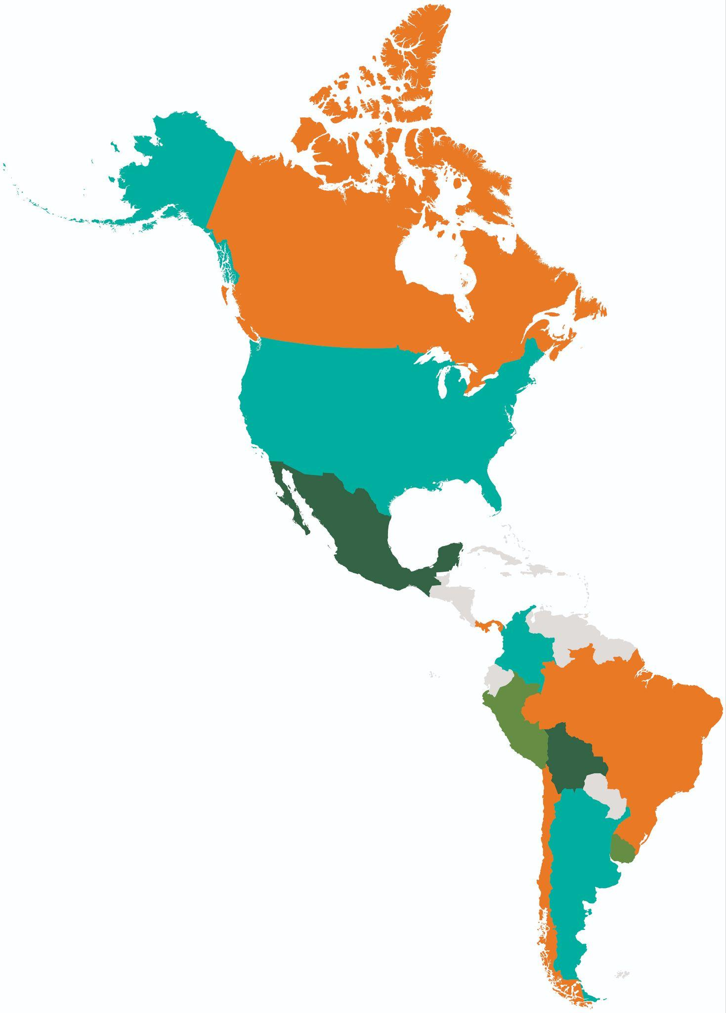
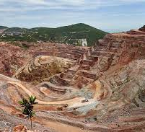
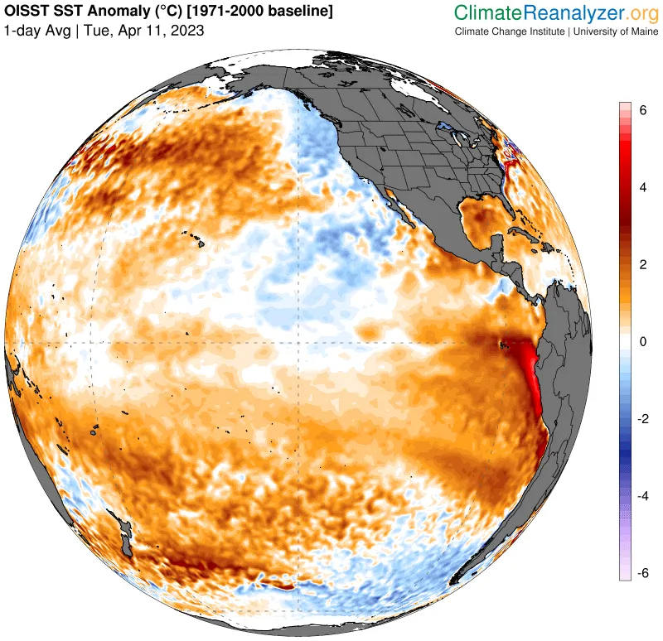
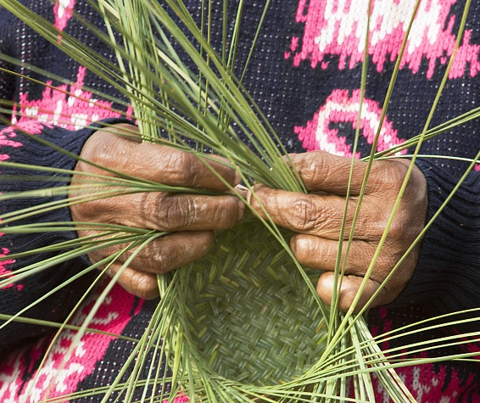
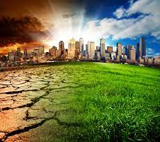
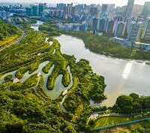
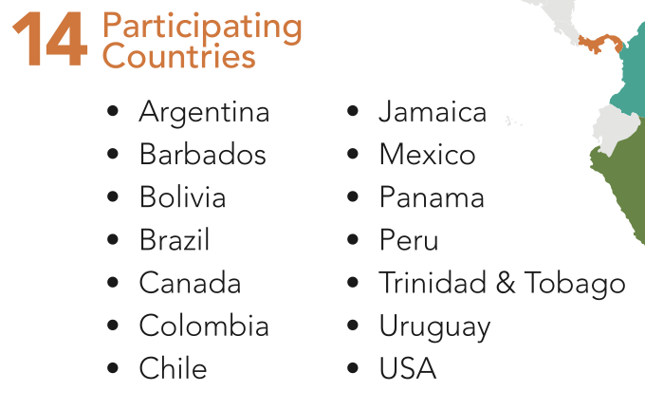
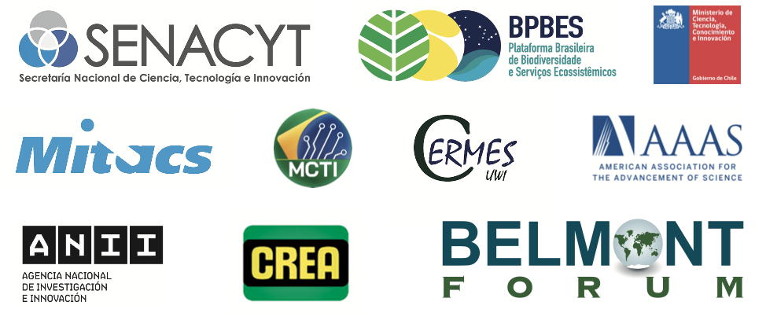
Science Technology and Policy (STeP) Fellowship Program Update
Professional Development 2023-2024
Science Diplomacy Projects
Fellows working in multi-country and multidisciplinary teams with mentors through April 2024 on the following topics
Orientation
Introduction to Multinational Organizations
International Decision Making Process
Transdisciplinary Approach to Science and Life
Communication in the Science Policy Interface
Evidence Documents for Decision Makers
Technical Considerations for writing and delivering an evidence note
United Nations Oceans Conference (UNOC) Stakeholder Meeting
El Niño and Health in LAC: how are countries/ sectors preparing?
Analysis of Local Community and Indigenous Peoples Committees in international/multilateral organizations
Science Diplomacy and Emerging Issues Affecting Climate Change: AI and Blockchain technology
Global Health and One Health and non-economic loss and damages (NELDs) in the Americas.
Assessment of Green Infrastructure in Cities for Climate Change Resilience across LAC
Comparative analysis of the implementation of oil drilling and mineral mining bans in LAC
Analysis and Impact of Climate Governance
Science Diplomacy
Introduction to Science Diplomacy
Science Diplomacy Tools and Project Brainstorming
Introduction to the UNFCCC
Conflict Resolution and Consensus Building Theory
Diplomatic Protocol for Scientists
*Monthly Office Hours
Under Development: STeP Conference: April 22-24, 2024 in Antigua Guatemala

Slide 8
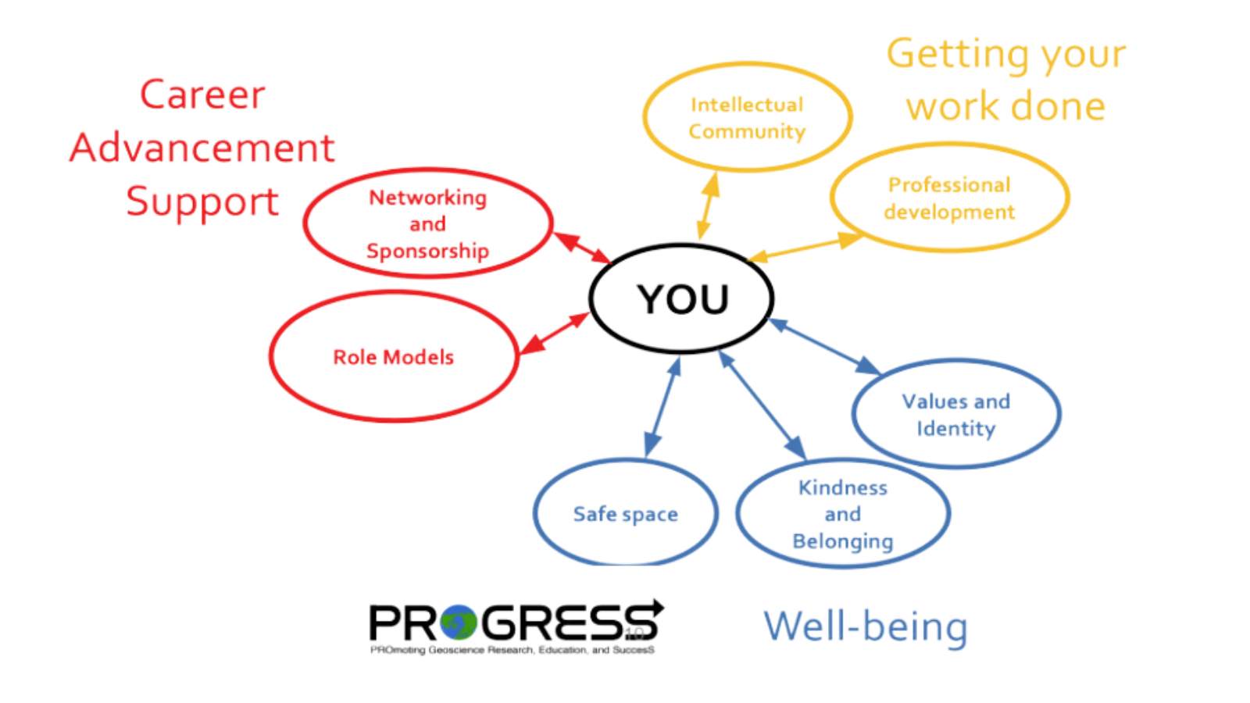
Science Technology and Policy (STeP) Fellowship Program Update
Ongoing Program Implementation Activities
Mentorship Program & Alumni Engagement Strategy
Objective: Strengthen the individual network of the STeP Fellows so they may better align skills and values needed to thrive in a transdisciplinary science-policy interface.
Supervisor Engagement Strategy
Objective: Create a community and network for fellow host institutions to share strategies for the institutionalization of STeP fellowship programs.
Action STePs
Objective 1: Capture, highlight and share the individual, on-the-ground, impact of STeP Fellows.
Recruitment & Selection Generation 4 (May 2024-2025)
Create Professional Development Schedule 2024-2025
Fundraising & In-Kind support
Planning beyond pilot pase: long-term program implementation

