Slide 1
56th Meeting of the IAI Executive Council
Video conference
14 November, 2023

Slide 2
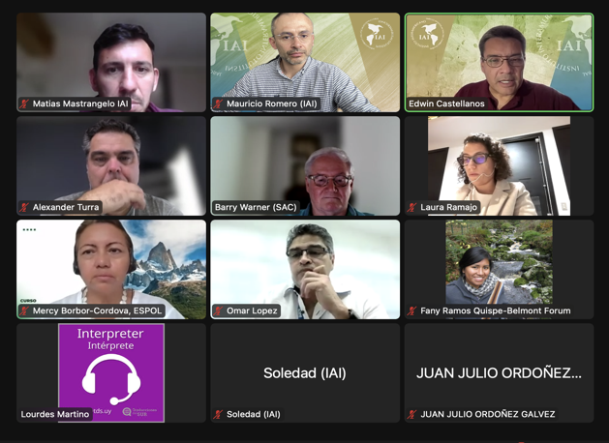
Research and training program on the nexus between oceans, islands and coastal systems.
The Oceans, Islands and Coastal Regions
Committee was formed and monthly meetings
are being held to define priority topics.
Discussion is starting on the next Belmont Forum
CRA which will focus on oceans.
Participated in the parallel event:
“Establishing a joint scientific agenda for the Americas: How can research councils contribute to the sustainability of the oceans?” during the regional meeting of the Global Research Council in Buenos Aires in November.
A side event will be held at the Oceans Pavilion during COP 28 in Dubai.
Notes:
The committee is made up of representatives from the SAC, Parties, staff, STeP fellows and associates. Monthly work meetings are being held to define the priority topics on which the IAI will focus.

Slide 3
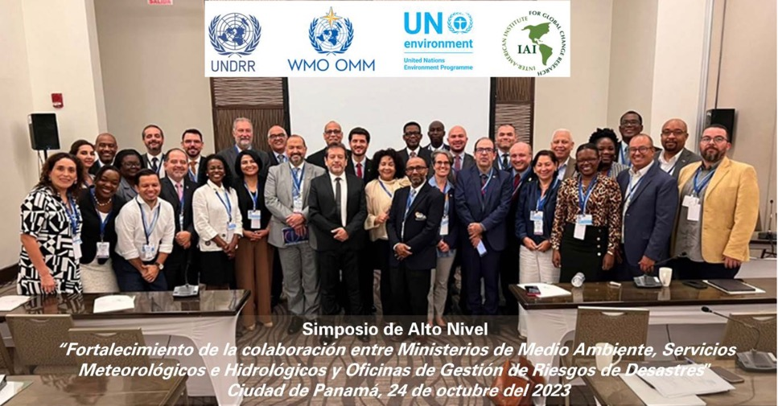
Participation during the Latin American Climate Week.
The central event was a High Level Symposium on “Strengthening collaboration between Ministries of Environment, Meteorological and Hydrological Services and Disaster Risk Management Offices”.
Participated in events on climate services and the use of early warning systems on health, drought, fires and other issues.
An event was held on Climate Resilient Development in the Central American Dry Corridor organized by the recently formed Central American Science Network on Climate Change RC4.
Notes:
The Executive Directorate had extensive participation during the Latin American Climate Week in Panama, where it participated in 5 events.

Slide 4
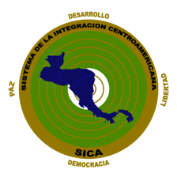
Participation during COP28 in Dubai.
The Executive Directorate will have extensive participation during COP 28 of the Framework Convention on Climate Change in Dubai.
Guatemala is being supported as the pro tempore Presidency of the AILAC Group, which includes Chile, Colombia, Costa Rica, Panama, Honduras, Paraguay and Peru.
Two events on climate and health will be organized, one in the Ecuador Pavilion and the other in the Guatemala Pavilion.
Two events will be organized in the Dominican Republic Pavilion, one on Scientific Diplomacy and another on the use of emerging technologies for mitigation.
An event will be organized in the Pavilion of the Central American Integration System SICA on climate change, water and agriculture.

Slide 5
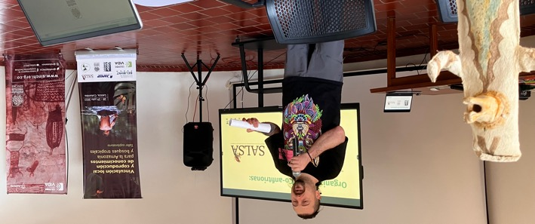
Other research and training activities.
The IAI Executive Directorate continued developing the CRA on Amazonia and Tropical Forests with FAPESP and the Belmont Forum. This call for research grants will be presented at the Belmont Forum plenary in November 2023, and the call is expected to be launched in June 2024.
Leticia workshop
A regional workshop on GEO Andes Mountains is being developed with the Mountain Research Initiative (MRI), IDEAM Colombia, the Humboldt Institute, ANDEX and AmeriGEO (Bogotá́, Colombia, February 20-22, 2024). The participation of 30 experts from the region is expected and the invitations and call are now open.
Notes:
In-person workshops were held with STRI in SRI Panama, and in Leticia, Colombia, with SINCHI and the Humboldt Institute. Virtual workshops were also held with stakeholders from Asia and Africa in July and October 2023.

