Slide 1
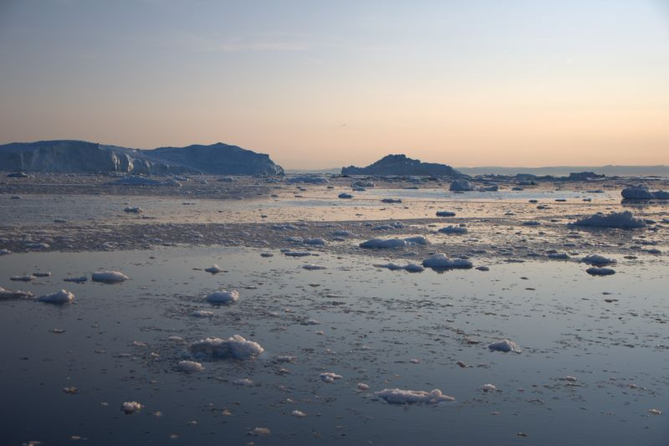
Reflecting Sunlight
Also referred to as
Solar Geoengineering,
Solar Radiation Modification,
Solar Climate Intervention
Sunlight Reflection Methods
Climate Engineering
Douglas MacMartin
Mechanical & Aerospace Engineering, Cornell University
Notes:
I think everyone here knows how fast the Arctic is changing, and already doesn’t look like it did a generation ago, and it’s going to change a lot more. In addition to cutting emissions of CO2, there is a possible option that could be considered that would cool the Arctic or the entire planet; that doesn’t mean it’s a good idea or a bad idea, that’s going ultimately going to be a hard choice to make. I’m only going to introduce a bit about what we know and don’t know.

Slide 2
We do not have a guaranteed strategy to avoid significant climate change
Business as usual
You are here
Cut emissions aggressively
Climate Impacts
1
CO₂ removal (“CDR”)
3
2
BECCS
Direct air capture
Afforestation
Soil mgmt…
Solar geoengineering?
Stratospheric aerosols
Marine cloud brightening
Time
Notes:
I’m going to talk really briefly about some of the geoengineering options, both for removing CO2 from the atmosphere, and for “solar geoengineering”, as well as how these fit into an overall strategy for managing climate change. The default strategy to date has been focused only on cutting carbon emissions – and that remains absolutely essential – but unfortunately at this point it looks like it will be pretty hard to cut emissions fast enough to stay below 2C, let alone 1.5. Current pledges as part of the Paris agreement are likely to lead to something more like 3 degrees of warming, and while we can do better than that, none of the economic models give solutions to hit 2C without really massive amounts of CO2 removal – of order 600 Gt by the end of the century.
Its also important to remember that cutting emissions to ZERO simply stabilizes the climate, and stops making things worse.
So that leaves us with 4 options to choose in some combination: accept higher temperatures, cut emissions more aggressively, massive CO2 removal, and solar geo.
CO2 removal or net-negative emissions are already included in most of the IPCC scenarios, typically in the form of BECCS – bioenergy with carbon capture and sequestration, so you grow plants, burn them in a power plant, suck the CO2 out of the flue gas, and store that underground somewhere. Some amount of CDR will always be needed to balance sources that are hard to eliminate, but CDR can also play an important role in the long term, by providing a way to ultimately resolve the climate problem. Because this gets at the actual problem, from a purely climate perspective this is low risk, although the actual approaches may have issues such as land-use competition for BECCS. There’s various other ideas for CO2 removal as well, including direct air capture, using chemical means to pull CO2 out of the atmosphere and then store underground, which is feasible but likely expensive, and things like afforestation and better carbon-smart soil management that can be components of a solution but are not scaleable enough to deal with the full level of CO2 removal required. Really broadly, everything in this category tends to involve some combination of expensive or hard to scale up or both, and with potentially important local impacts.
Solar geoengineering, in contrast, would be quick, but would have global effects. The main idea discussed is to put aerosols into the stratosphere to reflect a percent or two of sunlight back to space in order to cool the planet; we know that would work because large volcanic eruptions do it every now and then. The other main idea discussed is marine cloud brightening; basically spray sea salt into low marine clouds to make them more reflective. In principle you could do this from space, but the cost of that would almost certainly be prohibitive.
These approaches could provide a way of limiting damages during an overshoot scenario like this; that is, it is plausible that following this “blue” pathway is less risky than following the “green” one, though there’s too much uncertainty to answer that question today, and the risks are both climate risks and sociopolitical ones. But, for example, if this green pathway led to several metres of SLR that could be avoided, it is worth understanding what solar geoengineering might do. The reason these ideas might play a role in an overall strategy for managing climate risk is that they can act quickly.

Slide 3
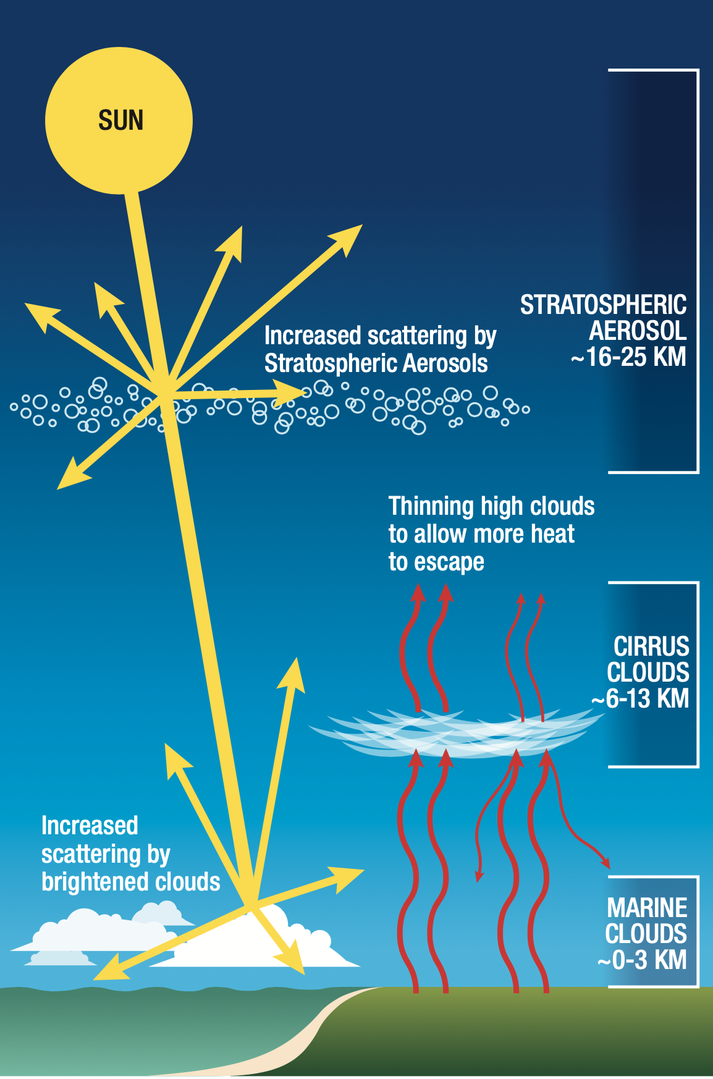
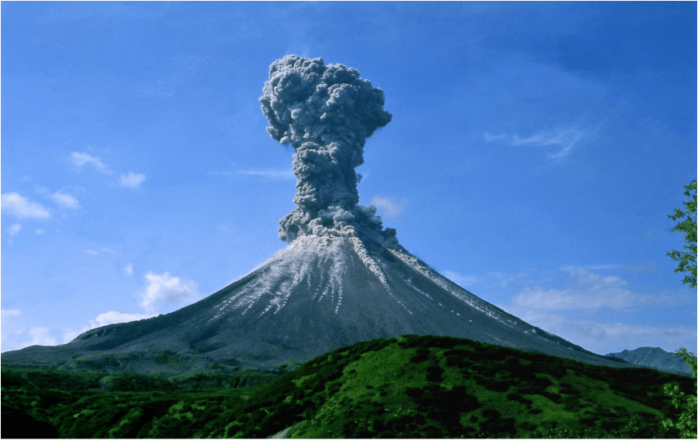
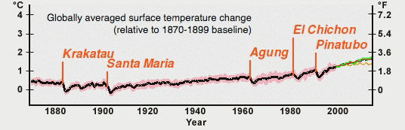
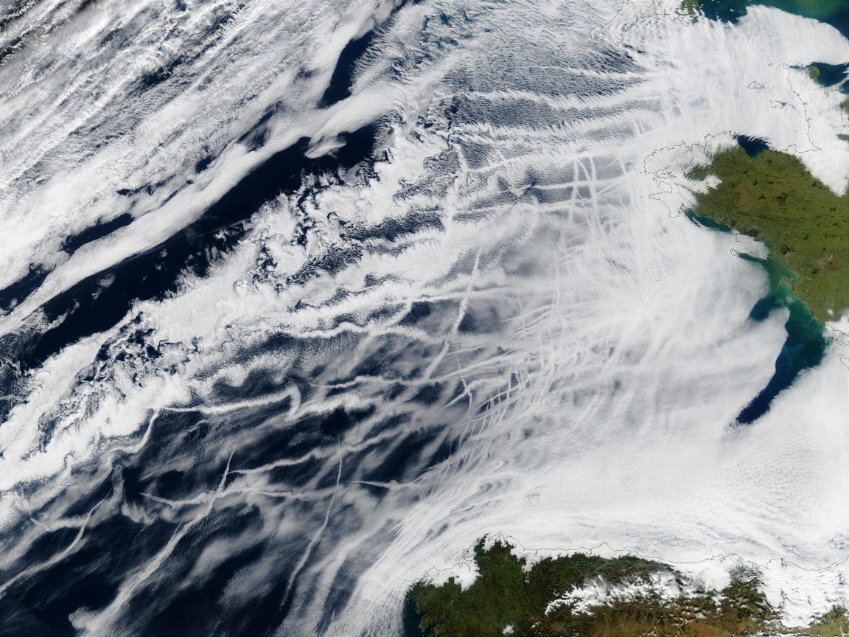
Stratospheric Aerosol Injection (SAI)
Marine Cloud Brightening (MCB)
Ship tracks off Europe’s Atlantic Coast (NASA)
US NASEM report, 2021
Notes:
Basic idea behind SRM: if you reflect more sunlight back to space, you will cool the planet.
There are a few ideas for how one could do this. This particular graphic comes from recent US Natl Ac report; one might be able to make some clouds over the ocean brighter, it’s possible that you could reduce cirrus cloud cover, which would result in cooling, and the one that I will focus on is stratospheric aerosols – putting small reflective droplets high enough in the Earth’s atmosphere that they stay there for a while; of order a year if you inject in the tropics, less if you inject at higher latitudes.
We know that this would cool because nature does this every now and then – the picture here is from the eruption of Mt. Pinatubo in the Phillippinnes that erupted in 1991, and cooled the planet by of order half a degree Celcius the following year.
In principle you could get the same effect by flying aircraft into the stratosphere; most of the research has focused on doing this at lower latitudes, and you’d need to develop new aircraft to do that. But one could also put the aerosols into the stratosphere at higher latitudes, like where we are now – and that could be done with existing aircraft.

Slide 4
Comparing SAI and MCB
Stratospheric aerosols better understood
Clear observational analog provides basis for climate modeling
Marine cloud brightening needs small experiments to understand physics
MCB could be done more regionally; SAI is inherently more global
Could do SAI at high latitudes to focus more on Arctic
Could do MCB even at very small scale, e.g., Great Barrier Reef in Australia
Using MCB to cool the planet would result in more heterogeneous changes
Different side effects
SAI would lead to some polar ozone loss, acid rain deposition, etc
MCB might have effects on marine biology
Public acceptability
Spraying salt over remote ocean regions vs spraying pollution into upper atmosphere…

Slide 5
Climate Model Simulations (of global SAI)
1
1° warming from CO₂ offset by 1° cooling from strat. aer.
3
2
1° warming from CO₂
Temperature (per degree)
Precipitation (per degree)
MacMartin et al, JGR 2019
Notes:
So before I talk too much about governance, just one slide showing some modeling results to put SRM in context. This happens to be for SAI, in one model; on the left is the patterns of temperature and precipitation change you’d get if you allow the climate to warm by a degree, and on the right, on the same scale, is if you offset that warming with stratospheric aerosols. Fundamentally, this is why people talk about this, because the modeling suggests that it could reduce a lot of climate impacts. The details matter, though. First, of course, the modeling is uncertain, and putting up any plot like this might make this seem more real than it should. And second, while on average there’s a lot less change in the right column, note for example that in this simulation India is dryer.
And just to make things a bit more complicated, the details – things like the precipitation change over India, depend on details of how things are done, so for SAI, changing the time of year that you inject aerosols or the latitudes or how much you do can give you a result where the precipitation over India is unchanged, but maybe it’s worse somewhere else. The reason to point that out is simply to point out that this isn’t just “one thing”.

Slide 6
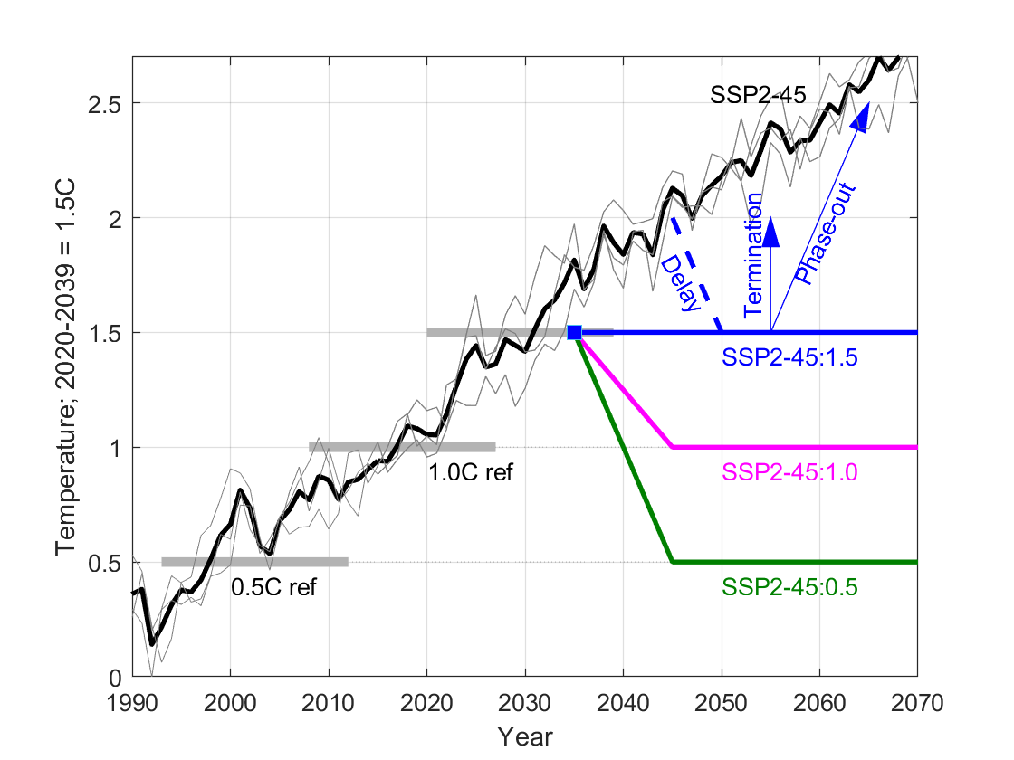
Scenarios & Strategies
SSP2-4.5
Equatorial injection
High-latitude injection
Balanced strategy
Interruption
How much cooling?
Risks from termination, interruption, etc?
What latitudes for aerosol injection?
Not yet simulated… more uncoordinated or inconsistent deployment
MacMartin et al., PNAS, 2022
Zhang et al., in prep.

Slide 7
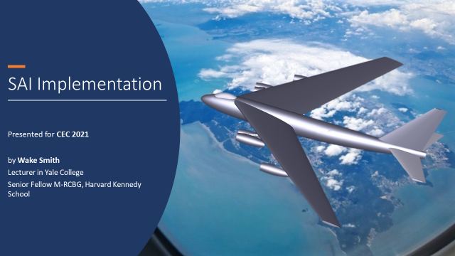
Implementation?
No aircraft exist that can loft sufficient payload to sufficient altitude*
Not fundamentally difficult to design an airplane that can get to ~21km (70,000 feet): Maybe $5B and 5 years to develop?
Engine technology limited to only a few countries
Cost of deployment might be tens of $B per year
*Possible to start deployment at high-latitude with existing aircraft
Notes:
Credit (obviously) to Wake Smith

Slide 8
What we know
In principle straightforward to do
cost measured in $B
relatively few countries with capability
We know it would cool
Reduce sea level rise, heat extremes, etc.
Does not simply reverse climate change
E.g., residual changes in precipitation
Outcomes depend on how it is done
E.g., latitudes to inject
Other impacts; e.g. for SAI:
Ozone loss
Acid rain deposition
Changes in direct / diffuse sunlight
Risks from societal dimension:
Effect on mitigation? (“Moral hazard”)
Potential for conflict?
Termination “shock” if ended abruptly
Broader set of scenarios under-explored
Relatively limited research to date
Mostly developed world
Mostly Earth System Modeling
“Curiousity” rather than mission-driven

Slide 9
What do we know? What do we need to know?
Imagine the year is 2030…
Emissions have peaked and are declining, but
Global mean temperature has just hit 1.5°C, projected to continue to rise to ~2.5°C
Massive heat-waves, forest fires, storms… Arctic summer sea ice is all but gone, Antarctic ice shelves show risk of collapse, permafrost is thawing…
Scientists say we can cool the planet but we don’t know the details of what might happen
What would you do?
What do you wish you knew?

Slide 10
What do we need to know? (Physical sciences focus)
What is our best estimate of the effects on things we care about?
Both the “good” and the “bad”
How confident are we? What are the risks?
How might one improve confidence? What are the limits?
How do these answers depend on scenarios and choices?
How much cooling, also how it is done.
What governance can improve the odds of making “good” choices and reduce the odds of “bad” ones?
Both governance of research and governance of deployment decisions

Slide 11
Research Needs (Physical Sciences)
Assessment
Develop broader set of scenarios
Climate modeling; understand physics
Impacts: Follow through to things that matter…
Assess uncertainty / risks
Systematic assessment of risks
Improve projections
Improve models (not just climate models)
Additional observations
Small-scale experiments
Understand what deployment might look like
How to deploy
Monitoring needs
Attribution?
These all need to be integrated
These need to be integrated with the human dimension
Research needs to be global

Slide 12
Summary
What does this mean?
“We” may need to think about all of the options…
Some form of SRM is the only way to quickly reduce temperatures
My personal view: We should do the research before we are facing hard choices
The hardest part will be how to decide…
Whose voices are heard?
How confident do we need to be?

Slide 13
Backup

Slide 14
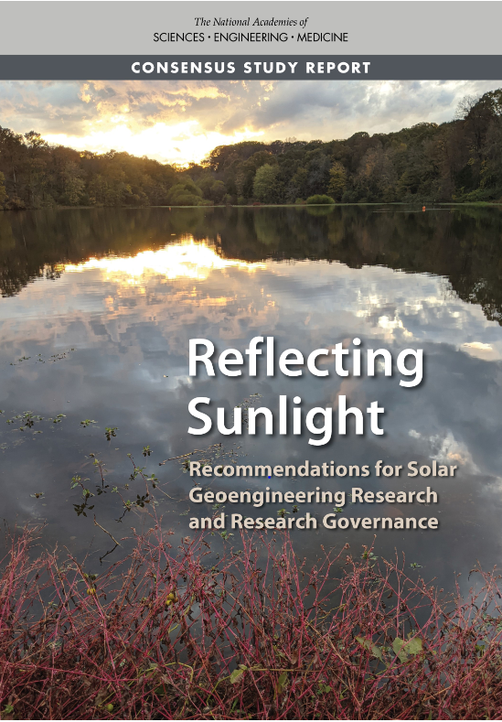
Key Messages
Given the urgent, growing risks of climate change, it is important to understand the feasibility, risks, and benefits of solar geoengineering as a possible addition to the portfolio of response strategies.
Solar geoengineering is not a substitute for reducing greenhouse gas emissions.
The current state of understanding of solar geoengineering is not sufficient for supporting informed decisions.
The U.S. should establish—in coordination with other countries—a transdisciplinary solar geoengineering research program. The U.S. Global Change Research Program should provide coordination and oversight for this program.
Solar geoengineering research should operate under robust research governance.

Slide 15
Messages
How this fits with rest of climate policy
What the ideas are, how confident we are
How MCB is different from SAI; regional vs global
Broad state of knowledge
Roughly what they might do.
Good
Bad
Uncertain
Dependence on cooling
Dependence on strategy
Research needs

Slide 16
What do we know?
We can cool the climate
The sign of the effect on many impacts (e.g. sea ice) is clear
There will be some changes to precipitation patterns
There will be other effects, e.g. ozone loss for SAI
We do not know whether/how choices might couple with broader climate policy
What do we need to know?
What are our choices? (E.g., how do effects depend on how much cooling)
What is our best estimate of impacts?
How confident are we?
1
3
2

