Slide 1

Building the capacity of developing countries to evaluate SRM
24 August 2022
Andy Parker
CEO – The Degrees Initiative
Hon Senior Research Fellow - University of Bristol
Notes:
Hello again everybody and welcome back to the afternoon session.
This presentation is designed to set the scene for the talks and discussion this afternoon. We will be getting updates on SRM activities in Africa, Asia, South America and the Caribbean, hearing how different regions are starting to engage with the issue of SRM.
I have been asked to give this overview because I’m one of the organising committee and I am also the founder of the Degrees Initiative, and as I mentioned this morning, we seek to build the capacity of developing countries to evaluate SRM. I’m going to tell you a bit about our work before handing over to this session’s two excellent speakers.

Slide 2
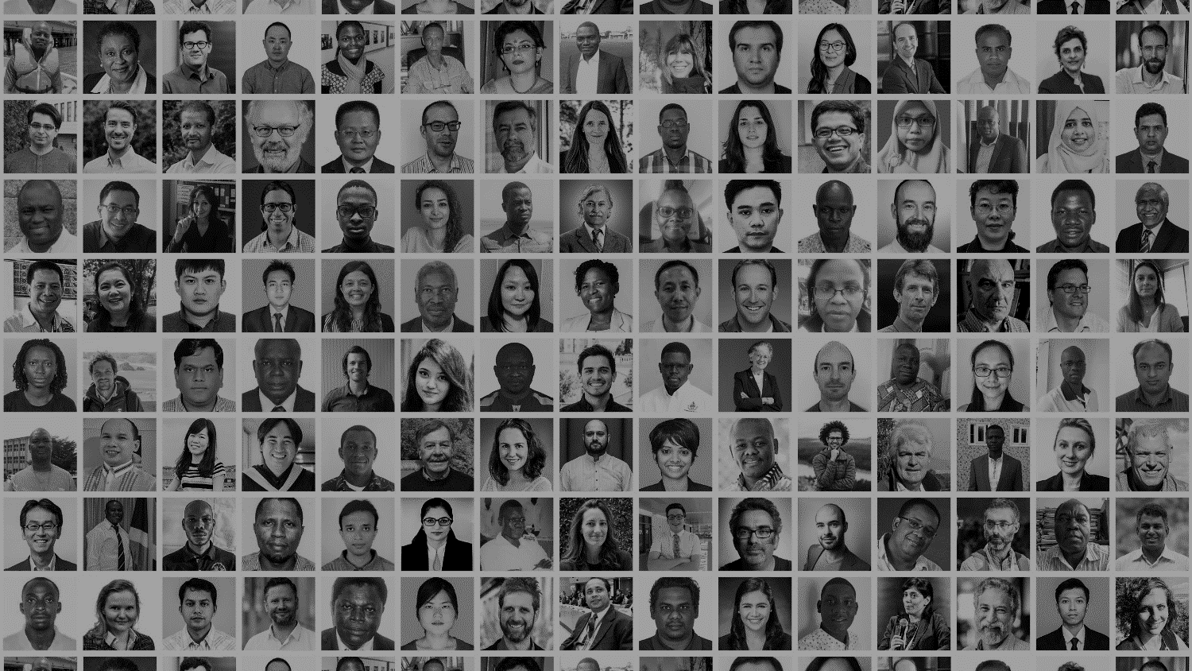
The Degrees Initiative
Developing country Governance, Research and Evaluation of SRM
Notes:
SRM is inherently a global issue, as we have heard from the excellent presentations so far. Its effects could not be limited to a single state or region and that means that every country has a stake in this discussion. And it’s in climate vulnerable countries where the stakes are highest.
As a result, Degrees has been working for over a decade to build the capacity of developing countries to evaluate SRM. In particular we focus on building expertise and creating a well-informed global community of experts to debate this controversial idea.
We are not in favour or against SRM, but we do think that more research is necessary if people are to make informed decisions, and we think a much wider global conversation is needed if people are to make equitable decisions

Slide 3
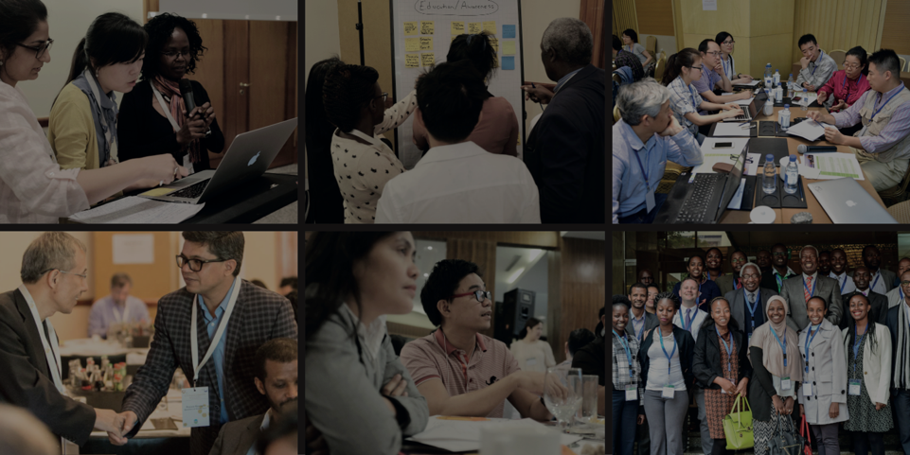
Outreach Workshops
Around the Global South
Notes:
Degrees was launched in 2010 as a partnership between the Royal Society – the UK national science academy where I used to work, Environmental Defense Fund – the green NGO from the USA. And TWAS - the academy of sciences for the developing world.
For most of the last decade we were known as the SRM Governance Initiative or SRMGI and we initially started out work by running engagement workshops in the Global South that bring new voices into the conversation.
Our events are always done in the same way: we partner with a respected local organisation, the focus is on listening rather than telling people what to think, and we never push for a consensus or group statement on SRM – it is far too early for this.
We have run more have 25 meetings and while they are an invaluable first step for connecting with people and hearing new ideas, but it became increasingly clear: we could run workshops for the next hundred years and we would not have built any expertise in the Global South. Where SRM expertise has developed, it has overwhelmingly happened where people have had the time and the money to engage with the topic over the long term, and typically this has come from people being supported to do their own research.
And so it became clear that we needed a research programme for the Global South. This was also an idea that was very commonly proposed and supported at our workshops. Wherever we went – from Bangladesh to Brazil – people would say 1) that they wanted local scientists to explore how SRM would affect their region – rainfall, agriculture, storms et. And 2) people told is that there was not enough research funding even for the climate science they wanted to do, let alone for a new and controversial topic like SRM.
So we set about building a research fund

Slide 4
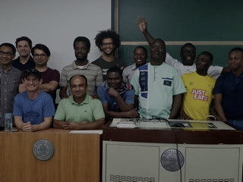
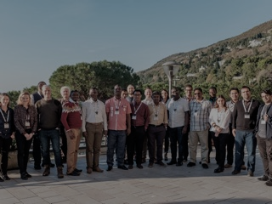
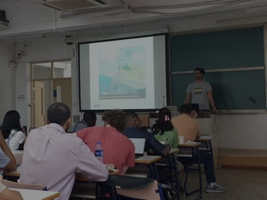
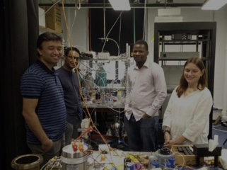
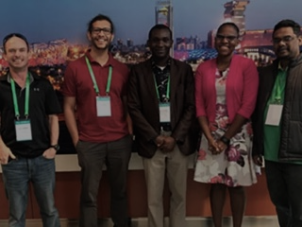
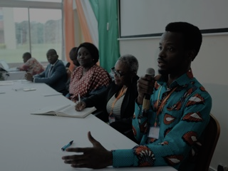
The DECIMALS Fund
Building SRM research capacity in the Global South
Notes:
I consulted widely in the Global North and South, and people like Prof Michael Taylor of UWI generously gave their time to advise on how we might set up a research programme. And in 2018 we launched the DECIMALS fund. DECIMALS stands for Developing Country Impact Modelling Analysis for SRM and it is the world’s first international SRM research fund and the first aimed exclusively at developing countries.

Slide 5
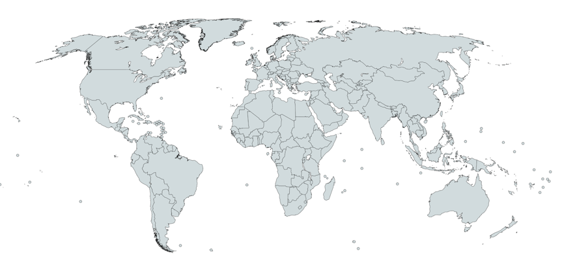
DECIMALS teams
Benin: West African precipitation and river discharge (2018-21) & SRM effects on climate change
Ivory Coast: Temperature and precipitation extremes & water resources over West and Central Africa (2018-21)
Iran: Storm tracks, dust storms and droughts in the MENA region
Bangladesh: Spread of malaria and cholera (2018-21) & impacts on hydrology
Jamaica: Effects on future climate & Caribbean agriculture
Philippines: Agriculture in Southeast Asia
Argentina: La Plata Basin’s hydroclimate in South America
Indonesia & SEA: Hydro-climatic extremes in Southeast Asia
South Africa: Drought, heat extremes and agriculture in Southern Africa
Kenya: Extreme rainfall and urban floods in East Africa
Notes:
DECIMALS was launched in with an open call for proposals and we received more than 75 applications for grants. Independent peer review recommended 11 projects for grants and so we have funded SRM research in Argentina, Jamaica, Benin, Ivory Coast, South Africa, Kenya, Iran, Bangladesh, Indonesia, and the Philippines.
The teams have free rein to design their own research questions and methods, and they work collaboratively with each other, and with a group of research collaborators from the Global North who volunteer their time to work with the teams,
It is hard to overstate how ground-breaking these projects have been. Collectively they are responsible for the first scientific research on SRM in:
South America
The Caribbean
Africa
The Middle East
Southeast Asia
Small Island Developing States
Least developed countries
This gives you an idea of how ground-breaking and how essential this work has been, and the teams have been producing top class research on how SRM could affect droughts in Southern Africa, dust storms in the Middle East, and the climate of the Caribbean. DECIMALS scientists are rightly taking their place as experts in the global conversation.

Slide 6
Next steps in the Americas and globally
Notes:
So we are blown away by the achievements of the DECIMALS scientists and the research fund has been more of a success than we could have hoped. But this was just the first step and we still have to go.
We are currently expanding and we just ran the second DECIMALS call for proposals. The applications are out for review at the moment but in another couple of months we will be announcing a new cohort of modelling teams, and I hope that some of these will be from the Americas.
We will also be launching a social science research programme
We want to support the expansion of the current teams
We will be organising more conferences and workshops to bring people together and build the global community
But here I also appeal for you input. We are going to hear this afternoon what is happening in Asia, Africa, South America and the Caribbean. But in the discussions I would like to hear your opinions:
- How can Degrees connect with new research teams in Central America and Mexico? We have never received a research proposal from this region
- How do we build collaboration for SRM research and governance activities, especially in the Americas (we will have a specific discussion on this later this afternoon)?
- Looking broader and with great ambition: how do we make sure that climate vulnerable developing countries are central to global efforts to understand and to govern SRM?

Slide 7
Thank you!
More information:
www.degrees.ngo
aparker@degrees.ngo

