Slide 1
Climate Change and livelihoods in Jamaica
Ashley Codner & Farrah Hansel Murray, Planning Institute of Jamaica
Americas Conference on Solar Radiation Modification: Science, Governance
and Implications for the Region
August 25, 2022
UWI, Mona

Slide 2
PRESENTATION OUTLINE
Jamaica’s Climate Context
Climate Sensitive Sectors and Impacts
Livelihoods in the Tourism Sector
Livelihoods in the Agriculture Sector
Adaptation and Mitigation
Conclusion
Photo credit: Ministry of Agriculture & Fisheries

Slide 3
Sensitivity
Jamaica’s Climate Context
Geographic location – Atlantic Hurricane Belt
Topography – Hilly interior, narrow coastal plain, extensive coastline
Key economic activities – Agriculture & Fisheries, and Tourism - are dependent on favourable climatic conditions and natural resources
Water resource recharge are dependent on rainfall
Agriculture is predominantly rainfed and practiced in open fields
Vulnerability

Slide 4
Projections
Jamaica’s Climate Context
Hotter temperatures -Temperature increases of 0.65° - 0.84°C by the 2030s; 0.86-1.10 °C by the 2050s, 0.82°-3.09°C for 2081-2100
Drier Conditions
Decrease in rainfall. The south and east showing greater decreases than the north and west
Up to 4% direr by 2030s, up to 9% drier by 2050s, up to 21% drier by EOC
Sea-level rise – 0.58 – 8.87m by EOC
More intense storms – higher rainfall rates, increased wind speeds
Increase in the number of intense storms (Cat. 4 and 5)

Slide 5
Impact of Extreme Climate Events on the Economy (1999- 2021)
Event | Year | Cost ($J Billion)
Drought | 1999/2000 | 0.73
Hurricane Michelle | 2001 | 2.52
May/June Flood Rains | 2002 | 2.47
Hurricane Charley | 2004 | 0.44
Hurricane Ivan | 2004 | 36.9
Hurricanes Dennis & Emily | 2005 | 5.98
Hurricane Wilma | 2005 | 3.6
Drought | 2005 | 0.52
Hurricane Dean | 2007 | 23.8
Tropical Storm Gustav | 2008 | 15.5
Drought | 2008 | 0.04
Event | Year | Cost ($J Billion)
Tropical Storm Nicole | 2010 | 20.6
Hurricane Sandy | 2012 | 9.9
Drought | 2014 | 0.9
March to June Flood Rains | 2017 | 4.05
Tropical Storms Zeta and Eta | 2020 | 2.5
Tropical Storm Elsa | 2021 | 0.035
Total |  | 130.485
Source: DaLA Reports (Planning Institute of Jamaica) & Ministry of Industry, Commerce Agriculture and Fisheries

Slide 6
National Development – lives & Livelihoods
Vision 2030 Jamaica
Sustainable Prosperity
GOAL 3 - Jamaica’s economy is prosperous
National Outcomes
A Stable macro economy
An enabling business environment
Internationally competitive Industry structures
Climate change is an immense risk that can threaten national development
GOAL 4 - “Jamaica has a healthy natural environment”
National Outcomes:
Sustainable management and use of environmental and natural resources
Hazard risk reduction and adaptation to climate change
Sustainable urban and rural development

Slide 7
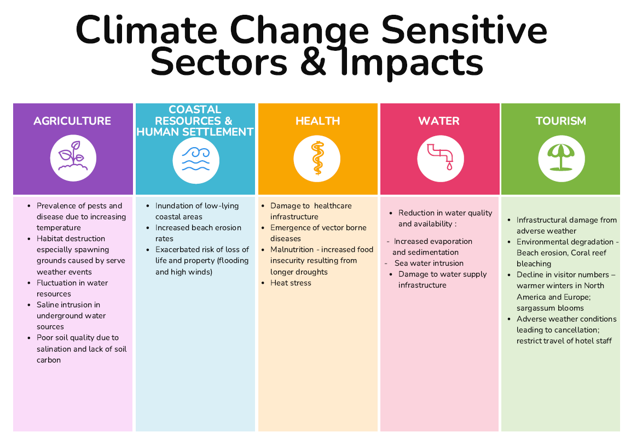

Slide 8
LIVELIHOODS IN THE TOURISM SECTOR

Slide 9
tourism and livelihoods
Economy- Contributing 4.2 per cent of Gross Domestic Product (PIOJ, 2021).
Foreign exchange - US$2,095.1 million (PIOJ, 2021).
Employment– average annual employment accounts for 7.8 % of the labour force
Linkages with Agriculture sector for fresh produce

Slide 10
Impact of Climate Change on Tourism
Climate Change Indices
- Quality of Natural Resources
- Holiday Climate Index
Factors contributing to indices
Decline in coral reef health
Beach erosion
Sargassum blooms
Poor water quality
Increased ambient temperatures
Hydrometeorological events

Slide 11
Impact of Hurricane Ivan on tourism
Damaged property and Loss revenues
Damage to hotel and restaurant infrastructure from winds and storm surge
Beaches and coral reefs sustained damage from storm surges
Cruise ships diverted from Jamaican ports
Livelihoods
Temporary loss of employment (Direct &Indirect; Formal & Informal)
Reallocation of workers to maintenance and rehabilitation activities

Slide 12
LIVELIHOODS IN THE AGRICULTURE SECTOR

Slide 13
agriculture & livelihoods
Rural Life – 46 per cent of population live in rural areas (STATIN, 2011).
Economy - Contributing 8 per cent of Gross Domestic Product (PIOJ, 2021).
Foreign exchange - Export earnings of US$80.4 million (PIOJ, 2021).
Food security – 770,456.2 tonnes domestic food crops (PIOJ, 2021) accounts for almost half of local consumption.
Employment – over 200,000 farmers and over 28,000 fishers. On average 191,133 persons, 15.5 per cent of the labour force (PIOJ, 2021).

Slide 14
Agriculture Production Index in Relation to Extreme Climate Events (2000-2021)

Slide 15
IMPACT OF DROUGHT ON LIVELIHOODS IN THE AGRICULTURE SECTOR
In 2014, severe drought conditions impacted the island.
Extremely severe in Southern parishes (the bread-basket region of Manchester and St Elizabeth).
Approximately, 16,398 farmers suffered losses.
Average farm household 4 - 5 persons.
Approximately,1,600 hectares, valued at just under $900M was lost or damaged due to drought and bush fires.
Shop keepers, processors, truckers experienced disruption in income.

Slide 16
IMPACT OF hurricanes ON LIVELIHOODS IN THE AGRICULTURE SECTOR
In 2007, Hurricane Dean, Category 4
Farming communities were most severely affected.
56, 537 food crop farmers and 7, 170 livestock farmers were negatively affected
J$23.8 Billion in damage and losses to the sector.

Slide 17
IMPACT OF hurricane DEAN ON LIVELIHOODS IN THE AGRICULTURE SECTOR
Banana Industry
Livelihoods of over 3,000 persons were directly affected while 8,000 persons (shop keepers, truck operators, processors) were indirectly impacted.
810 growers/suppliers of the domestic and export markets affected.
2,358.7 hectares damaged (export and domestic sector).
Estimated J$525 million in damages.

Slide 18
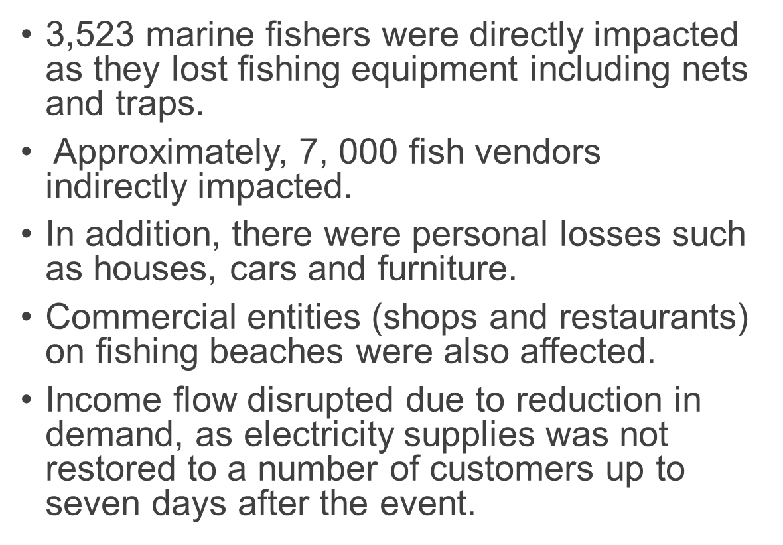
IMPACT OF hurricane DEAN ON LIVELIHOODS IN THE AGRICULTURE SECTOR

Slide 19
ADAPTATION &Mitigation
Photo credit: National Irrigation Commission

Slide 20
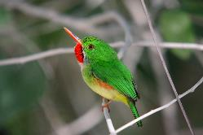
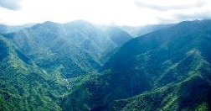
Adaptation to preserve Livelihoods in the Tourism Sector
Transition from Sun, Sand and Sea
- creates jobs, new opportunities and strengthens local economic
Explore:
Land-based eco-tourism
Rural community tourism
Cultural tourism
Visual Arts & entertainment
Food
History
Training:
Guides
Entrepreneurship
DIVERSITIFICATION
TRAINING

Slide 21
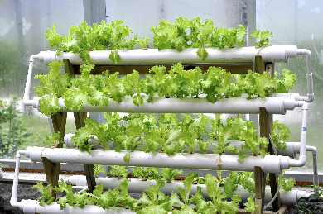
Adaptation for the AGRICULTURE Sector
Building Adaptive Capacity
Restoration
Improving Data
Restoration of degraded watershed through Integrated Land and Sustainable Landscape Management
Installation of soil moisture probes
Automatic weather stations
Installation of weather radar tower and Droppler Weather Radar
State of the Jamaica Climate Volumes I ,II, III
1800 MICRO check dams
Aquaponics
Climate smart greenhouses
Procurement and distribution of timber and fruit tree to restore denuded slopes

Slide 22
Mitigation
Updated Nationally Determined Contribution
25.4 % (unconditional) and 28.5 % (conditional upon international support) by 2030
Equates to 1.8 MtCO2e to 2.0 MtCO2e, relative to 2005 baseline
Areas of focus – Energy ; Land use and Forestry
Adaptation Co-benefits cross cutting all sectors

Slide 23
CONCLUSION
Primary economic sectors are climate sensitive.
Symbiotic relationship between economy and environment.
Agriculture and Tourism sectors are highly vulnerable to climate change.
Livelihoods have been negatively impacted by hydrometeorological events.
Multiple effect across the value chain and within households.

Slide 24
THANK YOU!
Photo credit: Ministry of Agriculture & Fisheries

