Slide 1
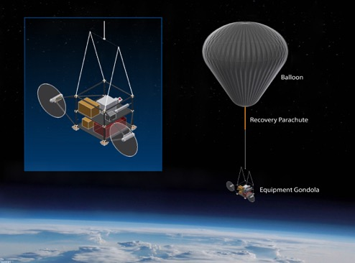
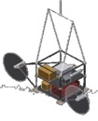
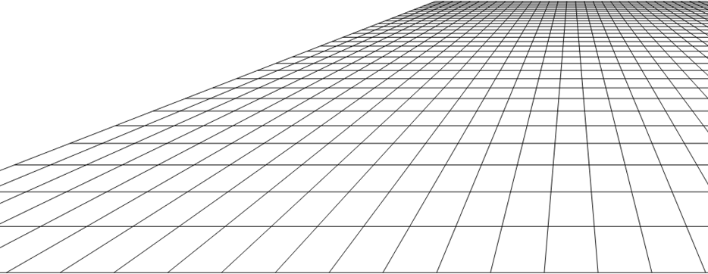
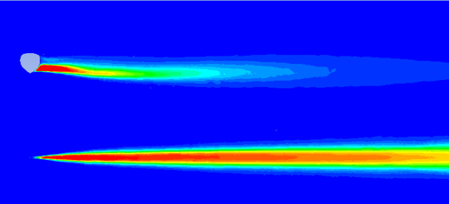
The Stratospheric Controlled Perturbation Experiment (SCoPEx): Science Motivation and Design
Frank Keutsch, Harvard University, August 25 2022
Americas Conference on Solar Radiation Modification:
Science, Governance and Implications for the Region
University of the West Indies, Kingston, Jamaica

Slide 2
What information would you need to decide whether intentional perturbative experiments should move forward?

Slide 3
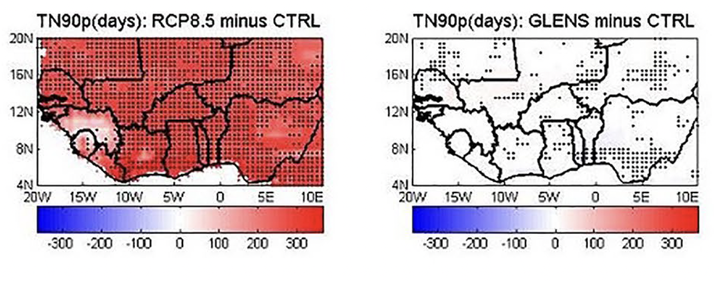
Stratospheric Aerosol Injection Research:
Nearly Exclusively Models
Number of warm nights are significantly lower with SAI
Models often show significant risk reduction from SAI
What observations are needed to relate model world to the real world?
3
Alamou, E. A. et al. Journal of Geophysical Research 2022
Notes:
Add reference

Slide 4
Stratospheric solar geoengineering research: the need for field experiments
Predictions
Temperature
Precipitation
Circulation
Diffuse Radiation
Ozone,
Impacts…
Models
Updated
Mechanisms
Inform new
studies
Field
Observations
Physics,
Laboratory Studies
Observations of:
- Natural perturbations: volcanic eruptions, thunderstorms and wildfires
- Unintentional human perturbations: rocket and aircraft plumes
- Intentional human perturbations: perturbations for process level studies, NOT, for global climate response.

Slide 5
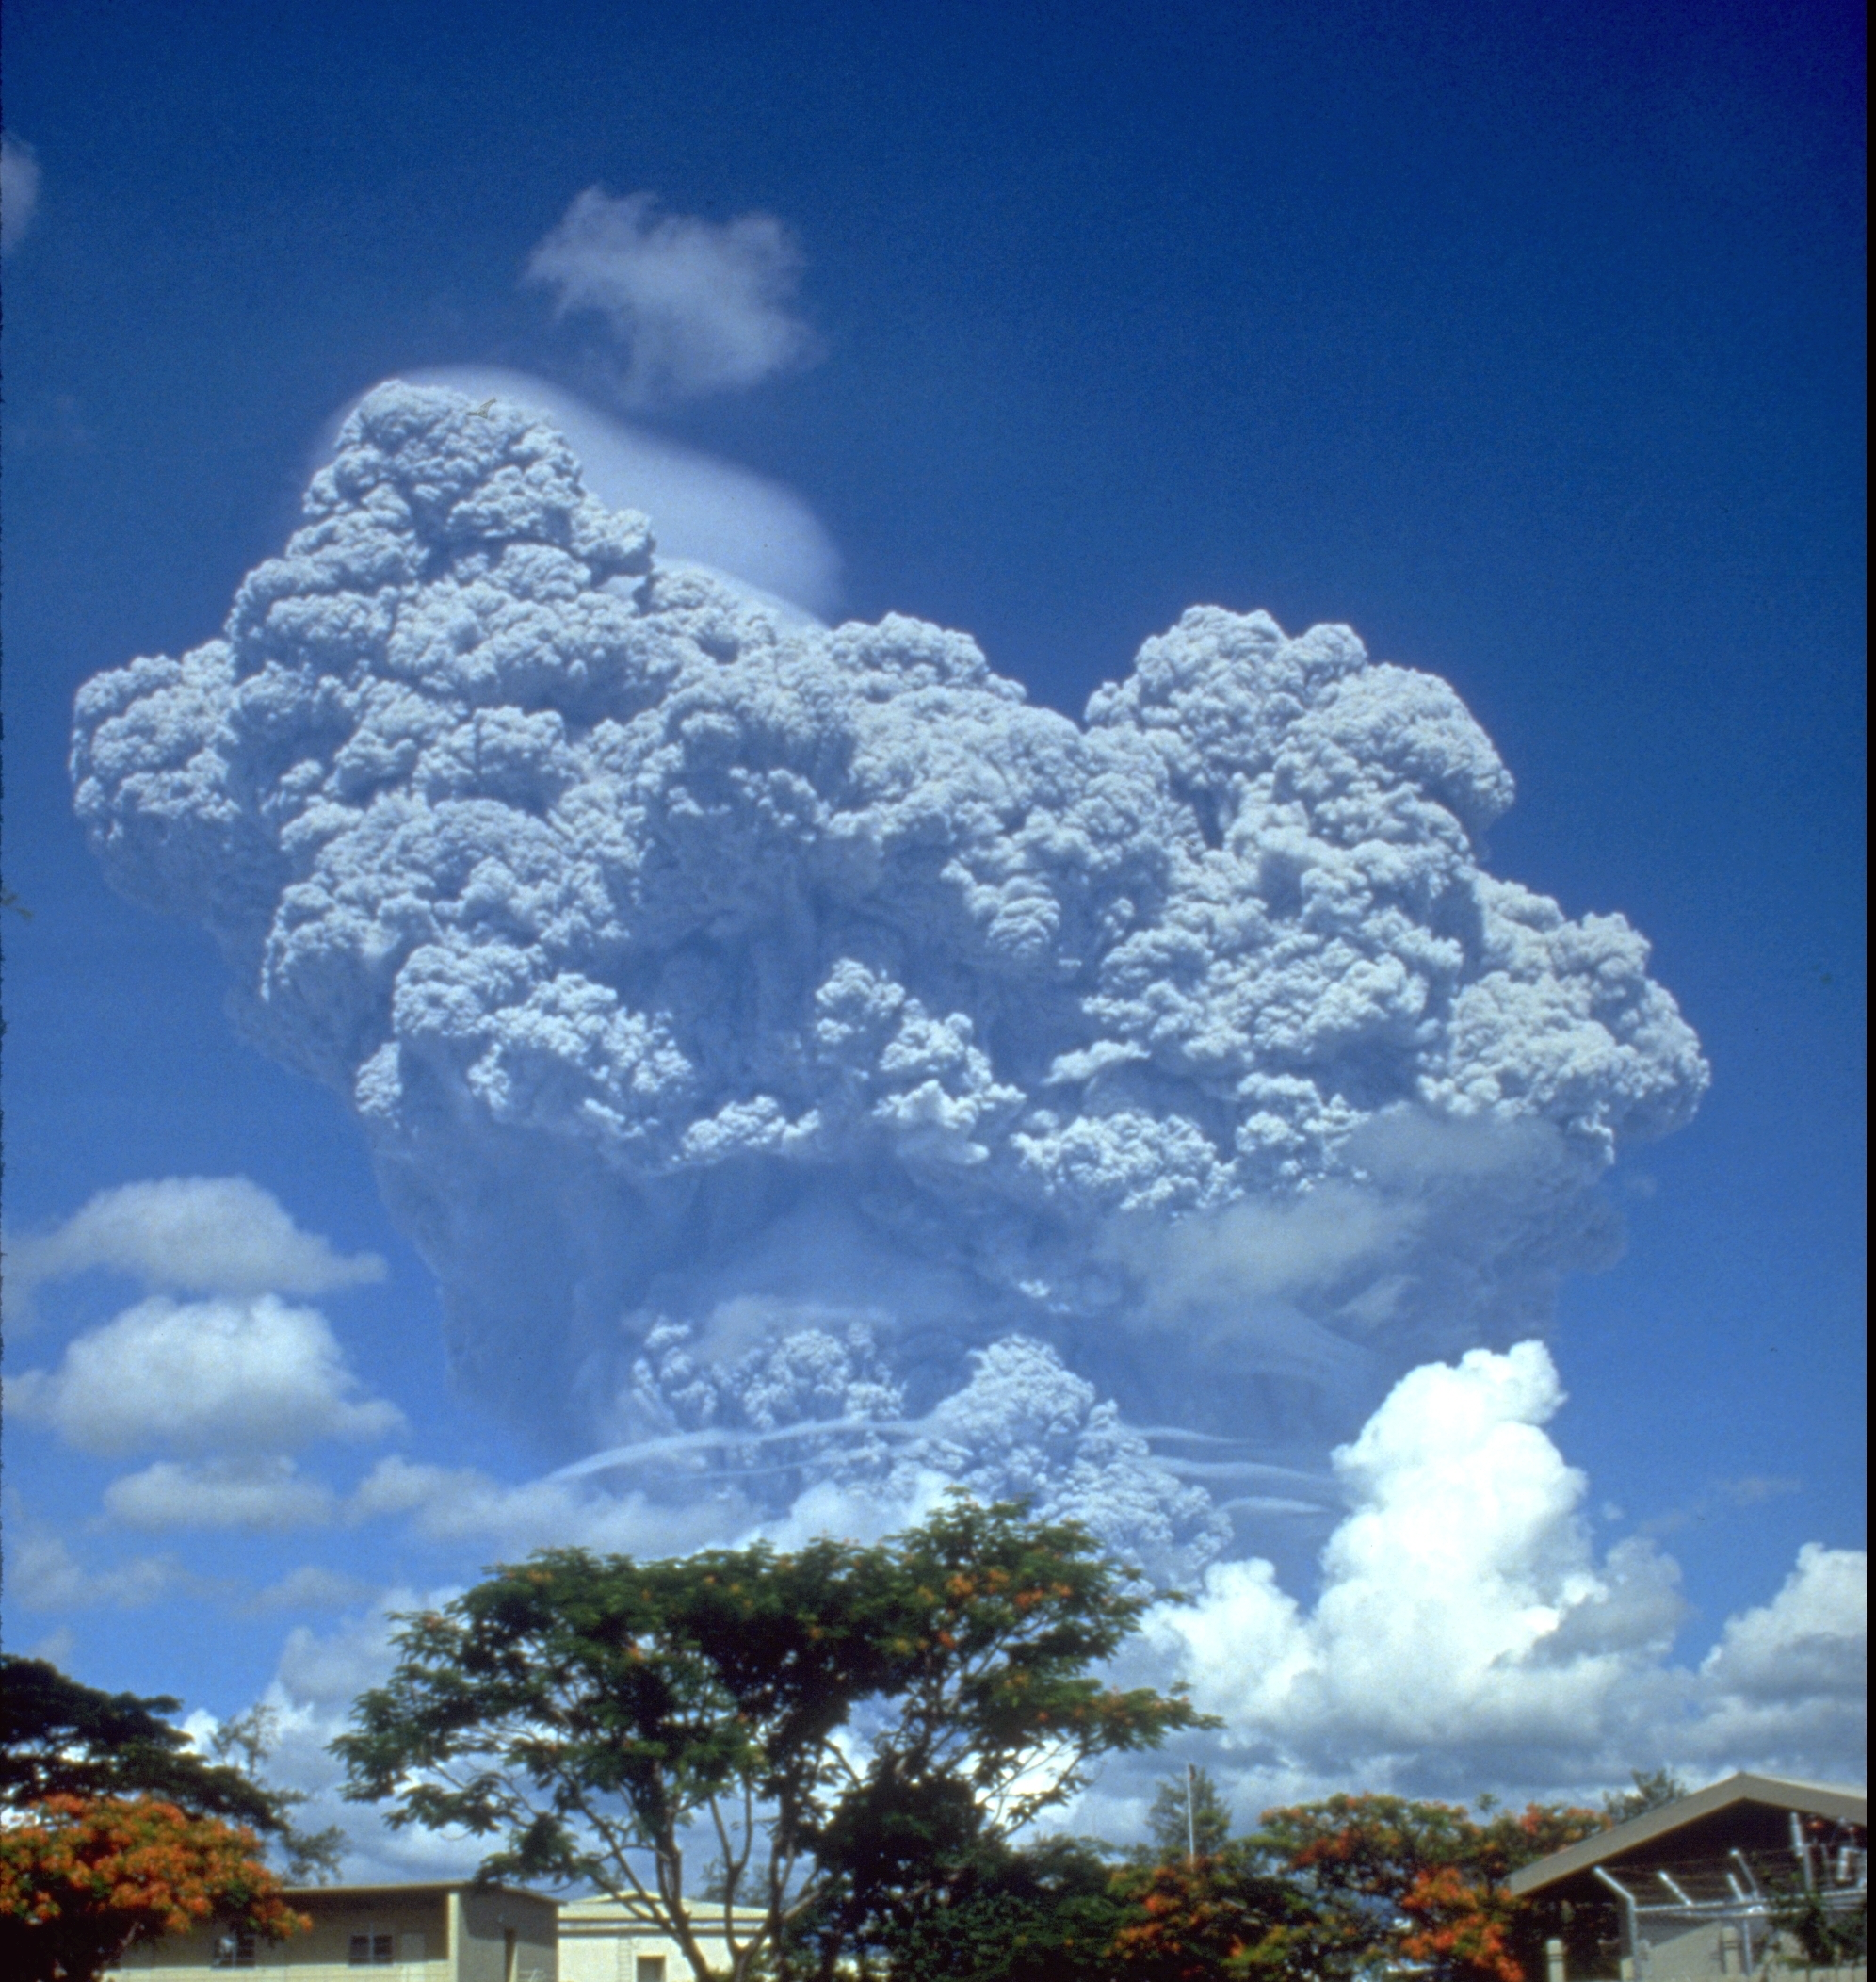
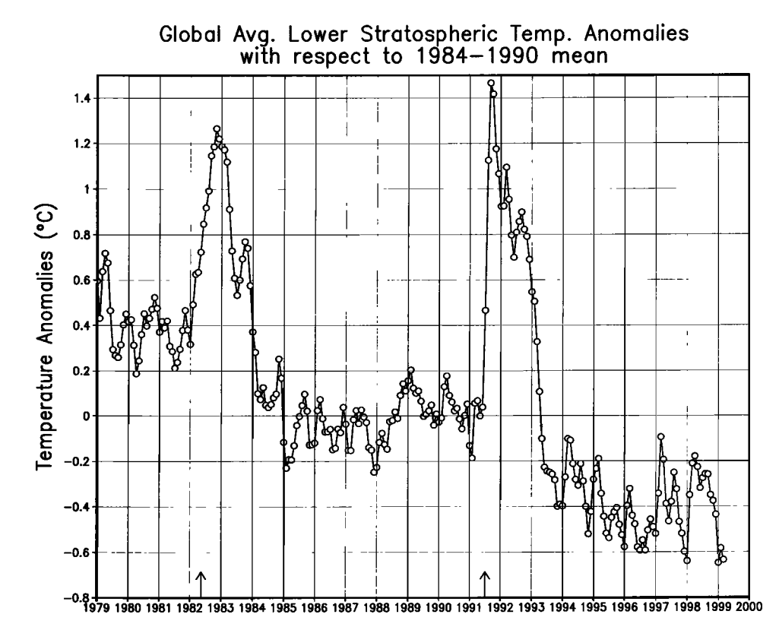
What do we know: Stratospheric Temperature Increase from Sulfate Aerosol
Mt. Pinatubo Eruption
Stratospheric Temperature
~ 10 MT sulfur
Sulfate Aerosol
Robock Rev. Geophys., 38, 191-219 2000
Changes in atmospheric circulation
5

Slide 6
What do we know: Stratospheric Temperature Increase from Sulfate Aerosol
Mt. Pinatubo Eruption
Stratospheric Temperature
~ 10 MT sulfur
Sulfate Aerosol
Robock Rev. Geophys., 38, 191-219 2000
Changes in atmospheric circulation
- Alternative materials (calcite, alumina, diamond) may greatly reduce risk but don’t exist naturally in stratosphere
- Only stratospheric field experiments with injection can compare laboratory with real stratospheric behavior
6

Slide 7
Injection would involve localized processes: Need for observations to test model sssumptions
Complex, non-linear plume chemistry and aerosol formation
Localized emissions on complex paths
Mixing of the plume with a complex background, including plume interactions
Slow plume dispersion (Newman et al 2001)
Notes:
Real emissions would involve slowly-evolving, fine-scale plumes but we simulate emissions as being All studies have used Eulerian grids with resolutions from 1 degree (MacMartin CESM) to 10 degrees (2-D model)
Plume scale processes occur at meters; these could affect our outcomes, and the response of the stratosphere to any “realistic” deployment
Questions:
What would stratospheric aerosols look like if we injected plumes of sulfur rather than simulating continuous injections?
How far do we need to go to capture this?

Slide 8
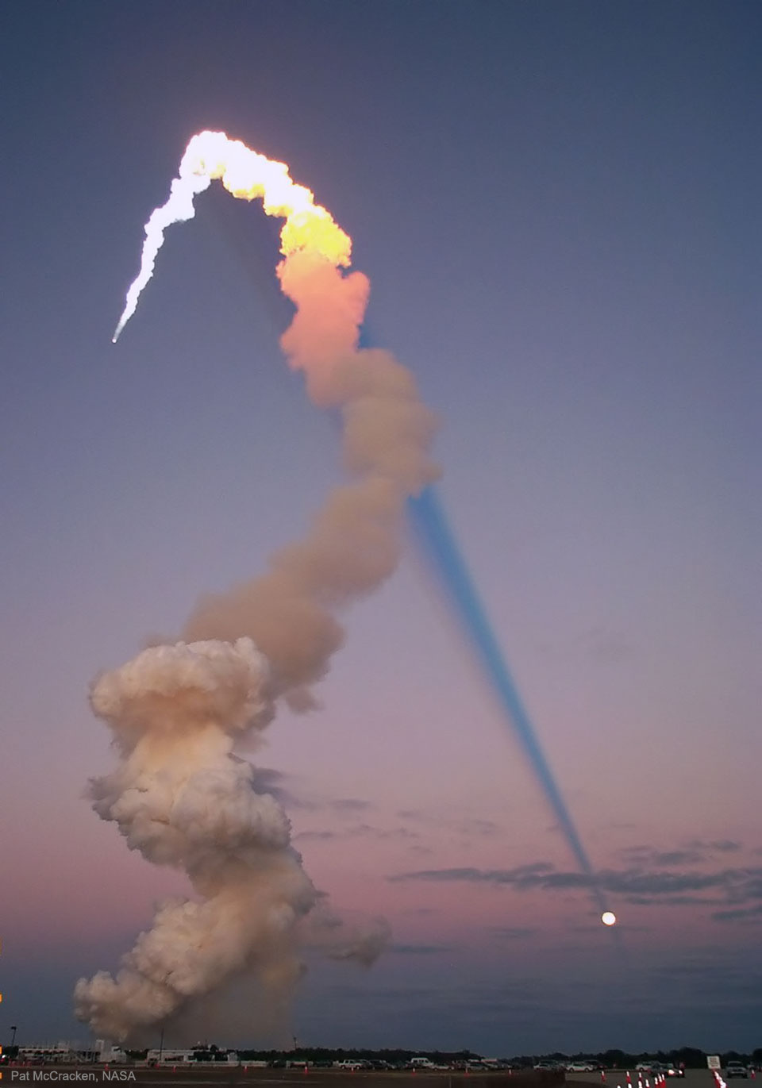
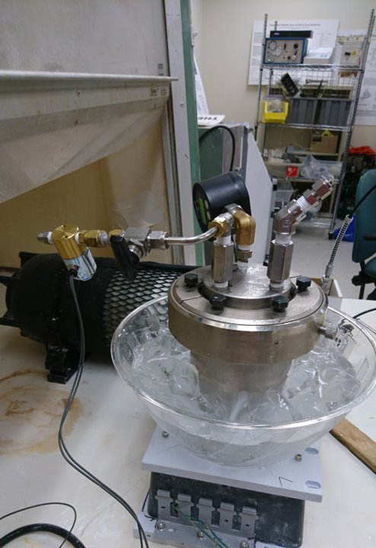
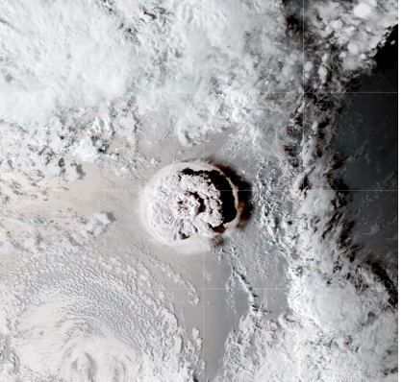
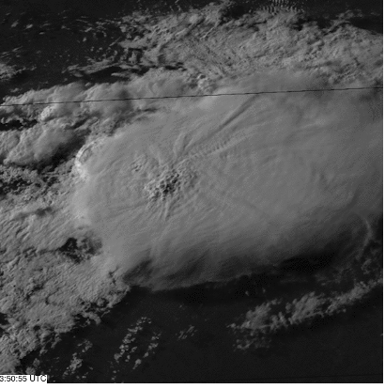
Scales of Observations Useful for Testing Stratospheric Aerosol Injection Models
LARGE
Small
Climate Model Scale
Mixing/Plume Evolution
Injection Scale
overshoots at 19 km Kansas
Hunga Tonga
Space Shuttle
CaCO₃ Nozzle
Pyrocumulus
Convection
Rocket/Aircraft plumes
Aerosol Injection Nozzle
Volcanoes
https://earthobservatory.nasa.gov/images/149347/hunga-tonga-hunga-haapai-erupts
https://apod.nasa.gov/apod/ap180624.html; courtesy Armand Neukerman
8

Slide 9
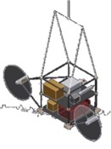
Small Scale Stratospheric Controlled Perturbation Experiment (SCoPEx)
Experiment at 20 km altitude in stratosphere
Duration less than one day
Size of plume < 10km, ~1 kg material
Injected material poses no risk
First flight(s) platform test without injection
20km
500 m
Outcome: improved risk/efficacy assessment
150 m
Plume: < 1 kg, 50 cm⁻³, 0.3 µm CaCO₃
For comparison: 747 flight 1-2 kg aerosol / minute

Slide 10
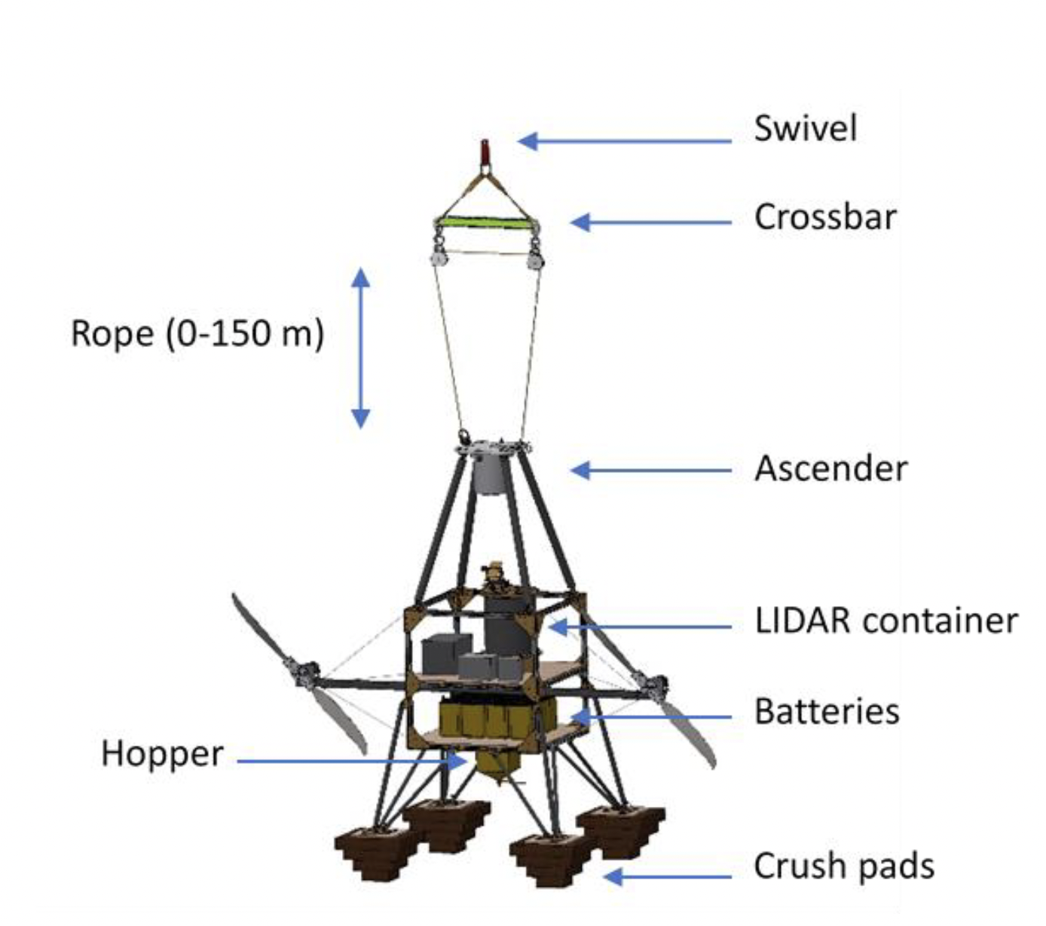
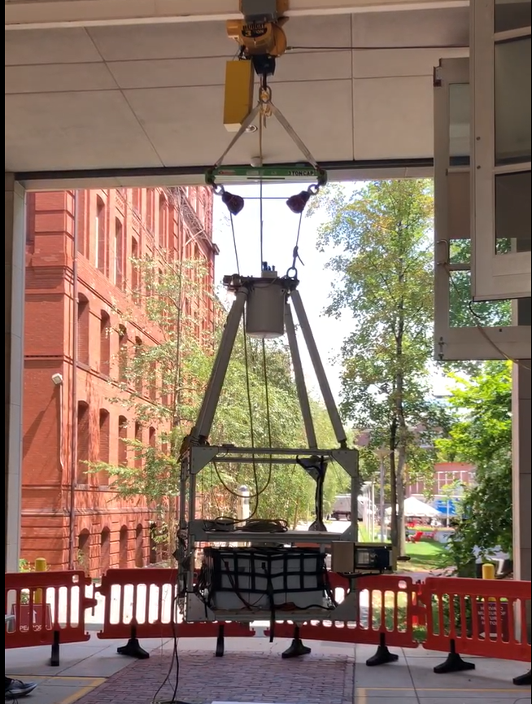
Small Scale Stratospheric Controlled Perturbation Experiment (SCoPEx) Operational Ground Tests

Slide 11
Small Scale Stratospheric Controlled Perturbation Experiment (SCoPEx) Operational Ground Tests

Slide 12
What information would you need to decide whether intentional perturbative experiments should move forward in your country?
What is missing or excessive in the model framework developed by the Advisory Committee?

