Slide 1
South american climate response to solar radiation modification
Americas Conference on Solar Radiation Modification: Science, Governance and Implications for the Region
Inés Camilloni
University of Buenos Aires/CONICET
Argentina
24-25 August 2022
University of the West Indies
Kingston, Jamaica

Slide 2
Objective
To analyze the South American hydroclimate response to Solar Radiation Modification using Stratospheric Aerosol Injection (SAI) in comparison to a high emission scenario in terms of changes in mean and extreme temperature and rainfall, and water availability and hydrological extremes in La Plata Basin

Slide 3
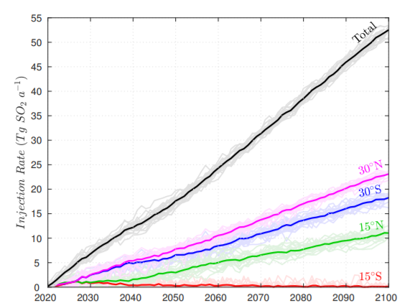
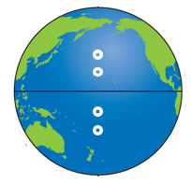
1. CLIMATE SIMULATIONS
GLENS Project: Community Earth System Model CESM1
The simulations consist in simultaneous SAI of sulfur dioxide at four locations
Historical: 1980-2010
Control: RCP8.5 (High emission scenario)
2021-2050 and 2051-2080
Feedback: SAI (Solar Radiation Modification)
Tilmes et al (2018)

Slide 4
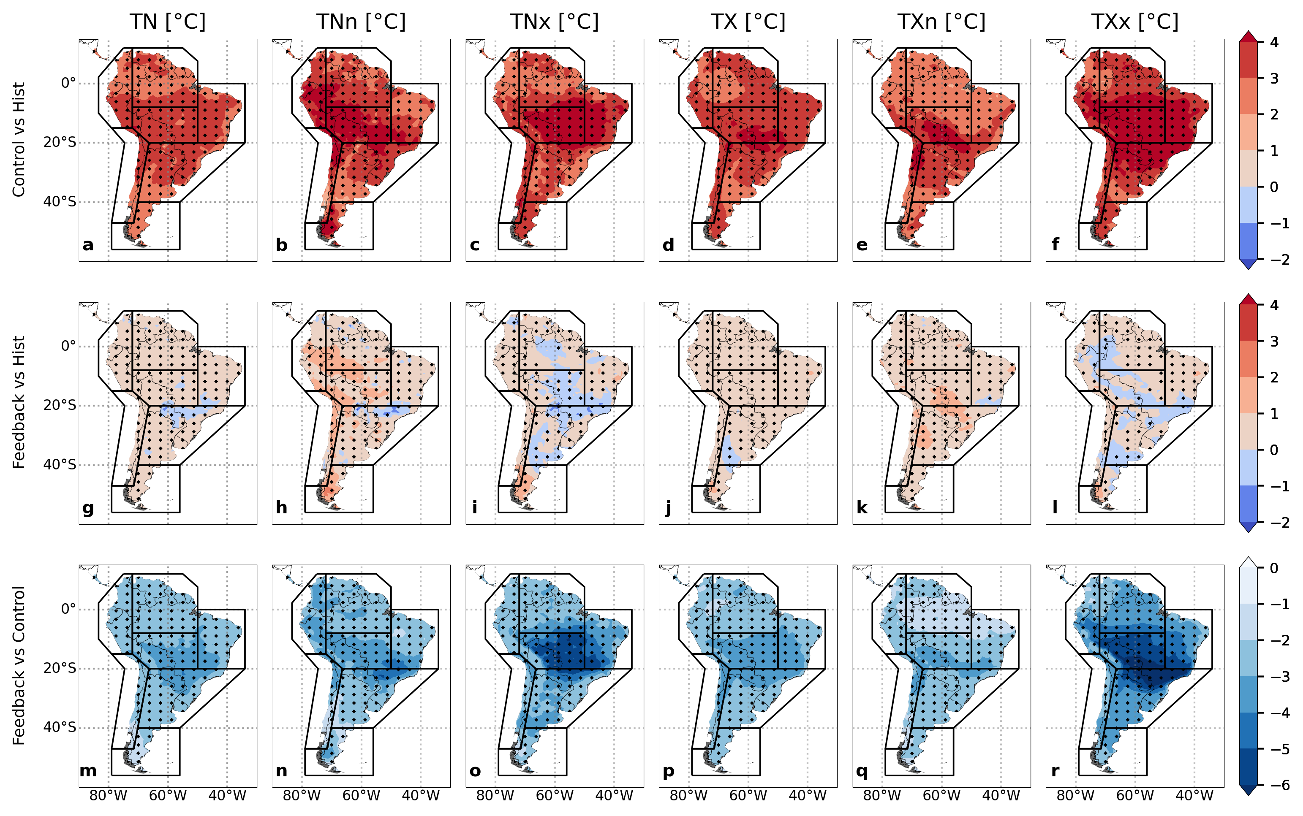
Minimum Temperature
Coldest night
Warmestnight
Maximum Temperature
Coldest day
Warmestday
RCP8.5 scenario
2051-2080
SRM scenario

Slide 5
Minimum Temperature
Coldest night
Warmestnight
Maximum Temperature
Coldest day
Warmestday
RCP8.5 scenario
2051-2080
SRM scenario
SRM – RCP8.5

Slide 6
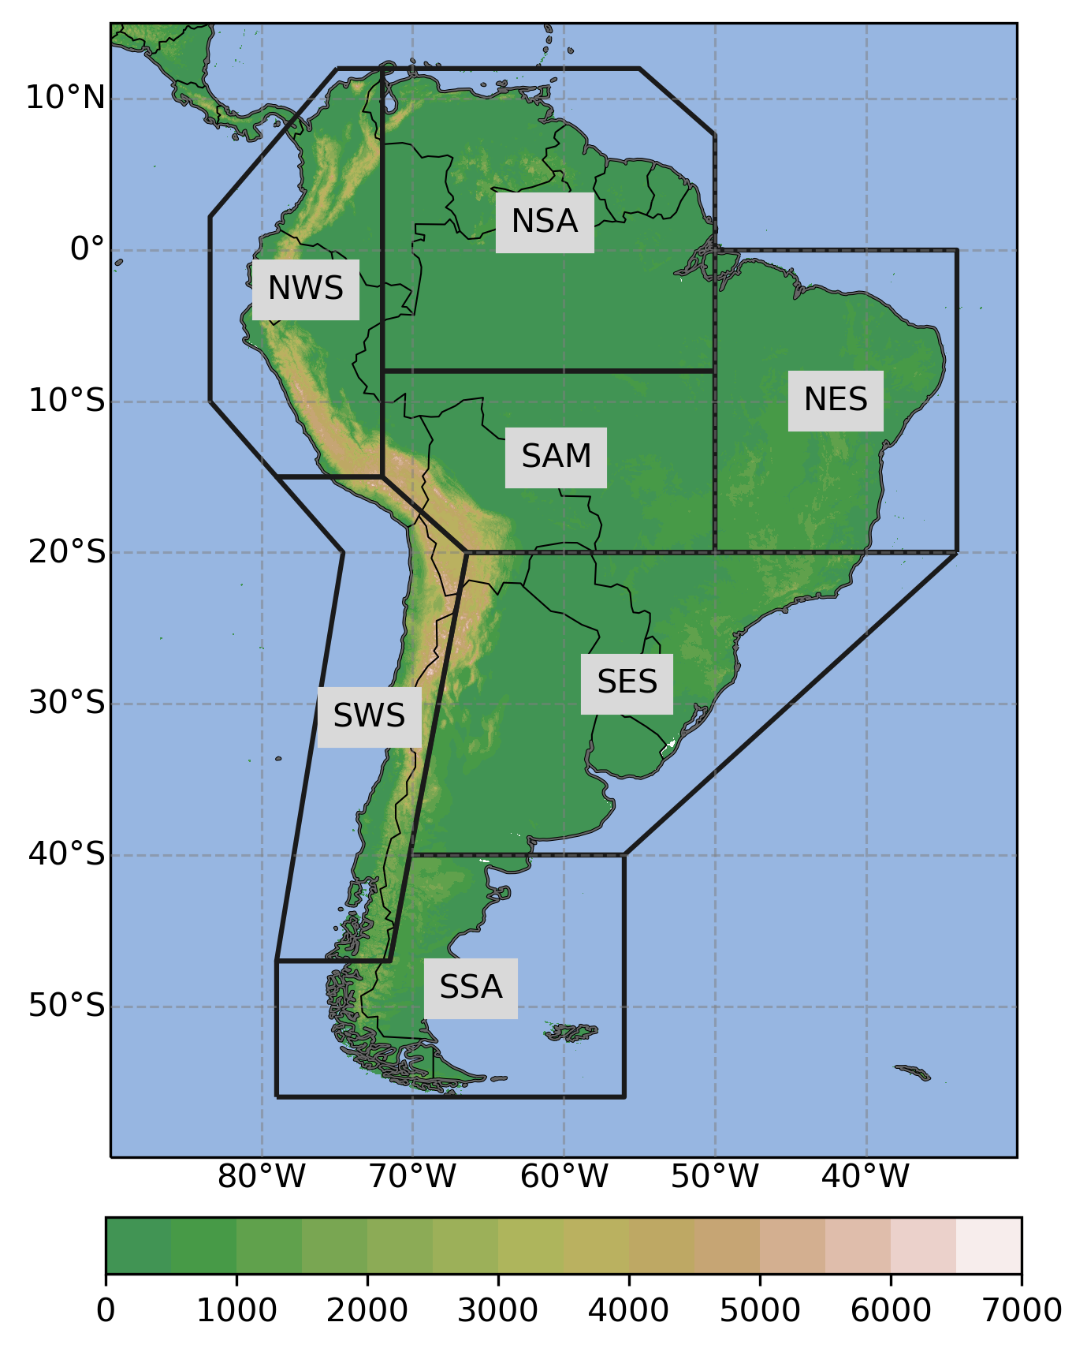
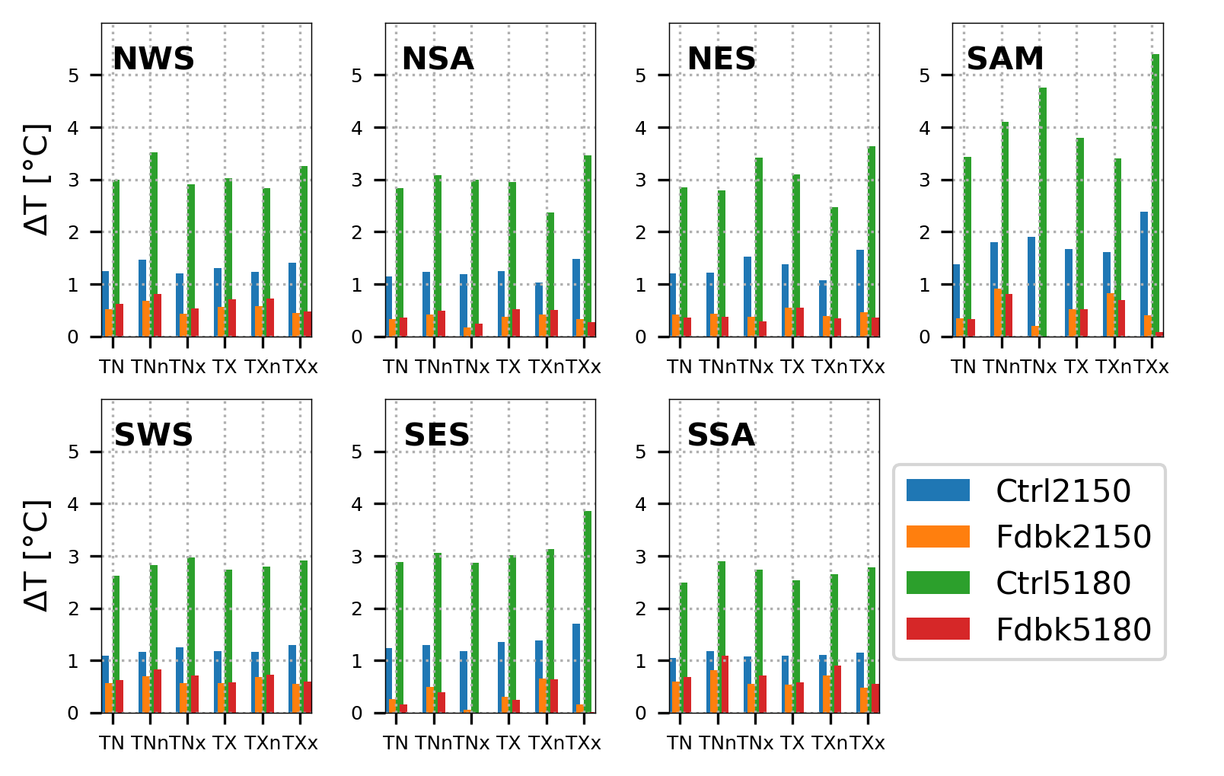
Regional changes: Mean and extreme temperature
NWS: Northwestern South America
NSA: Northern South America
SAM: South American Monsoon region
NES: Northeastern South America
SWS: Southwestern South America
SES: Southeastern South America
SSA: Southern South America

Slide 7
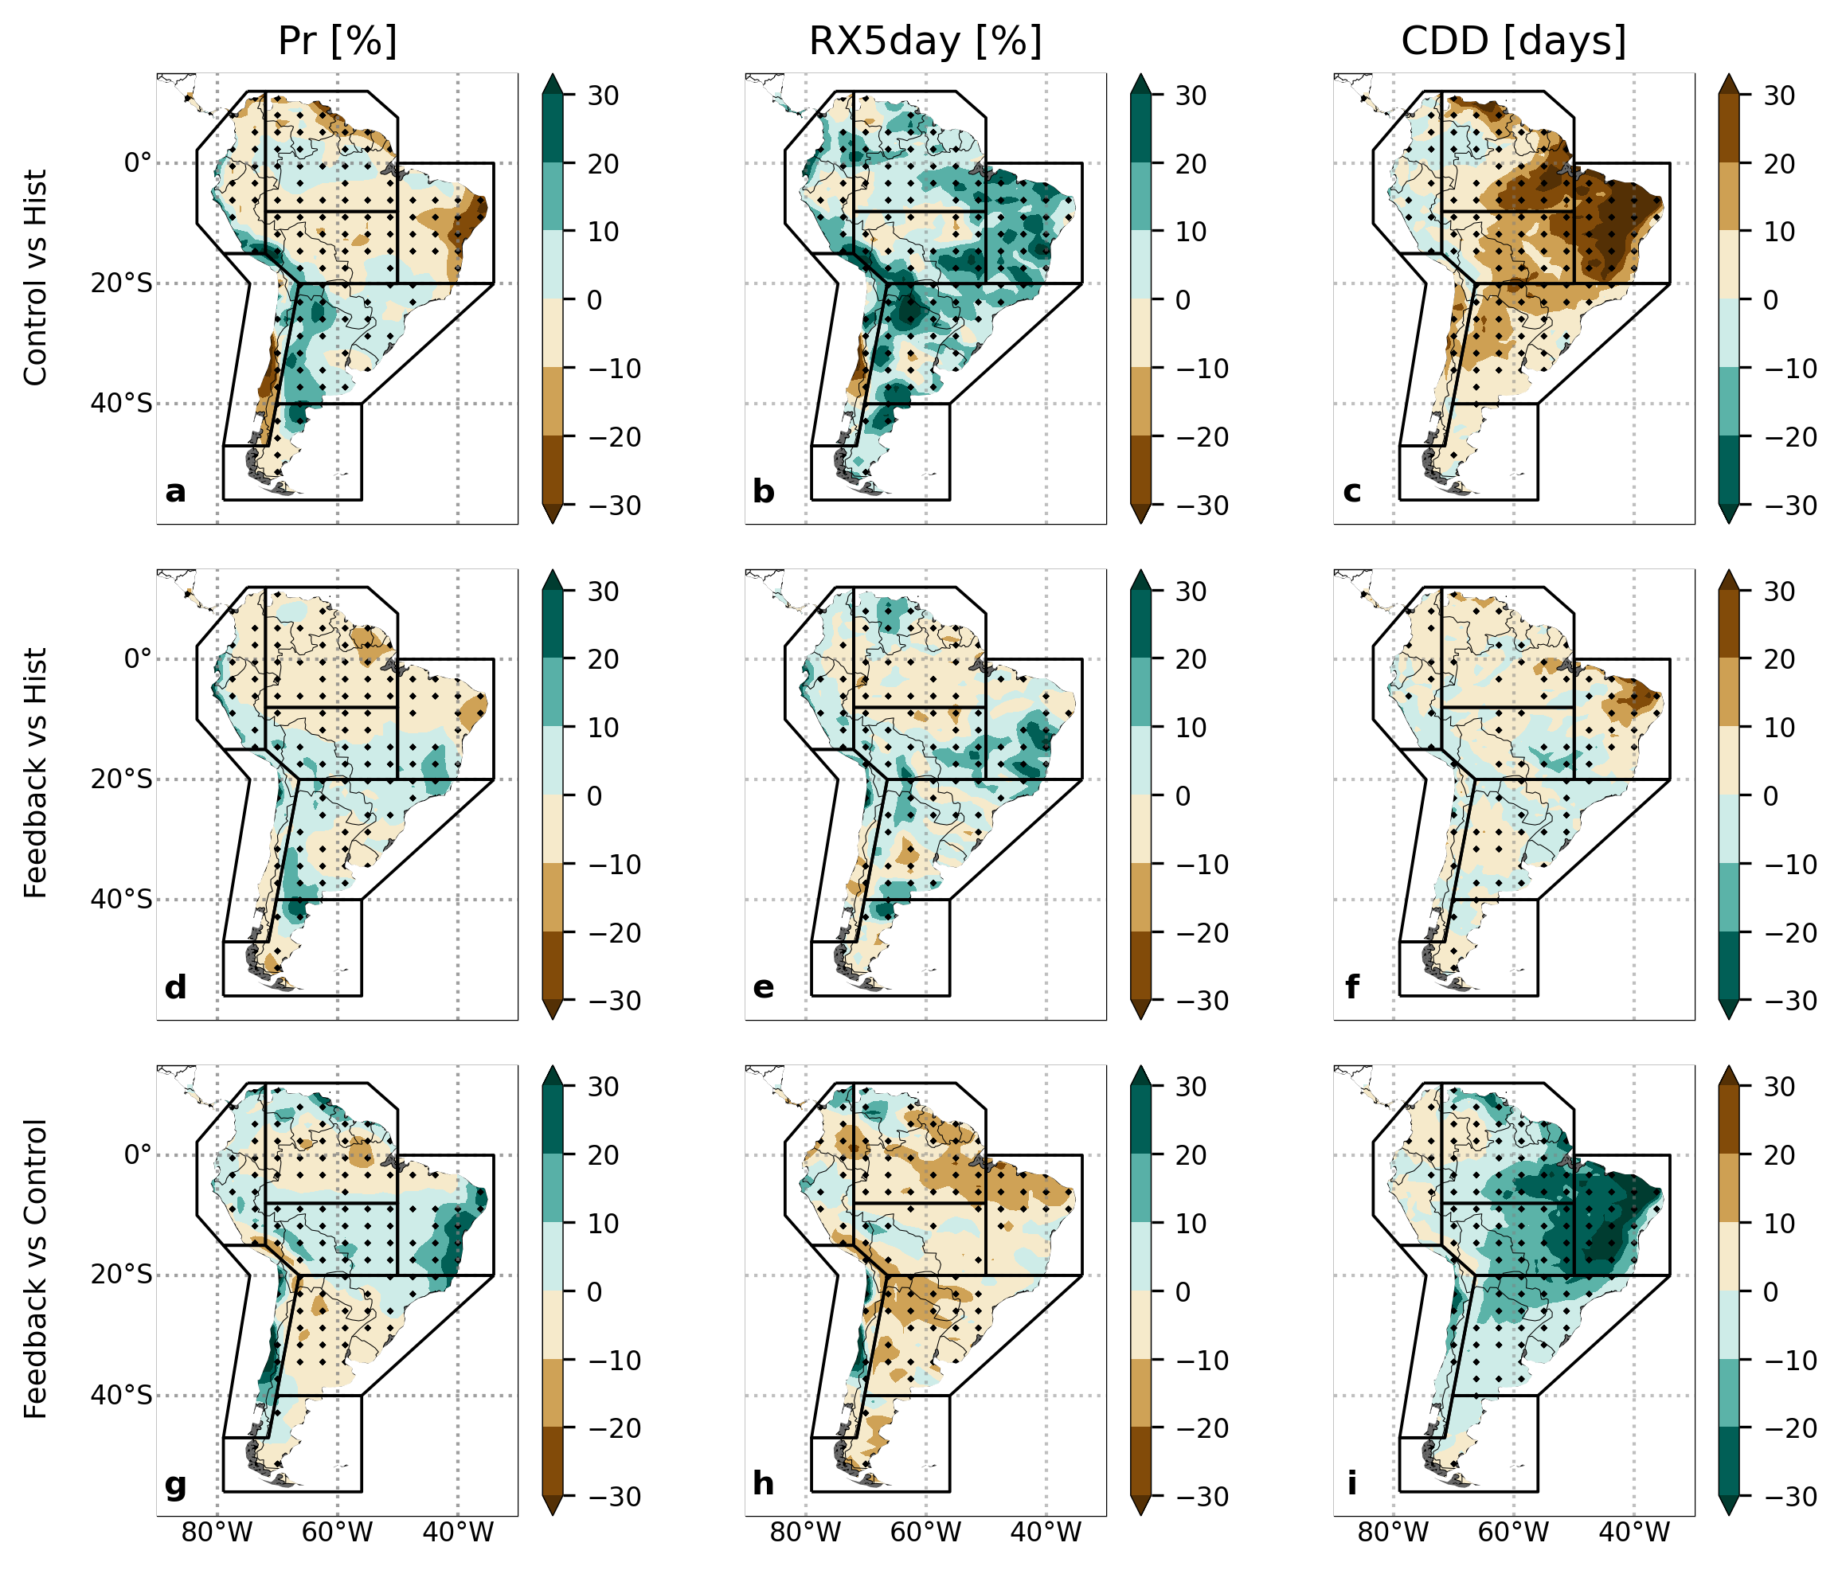
Precipitation
Westtest pentad
Consecutive dry days
RCP8.5 scenario
2051-2080
SRM scenario

Slide 8
Precipitation
Westtest pentad
Consecutive dry days
RCP8.5 scenario
2051-2080
SRM scenario
SRM – RCP8.5

Slide 9
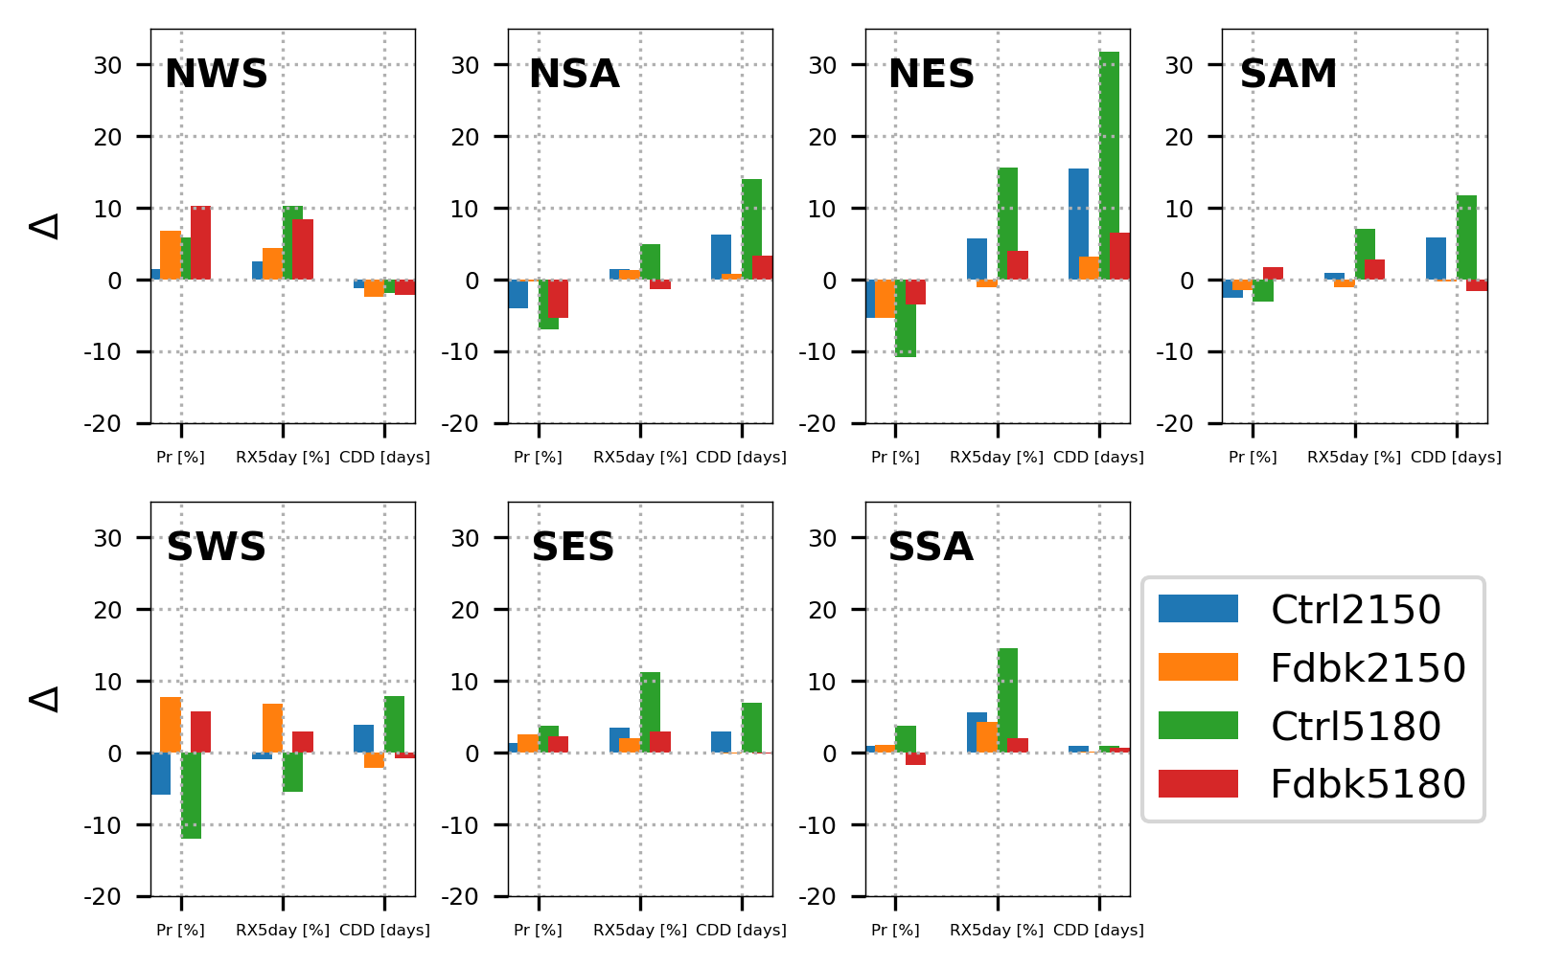
Regional changes: Mean and extreme precipitation
NWS: Northwestern South America
NSA: Northern South America
SAM: South American Monsoon region
NES: Northeastern South America
SWS: Southwestern South America
SES: Southeastern South America
SSA: Southern South America

Slide 10
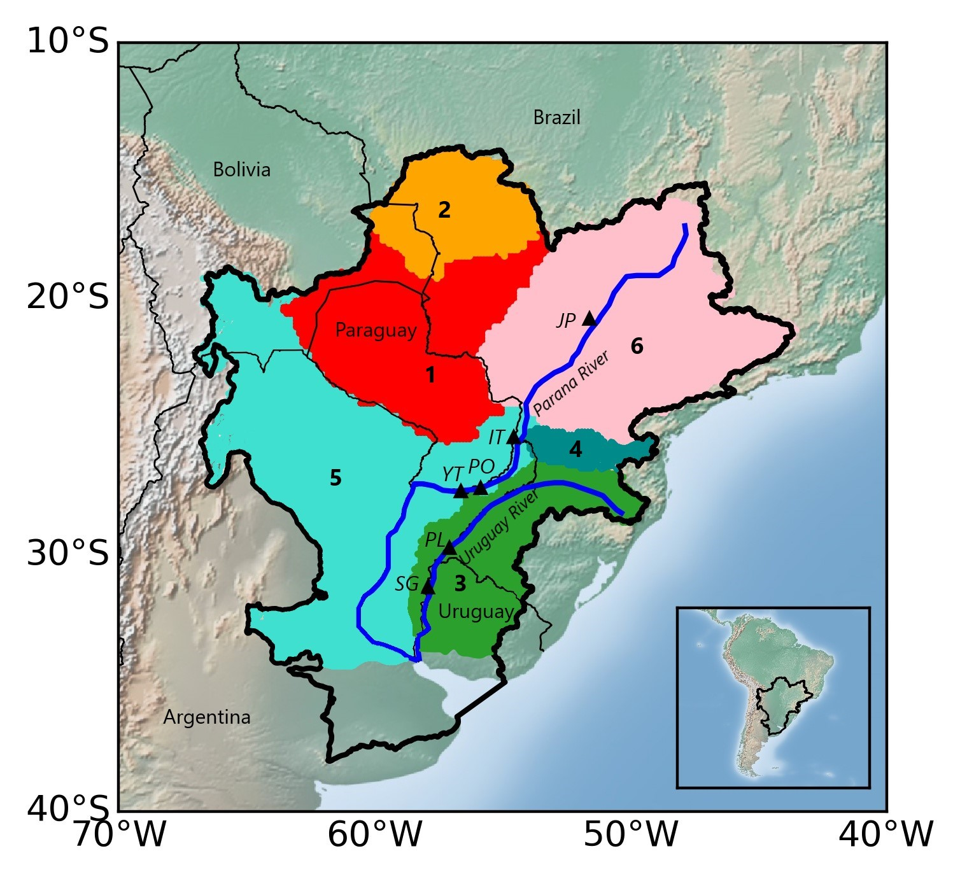
2. HYDROLOGICAL SIMULATIONS
VIC: Variable Infiltration Capacity Model
INPUT
Meteorological data (GLENS)
Daily precipitation
Daily Tmax and Tmin
CLOSING POINTS
Paraguay River
Ladario
Asunción
Soil data
5-min Global Soil Data Task dataset from the Distributed Active Archive Center
Paraná River
Jupiá (JP)
Itaipú (IT)
Posadas (PO)
Yaciretá (YT)
Vegetation data
University of Maryland’s 1-km
Global Land Cover product
Uruguay River
Paso de los Libres (PL)
Salto Grande (SG)
OUTPUT
Daily/monthly streamflow at closing points
Daily/monthly gridded runoff, ET, etc.
Iguazú River
Salto Caxias

Slide 11
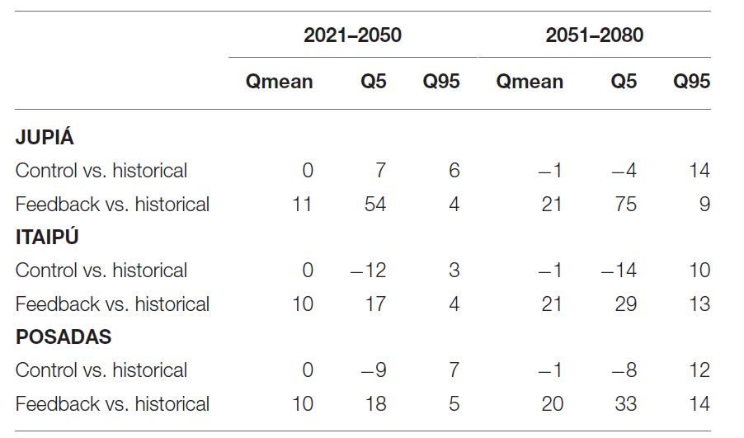
Changes (%) in the mean (Qmean), extremely low (Q5) and extremely high (Q95) Paraná River streamflow simulated by the VIC hydrology model
Camilloni et al. (2022)

Slide 12
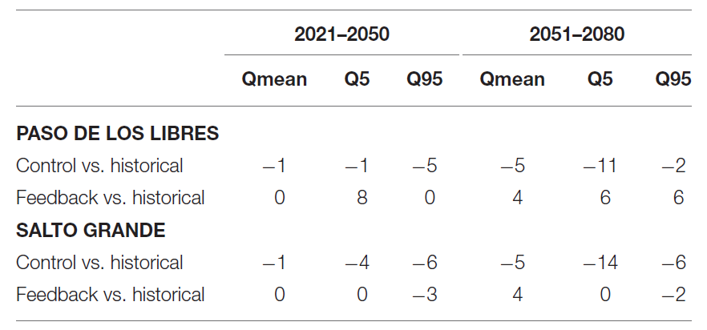
Changes (%) in the mean (Qmean), extremely low (Q5) and extremely high (Q95) Uruguay River streamflow simulated by the VIC hydrology model
Camilloni et al. (2022)

Slide 13
Summary
Relative to the historical conditions (1980–2010), SAI can offset the projected increase in the magnitude of mean and extreme temperatures. The cooling effect of SAI is not spatially homogenous.
The response of SAI on precipitation is not uniform with for example an increase in the northern sector of the LPB and a reduction to the south
Precipitation extremes are projected to decrease under the SAI scenario with different magnitudes depending on the location
SAI mostly increases mean and extreme flows of the main rivers of LPB. A reduction in the flow variability of the river and less severe drought conditions over the basin are also associated to the SAI scenario. However, this latter advantage could come at the expense of a slightly higher risk of flooding under extremely high flow conditions.

