Slide 1
Current state of SRM research
Kate Ricke
Scripps Institution of Oceanography and
School of Global Policy and Strategy, UC San Diego
Americas Conference on Solar Radiation Modification - August 24, 2022
Notes:
The impacts: what research has told us about how SRM would affect the climate
• Basic climate variables like temperatures and precipitation
• Effect on health, biodiversity, agriculture, regional climate, etc.
- Unknowns and uncertainties in SRM science
- Socio-political issues
• Moral hazard and reverse moral hazard
• Slippery slope
• Ethics
• Political and economic
dynamics - Summary
• Key messages about SRM
• How we might think about it

Slide 2
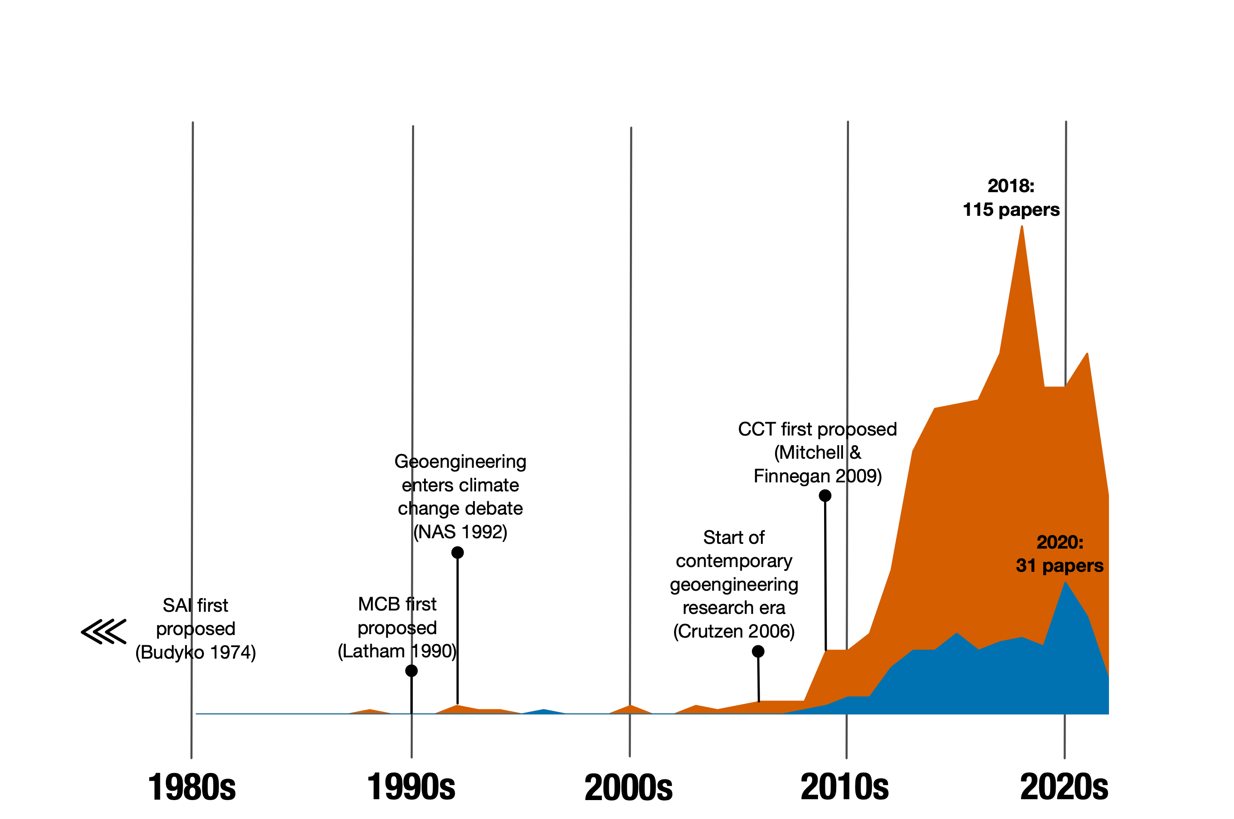
SRM research is fairly new
Vast majority of papers on SRM were published in the past 10 years

Slide 3
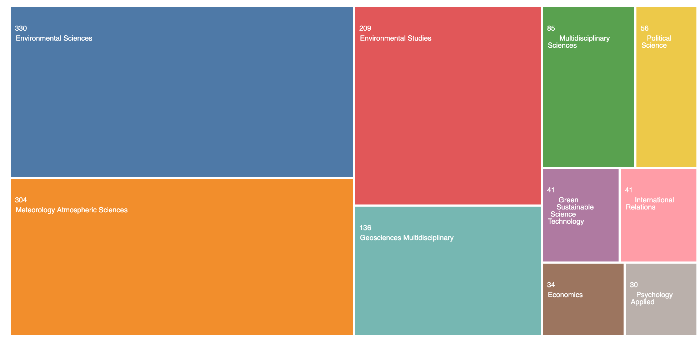
SRM research is mostly Earth system science (>75% of papers)
Source: Web of Science

Slide 4
Sandwiching of SRM Science
Assumptions about:
-Sociopolitical Background Conditions
-Solar Geoengineering Objectives
-Social and Legal Feasibility
Interpretation of physical modeling and analysis depends on anterior and posterior analysis outside the natural sciences.
Scenarios
How to make reflective particles, how much sunlight reflected, how much cooling the Earth, how does regional temperature and precipitation change, what are environmental side effects
Earth System Science:
Chemistry-Radiative Forcing-Climate-Biogeochemical and biophysical outcomes
]
Impacts Assessment
Interpretation of:
Economic impact, Equity, Social desirability, Ethics & Governance Constraints

Slide 5
Sandwiching of SRM Science
Assumptions about:
-Sociopolitical Background Conditions
-Solar Geoengineering Objectives
-Social and Legal Feasibility
]
Sociopolitical background conditions, objectives and scenarios that feed into modeling work
Scenarios
Earth System Science:
Chemistry-Radiative Forcing-Climate-Biogeochemical and biophysical outcomes
Impacts Assessment
Interpretation of:
Economic impact, Equity, Social desirability, Ethics & Governance Constraints
Notes:
These assumptions need to be operationalized to feed into ESMs – that done through scenarios

Slide 6
Scenarios:
“Decision space” for solar geoengineering
Notes:
What nas report says on scenarios

Slide 7
Decision space: “climate context” will affect outcomes
NASEM (2021), Section 3.1c
The “climate context” for SG decision making will depend in particular on the severity of climate impacts occurring and on the degree to which mitigation, CDR, and adaptation are being pursued. At least three types of scenarios have been commonly discussed:
“Peak shaving,” in which mitigation efforts (including CDR) are having a positive effect, but are not sufficient to prevent an “overshoot” of goals for limiting global mean temperature increase.
Notes:
Decisions about SG deployment would be made by a wide variety of actors with differing motivations and under differing climate, geopolitical, and societal conditions.
It is important to consider a wide range of possible scenarios in order to identify the types of information that could be necessary for robust decision making.
… characterized by the need for indefinite and ever-increasing levels of SG, with unmitigated direct harms from rising CO2 concentrations (e.g., ocean acidification), and growing risk of unintended side effects from SG.
The “climate context” for SG decision making will depend in particular on the severity of climate impacts occurring and on the degree to which other climate change responses (e.g., mitigation, carbon dioxide removal [CDR], and adaptation) are be- ing pursued. At least three types of scenarios have been commonly discussed in this regard:
A common framing scenario is referred to as “peak shaving,” in which mitiga- tion efforts are having a positive effect, but are not sufficient to prevent an “overshoot” of goals for limiting global mean temperature increase. Large- scale CDR could potentially help reduce temperatures but only over time periods of decades to centuries. It has been suggested that, in the interim, SG might be considered for deployment in a temporary way to reduce peak temperatures (MacMartin et al., 2018a; Tilmes et al., 2016; Wigley, 2006). Here “temporary” implies a sustained deployment over multiple decades to a half-century or more, to limit peak temperatures during a period of globally sustained decarbonization. In this context, an important factor influencing SG research or deployment considerations will be the trajectory of continuing mitigation measures and what is known about the plausibility of large-scale CDR relative to the required time frame of a commitment to SG once begun.
• An alternative (also time-bound) scenario is one in which there are emission reduction efforts but no reliance on CDR, large-scale adaptation is under way, and SG deployment is considered to slow the rate of temperature rise, with the goal of securing more time for adaptation (Irvine et al., 2019; Keith and MacMartin, 2015; MacMartin et al., 2014a). Current projections of peak tem- peratures, expected impacts, and the timescale for adaptation would influence considerations of how or if SG might be utilized.
• A third scenario is one in which efforts for meaningful mitigation, CDR, and adaptation have been inadequate, and SG is considered as an emergency response to blunt destruction caused by rapidly accelerating temperature rise. This scenario is characterized by the need for indefinite and ever-increasing levels of SG, with significant unmitigated direct harms from rising CO2 concentrations (e.g., ocean acidification), and growing risk of unintended side effects from intensifying SG deployment.

Slide 8
“Peak shaving”
Business as usual
Cut emissions aggressively
Global Temperature
CO₂ removal (“CDR”)
SRM
Time
Notes:
What Doug talked about (ideal?)

Slide 9
Decision space: “climate context” will affect outcomes
NASEM (2021), Section 3.1c
The “climate context” for SG decision making will depend in particular on the severity of climate impacts occurring and on the degree to which mitigation, CDR, and adaptation are being pursued. At least three types of scenarios have been commonly discussed:
“Peak shaving,” in which mitigation efforts (including CDR) are having a positive effect, but are not sufficient to prevent an “overshoot” of goals for limiting global mean temperature increase.
Emission reductions, but no reliance on CDR, adaptation under way: SG deployment is to slow the rate of temperature rise, securing more time for adaptation.
Notes:
Decisions about SG deployment would be made by a wide variety of actors with differing motivations and under differing climate, geopolitical, and societal conditions.
It is important to consider a wide range of possible scenarios in order to identify the types of information that could be necessary for robust decision making.
… characterized by the need for indefinite and ever-increasing levels of SG, with unmitigated direct harms from rising CO2 concentrations (e.g., ocean acidification), and growing risk of unintended side effects from SG.
The “climate context” for SG decision making will depend in particular on the severity of climate impacts occurring and on the degree to which other climate change responses (e.g., mitigation, carbon dioxide removal [CDR], and adaptation) are be- ing pursued. At least three types of scenarios have been commonly discussed in this regard:
A common framing scenario is referred to as “peak shaving,” in which mitiga- tion efforts are having a positive effect, but are not sufficient to prevent an “overshoot” of goals for limiting global mean temperature increase. Large- scale CDR could potentially help reduce temperatures but only over time periods of decades to centuries. It has been suggested that, in the interim, SG might be considered for deployment in a temporary way to reduce peak temperatures (MacMartin et al., 2018a; Tilmes et al., 2016; Wigley, 2006). Here “temporary” implies a sustained deployment over multiple decades to a half-century or more, to limit peak temperatures during a period of globally sustained decarbonization. In this context, an important factor influencing SG research or deployment considerations will be the trajectory of continuing mitigation measures and what is known about the plausibility of large-scale CDR relative to the required time frame of a commitment to SG once begun.
• An alternative (also time-bound) scenario is one in which there are emission reduction efforts but no reliance on CDR, large-scale adaptation is under way, and SG deployment is considered to slow the rate of temperature rise, with the goal of securing more time for adaptation (Irvine et al., 2019; Keith and MacMartin, 2015; MacMartin et al., 2014a). Current projections of peak tem- peratures, expected impacts, and the timescale for adaptation would influence considerations of how or if SG might be utilized.
• A third scenario is one in which efforts for meaningful mitigation, CDR, and adaptation have been inadequate, and SG is considered as an emergency response to blunt destruction caused by rapidly accelerating temperature rise. This scenario is characterized by the need for indefinite and ever-increasing levels of SG, with significant unmitigated direct harms from rising CO2 concentrations (e.g., ocean acidification), and growing risk of unintended side effects from intensifying SG deployment.

Slide 10
More time for adaptation
Business as usual
Cut emissions aggressively
Global Temperature
SRM
Time
Notes:
No CDR – can slow rate of change

Slide 11
Decision space: “climate context” will affect outcomes
NASEM (2021), Section 3.1c
The “climate context” for SG decision making will depend in particular on the severity of climate impacts occurring and on the degree to which mitigation, CDR, and adaptation are being pursued. At least three types of scenarios have been commonly discussed:
“Peak shaving,” in which mitigation efforts (including CDR) are having a positive effect, but are not sufficient to prevent an “overshoot” of goals for limiting global mean temperature increase.
Emission reductions, but no reliance on CDR, adaptation under way: SG deployment is to slow the rate of temperature rise, securing more time for adaptation.
Inadequate mitigation, CDR, and adaptation: SG is considered as an emergency response to blunt destruction caused by rapidly accelerating temperature rise
Notes:
Decisions about SG deployment would be made by a wide variety of actors with differing motivations and under differing climate, geopolitical, and societal conditions.
It is important to consider a wide range of possible scenarios in order to identify the types of information that could be necessary for robust decision making.
… characterized by the need for indefinite and ever-increasing levels of SG, with unmitigated direct harms from rising CO2 concentrations (e.g., ocean acidification), and growing risk of unintended side effects from SG.
The “climate context” for SG decision making will depend in particular on the severity of climate impacts occurring and on the degree to which other climate change responses (e.g., mitigation, carbon dioxide removal [CDR], and adaptation) are be- ing pursued. At least three types of scenarios have been commonly discussed in this regard:
A common framing scenario is referred to as “peak shaving,” in which mitiga- tion efforts are having a positive effect, but are not sufficient to prevent an “overshoot” of goals for limiting global mean temperature increase. Large- scale CDR could potentially help reduce temperatures but only over time periods of decades to centuries. It has been suggested that, in the interim, SG might be considered for deployment in a temporary way to reduce peak temperatures (MacMartin et al., 2018a; Tilmes et al., 2016; Wigley, 2006). Here “temporary” implies a sustained deployment over multiple decades to a half-century or more, to limit peak temperatures during a period of globally sustained decarbonization. In this context, an important factor influencing SG research or deployment considerations will be the trajectory of continuing mitigation measures and what is known about the plausibility of large-scale CDR relative to the required time frame of a commitment to SG once begun.
• An alternative (also time-bound) scenario is one in which there are emission reduction efforts but no reliance on CDR, large-scale adaptation is under way, and SG deployment is considered to slow the rate of temperature rise, with the goal of securing more time for adaptation (Irvine et al., 2019; Keith and MacMartin, 2015; MacMartin et al., 2014a). Current projections of peak tem- peratures, expected impacts, and the timescale for adaptation would influence considerations of how or if SG might be utilized.
• A third scenario is one in which efforts for meaningful mitigation, CDR, and adaptation have been inadequate, and SG is considered as an emergency response to blunt destruction caused by rapidly accelerating temperature rise. This scenario is characterized by the need for indefinite and ever-increasing levels of SG, with significant unmitigated direct harms from rising CO2 concentrations (e.g., ocean acidification), and growing risk of unintended side effects from intensifying SG deployment.

Slide 12
Emergency response
Business as usual
SRM
Global Temperature
Time
Notes:
Essentially being used as a substitute even though we know it’s not one– probably wouldn’t look smooth

Slide 13
Decision space: Political contexts also matter
NASEM (2021), Section 3.1c
SRM could be the product of:
deliberative action through a globally representative body or agreement, or
regional coalitions, collections of individual state actors act autonomously but with shared views or a lone actor, perhaps not even representing a sovereign nation, attempting unilateral deployment.
  actor(s)’ record of pursuing climate change mitigation, and inferences regarding underlying motivations, important to decision-making context.
Very little work on regional implementation…
or an anarchic evolution of a “geoengineered world”
Notes:
Differing political contexts and scenarios will also affect decision making. For instance, a scenario involving deliberative action through a globally representative body or agreement might best address social and governance concerns and provide the most resilient foundation for research activities or sustained deployments. But there may also be scenarios in which regional coalitions or collections of individual state actors act autonomously but with shared views or even scenarios involving a lone actor, perhaps not even representing a sovereign nation, attempting unilateral deployment. In each of these cases, the actor(s)’ record of pursuing climate change mitigation, and the associated inferences regarding underlying motivations and commitments to decarbonization, might be an important part of the decision-making context.

Slide 14
Ethics and Geoengineering
NASEM (2021), Section 2.3a
A number of ethically salient questions are raised by SRM research:
Is intentionally manipulation of the climate morally permissible?
How to determine the goals of geoengineering
Is just, fair, and equitable SRM possible?
How should geoengineering be governed?
How will mitigation, adaptation, and geoengineering interact from an ethical perspective?

Slide 15
Societal concerns: “Moral hazard”
NASEM (2021), Sections 2.3a and 3.2c
“Moral hazard” is the idea that geoengineering might undermine mitigation efforts.
Some public perception research showed that lay publics felt that if SG technology existed, it would reduce commitment to mitigation efforts;
other research has suggested that this response is not consistent and depends on how questions are framed or other factors.
Given that SG technologies are still in a very early stage of exploration, it is difficult to know how utilizing these technologies will affect mitigation options.
Notes:
Aka Mitigation deterrence
“a precise empirical measure of mitigation deterrence would require comparison to a counterfactual baseline (e.g., to know whether and to what extent SG research serves as a deterrent to mitigation, one would have to know how much mitigation would have occurred in the absence of SG research) “
“Despite persistent concerns about mitigation deterrence, some social science research has suggested that individuals may increase their com- mitment to mitigation when the prospect of geoengineering is introduced (see, e.g., Merk et al., 2016), though results from a variety of studies on this topic are equivocal (see Burns, 2016). “

Slide 16
Societal concerns: “Slippery slope”
NASEM (2021), Section 3.2c
“Slippery slope” is the idea that research leads to an acceleration toward eventual deployment, e.g.:
A research program could create political momentum toward deployment-- same actors who politically supported a research program may become invested in seeing it used.
Research programs could create sociotechnical communities of interest--some SG researchers could become focused on advocating for deployment.
Those developing the technology will seek an opportunity to monetize it, thus motivating a push for deployment.
Likelihood of a slippery slope from research to deployment is difficult to assess, but research governance could reduce the risk
Notes:
“There are also countervailing scenarios in which researched technologies are not deployed or in which governance could effectively mitigate acceleration:
Research could dissuade deployment if it is found that it is very difficult to produce a technology that is deployable, predictable, and controllable. If it is demonstrated that SG is not an “easy” alternative to GHG mitigation or large- scale adaptation, then it could become less politically attractive.
Moreover, if it were to take a long time to discern whether an SG intervention is working, it may attract less political support, since any positive outcome might not yield political capital for its proponents in their political lifetime.
The idea of a “sociotechnical community” accelerating deployment could be counterbalanced by the active cultivation of transparency among the research community.
The economic acceleration scenario is mitigated by the natural marketplace of capital allocation, as substantial economic forces are already pursuing more traditional climate mitigation measures. The current market for measures such as decarbonization of the energy sector is estimated in the tens of trillions of dollars - investors in these new energy systems will have little motivation to abandon these rev- enue streams in the face of relatively small research programs, which cannot be monetized in the near term.

Slide 17
Sandwiching of SRM Science
Assumptions about:
-Sociopolitical Background Conditions
-Solar Geoengineering Objectives
-Social and Legal Feasibility
Scenarios
Earth System Science:
Chemistry-Radiative Forcing-Climate-Biogeochemical and biophysical outcomes
]
Impacts Assessment
Impacts assessment and interpretation of ethical, social, economic and political implications
Interpretation of:
Economic impact, Equity, Social desirability, Ethics & Governance Constraints

Slide 18
Impacts:
Health, Agriculture, Economy, etc.

Slide 19
“Research to understand the potential magnitude and distribution of [SRM] impacts—on ecosystems, human health, political and economic systems, and other issues of societal concern—is in a particularly nascent state. Studies published to date do not provide a sufficient basis for supporting informed decisions.”
NASEM (2021), p.5

Slide 20
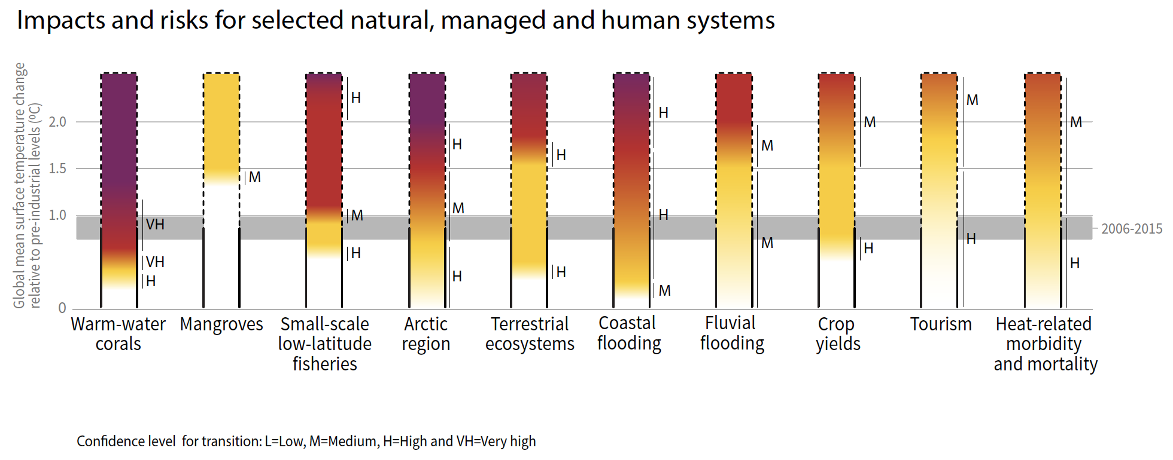
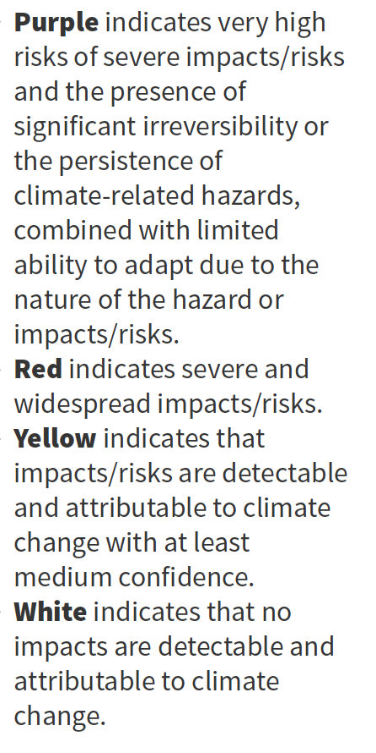
Use of global temperature as a proxy for climate change impacts
risk reduction with mitigation
risk reduction with SRM
Original figure from the IPCC Special Report on 1.5 degrees
Notes:
Put in context of the global temperature targets or goals in Paris Agreement.
global temperature has become a proxy for impacts in climate governance conversations
Burning embers plots in ipcc reports – as temperature is constrained with mitigation, impacts community has identified benefits in the form of reduced risk- but these are calibrated to scenarios that do not include SRM
In contrast a 1.5 degree world with SRM may have relatively lower or higher risks in each of these categories

Slide 21
Detailed regional studies are limited
For example, there are few regions of the world with multiple studies on impact-relevant hydrological changes from SRM

Slide 22

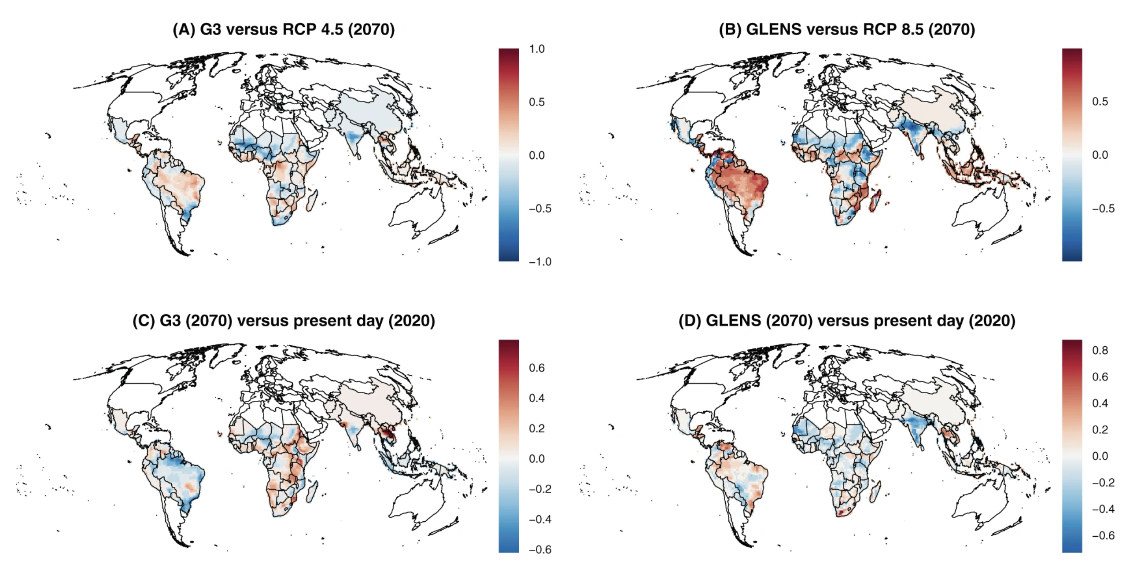
Human Health
Only a few studies to-date. For example:
Carlson et al (2022)
Notes:
This is a recent study on SRM and risk of malaria
Not just reduction or increase in risk but a redistribution

Slide 23
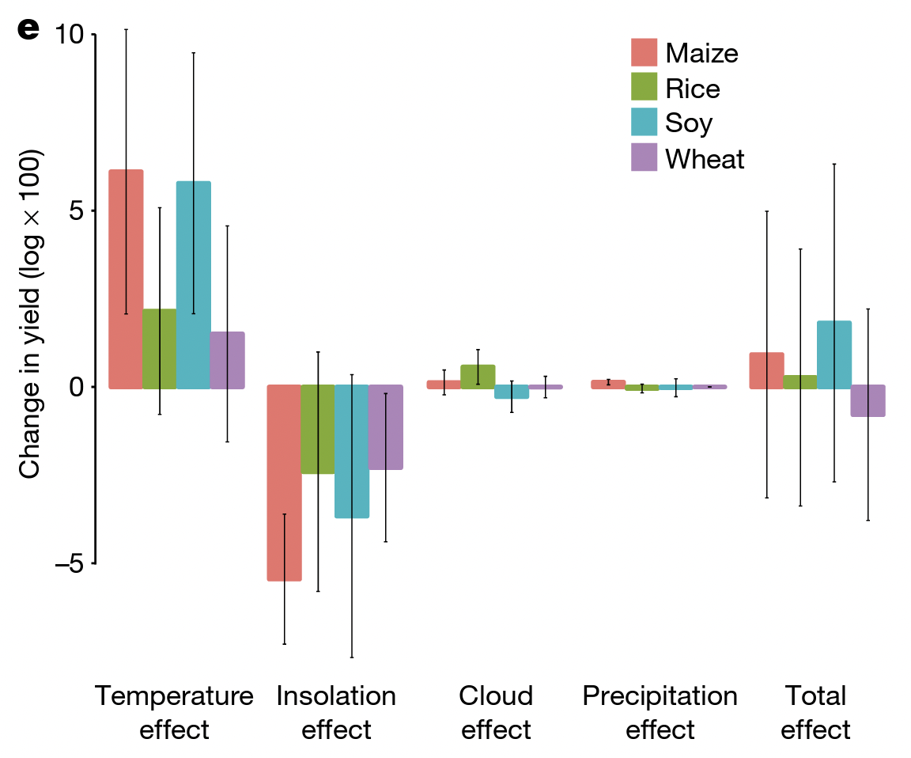
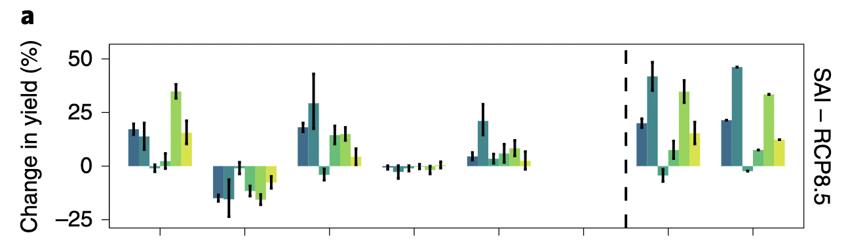
Agriculture
Several (<10) studies with mixed results, for example:
Proctor et al (2018) find that benefits to crop yields from reduced warming are offset by losses from reduced sunlight
Fan et al (2021) find no such effect (SRM alleviates climate change pressures on crop yields from temperature and increase yields due to CO2 fertilization)
Notes:
Pongratz et al. (2012) find that SAI results in global mean increases in yield and production for wheat, maize, and rice relative to both present-day and high-CO2 climates
Xia et al. (2014) find that relative to warming, solar dimming reduces precipitation across China but that rice production experiences no significant change, while maize production increases from averted heat stress
Trisos et al. (2018) SG would benefit crop production across the tropics by relieving heat stress, while high latitude crops may lose out on potential benefits from warming
Proctor et al (2018) find that benefits to crop yields from reduced warming are offset by losses from reduced sunlight
Fan et al (2021) find that SRM can alleviate climate change pressures on crop yields from temperature (and increasing yields from CO2 fertilization)

Slide 24
Assessment of Comparative Risk
NASEM (2021), Section 3.2b
Risk-risk assessment would characterize the risks of climate change without SRM versus the risks of climate change with SRM. Some challenges:
Dimensions of analysis: dependent on identification of the climate context (with its associated risks), relevant SRM options (with their associated risks), and interactions between these and other factors
Deep uncertainty: even with substantial further research, significant uncertainties will remain (about impacts of climate change with and without SRM)
Diverse risk perceptions: Climate change effects—with or without SRM—will not be distributed equally across the globe, and risk perceptions and risk-related values vary significantly across nations/communities
Notes:
Understand there will be further discussion of risk-risk frameworks later in this meeting, this is what our report had to say about this idea and in particular some of the challenges associated with it

Slide 25
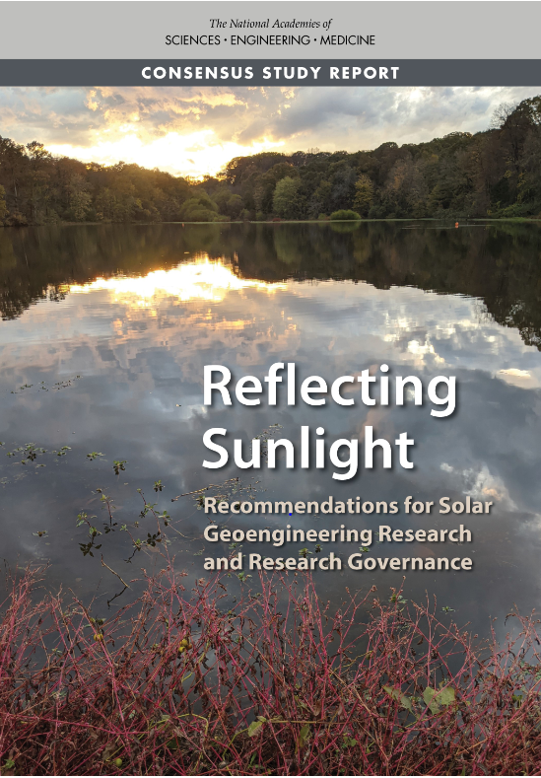
Reflecting Sunlight Report Conclusions
Given the urgent, growing risks of climate change, it is important to understand the feasibility, risks, benefits of all possible response options.
Solar geoengineering is a potential additional strategy for responding to climate change, but is not a substitute for reducing greenhouse gas emissions.
Notes:
Repeating what steven already said

Slide 26
Reflecting Sunlight Report Conclusions
Current scientific understanding is limited, fragmented
  insufficient basis for informing decisions
Currently no coordinated or systematic governance
  some legal mechanisms used in other contexts could apply
Goal of research is to characterize, reduce uncertainties
  but there are limits to uncertainty reduction
Research needs to be transdisciplinary, international
  with integration across physical, social, humanities research
Notes:
Repeating what steven already said

Slide 27
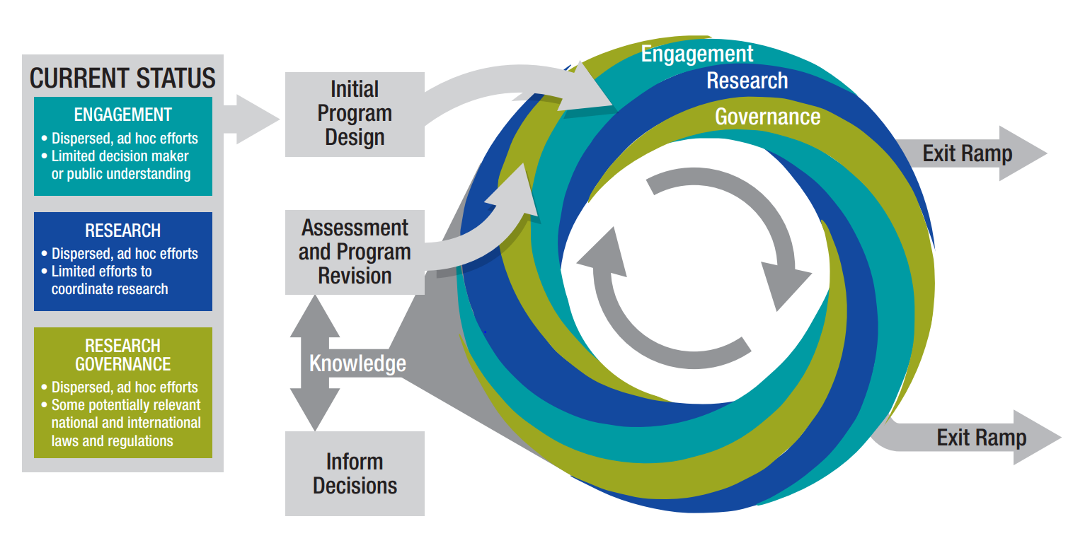
Reflecting Sunlight Recommendation
Notes:
The US currently has no coordinated federal approach to SG research.
An organized program could facilitate active integration across research areas [e.g., modeling, observations, process studies, social and economic studies, scenario designs], to help ensure that research being conducted informs and is informed by other research as efficiently as possible.
International: We felt that our mandate was to provide advice for advancing U.S. research efforts-- rather than providing advice to “the world” about starting a fully international program (a choice based on practical considerations). But we do feel that strong international research engagement and coordination will be critical on this topic.

