Slide 1
Americas Conference on Solar Radiation Modification: Science, Governance and Implications for the Region University of the West Indies 24 to 25 August 2025 Kingston, Jamaica

Slide 2
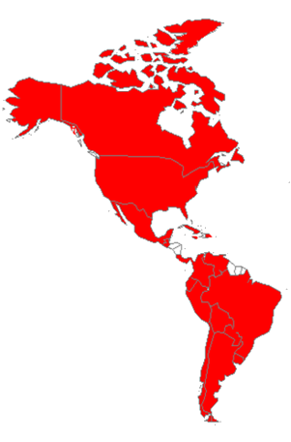
IAI is a treaty organization
1. Argentina
2. Bolivia
3. Brazil
4. Canada
5. Chile
6. Colombia
7. Costa Rica
8. Cuba
9. Dominican Republic
10. Ecuador
11. Guatemala
12. Jamaica
13. Mexico
14. Panama
15. Paraguay
16. Peru
17. Uruguay
18. USA
19. Venezuela
19 Parties
Notes:
Notes: 1) Depository of the IAI agreement: General Secretariat to the OAS; 2) IAI invites non-member Parties to join the Montevideo agreement that established the IAI

Slide 3
IAI and Regional Collaboration
Preamble of the Agreement:
CONCERNED that research on global issues requires cooperation among research institutes, among states and among the different parts of the Inter-American region, and with regional and international global change research programs;
CONVINCED that national and global efforts to address these issues must be supplemented by regional cooperation among States;

Slide 4
IAI and Regional Collaboration
Relevant Articles of the Agreement:
Article II: Objectives
The Institute shall pursue the principles of scientific excellence, international cooperation, and the full and open exchange of scientific information, relevant to global change.

Slide 5
IAI and Regional Collaboration
Relevant Articles of the Agreement:
Article II, a) Promote regional cooperation for interdisciplinary research on aspects of global change related to the sciences of the earth, ocean, atmosphere, and the environment and to social sciences, with particular attention to impacts on ecosystems and biodiversity, socio-economic impacts, and technologies and economic aspects associated with the mitigation of and adaptation to global change;

Slide 6
IAI and Regional Collaboration
Relevant Articles of the Agreement:
Article II, a) Promote regional cooperation for interdisciplinary research on aspects of global change related to the sciences of the earth, ocean, atmosphere, and the environment and to social sciences, with particular attention to impacts on ecosystems and biodiversity, socio-economic impacts, and technologies and economic aspects associated with the mitigation of and adaptation to global change;

Slide 7
IAI and Regional Collaboration
Relevant Articles of the Agreement:
Article II, c) Pursue on a regional scale that research which cannot be pursued by any individual State or institution and dedicate itself to scientific issues of regional importance;
g) Promote cooperation among the different research institutions of the region;

Slide 8
The Americas and shared priorities
Priorities are defined at the national/regional/international level by governance frameworks:
The Sustainable Development Goals
Post-2020 Biodiversity Framework
The Paris Agreement
Among other national obligations within a regional/international framework

Slide 9
The Americas and science to policy
The traditional model of science to policy at a regional level follows a well defined path:
Countries identify a problem where solutions must come from regional/international collaboration
Scientific bodies of Multi-lateral Environmental Agreements make recommendations
Recommendations go to a Conference of the Parties and are converted into policy

Slide 10
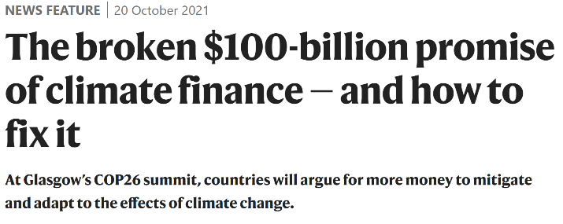
The Americas and science to policy
The traditional model of science to policy is under tremendous strain
The Guardian

Slide 11
The Americas and fragmented governance
Fragmented governance and treaty congestion:
There are now more than 900 multilateral and over 1500 bilateral treaties and other international agreements dealing with environmental issues*.
*The future of international environmental law / edited by David Leary and
Balakrishna Pisupati. United Nations University, 2010.

Slide 12
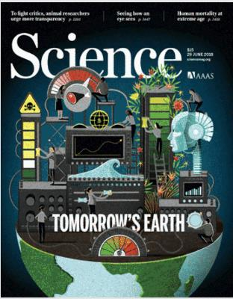
The Americas unexpected results
Unexpected results:
Prathapan, K & Pethiyagoda [et al]. (2018). When the cure kills—CBD limits biodiversity research. Science. 360. 1405-1406.
(more than 170 co-signatories, 71 of which are from the Americas)

Slide 13
The Americas and poor policy-science interface
The Article discusses the regulatory framework under the Nagoya Protocol on Access and Benefit-sharing*:
The resulting national legislations vary greatly, from being extremely prohibitive of research, to a very few that are relatively enabling, such as Costa Rica and South Africa. The problem is particularly acute where there is a poor policy-science interface resulting from weak scientific institutions.

Slide 14
The Americas international governance

Slide 15
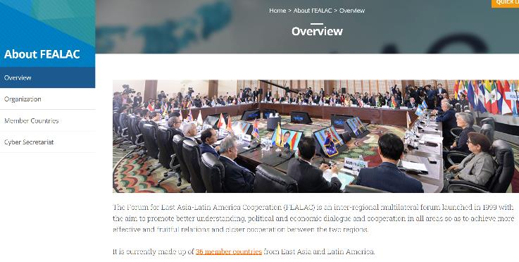
The Americas and fragmentation in cooperation
Fragmention and cooperation is also fragmented in our region.

Slide 16
Key opportunities and challenges
Within this fragmented governance environment the Americas has been uniquely effective in making its priorities known
GRULAC, for example, is an effective negotiating block in many MEAs
Such homogeneity in action provides many many opportunities

Slide 17
Key opportunities and challenges
Within international environmental governance (or international governance more generally) three issues come to the fore:
National sovereignty
Liability and redress
Enforcement
Mechanisms for liability and redress and enforcement are weak or non-existent

Slide 18
Geoengineering and governance
Which international instrument would be most appropriate as the umbrella agreement for sovereign nations to discuss challenges posed by Solar Radiation Modification?
UN General Assembly?
UNEP (UN Environment Assembly)?
The Convention on Biological Diversity?
UNFCCC?

Slide 19
Key opportunities and challenges
2
The IAI is the result of American countries deciding to establish a collaborative mechanism to provide its policy makers with the best available scientific information for more informed decision making
In many ways, it reflects the cooperative and successful regional framework found in Latin America and the Caribbean

Slide 20
Key opportunities and challenges
2
From a regional organization’s perspective, key opportunities and challenges are identified through:
The establishment of partnerships—realizing that no one organization can succeed alone;
Making use of partnerships to establish self-sustaining networks of peers
Supporting open science and data

Slide 21
Strategies for meeting challenges and identifying opportunities
The IAI functions in this ecosystem by working with Parties to understand national priorities as defined by regional/international frameworks
This understanding provides the context for the science and activities, including capacity building at the regional level, it supports

Slide 22
Strategy for identifying, developing and maintaining partnerships
None of this could have been possible without:
Funding to seed the scientific projects
A collaborative, multinational approach to identifying and researching an issue anchored to national needs and articulated internationally
Member country involvement through its scientific communities
Interdisciplinary and transdisciplinary research

Slide 23
Conclusions
Latin America and the Caribbean offers a unique opportunity for supporting collaborative, multinational effective scientific projects
It has a well established network of peers
As a region, it is uniquely effective in the articulation of its needs and in the involvement of its scientists and policy makers in international fora

Slide 24
Conclusions
In summary, Latin America and the Caribbean have will, the expertise and the willingness to:
overcome challenges and build opportunities for multi-national collaboration, and
strengthen linkages to global frameworks to leverage extramural funding for Americas Regional priorities

Slide 25
Conclusions
Solar Radiation Modification?

Slide 26
Thank you
Dr. Marcos Regis da Silva
IAI

