Slide 1
Overview of Current State of SRM Research
Americas Conference on Solar Radiation Modification:
Science, Governance and Implications for the Region
Steven Kendall, Ph.D., National Academies of Sciences, Engineering, and Medicine
Moderator
November 2022 update
Notes:
Please find training slides at the end of this template.

Slide 2
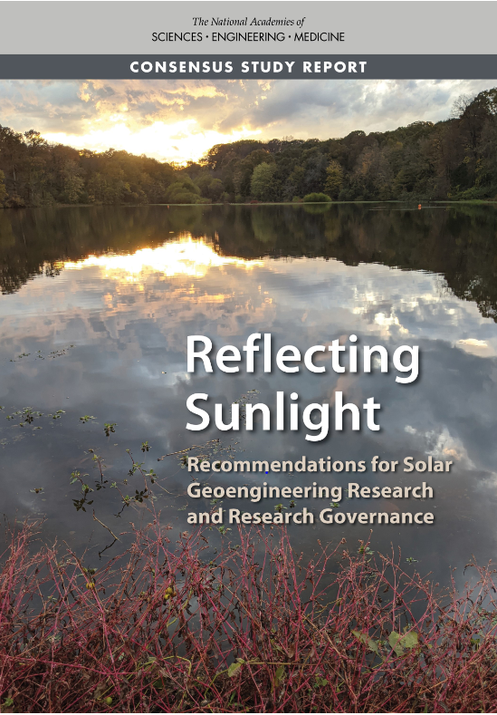
Reflecting Sunlight: Recommendations for Solar Geoengineering Research and Research Governance (March 2021)

Slide 3
Chris Field, Stanford University [Chair] William Cheung, University of British Columbia Lisa Dilling, University of Colorado Peter Frumhoff, Union of Concerned Scientists Hank Greely, Stanford Law School Marion Hourdequin, Colorado College Jim Hurrell, Colorado State University Andrew Light, George Mason University [until Jan. 2021] Albert Lin, University of California, Davis School of Law
Committee Members
Douglas MacMartin, Cornell University
Robert McHenry, Bright Silicon Technologies
Juan Moreno-Cruz, University of Waterloo
Kate Ricke, University of California, San Diego and Scripps Institution of Oceanography
Lynn Russell, Scripps Institution of Oceanography
Ambuj Sagar, Indian Institute of Technology, Delhi
Paul Wennberg, California Institute of Technology

Slide 4
The report makes recommendations regarding: 1. The development of a trans-disciplinary research agenda for solar geoengineering 2. Governance mechanisms for solar geoengineering research

Slide 5
Given the urgent, growing risks of climate change, it is important to understand the feasibility, risks, and benefits of all possible response options. Solar geoengineering is a potential additional strategy for responding to climate change, but is not a substitute for reducing greenhouse gas emissions.
Report Conclusions

Slide 6
Report Conclusions, continued
Current scientific understanding is limited, fragmented - insufficient basis for informing decisions
Currently no coordinated or systematic governance - some legal mechanisms used in other contexts could apply
Research needs to be transdisciplinary, international - with integration across physical, social, humanities research

Slide 7
Critically, the report emphasizes the importance of international coordination and co-development of research with other countries, in line with its governance recommendations.

Slide 8
The ultimate goal is to find an appropriate balance and interplay among all of the strategies for responding to climate change, not to study solar geoengineering in isolation.
A Concluding Thought
Reflecting Sunlight: Recommendations for Solar Geoengineering Research and Research Governance is available for download at www.nap.edu.

