Slide 1
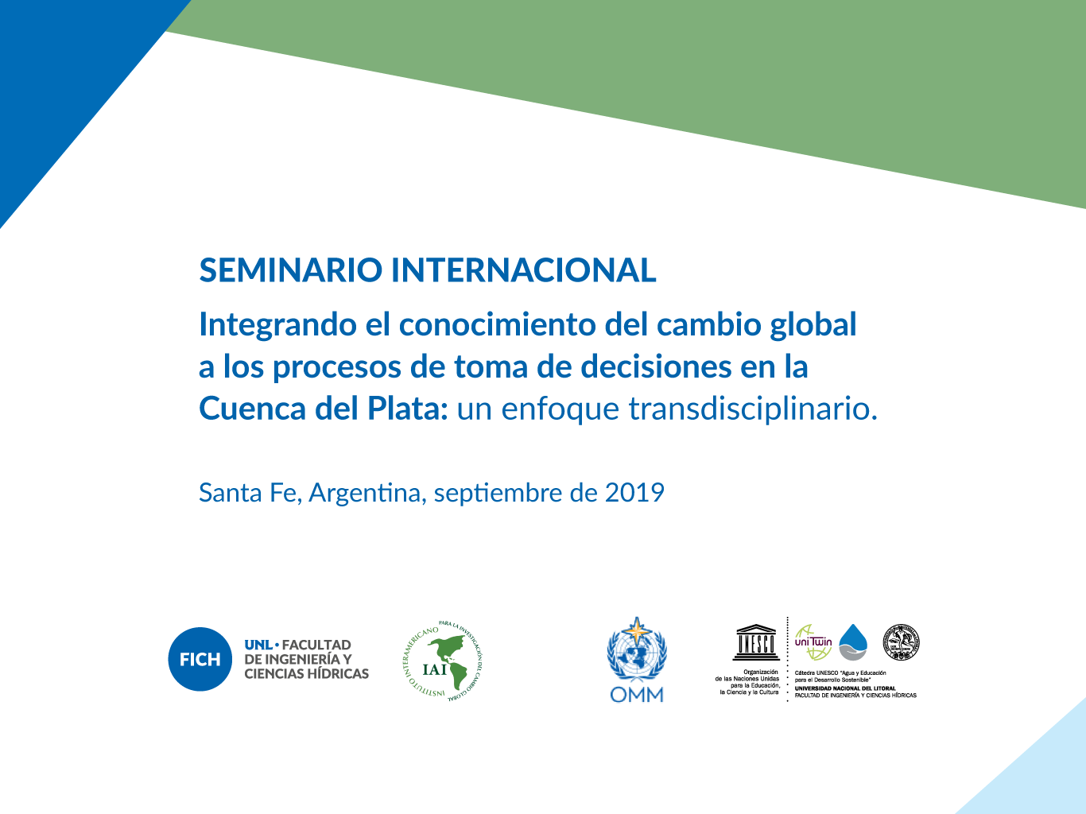

Slide 2

Gestión integral del riesgo
Osvaldo Moraes
Centro Nacional de Monitoramento e Alerta de Desastres Naturais
CEMADEN
osvaldo.moraes@cemaden.gov.br

Slide 3

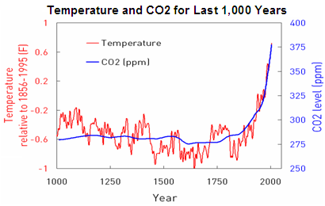
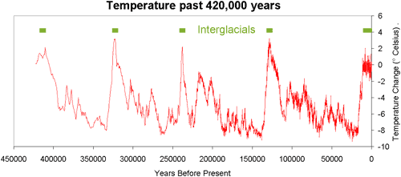
Afinal, quais as causas destas mudanças?

Slide 4
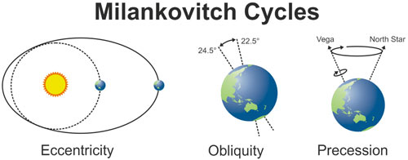

Slide 5
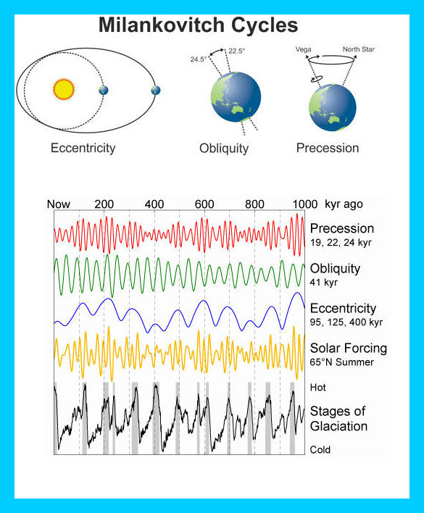

Slide 6
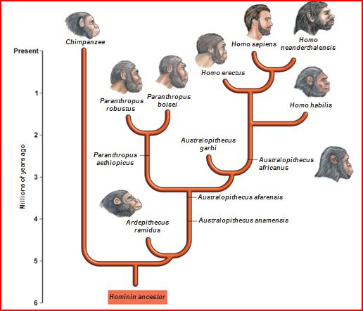
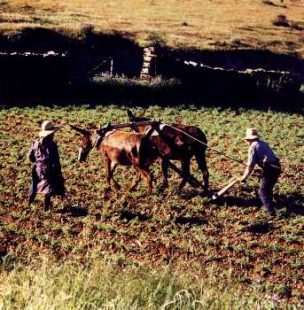

Turning points na história da humanidade
3 grandes revoluções
Cognitiva (+/- 70.000 anos atrás)
Agrícola (+/- 7 a 6 anos atrás)
Científica ( século XVI e XVII)

Slide 7
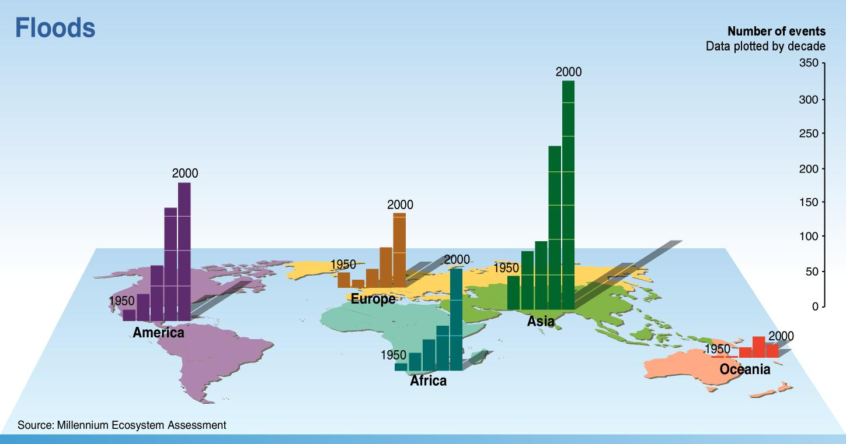
Aumento da densidade da população
+
Aumento dos eventos severos de tempo
=
Aumento dos desastres
Millennium Ecosystem Assessment, 2007

Slide 8
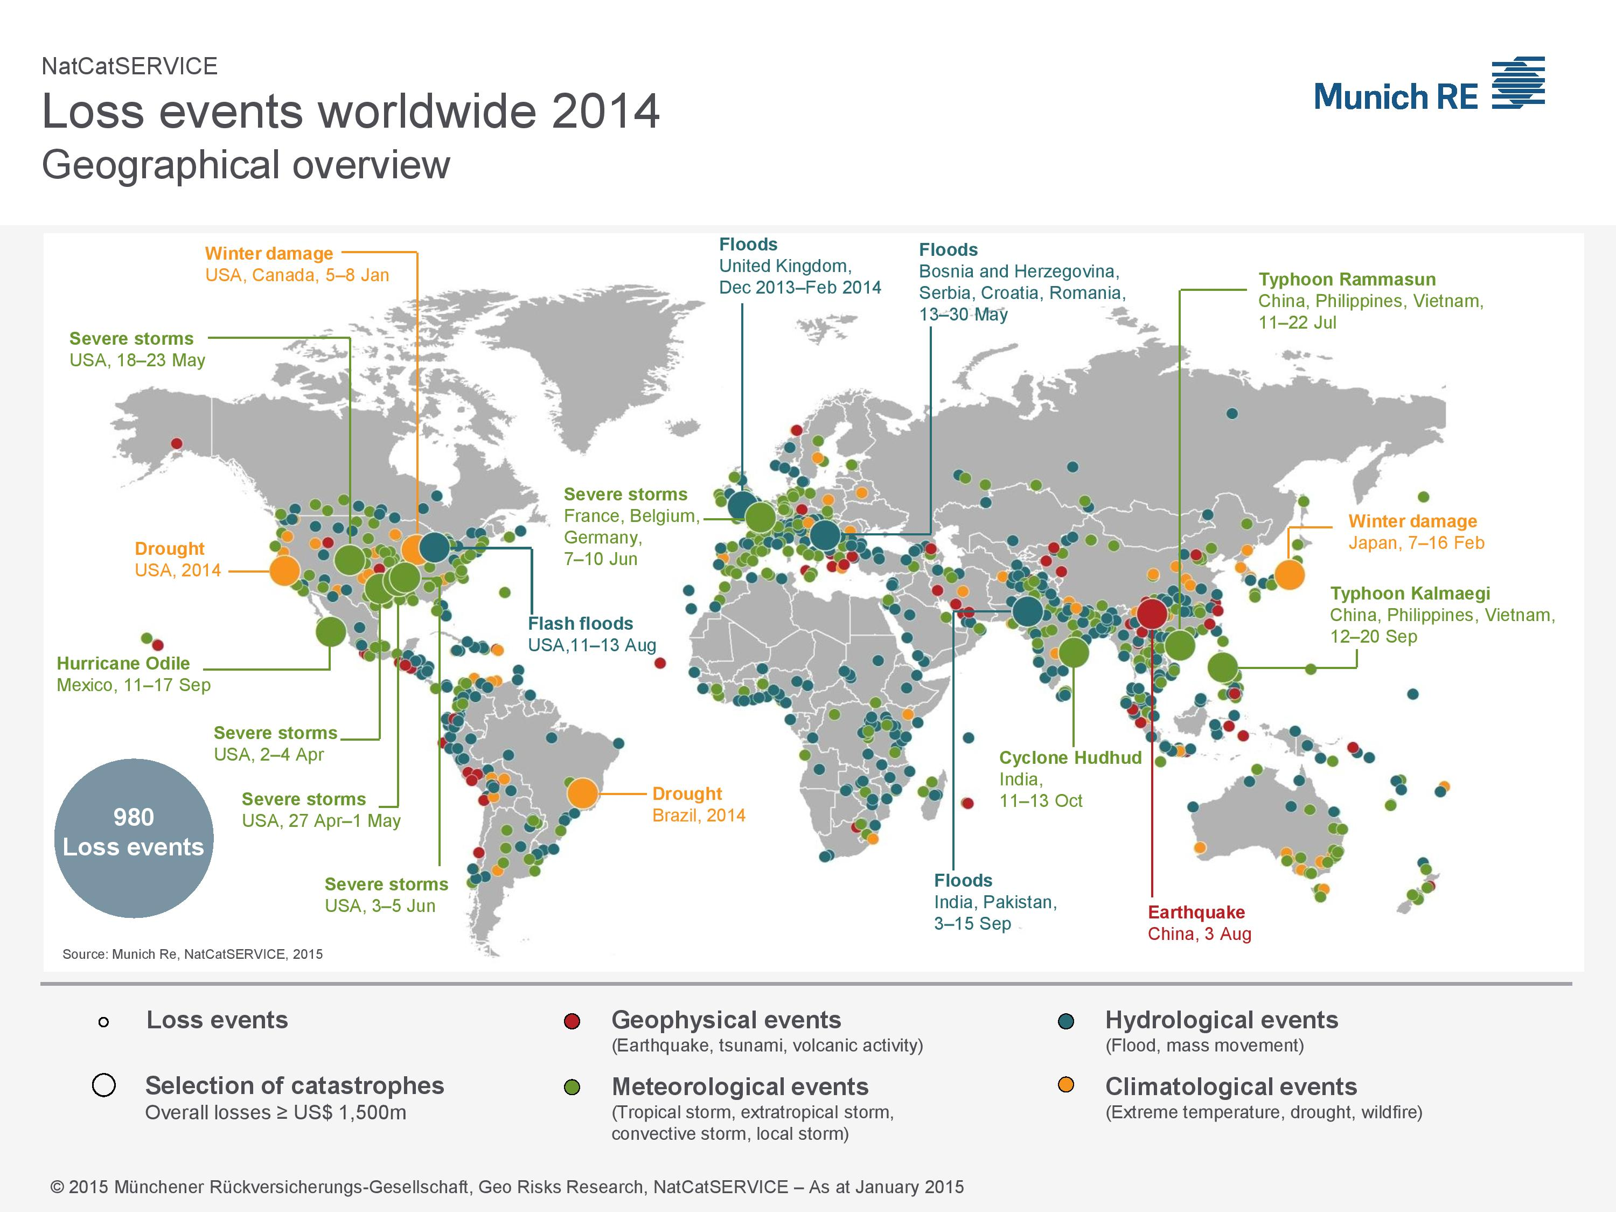
Eventos e Perdas Econômicas 2014

Slide 9
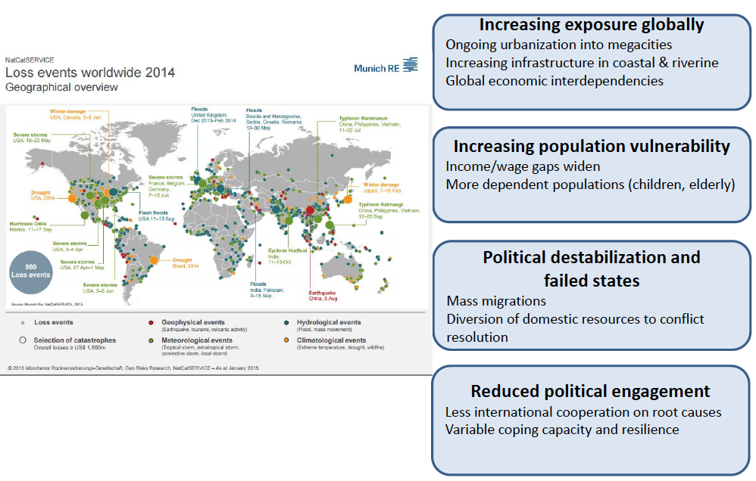
Context for disaster risk

Slide 10
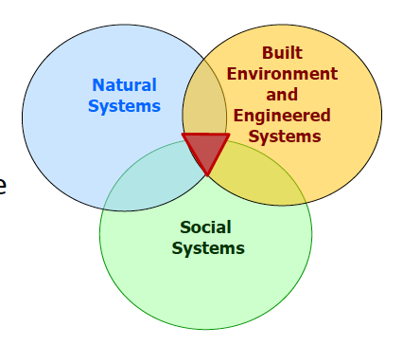
DRR knowledge for policies related
to the Sendai Framework, SDGs and UNFCCC
Disasters are complex problems
Requires integrated knowledge and understanding Holistic view
•Threats to local communities, national security
•Consequences amplified by unsustainable development
•Variability in exposure and vulnerability of communities and assets

Slide 11

TIMELINE
2002
2009
UNISDR Terminology on Disaster Risk Reduction
2015
Sendai Framework for Disaster Risk Reduction.
Hyogo Framework for Action 2005-2015
2005
Following feedback from experts and practitioners
2004
First set of UNISDR Disaster Risk Reduction

Slide 12
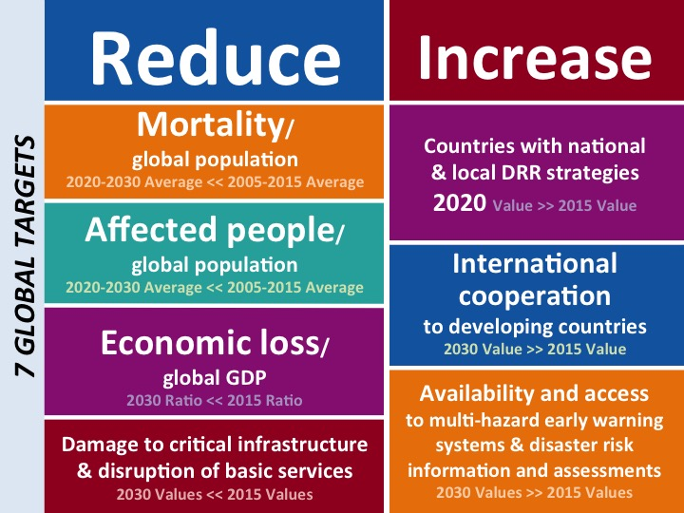
decrease
increase
disaster mortality/
Global population
Average 2020-2030 << Average 2005-2015
increase the number of countries with national and local DRR strategies
2020 value >> 2015 value
Affected people/
Global population
Average 2020-2030 << Average 2005-2015
7 GLOBAL TARGETS
enhance international cooperation to developing countries
2030 value >> 2015 value
Disaster economic loss/
Global gross domestic product
2030 proportion << 2015 proportion
increase the availability of and access to multi-hazard early warning systems and disaster risk information and assessments to people
2030 value >> 2015 value
reduce disaster damage to critical infrastructure and disruption of basic services
2030 value << 2015 value

Slide 13
Monitoramento do Marco de Sendai
Os indicadores para medir a implementação do Marco de Sendai foram desenvolvidos através de dois procesos distintos:
Indicadores Globais (nivel de resultado) provenientes do processo do Grupo de Trabalho Intergovernamental (OEIWG). Alguns dos indicadores desenvolvidos pelo OEIWG também monitoram as metas das ODS.
Um conjunto mais detalhado de indicadores nacionais específicos por país (insumos e productos) mede a implementação de estrategias e planos nacionaiss de RRD.

Slide 14
Em termos de implementação e monitoramento do Marco de Sendai para a RRD, todos os países devem completar as seguintes tarefas no período 2015-2020:
Até 2017 desenvolver linhas de base nacionais para iniciar a monitorar as sete metas globais de Sendai.
Até 2017 desenvolver um conjunto nacional de metas e indicadores do Marco de Sendai.
Até 2020 desenvolver estratégias nacionais de RRD com objetivos e indicadores alinhados com Sendai.

Slide 15
Plano de Ação Regional para a Implementação do Marco de Sendai
e para a Redução de Risco de Desastres 2015-2030 nas Américas
Primeira Prioridade: Compreender o risco de desastres
Segunda Prioridade: Fortalecer a governança do risco de desastres para gestão deste risco
Terceira Prioridade: Investir na redução do risco de desastres para a resiliência
Quarta Prioridade: Aumentar a preparação para casos de desastre a fim de dar uma resposta eficaz e “reconstruir melhor” nos âmbitos da recuperação, da reabilitação e da reconstrução.

Slide 16
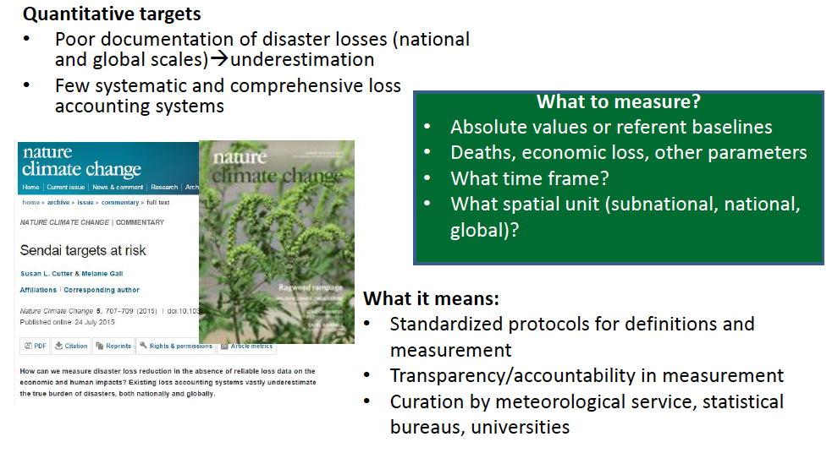
Fully Integrated System of DRR Disaster Risk Governance
Science inputs into Sendai targets monitoring

Slide 17

H = Hazard (flood; drought; landslides; etc.)
V = Vulnerability (social; physical; economical; technological; cultural; ecological; etc.)
C = Protection Capacity
M= Mitigation
E = Education
PLEASE DO NOT LOOK THIS “EXPRESSION” AS AN EQUATION

Slide 18
FUNDAMENTAL TERMINOLOGY
DISASTER
DISASTER RISK
RISK MANAGEMENT
DISASTER RISK MANAGEMENT
DISASTER RISK REDUCTION

Slide 19
The importance of a common and updated terminology on disaster risk reduction was highlighted in The Sendai Framework for Disaster Risk Reduction 2015-2030:
“to support the implementation, follow-up and review of the this framework through …leading, in close coordination with States, the update of 2009 Terminology on Disaster Risk Reduction in line with the agreed terminology by States;…” (paragraph 48 c) and “…recommends that the Working Group [comprising experts nominated by Member States] considers the recommendations of the Scientific and Technical Advisory Group on the update of the 2009 UNISDR Terminology on Disaster Risk Reduction by December 2016,…” (Sendai Framework, paragraph 50).

Slide 20
DISASTER
UNISDR 2017: A serious disruption of the functioning of a community or a society at any scale due to hazardous events interacting with conditions of exposure, vulnerability and capacity, leading to one or more of the following: human, material, economic and environmental losses and impacts. (Approved by the General Assembly on 01/12/2016)
WMO 2016: A serious disruption of the functioning of a community or a society causing widespread human, material, economic or environmental losses which exceed the ability of the affected community or society to cope using its own resources.
IPCC 2012: Severe alterations in the normal functioning of a community or a society due to hazardous physical events interacting with vulnerable social conditions, leading to widespread adverse human, material, economic, or environmental effects that require immediate emergency response to satisfy critical human needs and that may require external support for recovery.

Slide 21
DISASTER RISK
UNISDR 2017: The potential loss of life, injury, or destroyed or damaged assets which could occur to a system, society or a community in a specific period of time, determined probabilistically as a function of hazard, exposure, vulnerability and capacity (Approved by the General Assembly on 01/12/2016).
WMO 2016: Probable impacts, expressed in terms of expected loss of lives, people injured, property, livelihoods, economic activity disrupted or environmental damage (RISK)
IPCC 2012: The likelihood over a specified time period of severe alterations in the normal functioning of a community or a society due to hazardous physical events interacting with vulnerable social conditions, leading to widespread adverse human, material, economic, or environmental effects that require immediate emergency response

Slide 22

Methodology to Risk and Disaster Analysis
(definitions are not enough to stablish a DRR and Adaptation policy)
More than 95 percent of all deaths caused by natural disasters occur in developing countries, and losses due to natural disasters are 20 times greater (as a percentage of GDP) in developing countries than in industrialized countries (UNFCCC, 2008).
THIS IS MY DATA BASE

Slide 23
IS THERE ONLY ONE AND UNIVERSAL DATA SET TO IDENTIFY, CHARACTERIZE AND QUANTIFY DISASTERS AND IMPACTS?
Database needs:
TIME: frequency and seasonality. (WHEN)
SPACE: where and geographic scope. (WHERE)
IMPACTS: social and economic damages (directs and no directs). (WHAT)
CAUSE: natural, social or technologic trigger. (WHO)

Slide 24
1. Tech is only a part of the solution
Tech does not solve problems like magic.
2. Tech should be good
S&T needs active leadership and coordination
S&T for DRR - 7 (my) points
3. Consider simple inovations
Developing countries often have difficult to mantain well functioning advanced tech systems

Slide 25
4. Collaboration
Tech can help us to do that
5. Role of Polimakers
What do policymakers need to know, and do, about to use of S&T for DRR?
6.Upgrade what exists
Our work could be more extensive, involving system modidfication and improvements
7. Hardware and Software needs Peopleware

Slide 26
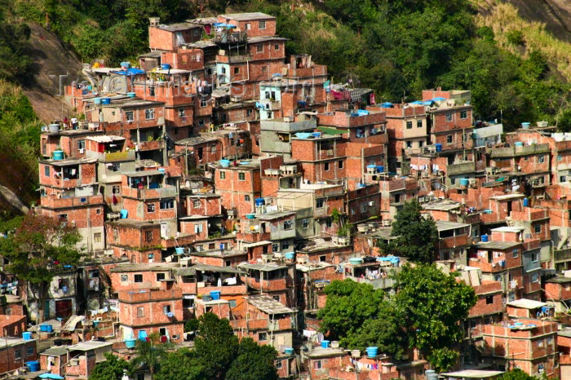
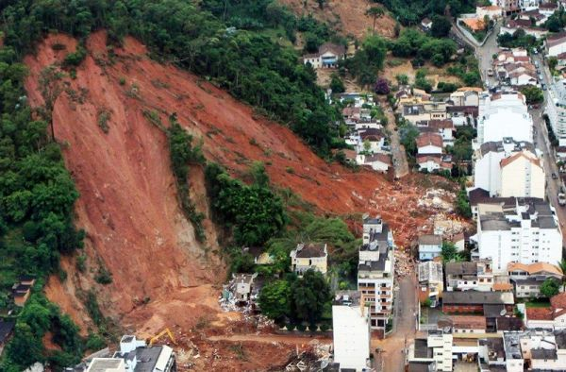
Catalyst for Recent Disaster Risk Reduction Policies in Brazil
Natural disaster of 11-12 January 2011 in the mountains west of Rio: over 900 fatalities, 350 missing and thousands left homeless. A catalyst for DRR policies focused on prevention
→ Creation of CEMADEN
Over 10 million people, mostly poor and vulnerable, living in areas of high disaster risk in Brazilian cities

Slide 27
Domicílios particulares permanentes em aglomerados subnormais, por características topográficas predominantes, situados em capitais brasileiras, ano de 2010 (IBGE, 2013)
Fonte: IBGE (2013) (adaptado)
*A aclividade/declividade moderada foi classificada entre 5% (2,9 graus) e 30% (16,7 graus) de inclinação.
**A aclividade/declividade acentuada como igual ou superior a 30% (16,7 graus) de inclinação.
Aglomerado subnormal é um conjunto constituído por no mínimo 51 unidades habitacionais (barracos, casas), ocupando ou tendo ocupado até período recente terreno de propriedade alheia (pública ou particular), dispostas, em geral, de forma desordenada, densa, e carentes, em sua maioria de serviços públicos e essenciais. Geralmente, se apresentam de forma fragmentada no conjunto urbano.

Slide 28

Prevention
Building structural resilience (slope, stabilization, drainage and flood control)
Relief and recovery
Mapping and understanding risk
Response
High resolution mapping of risk areas for 1000 municipalities
Monitoring and warning
Strengthening early warning networks
(e.g., 4 thousand automated raingauges, 9 weather radars,
300 riverflow sensors, data integrations, modeling, hazard prediction, etc.)
Post-2011 DRR Policy in Brazil: A Paradigm Shift
National Plan for Risk Management and Response to Disasters

Slide 29
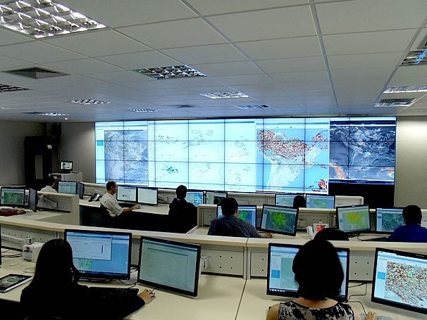
...Towards a National Strategy for Disaster Risk Management
  Multidisciplinary Team:
  Geologists
  Geographers
  Engineers
  Hydrologists
  Meteorologists
  IT professionals
  Social scientists
INMET, INPE, DECEA/MD & STATE CENTRES
Hydrometeorology information
MI, MCid e IBGE
Disaster Risk &
Vulnerability Analyses
CPRM
Geological Vulnerability Mapping
ANA
Hydrological information
COMMUNITY
Local feedback
CEMADEN
UNIVERSITIES & RESEARCH INSTITUTES
Knowledge transfer, methods and hypothesis-testing, applied research databases on natural disasters (vulnerability, exposure, hazards, risks)
Monitoring and Early Warning
CENAD
MS, GSI, MT, Army Force
Alert & Logistics
CIVIL DEFENSE
Contingency & Response Plans

Slide 30
Where is each type of hazard likely to be presented and why?
What scientific principles govern the process responsible for the disaster?
How often do these hazards develop into disasters?
How can each type of disaster be predicted and/or mitigated?

Slide 31
Conceptual Structure and Some Numbers
R & D - 25 PhD
10 Meteorology
6 Hidrology
3 Geology
6 Social Sciences
CEMADEN IS MORE THAN AN OPERATIONAL ROOM
OR – 45 MSc/PhD
12 Meteorology
12 Hidrology
12 Geology
9 Social Sciences
IT&E – 15 MSc/PhD
10 Computer Sc
5 Eng
Alerts
( > 10000)
Observational Network
( > 6000 sensors)
Notes:
31

Slide 32
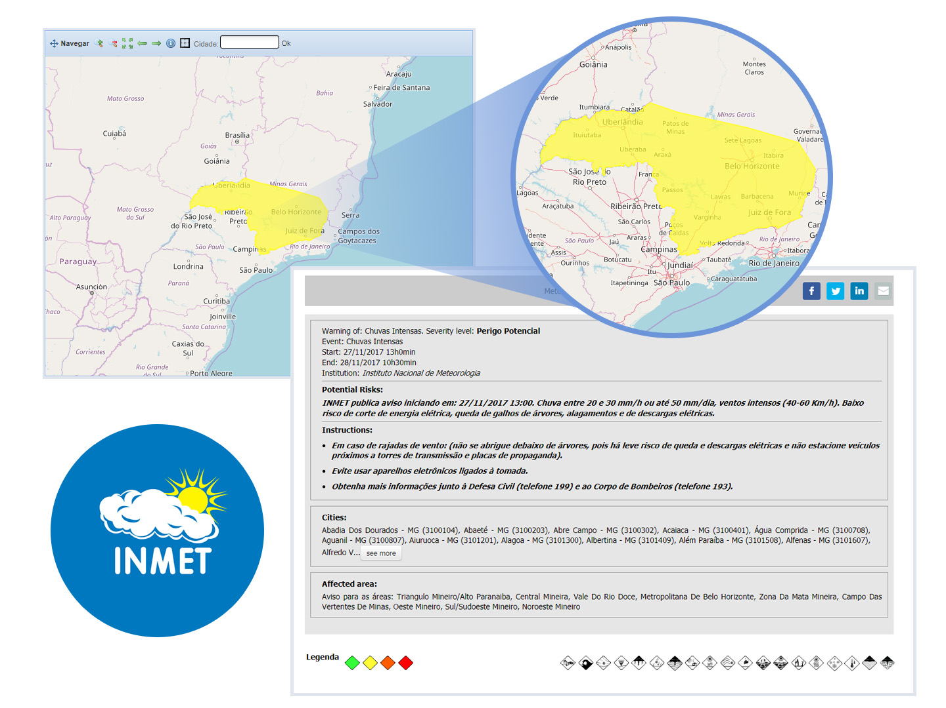
Meteorological Warning issued on 27/11/17
NECESSARY BUT NOT SUFFICIENT
WHY ?
EVENT IS NOT A DISASTER
DISASTER IS THE IMPACT

Slide 33
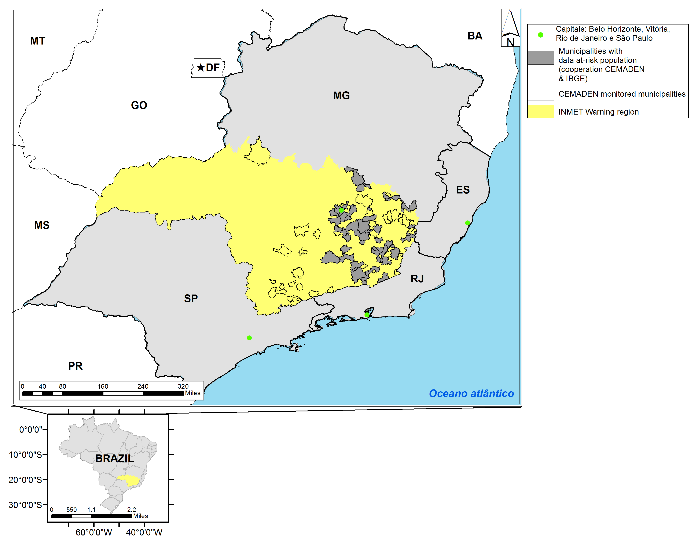
INMET warned regions & CEMADEN monitored municipalities
INMET: Number of municipalities in the warning region | CEMADEN: Number of monitored municipalities | Total Population in the monitored municipalities (IBGE 2016) | Number of risk areas in the monitored municipalities | % At-risk population in situation of very high social vulnerability*
573 | 89 | 8.245.599 | +/- 5.000 | 15%
Notes:
33

Slide 34
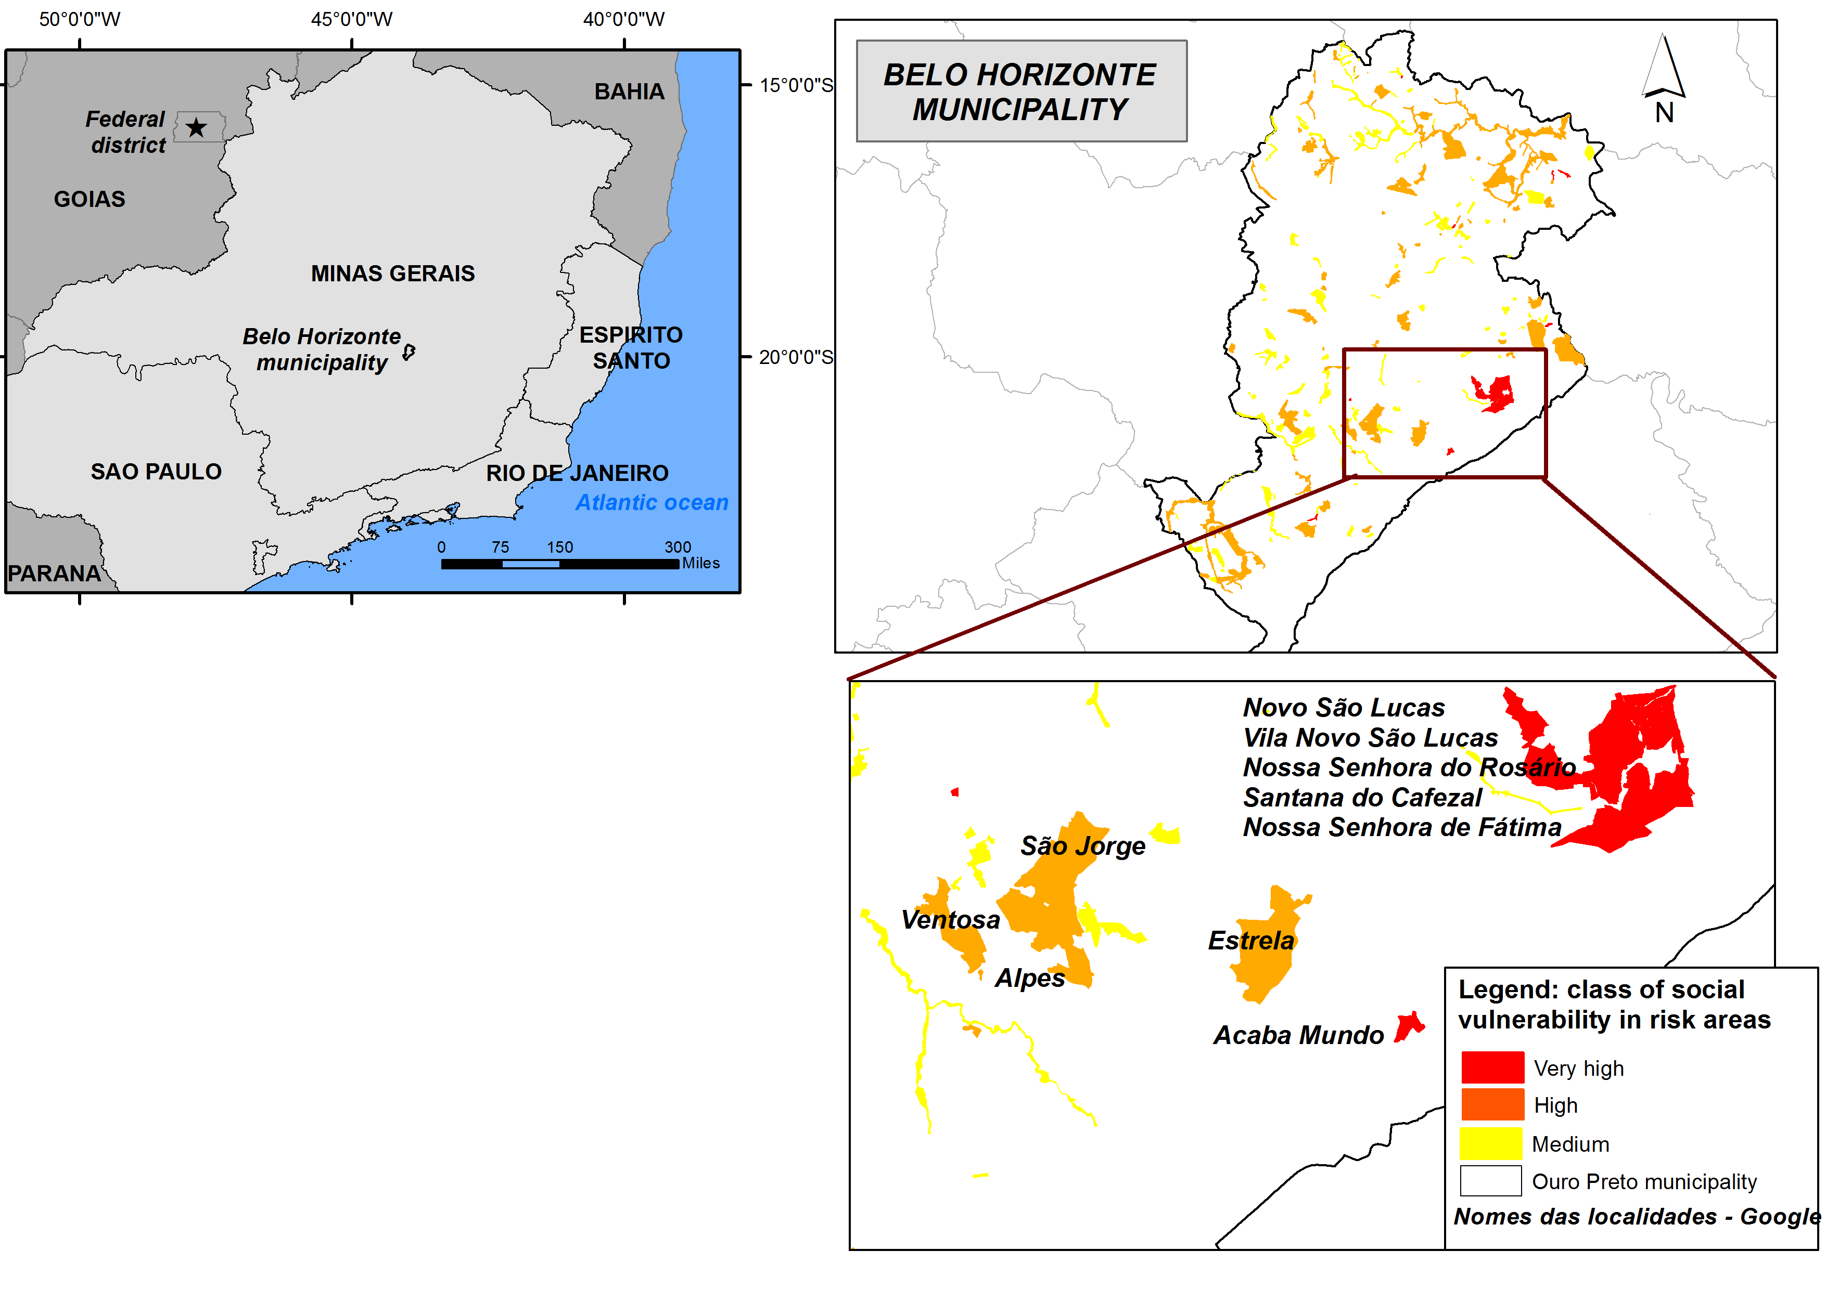
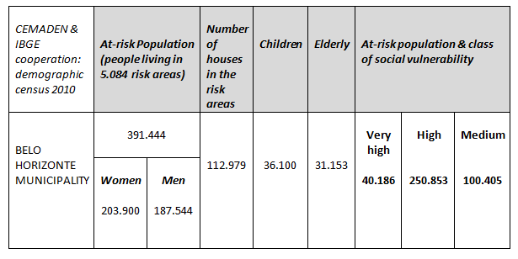
Social vulnerability at Belo Horizonte in areas suscepitible to landslides
Notes:
34

Slide 35
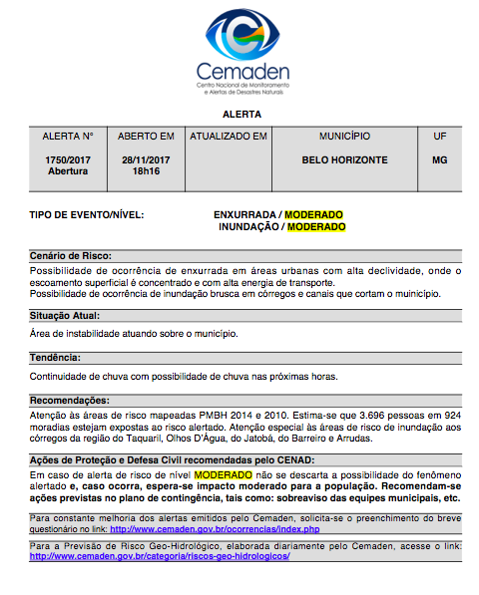
“Flood and Flashflood Warning”
issued on 28/11/17; start at 18:16; continuously updated
persons and houses that could be affected
and city districts

Slide 36
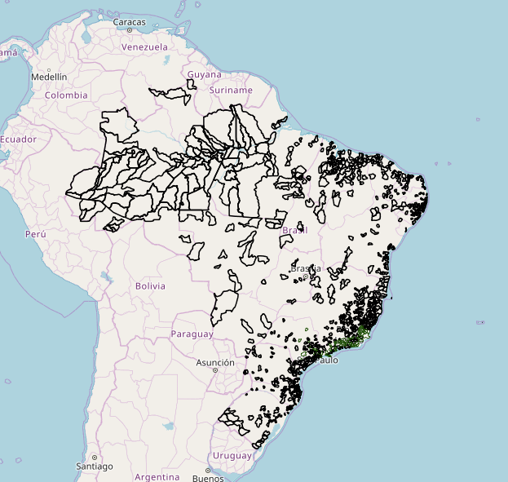

Slide 37
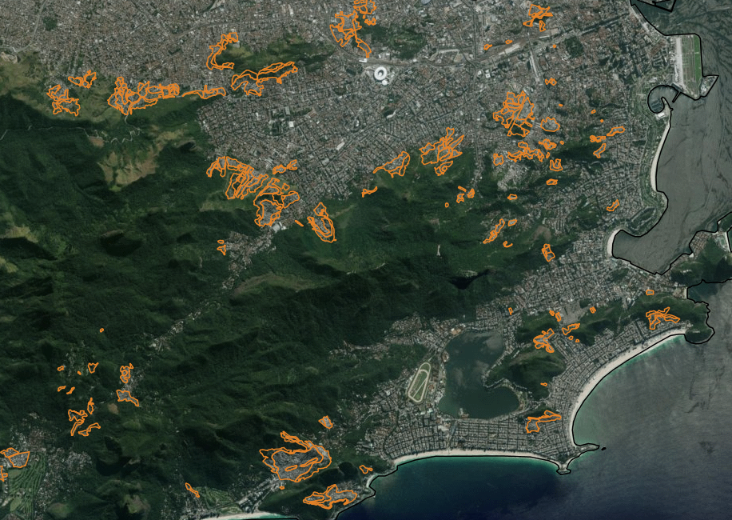

Slide 38
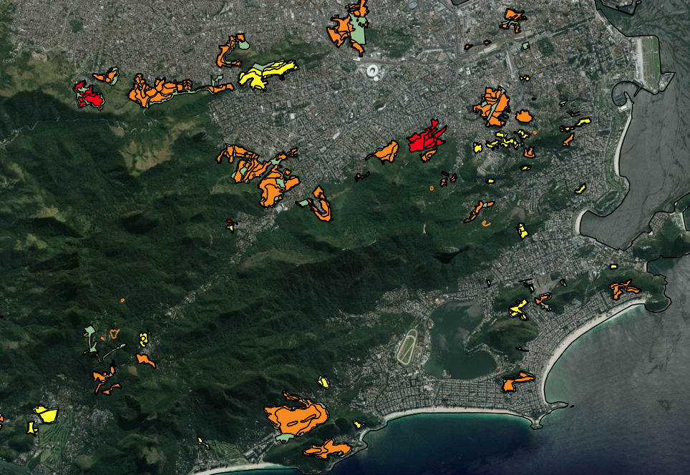

Slide 39
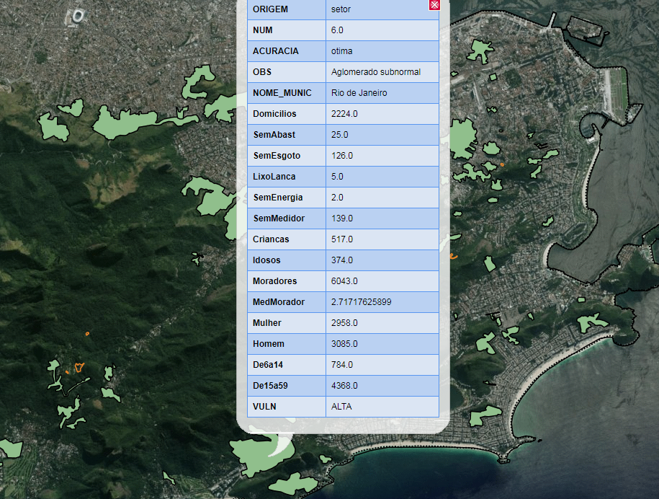

Slide 40
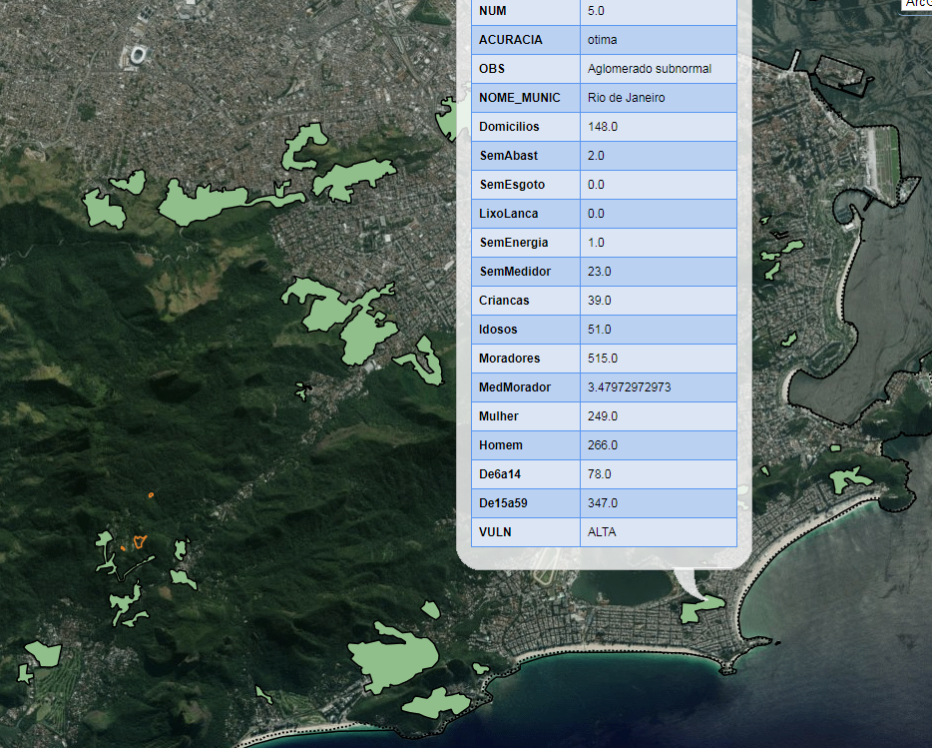

Slide 41
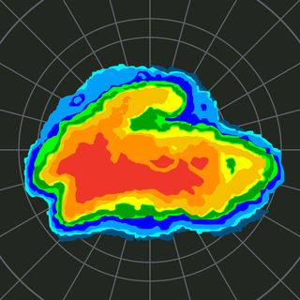
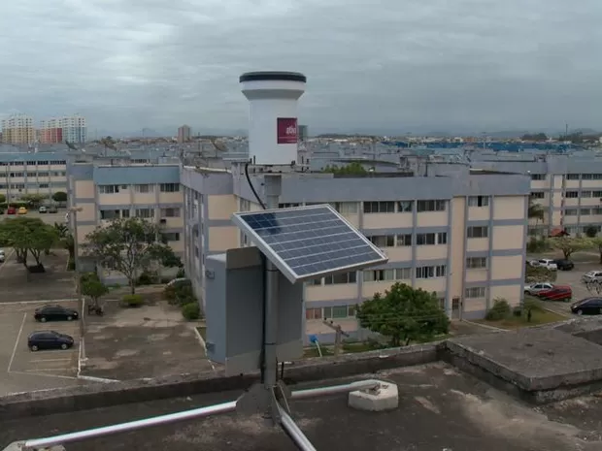
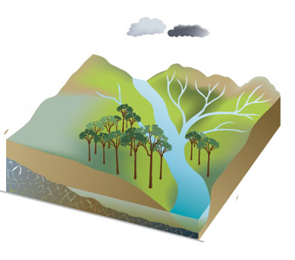
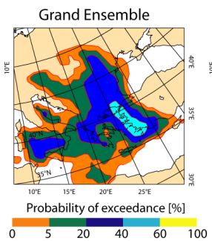
Basic protocol for issuing alert
Hidrology
Meteorology
and/or
Geotechnical
Construction of the risk scenario for impact
construction of the risk scenario for the physical event

Slide 42
 | Low Impact | High Impact | Very Hight Impact
Very High Probability | Moderate | High | Very High
High Probability | Moderate | High | High
Low Probability | Observation | Moderate | Moderate
Between 2012 and 2017, 8451 alerts were issued; totaling 192, 1766 and 6493 at a very high, high and moderate level, respectively. In this period 1742 events were recorded, being 116, 709 and 917 of very high, high and moderate impact

Slide 43
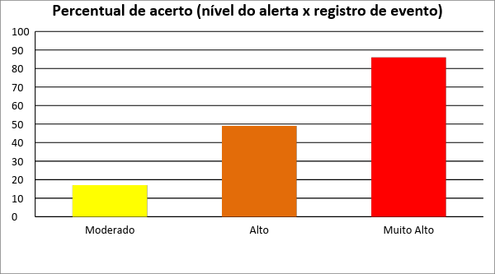
2017
Nível do alerta | Total de alertas | Alertas com eventos registrados
Moderado | 1604 | 279
Alto | 473 | 231
Muito Alto | 14 | 12
Total | 2091 | 522

Slide 44
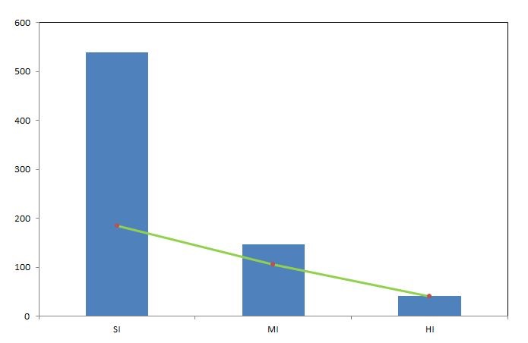
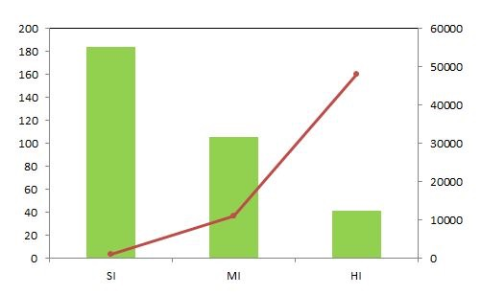
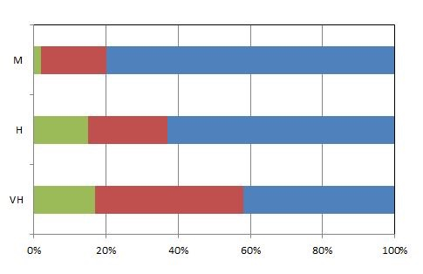
2017
(a) top left: disasters with someone affected;
(b) top right: total citizens affected by disasters; (c) bottom left:relation between alert level and disaster impact.
Green, red and blue accounts for high, medium and small impact disasters.

Slide 45
Projeto Semiárido
Sistema de Previsão de Riscos de Colapso de Safras no Semiárido Brasileiro
    Rede de monitoramento agrometeorologico
    Modelagem agrometeorologica
    “Crowdsourcing” para a coleta e envio de dados agrícolas (apoio: INCT-MC; CEMADEN-IIASA)
2) Monitoramento dos Impactos da Seca
    Resolução Nº 13 (22 de maio de 2014) CEMADEN tem a responsabilidade de prover conjunto de dados indicativos de condição de seca para o MI para subsidiar ações auxílio emergencial financeiro (Bolsa Estiagem).
    Apoio ao Programa Garantia Safra - MDA

Slide 46
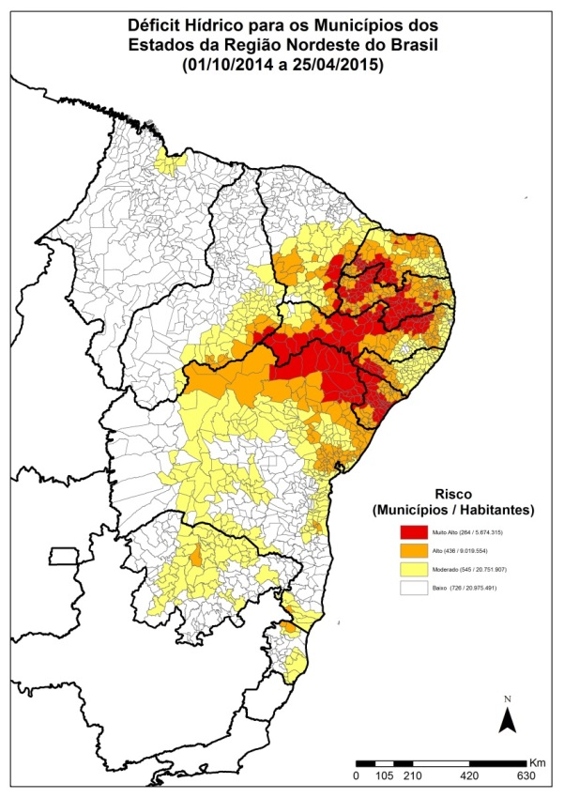
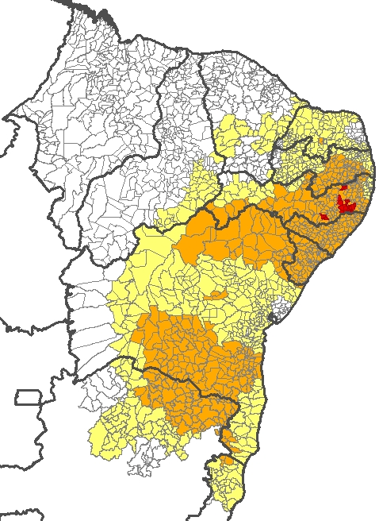
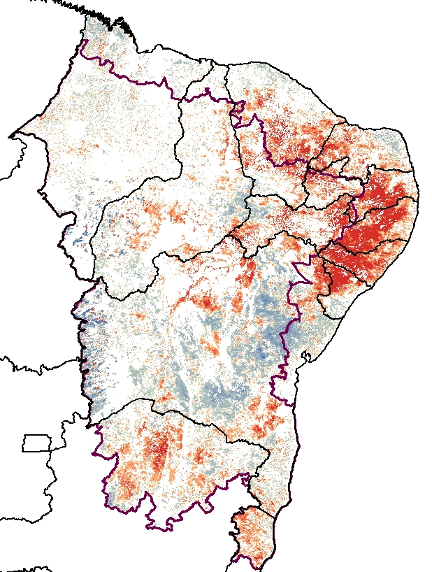
Impactos da Seca
Modelo de Balanço Hídrico
Rede observacional de superfície
Sensoriamento Remoto
1) Número de dias com déficit hídrico nos municípios:
2) Integração de bancos de dados observacionais de precipitação
3) Anomalia VSWI
Fonte: PROCLIMA: CPTEC/INPE
Fonte: Centros Nacionais (INMET, INPE, ANEEL e CEMADEN) e Centros Estaduais de Meteorologia de cada Estado da área de atuação da SUDENE.
Produto CEMADEN gerado a partir de NDVI e TS (MODIS/NASA)

Slide 47
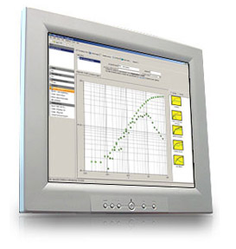

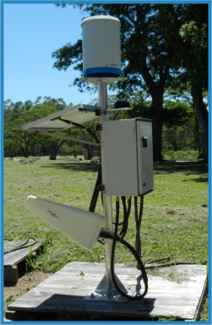
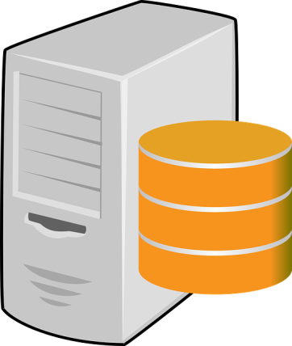
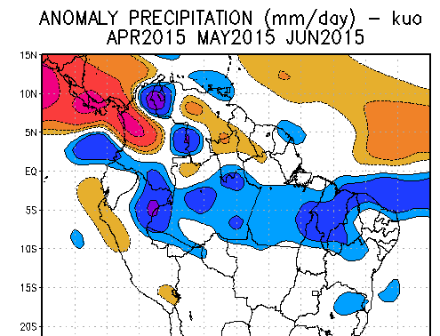
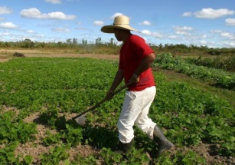
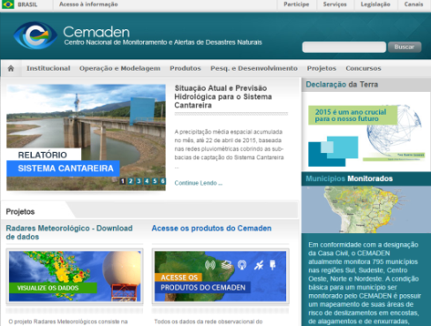

Sumário : Sistema de Previsão de Riscos de Colapso de Safras no Semiárido Brasileiro
Crowdsourcing: Captura de dados de manejo
Simulações com os modelos de rendimento agrícola
Banco de dados de entrada para modelos agrometeorológicos
Aplicação de SIG Para Elaboração dos Alertas
Dados agrometeorológicos das PCDs
DISSEMINAÇÃO DOS ALERTAS:
Previsão Climática

Slide 48
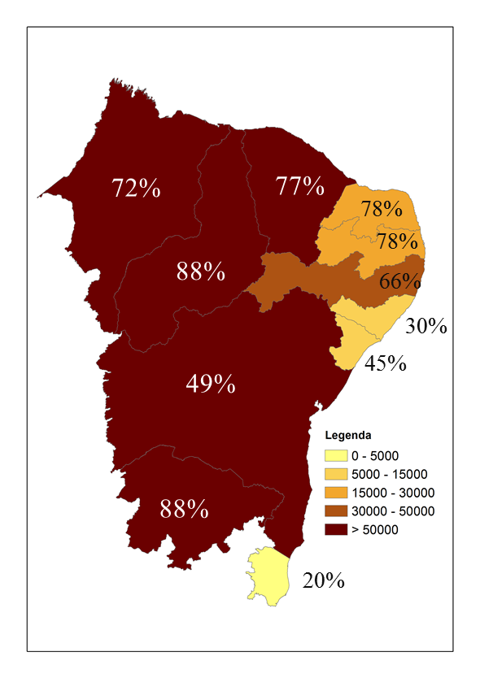
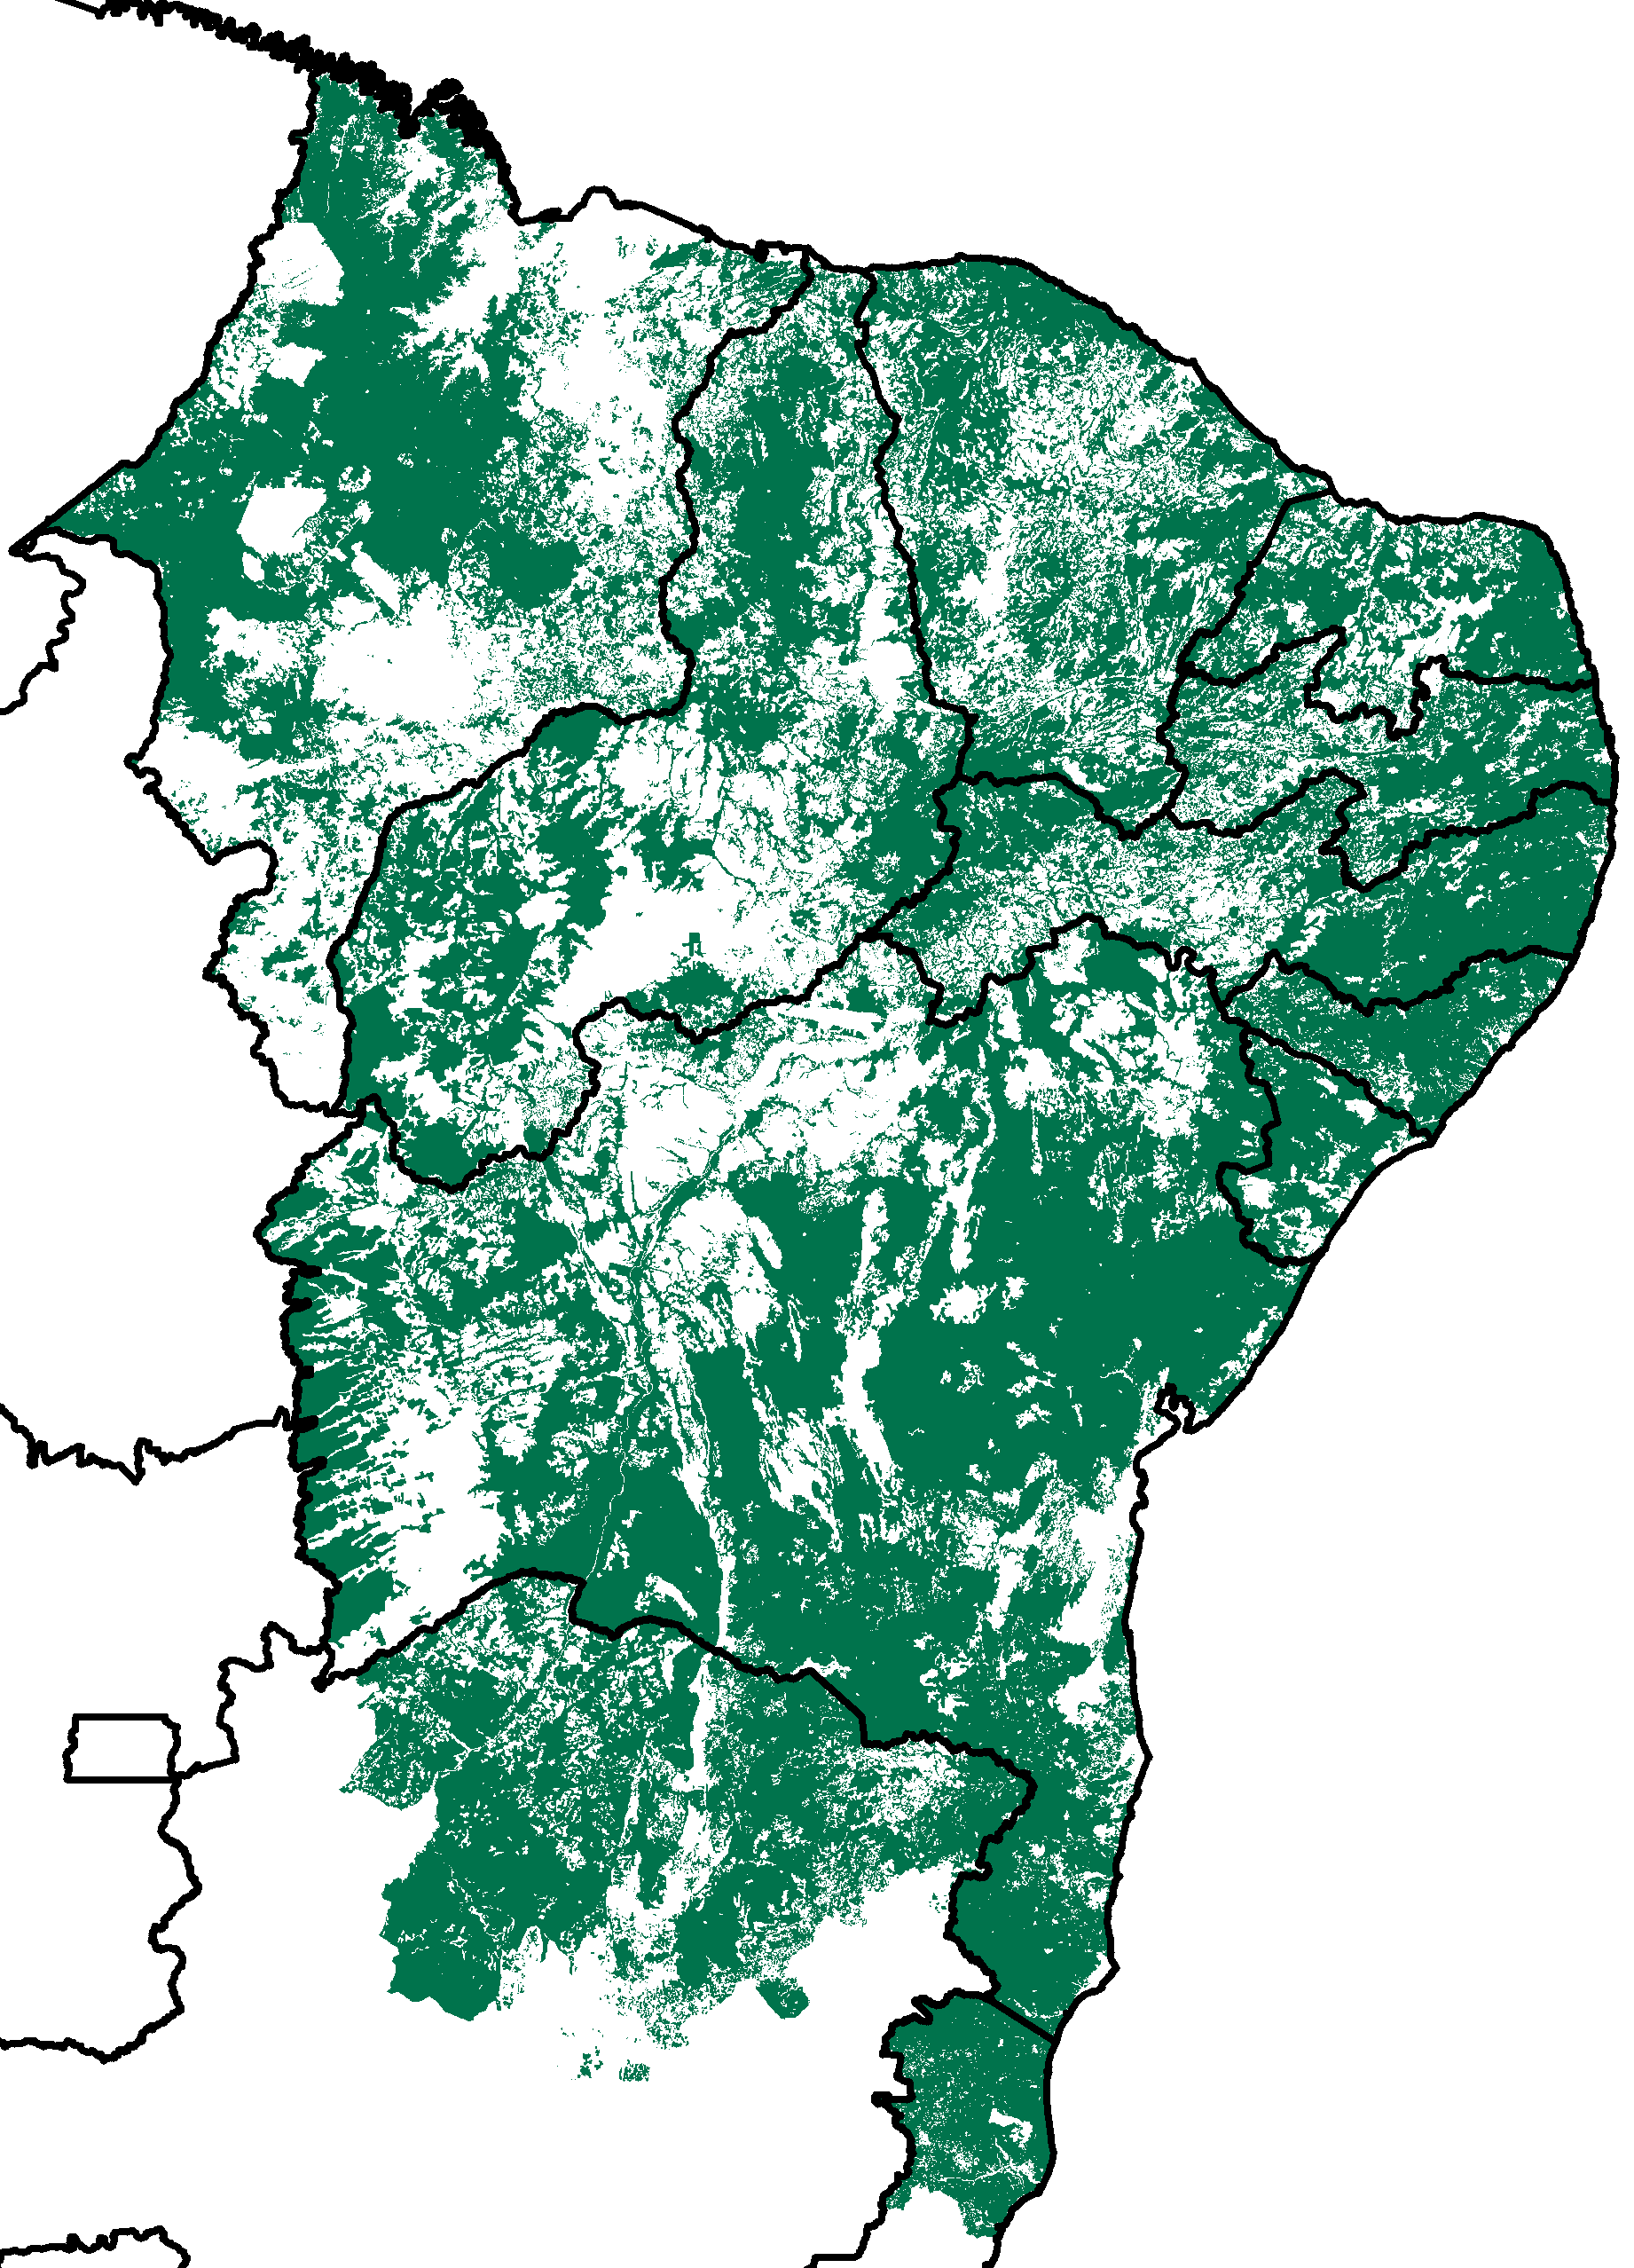

Monitoramento dos impactos da seca em áreas de PASTAGENS e AGRÍCOLAS - VSWI
Área total de pastagens e agrícolas impactadas pela seca entre agosto e setembro (Km²)
A maior parte dos Estados possuem mais de 50% das áreas de pastagens e agrícolas em condição de seca;
Situação esperada em função da estação seca na Região.
Áreas agrícolas e de pastagens

Slide 49
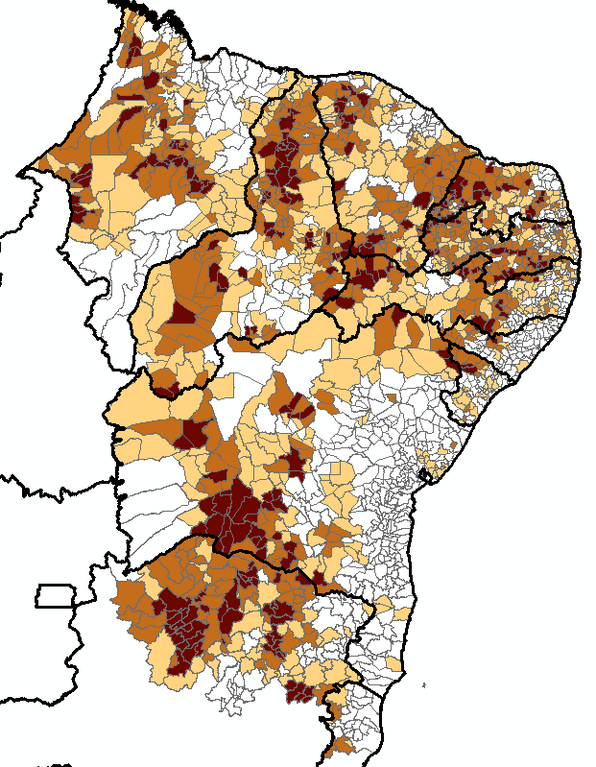

Monitoramento dos impactos da seca em áreas de PASTAGENS e AGRÍCOLAS - VSWI
Porcentagem de Área de pastagens e agrícolas impactadas pela seca: ago-set (Km²)
210 Municípios com mais de 80% de sua área impactada pela seca;
758 Municípios com mais de 50% de sua área impactada pela seca.

Slide 50

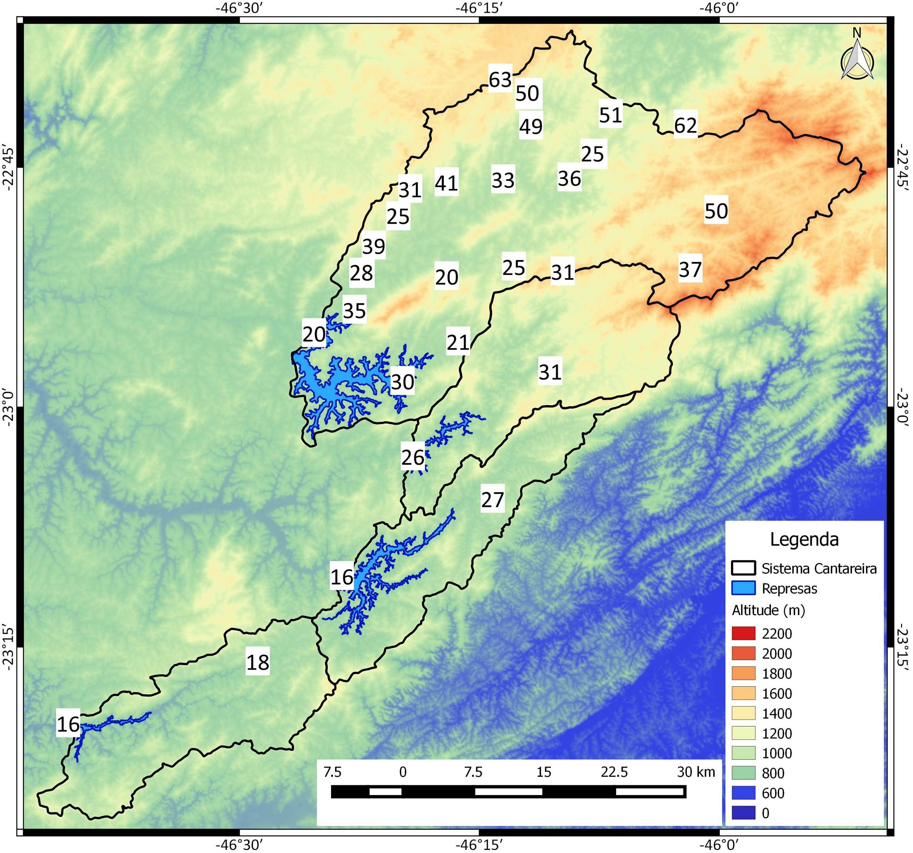
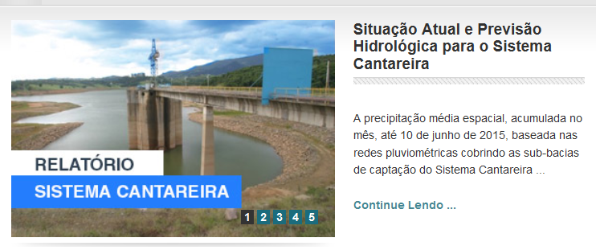

Chuva Acumulada
de Junho (até dia 16)

Slide 51
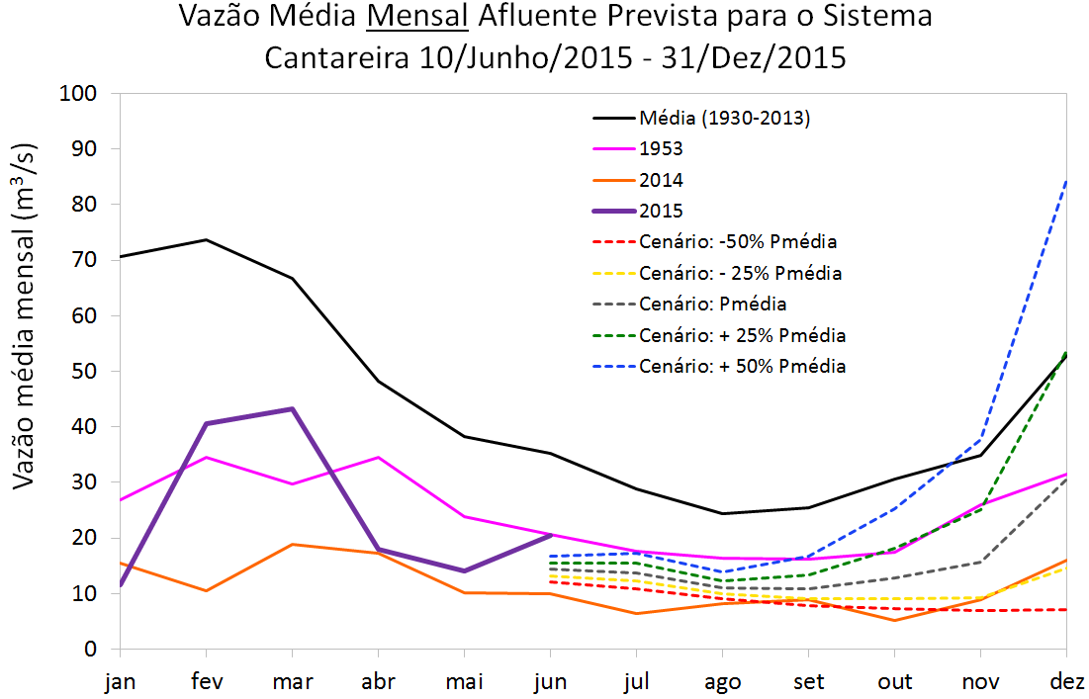
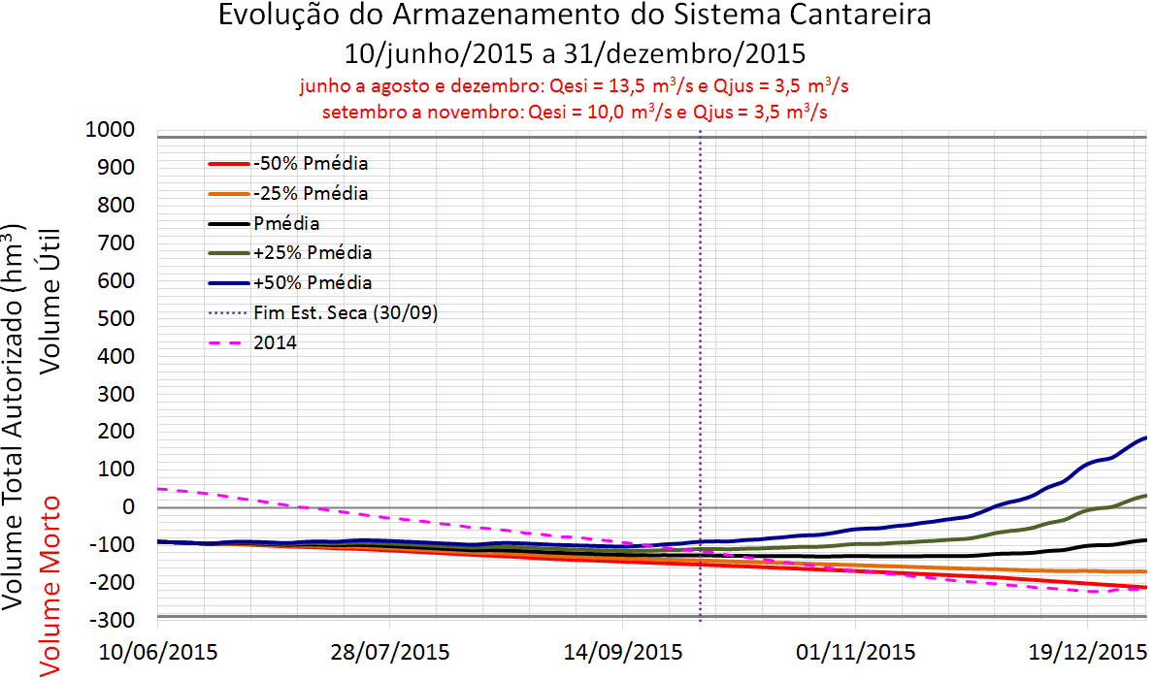

Sistema Cantareira
Projeção
vazão (m³/s)
Projeção
volume armazenado (hm³)

Slide 52
Muchas Gracias

