Slide 1
Avances de la Evaluación Regional Progress on the Regional Assessment
54th meeting of the IAI Executive Council
November 15th, 2022
Montevideo, Uruguay

Slide 2
Etapas de la Evaluación Regional completadas en 2022 /
Steps of the Regional Assessment completed in 2022
Febrero: Sesión informativa para las Partes - February: Information session for Parties
Marzo-abril: Distribución de encuesta en línea - March-april: Distribution of online survey
Mayo: Análisis de datos de las encuestas - May: Analyses of survey data
Junio: Presentación de estado y progreso en la CoP-30 – June: Update on progress and status at CoP-30
Julio: Sesiones de trabajo sub-regionales - July: Sub-regional listening sessions
Septiembre-octubre: Análisis de sesiones sub-regionales - September-october: Analysis of sub-regional sessions
Noviembre: Presentación de estado y progreso en la EC-54 - November: Update on progress and status at EC-54

Slide 3


Sub-regional sessions: Southern Cone
Participating countries: Argentina, Paraguay, Chile
Topic discussed | More prevalent strategic goal | Examples
Priority decisions and policies | Climate action | Climate Change Law (Chile and Paraguay)
Relevant transboundary issues | Water security | Glaciers (Chile), Pilcomayo River (Paraguay), Del Plata basin (Arg)
Opportunities for collaboration | Climate action | Climate Change Risk Atlas (Chile)

Slide 4

Sub-regional sessions: Southern Cone
Participating countries: Argentina, Paraguay, Chile
“Sería muy bueno que pudiésemos desarrollar algún tipo de atlas de cambio global a nivel regional, donde podamos ir completando la información sobre las problemáticas y al mismo tiempo compartiendo experiencias e incorporando capacidades en los países.” Participante de Chile
“It would be very good if we could develop some kind of atlas of global change at the regional level, where we could complete the information on the problems and at the same time share experiences and incorporate capacities in the countries.” Participant from Chile

Slide 5


Sub-regional sessions: Andes
Participating countries: Peru, Ecuador, Colombia
Topic discussed | More prevalent strategic goal | Examples
Priority decisions and policies | Biodiversity and ecosystem services | Land-use planning (Peru and Ecuador)
Relevant transboundary issues | Biodiversity and ecosystem services | Ecosystem services of páramos (Colombia), Riverine biodiversity (Peru)
Opportunities for collaboration | Food security | Healthier, nature–based diets (Peru)

Slide 6

Sub-regional sessions: Andes
Participating countries: Peru, Ecuador, Colombia
“Estamos trabajando como país pionero en generar un distintivo para la producción sostenible, trabajando con cadenas de valor que han sido los mayors drivers de la deforestación. Queremos demostrar que los servicios ambientales pueden ser una fuente de ingresos para el país y para mejorar la calidad de vida de la gente.” Participante de Ecuador
"We are working as a pioneer country in generating a label for sustainable production, working with value chains that have been the major drivers of deforestation. We want to demonstrate that environmental services can be a source of income for the country and improve people's quality of life.“ Participant from Ecuador

Slide 7
Sub-regional sessions: Central America and the Caribbean
Participating countries: Panama, Jamaica
Topic discussed | More prevalent strategic goal | Examples
Priority decisions and policies | Climate action | National Plan for Climate Action (Panama)
Relevant transboundary issues | Biodiversity and ecosystem services | Illegal fishing (Jamaica), migration driven by env change (Panama)
Opportunities for collaboration | Climate action | Vulnerability assessments (Panama)

Slide 8

Sub-regional sessions: Central America and the Caribbean
Participating countries: Panama, Jamaica
“Hay un proyecto en el que se aborda la sequía en el corredor seco centroamericano, dado que las estaciones secas son cada vez más fuertes y largas. Pero intentando asegurar las conexiones para reducir la vulnerabilidad de las especies.”Participante de Panamá
"There is a project addressing drought in the Central American dry corridor as the dry seasons are getting stronger and longer. But trying to secure connections to reduce species vulnerability.“ Participant from Panama

Slide 9
Sub-regional sessions: North America
Participating countries: United States, Canada, Mexico
Topic discussed | More prevalent strategic goal | Examples
Priority decisions and policies | Climate action | Emsision reductions (Canada), National Climate Assessment (US)
Relevant transboundary issues | Biodiversity and ecosystem services | Species migrations, landscapes across borders (Canada and US),
Opportunities for collaboration | Climate action | Training of boundary spanners (Canada)

Slide 10

Sub-regional sessions: North America
Participating countries: United States, Canada, Mexico
“That´s going to look at reducing methane emissions from our key emitting sectors, which are oil and gas and agriculture. We´re also trying to recognize indigenous rights and responsibilities in conserving ecosystems.” Participant from Canada
"Eso va a contemplar la reducción de las emisiones de metano de nuestros principales sectores emisores, que son el petróleo y el gas y la agricultura. También estamos tratando de reconocer los derechos y responsabilidades de los indígenas en la conservación de los ecosistemas". Participante de Canadá

Slide 11
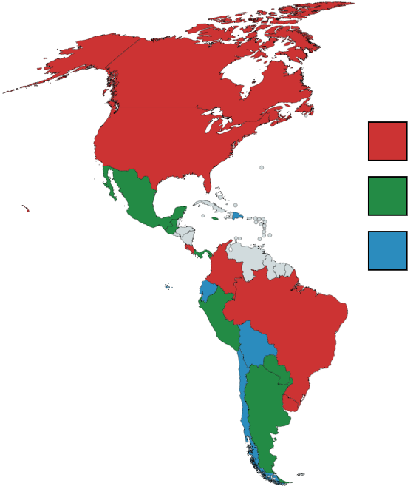


Survey results: Country clusters based on shared current priorities
Climate action
Biodiversity and ecosystem
Clean air, water and soil
Food security
Energy security
Climate action
Water security
Climate action
Biodiversity and ecosystem

Slide 12
Próximos pasos / Next steps
Análisis en profundidad de los datos de la encuesta regional y las sesiones sub-regionales - More in depth analysis of data from regional survey and sub-regional sessions
Revisión de documentos describiendo políticas y decisiones relacionadas con CAG – Review of documents describing policies and decisions related to GEC
Presentación de resultados en la CoP-31 – Presentation of results at CoP-31
Integración de información y redacción de reporte – Integration of information and report writing

Slide 13
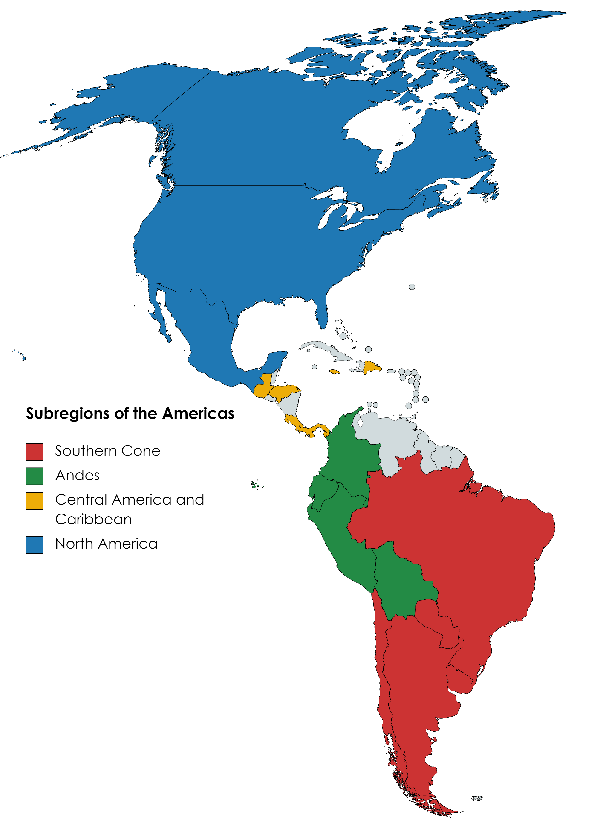
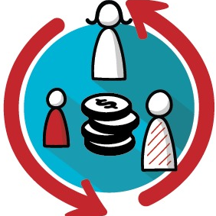


More relevant trans-boundary issue per sub-region

Slide 14
Survey results: country clusters based on current priorities
17 out of 19 IAI member countries completed the online survey
Cluster of countries | Shared current priorities
Colombia, Uruguay, Brazil, Canada, Costa Rica, United States | Climate action, Biodiversity and ecosystem services, Clean air, water and soil
Peru, Panama, Mexico, Jamaica, Paraguay, Guatemala, Argentina | Food security, Energy Security, Climate Action
Bolivia, Ecuador, Chile, Dominican Republic | Water security, Climate Action, Biodiversity and Ecosystem Services

Slide 15
Survey results: country clusters based on emergent priorities
17 out of 19 IAI member countries completed the online survey
Cluster of countries | Shared emergent priorities
Colombia, Argentina, Uruguay, Brazil, Canada, Paraguay, Guatemala, Chile | Water security, Human health and wellbeing
Peru, Panama, Mexico, Jamaica, United States | Energy security, Biodiversity and ecosystem services, Clean air, water, and soil, Human health and wellbeing, Poverty & Equality
Bolivia, Ecuador, Dominican Republic, Costa Rica | Food security, Energy security, Human health and wellbeing, Clean air, water, and soil

Slide 16
Prioridades actuales |  | Prioridades emergentes
Colombia | Climate action | Colombia | Water security
Uruguay | Biodiversity and ecosystem services | Uruguay | Human health and wellbeing
Brazil | Clean air, water, and soil | Brazil
Canada |  | Canada
 |  | Paraguay
 |  | Guatemala
Paraguay
Guatemala
Peru | Food security | Peru | Energy security
Panama | Energy security | Panama | Biodiversity and ecosystem services
Mexico | Climate action | Mexico | Clean air, water, and soil
Jamaica |  | Jamaica | Human health and wellbeing
 |  |  | Poverty & Equality
Bolivia | Water security | Bolivia | Food security
Ecuador | Climate action | Ecuador | Energy security
Dominican Republic | Biodiversity and ecosystem services | Dominican Republic | Human health and wellbeing
 |  |  | Clean air, water, and soil

