Slide 1
Informe resumen de la Dirección Ejecutiva del IAI
Programa de Ciencias
Reunión del Consejo Ejecutivo, CE-54
15 noviembre 2022
Montevideo, Uruguay

Slide 2
Programa de Ciencias
Articulación
FINANCIAMIENTO
IMPLEMENTACION
COMUNICACION
Construcción de capacidades
Notes:
I will present an overview of the work of the IAI’s science program during the intercessional period. I’d like to recognize the efforts of the SAC/SPAC in support of these activities.
SAC/SPAC discussed the transformation of the IAI, shifting from funding to an integrated approach, and this aligns with the IAI’s strategic plan to better serve IAI Parties
Regional assessment is going to guide these priorities
Implementation/mainstreaming of EDI policy already in different initiative
To do this work, we have raised almost $ 4 million in external funding from national funding agencies, international development banks, and charitable foundations

Slide 3
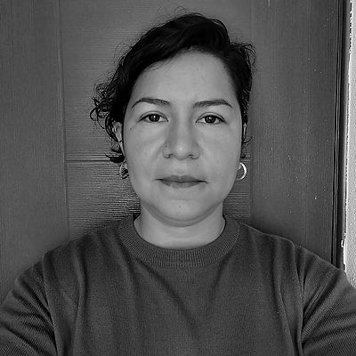

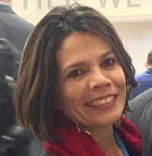
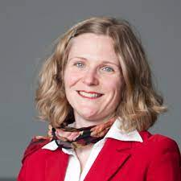
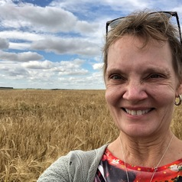
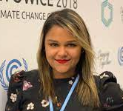
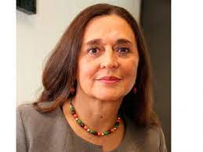
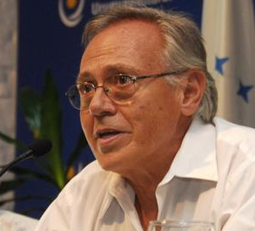
Programa de Ciencias: SAC & SPAC
Nuevos miembros
Reuniones en julio, agosto, septiembre, y octubre
Miembros de 13 países
Comités
Género, Equidad, Diversidad e Inclusión
Un curriculum para la ciencia trandisciplinar
Clima, ambiente y salud
Centro de Diplomacia Científica
Notes:
SAC and SPAC members have participated in several regional meetings including the Solar Radiation Modification Meeting in Jamaica, the Disaster Resilience meeting in Dominica (co-hosted with OEA), and the science diplomacy board meeting held this past week in Uruguay.
They have participated in science-policy communication efforts including leading sessions at SSUNGA, the CEH course, the pre and post UNFCCC CoP-27 webinars, drafting of a science policy brief with IPCC key messages on water security.
Dr. Omar Lopez, the SAC chair is also playing a lead role in the planning of SRI2023, as co-chair of the scientific program committee, and this is fantastic because SENACYT, where Omar is based, is hosting the conference.

Slide 4
Programa de Ciencias: Financimiento
En desarrollo:
Belmont CRA: Iniciativa de investigación regional de la Amazonía y en bosques tropicales, co-liderado con FAPESP (etapa de estudio de alcance)
Belmont CRA Enfoques integrados de la migración/movilidad humana en una era de cambios globales rápidos (por financiar)
Clima y Salud respuesta en las Américas: Capacitaciones – Subsidios semillas
Abierto o por abrir
Abierto: SRI2023 becas para asistir al congreso para estudiantes y investigadores de carrera temprana de América Latina y el Caribe (Partes del IAI)
Al incio de 2023: Belmont CRA Clima, medio ambiente y salud (CEH2)
Notes:
-IAI Participated in the CEH2 scoping process for LAC region at AmeriGeo Week in 2021, and shared the preliminary results in a PLOS Climate article.
The IAI is providing key training on transdisciplinary science and science-policy communication at SRI 2022, in partnership with the Belmont Forum and START.
CEH TD training with PAHO and GCCHE will allow teams to prepare for the CEH Belmont Forum CRA
IAI will provide funding to its Parties for researchers to apply to the Migration & Mobility and Global Change Call

Slide 5

Belmont CRA con FAPESP: Amazonia & bosques tropicales
junio 2022: Lanzamiento del proceso de estudio de alcance
sept 2023 Borrador del texto de la convocatoria
junio 2023 Presentación del report de alcance en SRI2023
oct 2022 -abril 2023 Talleres de alcance
abril-sept 2023 Reuniones para financiadores
oct 2023 Presentación de la convocatoria en el plenario del Belmont
enero 2024 Lanzamiento de la convocatoria (CRA)

Slide 6
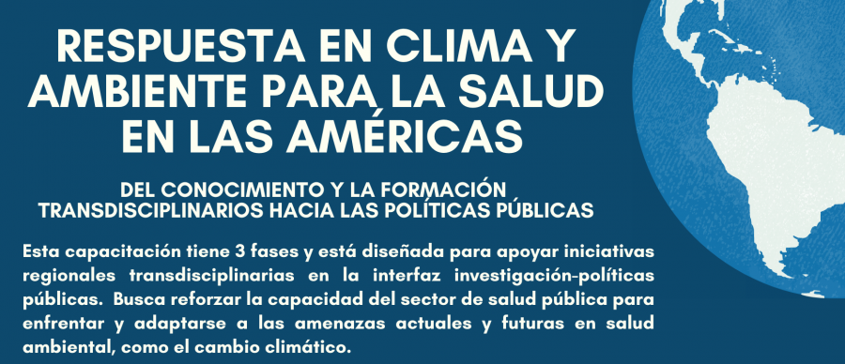


Programa de Ciencias: Fondos Semillas para Clima, Ambiente y Salud
Taller presencial en San Martín de los Andes, Neuquen, Argentina, 13-18 marzo 2023
Resultado esperado: 12-15 proyectos co-financiados por IAI, PAHO, MRI, UNICEF, entre otros.
Notes:
tNext phase of training

Slide 7
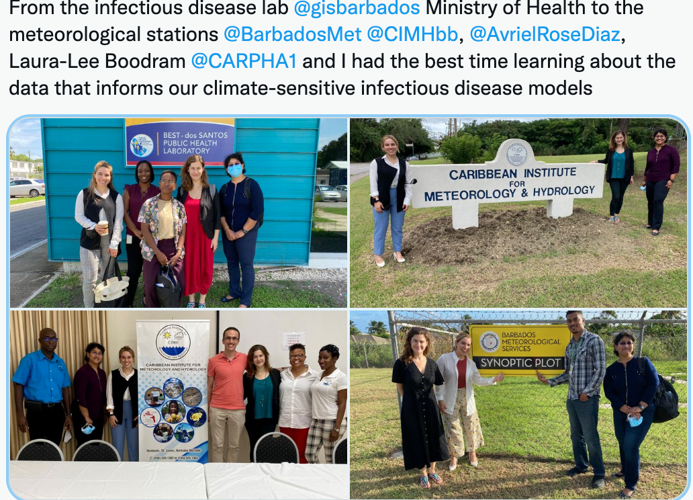

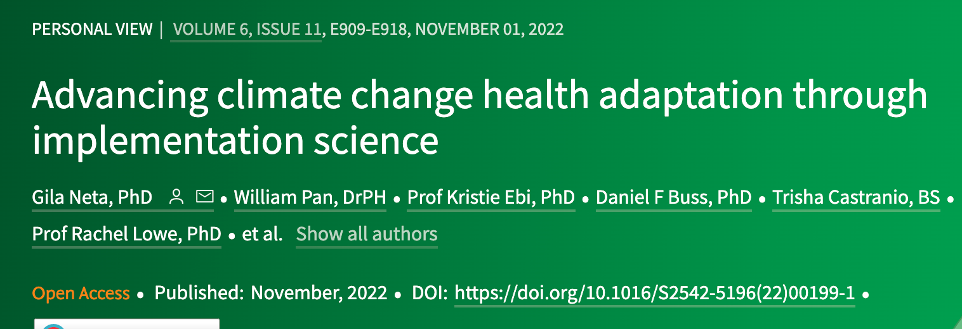
Programa de Ciencias: Sistemas de alerta temprana para salud

Slide 8
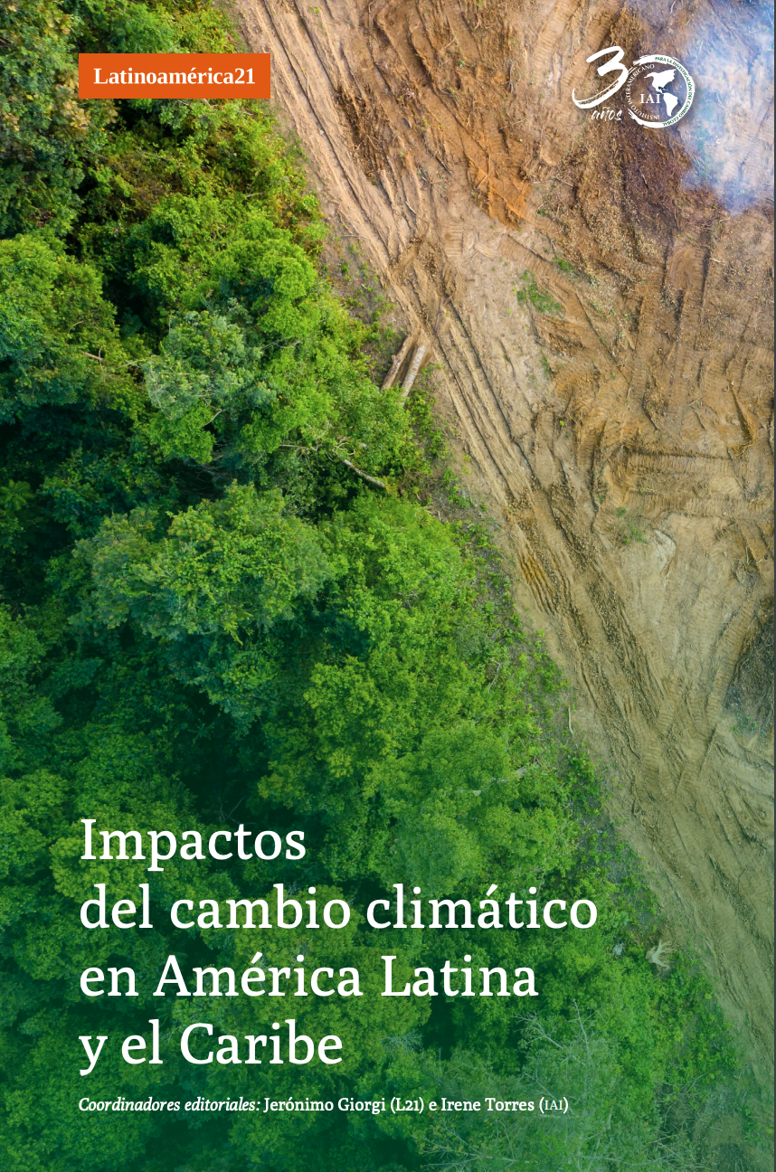
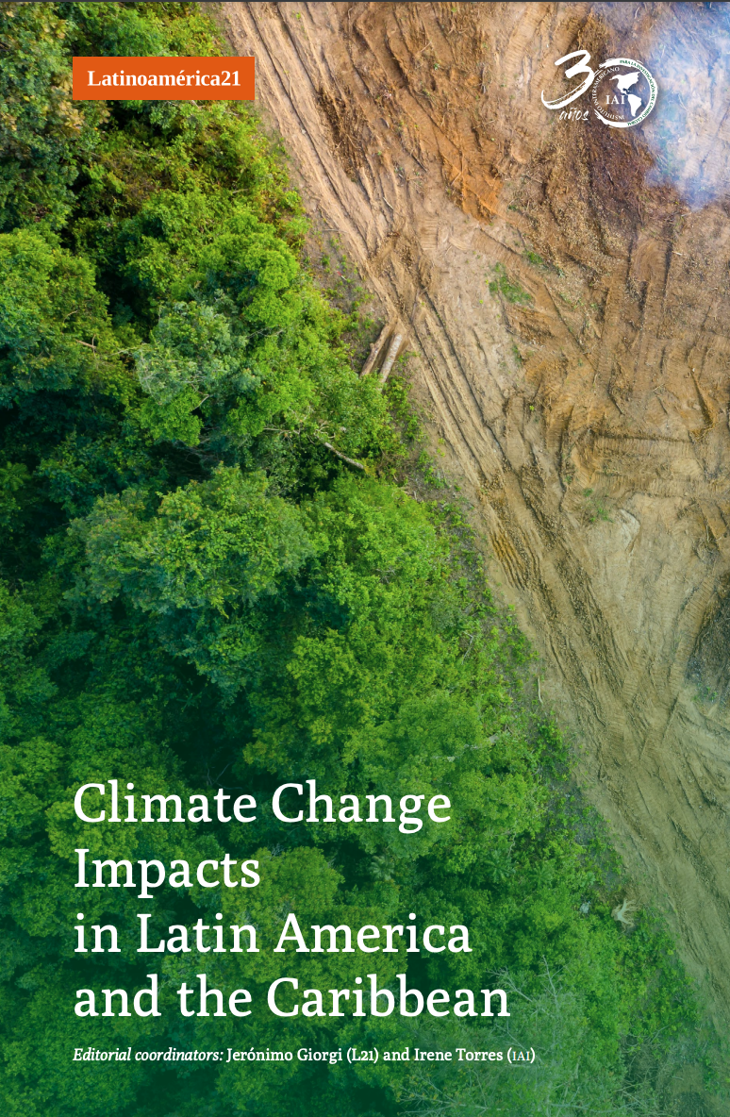
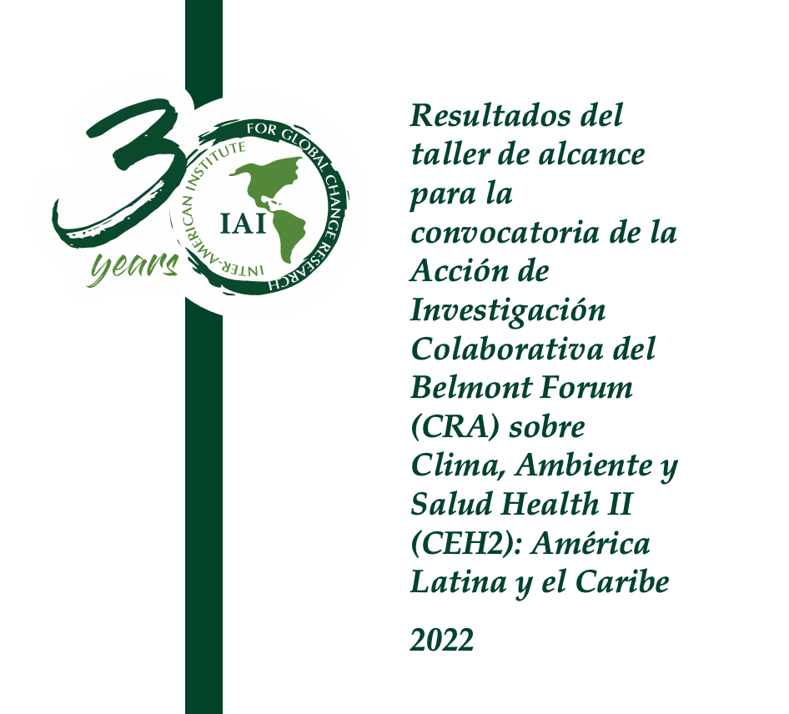
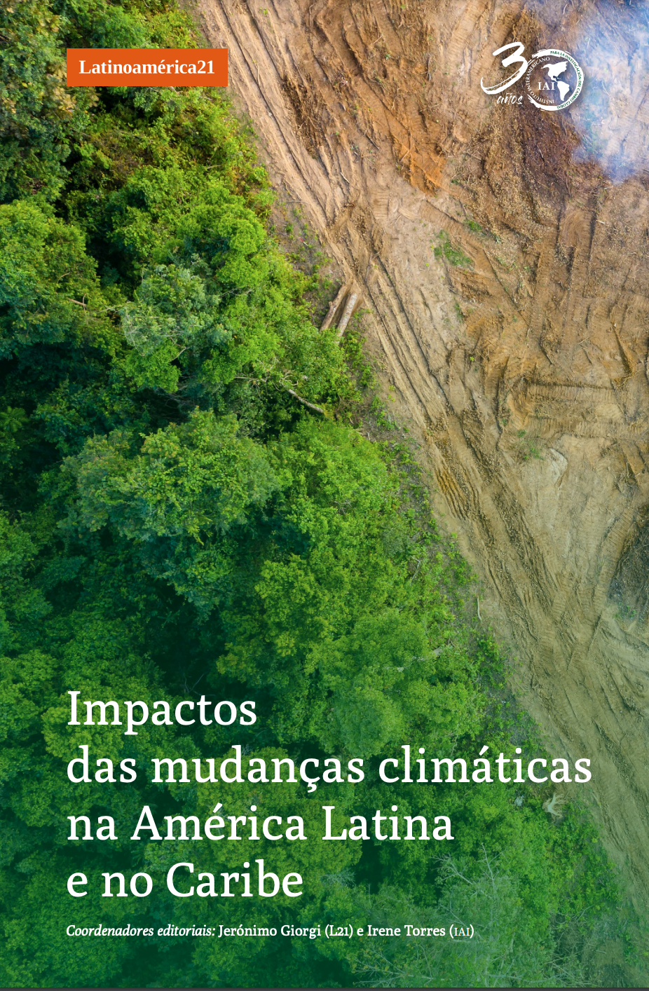
Programa de Ciencias: Reportes y comunicación
Add CEH report
Add other covers in Eng/Port
Notes:
Communications have improved in English and Spanihs.
- The IAI Newsletter has increased its readership threefold (as measured by the number of total opens) between July 2021 and February 2022, and the Updates email readership has more than doubled between September 2021 and 2022.
- The IAI website has seen an increase of 38,209 new users between June 2021 and June 2022.
- WEBINARS on: 6th IPCC report results, academic publishing and editing, academic best practices, migration and health in a context of global change, software tools for climate-sensitive infectious disease modeling.

Slide 9


Programa de Ciencias: Eventos virtuales
6 webinars para UNFCCC CoP-27: Preparación previa y análisis post-CoP
17 sesiones sobre ciencia y política en la Cumbre Científica de la Asamblea General de las Naciones Unidas (UNGA77)
Nuevo evento sobre redes sociales para comunicación en la interfase ciencia-política con L21
Nuevo evento sobre computación en la nube y desastres con Amazon y NASA
Notes:
á lUpcoming webinar with Amazon web services and NASA on cloud based computing for disaster prevention, response, and resilience

Slide 10
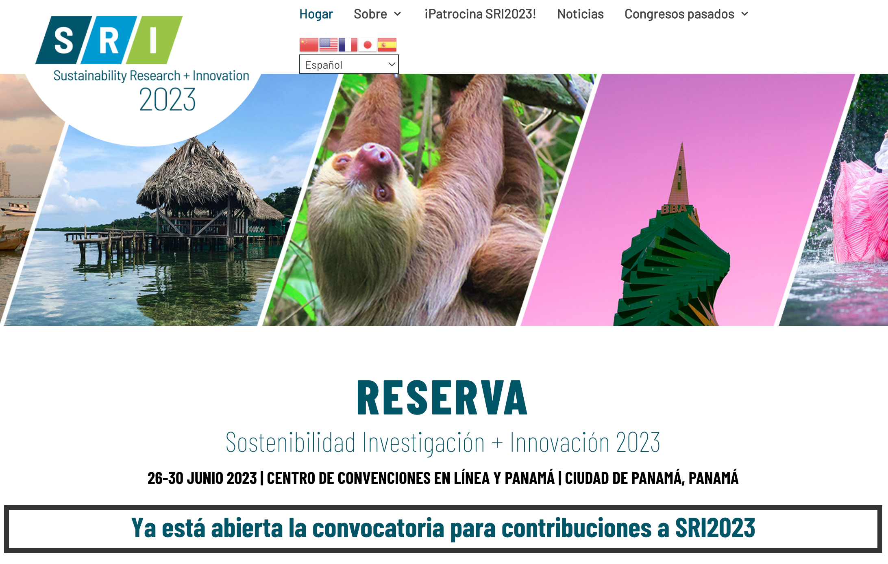

Programa de Ciencias: SRI2023 Panama
Notes:
Add image of SRI webpage
Call for submission opens
IAI will provide scholarships
Back to back with the IAI CoP-31

