Slide 2
LACI
ENHANCING CAPACITY FOR CLIMATE RISK ASSESSMENT AND CATALYZING PARTNERSHIPS TO INFORM DECISIONS IN LATIN AMERICA AND THE CARIBBEAN
Dr. Maria Uhle
National Science Foundation

Slide 3


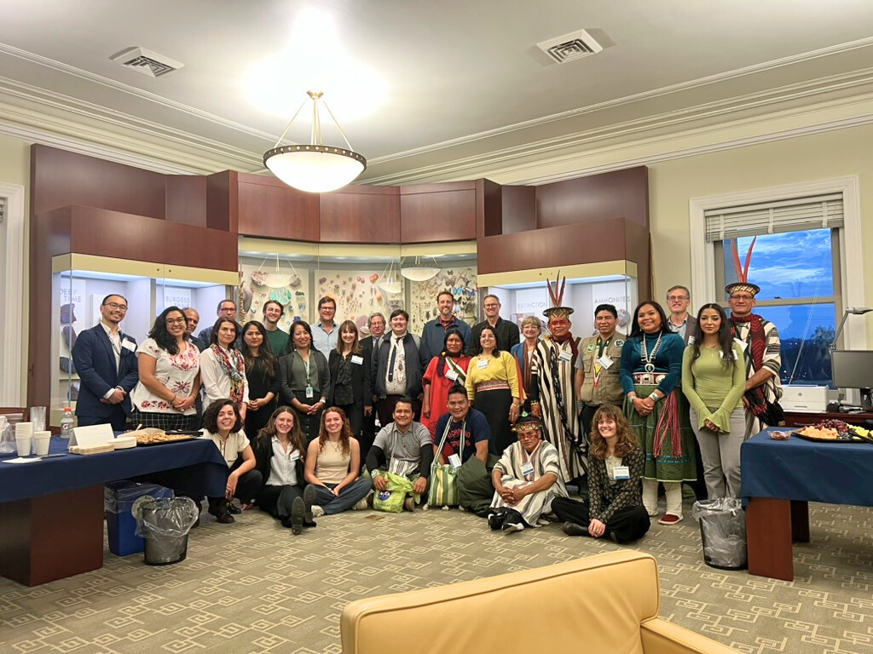


LACI is a collaborative effort, among:
LACI introduction
Starting in 2021, partners across the Americas worked together to co-design this initiative aimed at advancing climate risk assessment capacity through regional partnerships and peer-to-peer exchange of knowledge, tools, and methodologies.
22 - May - 2024

Slide 4
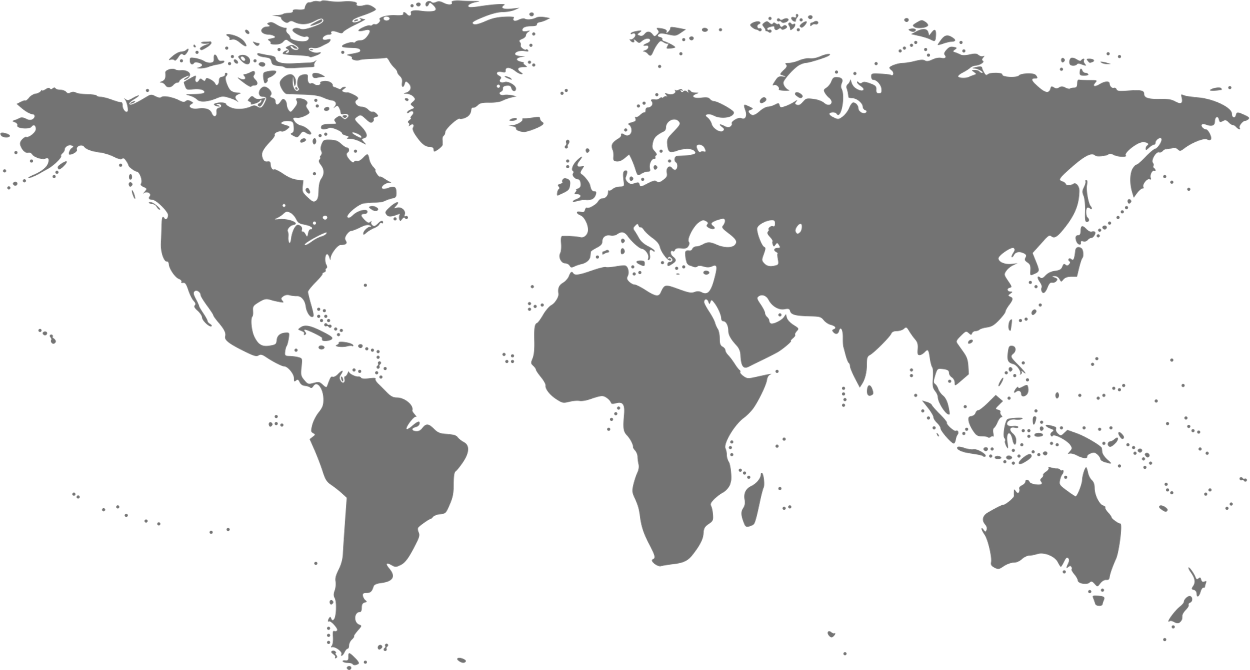
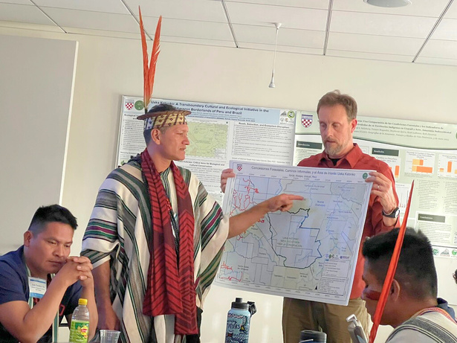
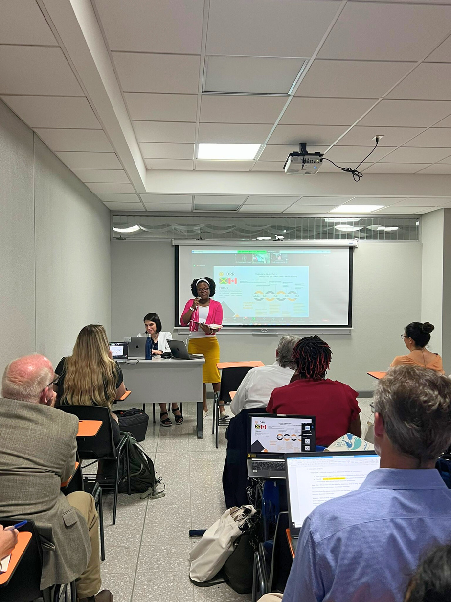
LACI’s Overarching Vision
LACI’s overarching vision is to provide opportunities for partnerships between countries in the Americas to enhance capacity for climate risk and vulnerability assessments that would support local and regional decision-making in response to climate change impacts.
LACI IS A VOLUNTARY COLLABORATION AMONG COUNTRIES.
22 - May - 2024

Slide 5

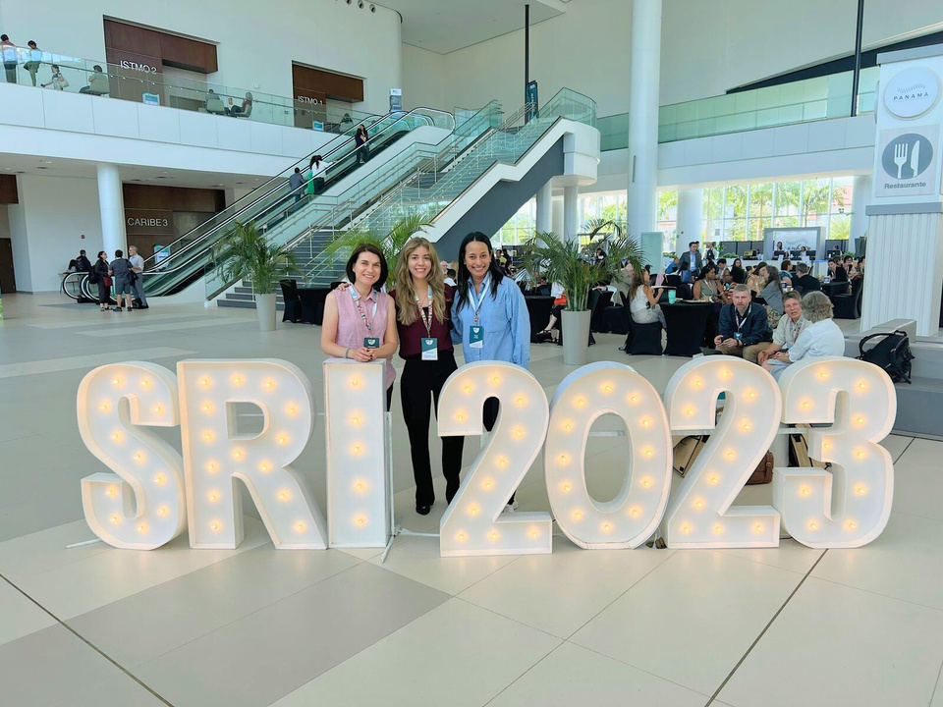
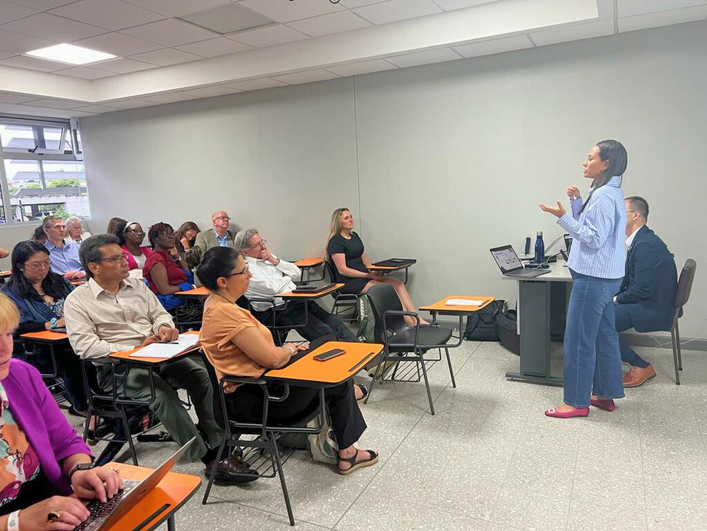

El Salvador
The primary objective of the El Salvador Pilot is the development of an easy-to-use and reliable climate change vulnerability and risk atlas that will help inform climate adaptation decisions in El Salvador.
Opportunities for scaling up a biodiversity risk atlas would support biodiversity efforts across central America.
22 - May - 2024

Slide 6
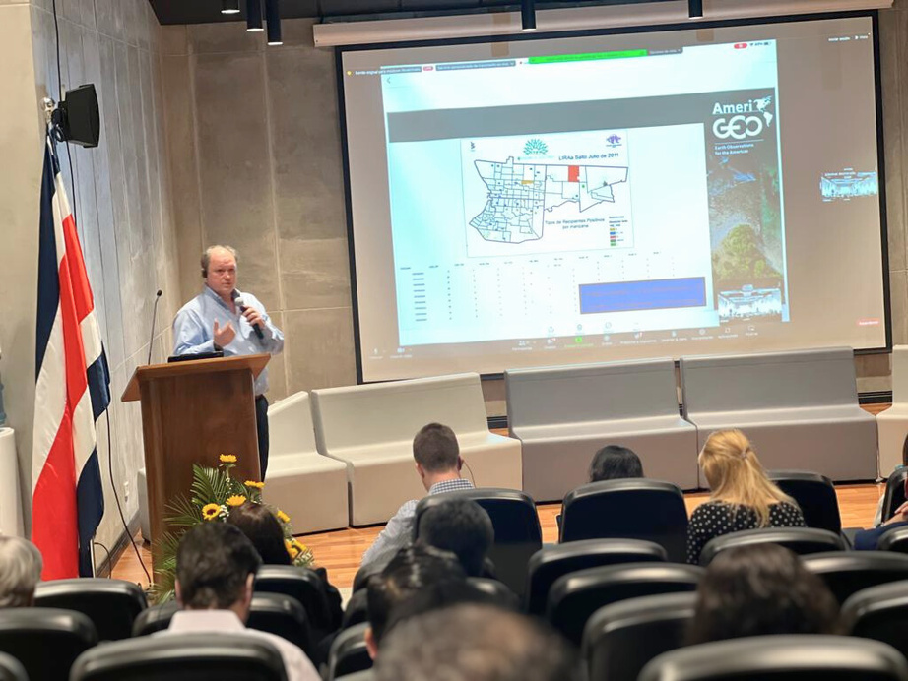

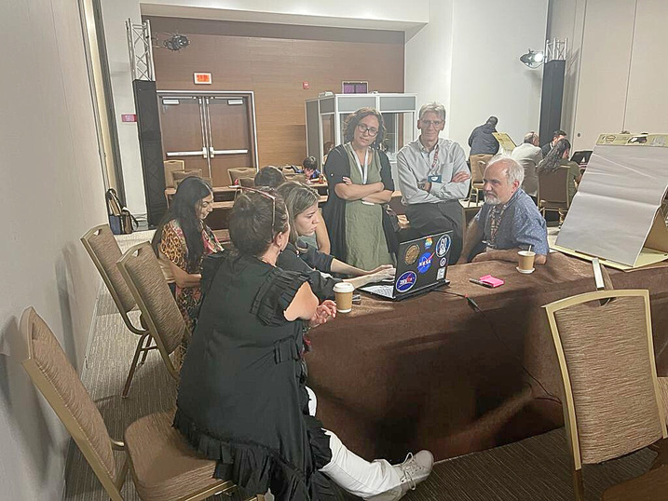





La Plata
The primary aim is to facilitate regional collaboration in the development of a comprehensive data and information observatory that supports the assessment of climate impacts on compound disasters (e.g., climate, water, and health) to help facilitate informed decision-making at local and regional levels.
Upcoming Workshop in Santiago Chile: Q3
22 - May - 2024

Slide 7

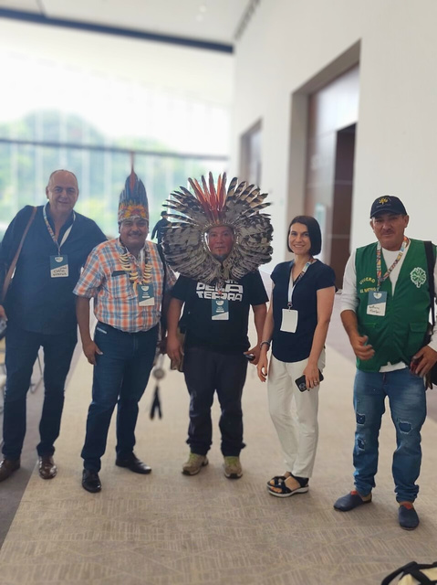
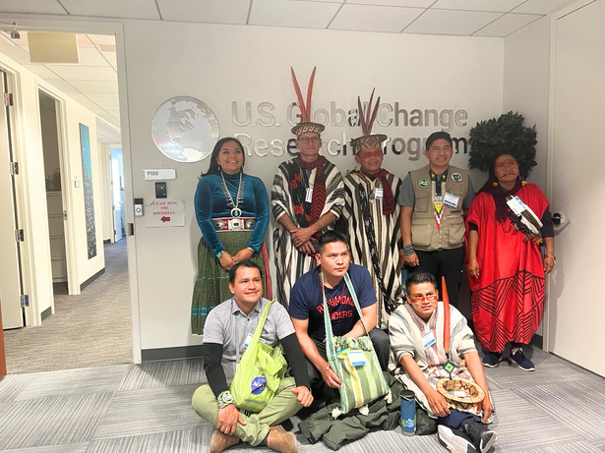


Amazonia
The LACI Amazonia Pilot is developing user-friendly climate-informed decision support tools with Indigenous Peoples and local communities in the Amazon region, incorporating locally relevant climate projections and capacity exchange to empower women and youth.
The pilot concentrates on three Amazon regions in Vichada (Colombia), Acre (Brazil), and Ucayali (Peru), which have predominantly Indigenous populations.
22 - May - 2024

Slide 8

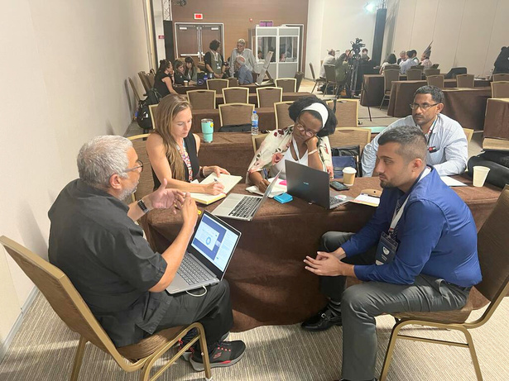


Amazonia
The goal of the LACI Pilot in Jamaica is to help advance disaster resilience in Jamaica by co-developing geospatial decision-support tools and providing capacity building support. Co-developed with and co-lead by a Group on Earth Observations (GEO) Disaster Risk Reduction (DRR) Canadian-led sub-working group, this pilot developed through relationship-building and collaborative efforts with pilot team members in Jamaican government and academia.
22 - May - 2024

